Slide 1
September 2021 doc.: IEEE 802.15-21-0493-00-0dep
Project: IEEE P802.15 Working Group for Wireless Personal Area Networks (WPANs)
Submission Title: [Draft Technical Requirement of IEEE802.15.6a for Amendment of 15.6 BAN with Enhanced Dependability]
Date Submitted: [16 September 2021]
Source: [Ryuji Kohno1,2, Marco Hernandez2, Takumi Kobayashi1,2, Minsoo Kim2]
[1;Yokohama National University(YNU), 2;YRP International Alliance Instiitute(YRP-IAI)]
Address [1; 79-5 Tokiwadai, Hodogaya-ku, Yokohama, Japan 240-8501
2; YRP1 Blg., 3-4 HikarinoOka, Yokosuka-City, Kanagawa, Japan 239-0847 ] Voice:[1; +81-90-5408-0611], FAX: [+81-45-383-5528],
Email:[1: kohno@ynu.ac.jp, kobayashi-takumi-ch@ynu.ac.jp, 2:kohno@yrp-iai.jp, kobayashi-takumi@yrp- iai.jp]
Abstract: [This document summarizes a draft technical requirement of a new standard IEEE802.15.6a for amendment of IEEE802.15.6 - 2012 Body Area Network(BAN) corresponding to new PAR and CSD for increasing demand for enhanced dependability in wireless sensing and controlling human and car bodies for medical healthcare and automotive uses.]
Purpose: [information]
Notice: This document has been prepared to assist the IEEE P802.15. It is offered as a basis for discussion and is not binding on the contributing individual(s) or organization(s). The material in this document is subject to change in form and content after further study. The contributor(s) reserve(s) the right to add, amend or withdraw material contained herein.
Release: The contributor acknowledges and accepts that this contribution becomes the property of IEEE and may be made publicly available by P802.15.
Slide 1

Slide 2
September 2021
doc.: IEEE 802.15-21-0493-00-0dep
Draft Technical Requirement of IEEE802.15.6a for Amendment of 15.6 BAN with Enhanced Dependability
Ryuji Kohno^{1,2}, Marco Hernandez², Takumi Kobayashi^{1,2}, Minsoo Kim²
1 Yokohama National University, Japan(YNU)
2 YRP International Alliance Institute, Japan(YRP-IAI)
Slide 2
R.Kohno,M.Hernandez,T.Kobayashi,M.Kim(YNU/YRP-IAI)

Slide 3
Agenda
September 2021
Necessity and Uniqueness for Amendment of BAN with Enhanced Dependability
Specified Use Cases for HBAN and VBAN with Channel and Environment Models
Technical Requirement for the Amendment of Std. 15.6 to Enhance Dependability
Submission
Slide 3
R.Kohno,M.Hernandez,T.Kobayashi,M.Kim(YNU/YRP-IAI)

Slide 4
September 2021
2. Technical Requirement of IEEE802.15.6a for the Amendment of Std. 15.6 to Enhance Dependability
Submission
Slide 4

Slide 5
1.1 Necessity for Enhanced Dependability in std 15.6 BAN
September 2021
In case of coexistence of multiple BANs
Current existing standard IEEE802.15.6 has not been designed to manage contention and interference among overlaid BANs. The more BAN uses in dense area, the more contention and inference cause performance degradation.
Amendment of PHY and MAC for resolving these problems in coexistence of BANs is necessary.
In case of coexistence with other radios
For enhanced dependability, UWB PHY of BAN should be updated to avoid performance degradation due to interference with coexisting other narrow band and UWB networks in overlapped frequency band.
In case of feedback sensing and controlling loop
Remote medical diagnosis with vital sensing and therapy and control actuators and robotics need more dependable and efficient protocol.
Usability and Implementation Complexity
Interoperability with other radio networks, more flexible network topology,
Transparency with other standards such as ETSI SmartBAN
Capability of ranging and positioning in UWB is required for mobility and security.

Slide 6
1.2 Technical Challenges for Enhanced Dependability
September 2021
First of all, we should recognize that any technology in PHY and MAC cannot guarantee full dependability in every use case.
However, we can design a new standard which can guarantee a certain level of enhanced dependability in a specific defined use case.
As an analogy of informed consent in medical doctor to a patient, a manufacturer of a dependable wireless network can describe such a specific defined use case that the manufacture can guarantee a defined level of dependability showing necessary cost and remained uncertainty. This is an honest manner and much better than no guarantee for any use case.
Therefore, an expecting standard describes a specific use case in which worst performance can be guaranteed enough high while most of exiting standards have been designed with average performance base.
Technical requirement for the specific use case can be guaranteed.
Submission
Slide 6
R.Kohno,M.Hernandez,T.Kobayashi,M.Kim(YNU/YRP-IAI)

Slide 7
1.3 Uniqueness different from existing standards (1/2)
September 2021
MAC protocol for around packets and recursive access for feedback loop in remote sensing and controlling;
Level of dependability can be defined with showing necessary cost and remained uncertainty. This is an honest manner and much better than no guarantee for any use case.
Worst performance can be guaranteed enough high while most of exiting standards have been designed with average performance base.
Others
Slide 7
R.Kohno,M.Hernandez,T.Kobayashi,M.Kim(YNU/YRP-IAI)

Slide 8
1.3 Uniqueness different from existing standards (2/2)
September 2021
PHY technologies to satisfy technical requirement for enhanced dependability in the focused use cases
In feedback loop for remote monitoring sensors or radars and feedback controlling actuators, real-time cognition of varying condition on site and adaptive reconfiguration in relatively messy, small, and dense areas are requested to guarantee worst performance with permissible delay and errors.
Within a permissible limited feedback delay, propagation paths connecting between nodes and coordinator should be found to keep connectivity by diversity, channel switching etc. .
For such a dynamic environment and QoS requirement changing situation, sophisticated PHY technologies are requested to guarantee minimum requirement of performance.

Slide 9
1.4 Focused Issues in Amendment of std 15.6 BAN with Enhanced Dependability
September 2021
MAC Protocol in case of coexistence of multiple BANs
Amendment of MAC for resolving these problems in coexistence of BANs is necessary.
Specified MAC protocol for feedback sensing and control loop between coordinator and nodes.
PHY Interference Mitigation In case of coexistence with other radios
For enhanced dependability, UWB PHY of BAN should be updated to avoid performance degradation due to interference with coexisting other narrow band and UWB networks in overlapped frequency band.
Usability and Implementation Complexity
Interoperability with narrow band and UWB PHY
more flexible network topology,
Transparency with other standards such as ETSI SmartBAN
Ranging and Positioning Capability of UWB-BAN
Mobile nodes and coordinator of BAN need ranging and positioning of UWB-BAN

Slide 10
September 2021
2. Specified Use Cases for HBAN and VBAN with Channel and Environment Models
Submission
Slide 10

Slide 11
2.1 Proposed applications
Remote healthcare monitoring
Remote sensing and controlling
Vehicle internal sensing and controlling
Collision avoidance radar
Inter-vehicle communications and ranging
Wearable and implant wireless medical sensing and controlling
Applications for ultra wideband radio
Reliable and robust radio control
Wearable healthcare sensing
Secure remote healthcare and medicine
Wireless sensing system for Factory with feedback control
Dependable multi-hop inter-vehicle communications
Inter-navigation and inter-vehicle information sharing in normal and emergency conditions
Single wireless communication network solution that functions both in normal and in disaster environments
Disaster prevention, emergency rescue and recovery
T.Kobayashi, M.Kim, M. Hernandez, R.Kohno (YNU/YRP-IAI)

Slide 12
QoS 1; Highest Priority of Demand
of Dependability
September 2021
2.2 Visualizing Portfolio of Focused Applications
Car, Bldg Care
business
Highly Life Critical Uses(High QoS)
Regulatory Compliance
Test
Hospital Clinical Service
Remote Diagnosis
for Factory Automation
Government Infrastructure
Internal Car Dependable M2M
Home Medical Therapy
QoS 3; Relatively Lower Priority for
Demand of Dependability
Inter-Vehicle M2M
QoS 2; Middle Priority of Demand of Dependability
Life Line
(Water/Gas/Electricity Supply)
Remote Wellness
& Well-being
Inter-Vehicle M2M
Fitness, Massage
& Sauna
Home &
Consumer
Uses
Industrial &
Governmental
Uses
Public Safety
Remote Diagnose
s of Infra(bridge/bldg./train)
Sports: Walking, Jogging,
Bicycling, Hiking, Skiing etc
Disaster Analysis
& Prevention
Big Data Mining
Remote Sensing
& Controlling Mobile Robots
Entertainment business
Less Life Critical Uses(Low QoS)
T.Kobayashi, M.Kim, M. Hernandez, R.Kohno (YNU/YRP-IAI)

Slide 13
2.3 Three Classes of Focused Potential Applications
September 2021
We have classified focused potential applications into three classes according to demands of dependability.
QoS 1 Class: Highest Priority Level for Demand of Dependability
1.1 Car Internal M2M
1.3 Remote Diagnosis in Factory
2.3 Professional Medicine
3.2 Public Safety
QoS 2 Class: Meddle Priority Level for Demand of Dependability
1,2 Inter-vehicle M2M
2.2 Healthcare
3.1 Life Line (Water/Gas/Electricity Supply)
4.1 Remote Diagnosis of Infra(bridge/bldg./train)
QoS 3 Class: Low Priority Level for Demand of Dependability
2.1 Wellness, Wellbeing
3.3 Government System
4.2 Remote Sensing and Controlling Mobile Robots
4.3 Disaster Analysis and Prevention

Slide 14
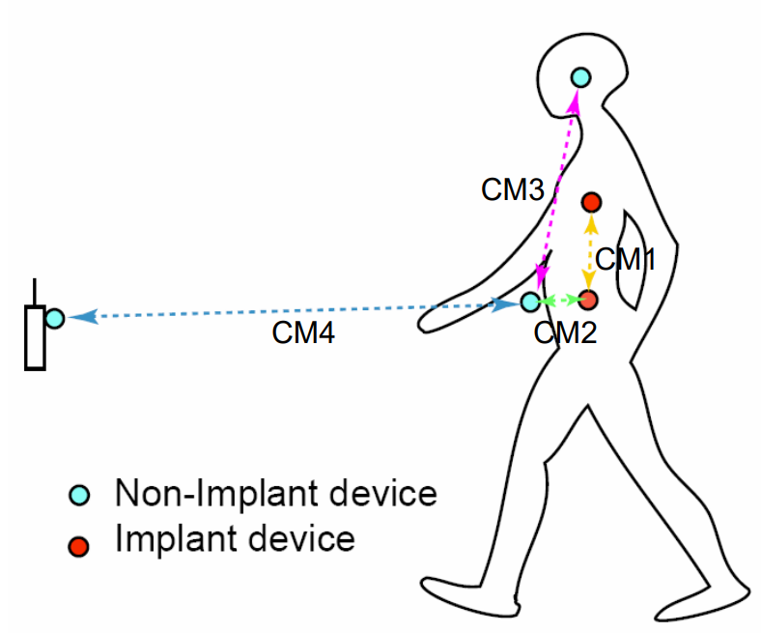
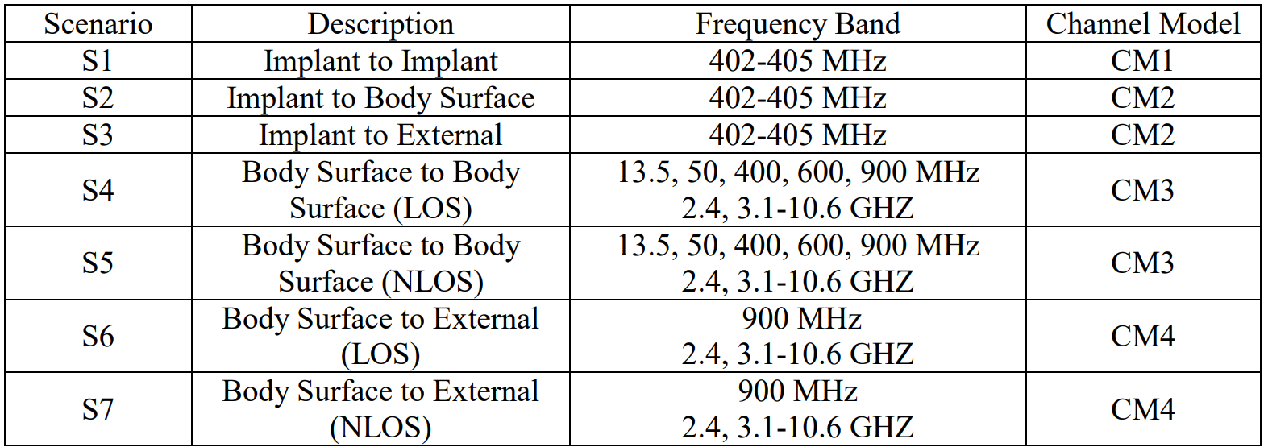
2.4 Channel models and scenarios in IEEE802.15.6-2012 for Human BAN(HBAN)
IEEE P802.15-08-0780-12-0006-TG6
IEEE 802.15.6-2012 channel models considered
Fading ( Small scale/ large scale)
Path loss
Shadowing
Power delay profile
In-body (implant)
On-body (body surface)
CM1, 2, 3, 4
Scenario 1, to Scenario 7. (S1 – S7)

Slide 15
2.5 Classification of Channel and Environment Models for Human and Vehicle Body Area Networks (HBAN&VBAN)
Channel model
※Covered by IEEE 802.15.6-2012
HBAN model
In-body (Implant)
※
On-body
※
Around body
Outdoor
※Around meaning;
Desk, WiFi AP in the room etc.
Channel model
With environment
※not covered yet
Indoor
※
Home
Office
※
Medical (e.g. Hospital)
※
VBAN model
In-vehicle
Engine room
Cabin
Note:
HBAN-model:
-Environment with co-existing systems is not considered.
VBAN model:
Key-less entry system
Localization in-body, on-body
Most dominant model should be defined and separatory defined as Mandatory and Optional.
※mandatory
Through engine room and cabin
On-vehicle
Roof
Around vehicle
Side Right/Left/Front/back
※mandatory
Bottom
Static vehicle
※mandatory
Moving vehicle

Slide 16
2.6 Channel and Environmental Models
Environment model
※will be defined in this amendment
Channel model
Environment model
Channel model
Path loss
Reflection
Multipath
Fading
LOS / NLOS model
White Gaussian noise
Interference from co-existing wireless systems e.g. Bluetooth, IEEE 802.11, IEEE 802.15.4 etc.
Interference from the other BANs.
Interference from the other electric systems, devices and components (Electro-magnetic interference; EMI from electric motors, spark plugs in vehicles, etc.
Electro-magnetic compatibility; EMC. Possibility to affect to the other systems and human body.
VBAN ⬄ HBAN interference
VBAN and HBAN ⬄ Vehicle control and human body impacts.
Colored noise (Impulse noise, spike noise, ignition noise etc.)
Time-varying channel and interference modeling (Statistic, non-static, pseudo static model)
※IEEE802.15.6-2012
Other wireless systems
EMI EMC
Colored noise
Time-varying modeling
※mandatory
※optional
※mandatory
※mandatory
※Comments in May 2021.
※optional
or
?
※mandatory
or
?
※optional
※mandatory
※mandatory
※optional

Slide 17
September 2021
doc.: IEEE 802.15-21-0023-02-0dep
3. Technical Requirement of IEEE802.15.6a for the Amendment of Std. 15.6 to Enhance Dependability
Submission
Slide 17

Slide 18
3.1 Update of Technical Requirements for IEEE802.15.6a, Amendment of BAN
September 2021
IEEE802.15.6 for Medical BAN was established in Feb.
2012 and has not been updated for successive applications.
IG-DEP has been discussing with ETSI Smart BAN for digital healthcare and further medical applications.
NICT Brain Machine Interface; BMI labs with medical community requests amendment of IEEE802.15.6 for much higher capacity and reliability in IG-DEP, particularly 2nd Generation of ECoG with much more electrodes beyond EEG using UWB technologies.
IG-DEP has decided to include dependable medical BAN with higher capacity and reliability in focused applications.
Then updated technical requirement has been discussed.
The updated requirement will be summarized in next pages.
Slide 18

Slide 19
September 2021
doc.: IEEE 802.15-21-0023-02-0dep
3.2 Updated Technical Requirements(1/5)
 | Car | Factory automation | UAV(Dron e)Sensing &Control | High Data Rate BAN (HRP) | Low Data Rate BAN (LRP) | Dependable BAN including Car Body as well as Human and Robotic Body | Reference standard 802.15.6
Number of sensors | Up to ten per netw ork | Up to ten per network | Up to ten (ex. camera, GPS etc.) | Up to 4096 | Up to 256 | 128, 64, 32, 16, 8, 4, 2 nodes for each unit. In case of Human body,4 units can cover 256 nodes as the same as 15.6. In case of Car body, M>4 units can cover 64xM nodes in layer structure. Class A; node transmitting periodical packets Class B: node doing non-periodical ones. | 256 For 2nd G ECoG BMI 128x32, 64x64 32x128, 16x256, 8x512 4x1024. 2x2048
Support for multiple network co- existence & interoperab ility | Less than 100 | Up to 100 | Up to ten (ex. at least 4 drones for relative localization) | Single | Up to 3 BANs | Less than 64 units. 1 unit contains 64 sensors. Includes multiple BANs overlaid. Other choices are 32 nodes/unit and max no. of units is 100 Ref. 64 sensors x 64 Units = 4,096 sensors that is sufficient for 2nd G ECoG BMI | 0 Not expected multiple BANs overlaid
Topology | Exten ded star | Star + bus | Star(dynami c allocation of coordinator) | Star(2pairs) | Star+multi hop | Star +multiple hop or Star + mesh Due to relationship with smart BAN and smart M2M Two layered cluster tree | (extended) star+one hop
Data rate | Com parab le to CAN, RIM | 2 Mbps/se nsor | Up to several ten Mbps/cam era/drone | Up to 1KHzx12 =12kbps/se nsor | Aggregate rate up to 2Mbps | 2 Mbps For high QoS(priority) packets, 1Mbps while shorter back-off time or delay For low QoS packets, 2 Mbps or higher while permissible delay longer | 1 Mbps for narrow Band 11 Mbps for UWB in max
Submission
Slide 19

Slide 20
September 2021
doc.: IEEE 802.15-21-0023-02-0dep
3.2 Updated Technical Requirements(2/5)
 | Car | Factory automation | UAV(Drone) Sensing & Controlling | High Data Rate BAN (HRP) | Low Data Rate BAN (LRP) | Dependable BAN for Car Body as well as Human Body | Reference standard 802.15.6
Aggregate data rate over interoperating networks | Few hundred Mbps | Up to 1 Gbps | Up to several Mbps/drone | 50 Mbps | 2 Mbps | 6 hundred Mbps in case of 4 nits x 64 nodes/unit Ref. Satisfying 49Mbps for 2nd G ECoG BMI | N/A
Latency in normal operation | Comparab le to CAN, RIM or Flex Ray | 250 ms to 1s | 250 ms to 500 ms | Frame length 10-20 ms Latency 10ms | 10 ms to 20ms | 250 ms to 1s Ref. to be considered use case of 2nd G ECoG BMI | Typical 50 to 100 ms Ref. 15.4e
Latency in critical situation | Comparab le to CAN, RIM or Flex Ray | Few ms to 15 ms * | Several 10 ms | 5-10 ms | 10 ms | 100 ms Ref. to be considered use case of 2nd G ECoG BMI | Less than typical case
Association delay | N/A | < 1 s | < 100ms | Same direction < 30ms | < 60 ms | < 1 s Ref. to be considered use case of 2nd G ECoG BMI | Less than 1s Optional requirement
Authenticatio n and security delay | N/A | < 1 s | N/A | Same direction < 50ms | < 100 ms | < 1 s Ref. to be considered use case of 2nd G ECoG BMI | Seconds Optional requirement
Delivery ratio requirement *Reference: | > 99.9% Factory Auto | > 99% mation critical l | > 99.9% atency: FFPJ docs n | > 99.9% ew-maruhashi-ge | > 99% neral-industrial- | >95% Ref. to be considered use case of 2nd G BMI | 95%
usage-part1-0317-v00.pdf & new-itaya-general-industrial-usage-part2-0317-v00.pdf
Submission
Slide 20

Slide 21
September 2021
doc.: IEEE 802.15-21-0023-02-0dep
3.2 Updated Technical Requirements(3/5)
 | Car | Factory automation | UAV(Drone) Sensing & Controlling | High Data Rate BAN (HRP) | Low Data Rate BAN (LRP) | Dependable BAN including Car Body as well as Human Body | Reference standard 802.15.6
Disconnection ratio (of time) | < 0.01% | < 0.01% | < 0.001% | < 0.01% | < 2% | < 1% to be considered use case of 2nd G ECoG BMI | ?
Synchronizati on recovery time | < 100 ms | < 100 ms | < 70 ms | < 10 ms | N/A | < 50 ms to be considered use case of 2nd G ECoG BMI | Seconds
Coverage range | 6 m | 5 m | 100m(among drones) some km(with controller) | 10cm | 50cm | < 10 m Much less coverage for 2nd G ECoG BMI | < 10 m
Feedback loop response time | < 10 ms | < 1 s | < 10 ms | < 10ms | < 100ms | < 50 ms Ref. to be considered use case of 2nd G ECoG BMI | < 500 ms
Handover capability | N/A | < 2 s | N/A | N/A | N/A | N/A | Not defined
Data packet size | CAN & RIM compatibil ity | 10 to 1000 bytes | 802.11 compatible | 802.11 compatible | 802.11 compatible | Up to 255 octets | Up to 255 octets
Submission
Slide 21

Slide 22
September 2021
doc.: IEEE 802.15-21-0023-02-0dep
3.2 Updated Technical Requirements(4/5)
 | Car | Factory automation | UAV(Drone) Sensing & Controlling | High Data Rate BAN (HRP) | Low Data Rate BAN (LRP) | Dependable BAN including Car Body as well as Human Body | Reference standard 802.15.6
Jitter: typical max | 5 ms | 50 ms | N/A | N/A | N/A | Dependent on Highest QoS | QoS dependen t
Jitter: critical max: 5% outliers acceptable | 5 ms | 5 ms | N/A | N/A | N/A | Dependent on Highest QoS | QoS dependen t
Multi BAN Overlaid (A) Intra network interference | Driver/P asseng ers room: <10 | <50 according to coverage range | <10 according to no. of drones cluster | Single(2pairs) according to spacing between BANs | Up to 3 BANs according to covering range | <64 Ref. to be considered use case of 2nd G ECoG BMI | By a few use case models, worst interference can be defined
 | Engine room: <10 |  |  | implant | wearable
Different PANs (B) Inter network interference (number of coexisting networks) | Driver/P asseng ers room: < 5 | <10 according to factory condition | <5 according to no. of drones cluster | single Corresponding for interference mitigation technologies | Up to 3 PANS Corresponding to specification of coexisting PANs | <10 Ref. to be considered use case of 2nd G ECoG BMI | By a few use case models, worst interference can be defined.
Submis
sion
Slide 22

Slide 23
September 2021
doc.: IEEE 802.15-21-0023-02-0dep
3.2 Updated Technical Requirements(5/5)
 | Car | Factory automation | UAV(Drone) Remote Sensing and Controlling | High Data Rate BAN (HRP) | Low Data Rate BAN (LRP) | Dependable BAN | Reference standard 802.15.6
Channel model resilience | Driver/Pass engers room: Light multipath | Heavy multipath with shadowing | Line of sight (LOS) | Dedicated short distance (DSRC) with line of sight (LOS) | No Line of sight (NLOS) with shadowing and multipath | Dependent on Highest QoS Ref. to be BMI | By a few use case models, worst interference can be defined
 | Engine room: Heavy multipath with shadowing |  | No Line of sight (NLOS) using camera | Compliance for safety guide line with SAR & EMC | Compliance for safety guide line with SAR & EMC
considered
use case of
2nd G ECoG
Submission
Slide 23

Slide 24
4. Concluding Remark
September 2021
Corresponding request from ETSI smart BAN and smart M2M, IG-DEP and its successive SG15.6a have discussed to focus on internal car network for IoT/M2M connections that is focused on BAN for human and car bodies.
As amendment of IEEE802.15.6, MAC for multiple BANs can be guaranteed to
satisfy permissible delay or back-off time and throughput of high QoS packets for human and vehicle BANs while maintaining average performance.
As amendment of IEEE802.15.6, PHY for UWB radios should be revised for updated UWB regulation. In particular, coexistence among different UWB
radios of IEEE802.15 such as 15.4a, 15.4f, 15.4z can be supported. For instance, during CCA, types or features of these UWB radios can be analyzed to control
access of packets from each radio.
To include new use cases with enhanced dependability such as the 2nd Generation of ECoG for Brain-Machine-Interface(BMI), technical requirement has been updated to cover higher data rate and more units of ECoG sensors .
We focus on amendment of IEEE802.15.6 for enhanced dependability in PHY and MAC and move on TG to complete the amendment.
If you have any question and comment, you are welcome to discussion in SG15.6a and send content contributions to
Ryuji Kohno <kohno@ynu.ac.jp> and Takumi Kobayashi <Kobayashi-takumi- ch@ynu.ac.jp>
Slide 24

