Slide 1
Project: IEEE P802.15 Working Group for Wireless Specialty Networks (WSN)
Submission Title: [Downlink TDOA (DL-TDOA) Location Service in 802.15]
Date Submitted: [16 September 2021]
Source: [Zhenzhen Ye] Company [Red Point Positioning]
Re: Call for contributions to SG15.4ab
Abstract: Presentation, UWB in 802.15, DL-TDOA
Purpose: Present technical content for consideration by the group
Notice: This document has been prepared to assist the IEEE P802.15. It is offered as a basis for discussion and is not binding on the contributing individual(s) or organization(s). The material in this document is subject to change in form and content after further study. The contributor(s) reserve(s) the right to add, amend or withdraw material contained herein.
Release: The contributor acknowledges and accepts that this contribution becomes the property of IEEE and may be made publicly available by P802.15.

Slide 2
PAR Objective | Proposed Solution (how addressed)
Safeguards so that the high throughput data use cases will not cause significant disruption to low duty-cycle ranging use cases
Interference mitigation techniques to support higher density and higher traffic use cases
Other coexistence improvement
Backward compatibility with enhanced ranging capable devices (ERDEVs) | The proposed MAC enhancements are compatible with legacy ERDEVs; All required information is conveyed using IEs in existing MAC frame formats harmlessly ignored by non-participating legacy devices
Improved link budget and/or reduced air-time
Additional channels and operating frequencies
Improvements to accuracy / precision / reliability and interoperability for high-integrity ranging | The new feature will provide enhanced reliability in some high density use cases.
Reduced complexity and power consumption
Hybrid operation with narrowband signaling to assist UWB
Enhanced native discovery and connection setup mechanisms
Sensing capabilities to support presence detection and environment mapping
Low-power low-latency streaming
Higher data-rate streaming allowing at least 50 Mbit/s of throughput
Support for peer-to-peer, peer-to-multi-peer, and station-to-infrastructure protocols | The proposed superframe structure, transmission scheme and messages are to support downlink TDOA location service
Infrastructure synchronization mechanisms

Slide 3
Downlink TDOA (DL-TDOA) Location Service in 802.15

Slide 4
Benefits of DL-TDOA - Recap
DL-TDOA, aka Reverse TDOA in 802.15.4/4z
Leveraging the capability of new UWB tag platform – UWB is integrating into device like a smart phone which have substantial computing resources compared to traditional tags
Fixed location spectrum usage, unlimited tag capacity
Determined by anchor transmit schedules
Independent of number of tags in the area
Privacy
Mobile device (tag) can be anonymous - figure out where it is by listening without transmitting
Mobile device can decide what to share
Accuracy
Accuracy comparable to traditional TDOA or two-way ranging
Accuracy is independent of the number of tags in the network
Support for fusion of UWB TDOA ranging with local sensors
Leverage resources in the tag platform
Improves performance without increasing network traffic

Slide 5
General Considerations
Builds upon capabilities of 802.15.4/4z
No PHY changes
Uses existing frame structures with IEs
Compatible with legacy devices: non-participating legacy devices simply ignore IEs not implemented
Leverages concepts in the standard
Uses the multi-node ranging of 15.4z
Adds a hierarchical control/scheduling concept to enhance scaling with the existing multi-node scheduled ranging capability
Re-purpose some ideas from other parts of the standard (e.g., IE design)

Slide 6
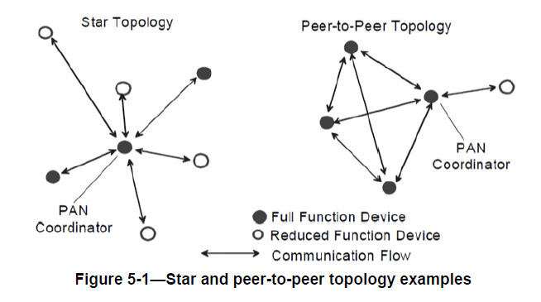
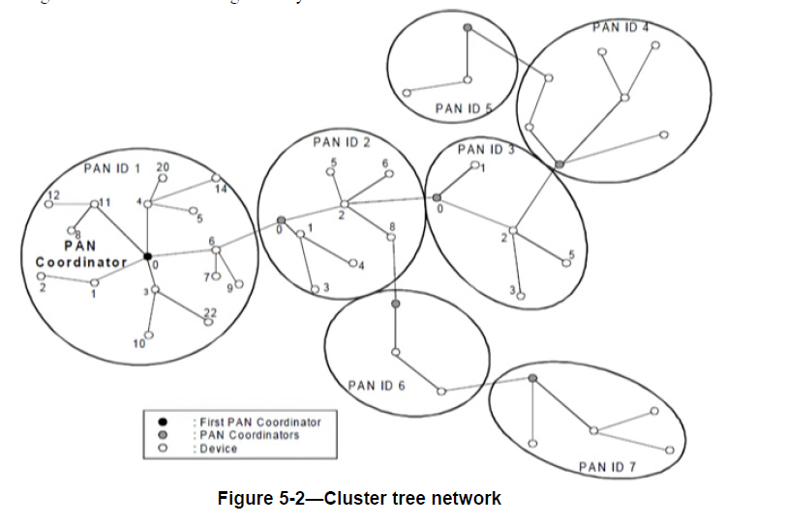
Network Topology - Mesh
Example topologies in 802.15.4/4z
Example Mesh topology to support DL-TDOA location service
PAN coordinator
Anchor
DL-TDOA uses topologies already supported by 802.15.4
Tag

Slide 7
Superframe Structure
Three main periods in a superframe: Beacon only period (BOP), contention-free period (CFP), contention access period (CAP)
Similar superframe structure in 802.15.4/4z includes TVWS multichannel cluster tree PAN, RCCN. However, to support a generic DL-TDOA location service, we’d like to propose a superframe structure like following
BOP: slot based, for network identification, superframe configuration, frame synchronization, etc.
CFP: slot based, for anchors transmitting messages to provide DL-TDOA location service
CAP: contention access period for supporting other ranging/communication modes (e.g., TWR, UL-TDOA, data communication, etc.)
BOP
CFP (for DL-TDOA)
CAP

Slide 8
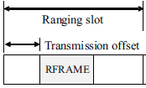
Superframe Structure (Cont’d)
Ranging block structure from 802.15.4/4z for CFP period
The inter-anchor communication during DL-TDOA procedure is similar to TWR
CFP (for DL-TDOA)
REQ
A
B
RSP
REQ
RSP
M
Ranging block = CFP
Ranging round = the period of an anchor pair
Ranging slot = the period of transmitting a REQ or RSP frame

Slide 9
Superframe Structure (Cont’d)
Control of DL-TDOA Ranging
Controller: PAN coordinator (could be a server)
Controlee: all anchors
Initiator: anchor sending REQ
Responder: anchor sending RSP
Controller (Coordinator)
schedule
Controlee
Controlee
Controlee
Controlee
Initiator
Responder
Initiator
Responder
Ranging initiation msg
Ranging initiation msg
Ranging response msg
Ranging response msg

Slide 10
MAC Frames and IEs to support DL-TDOA (Ongoing)
Beacon Frame – in progress
Data & Ranging Frame – to be designed

Slide 11
Beacon Frame and IEs to support DL-TDOA
Using Enhanced Beacon Frame Format with IEs to convey superframe structure and provide control information (broadcast)
No unstructured MAC payload
HIE contains DL-TDOA PAN descriptor
PIE contains information such as beacon commands (BCMDs), routing information, and other information that may be needed.
Octets: 2 | 0/1 | 4/8/10 | Variable |  | 0 | 4
Frame Control | BSN | Addressing | IE Lists |  | MAC Payload | FCS
 |  | PAN ID and Source Address | HIE | PIE | No unstructured payload | CRC-32
 |  |  | DL-TDOA PAN descriptor | BCMD, Routing info, etc.
MHR |  |  |  | MAC Payload |  | MFR

Slide 12
Beacon Frame and IEs to support DL-TDOA (Cont’d)
DL-TDOA PAN descriptor
Header IE
Describes the superframe structure and timing
Superframe duration & slot unit duration (SSUD)
Beacon slot duration & number of beacon slots
DL-TDOA slot duration & number of DL-TDOA slots
CAP duration
Inactive period duration (if any)
Frame synchronization related information, e.g., Time offset from the SF start, SYNC slot, SYNC hop, etc.
Provides information for anchors to identify and sync to the SF schedule

Slide 13
Beacon Frame and IEs to support DL-TDOA (Cont’d)
Beacon Command (BCMD) IE
Payload IE
Possibility to be secured
Used for beacon allocation requests and responses, including
Request, response, confirmation, exchange of control information.
Command parameter specific to a command
Information used to maintain coordination
Still a work in progress

Slide 14
Question?

