Slide 1
Invitation to Synthetic Aperture Standards Committee
Date: 2021-09-15
Authors:

Slide 2
Abstract
The new Synthetic Aperture Standards Committee (SynApSC) recently created under the auspices of the IEEE Signal Processing Society (SPS) and the IEEE Standards Association (SA) is inviting 802.15 members to join
This presentation provides an overview of synthetic apertures and describes applications to channel sounding and over-the-air calibration
Interested 802.15 members please contact Peter Vouras at synthetic_aperture_twg@ieee.org

Slide 3
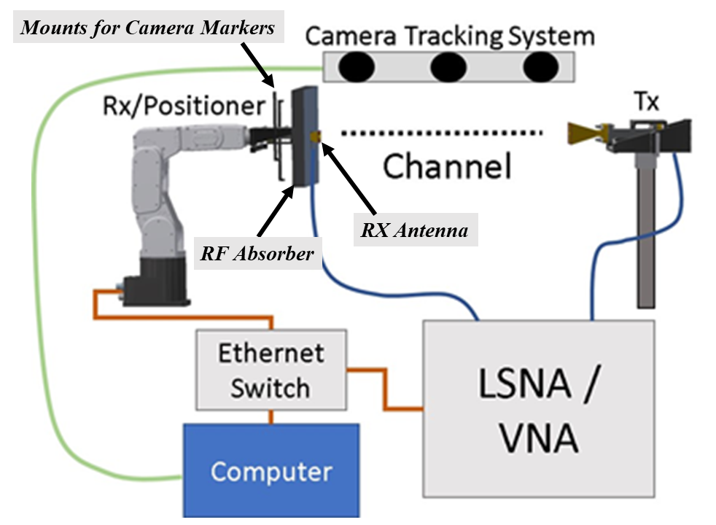
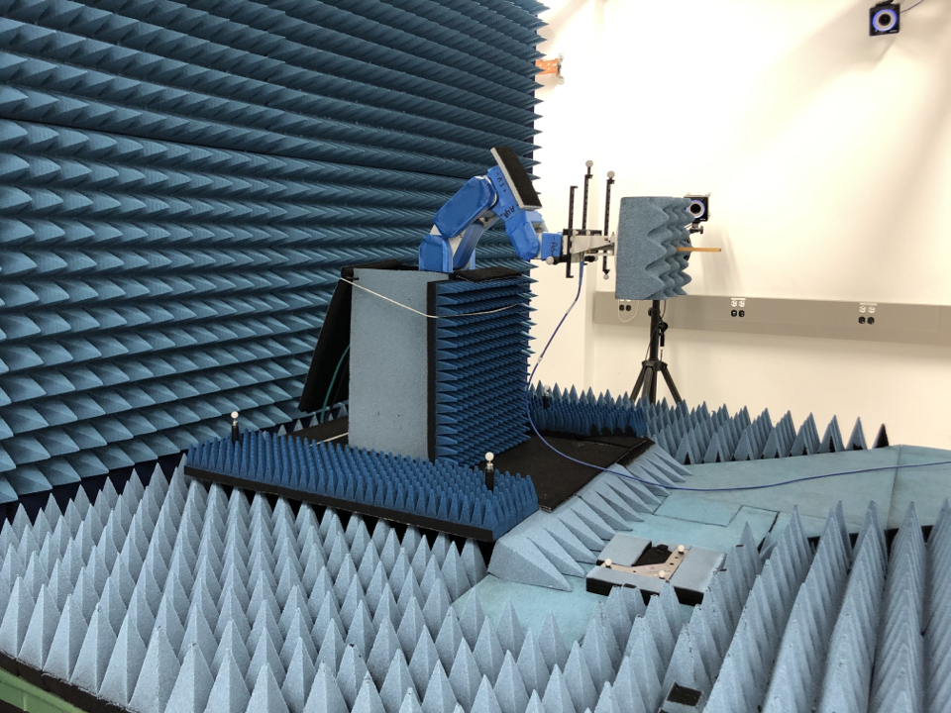
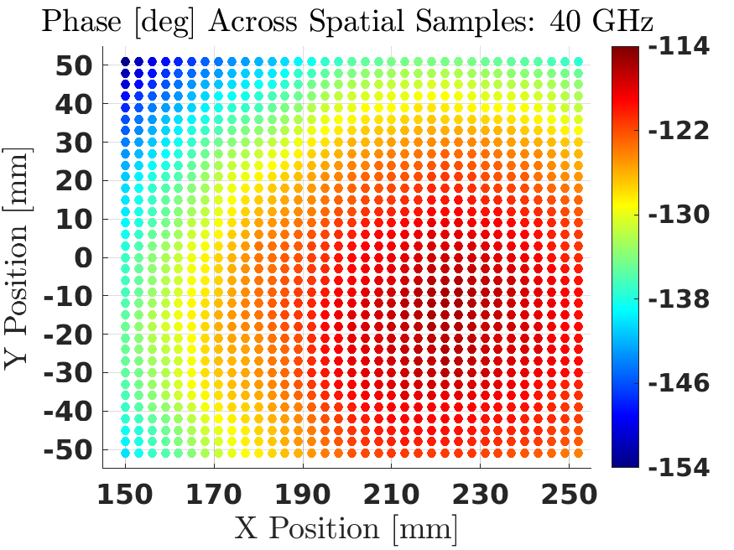
What is a Synthetic Aperture?
A synthetic aperture sequentially collects digitized signal samples across a spatial volume
In post-processing the samples are coherently combined to yield an image of signal sources

Slide 4
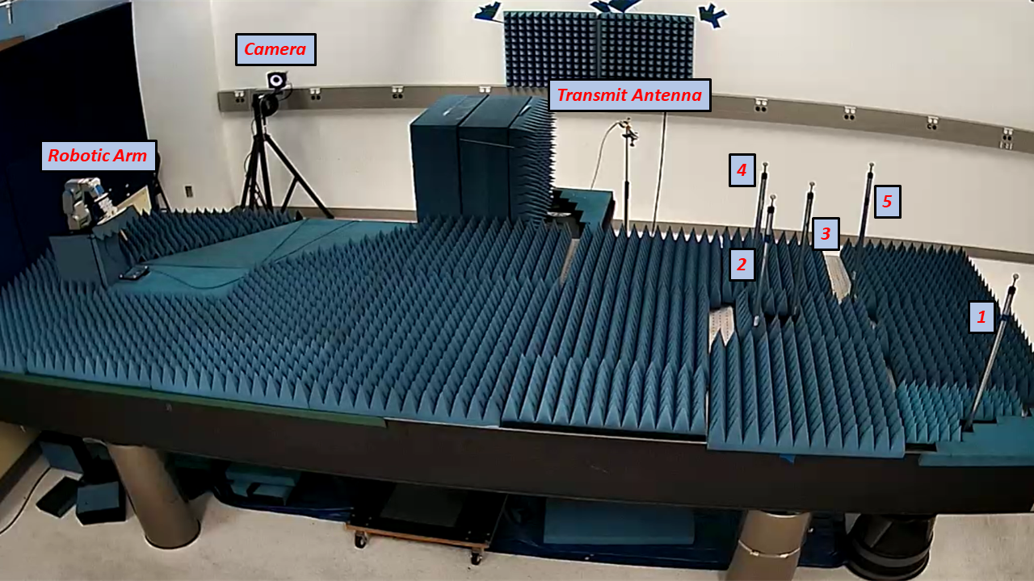
Angle and Delay Resolution Experiments

Slide 5
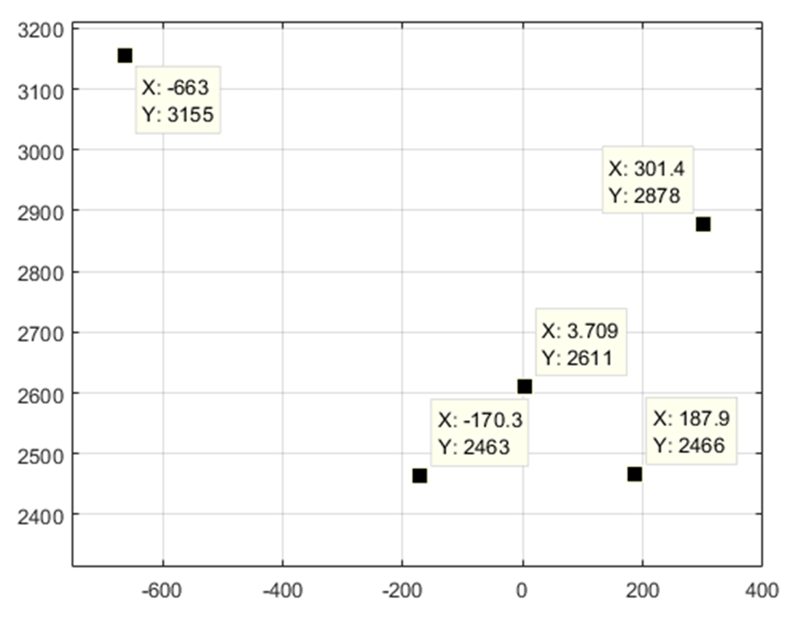
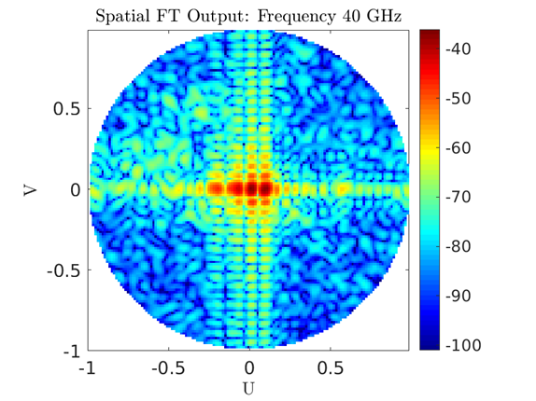
Resolution of Closely Spaced Objects in Delay and Angle
1
4 peaks are visible here,
but there are 5 cylinders
5
3
2
4
RX at (0,0)
TX
5 cylinders were configured on an optical table as shown on the left
Two of the cylinders (#4 and #5) reside in the same beamwidth and must be resolved using delay
Cylinders #2 and #3 are in the same delay bin but can be resolved in angle

Slide 6
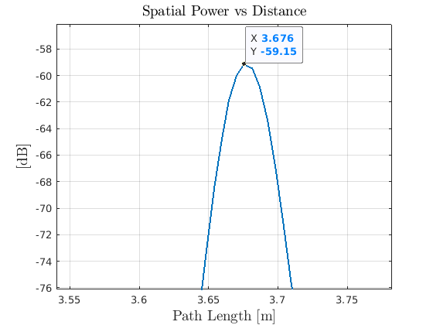
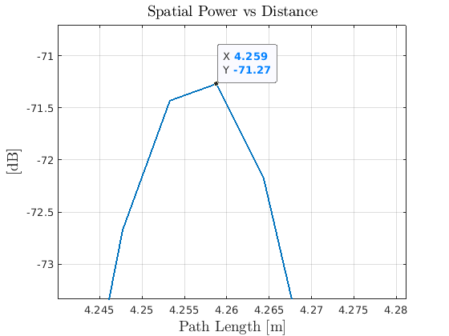
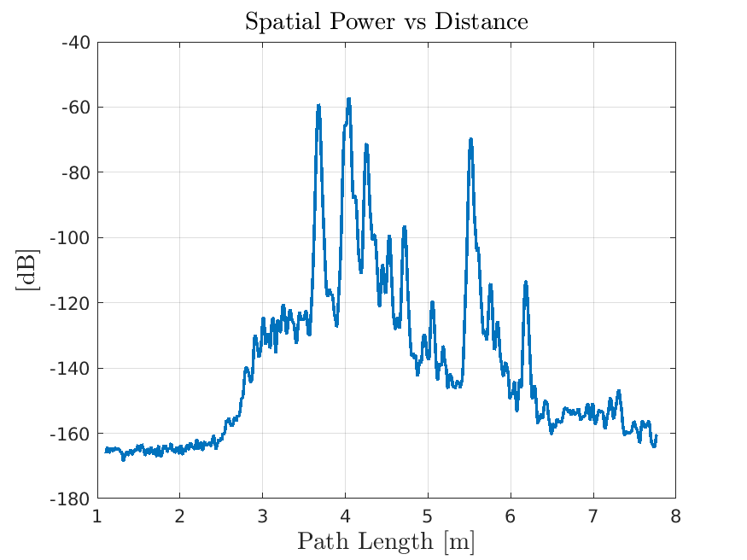
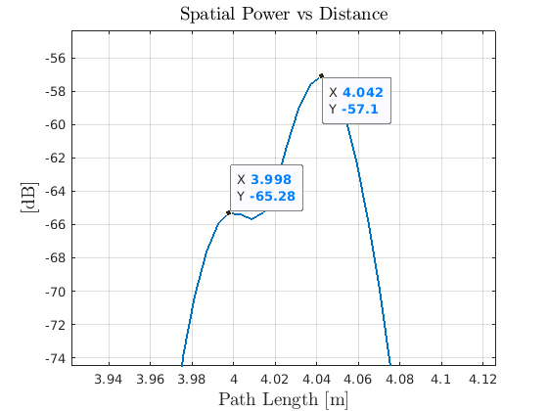
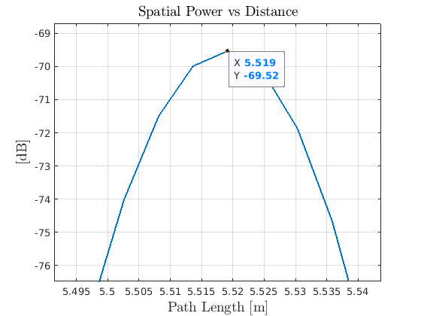
Cylinders (4 and 5) in Same Beamwidth Resolved in Delay
Cylinder 4
Cylinder 5
Cylinders 2, 3
Cylinder 1
Cylinders 4 and 5 in the same beamwidth are well resolved in delay
Cylinders 2 and 3 are 0.044 meters apart in delay and can be unambiguously resolved in angle
Power Delay Profiles

Slide 7
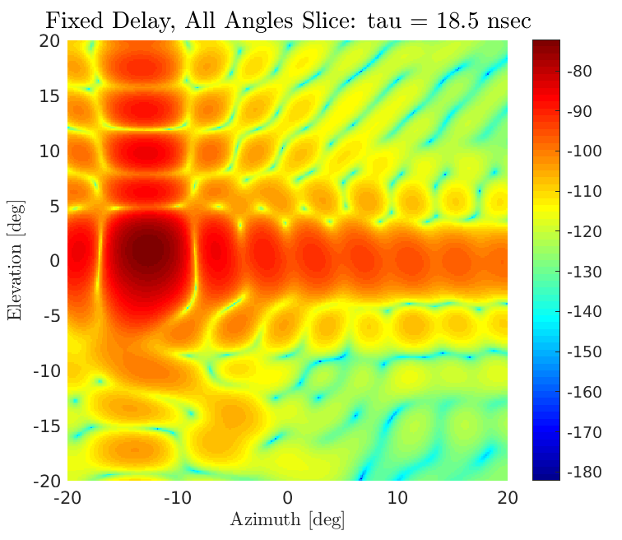
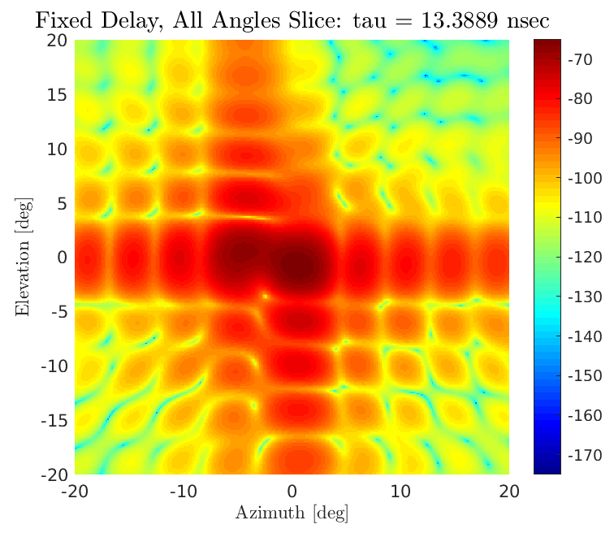
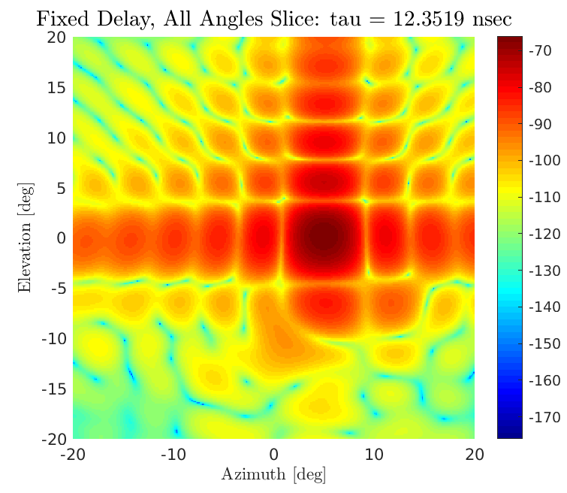
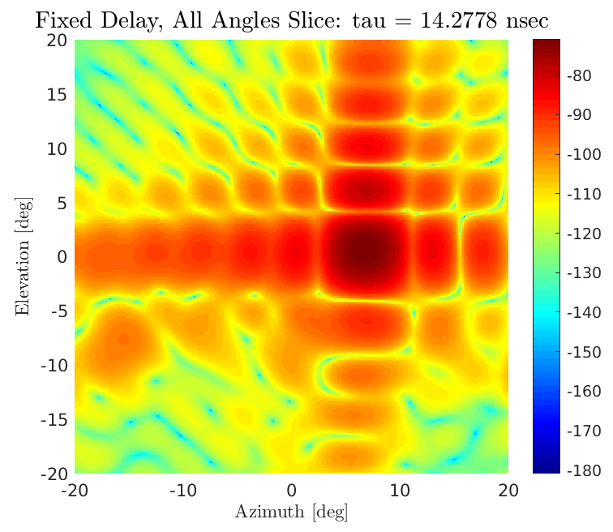
Cylinders in Same Delay Bin Resolved in Angle
Cylinder 2 on left
Cylinder 3 at (0, 0) is also visible
Cylinders 4, 5 are in same beam, different delay bins
Cylinder 1
Cylinder 4
Cylinder 5
Cylinders 2 and 3 are well separated in angle after taking delay slices

Slide 8
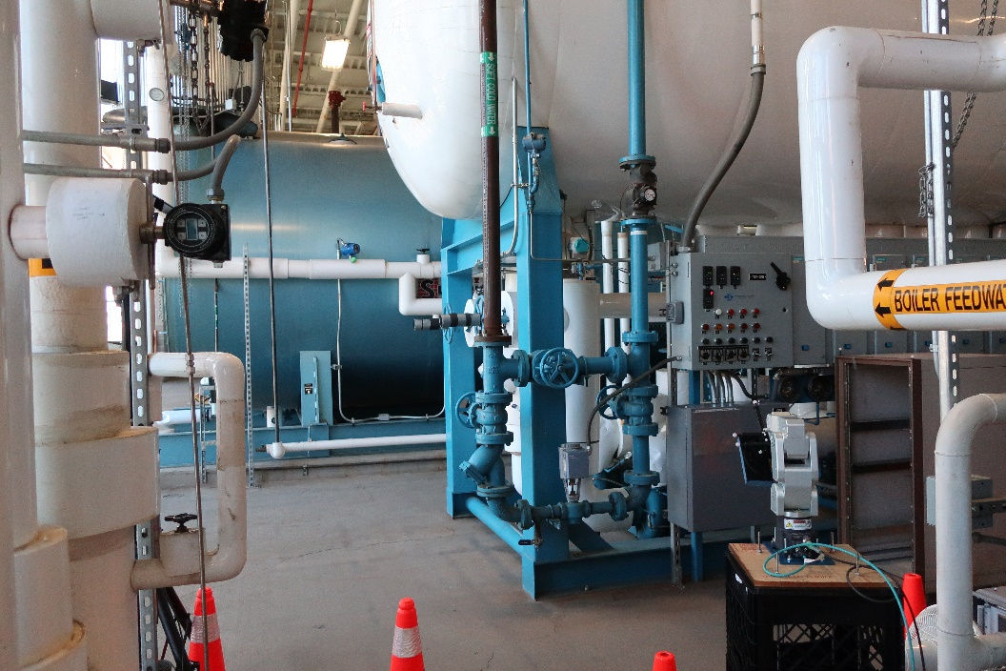
Channel Sounding Applications
Robotic Arm
Synthetic apertures can provide high-resolution measurements in dense scattering environments

Slide 9
Synthetic Aperture Standards Committee
The scope of the Synthetic Aperture Standards Committee (SynApSC) is limited to the development, validation, and dissemination of technical standards that describe the processes, procedures, and hardware necessary to correctly perform synthetic aperture measurements in electromagnetic environments
The SynApSC is currently recruiting new members with an interest in synthetic aperture applications including channel sounding and radar. Please contact Peter Vouras at synthetic_aperture_twg@ieee.org

Slide 10
References
A. J. Weiss, J. Quimby, R. Leonhardt, B. Jamroz, D. Williams, K. Remley, P. Vouras, A. Elsherbeni, “Configuration and Control of a Millimeter-Wave Synthetic Aperture Measurement System with Uncertainties,’’ 2020 95th ARFTG Microwave Measurement Conference
A. J. Weiss, J. Quimby, R. Leonhardt, R. Jones, J. Kast, B. Jamroz, P. Vouras, D. Williams, K. A. Remley, “Millimeter-Wave High Multipath Channel Measurements,” 2020 XXXIIIrd General Assembly and Scientific Symposium of the International Union of Radio Science
P. Vouras, B. Jamroz, A. Weiss, J. Quimby, D. F. Williams, R. Leonhardt, D. Guven, R. Jones, J. Kast, K. A. Remley, “Wideband Synthetic-Aperture Millimeter-Wave Spatial-Channel Reference System with Traceable Uncertainty Framework,” under review IEEE Transactions on Antennas and Propagation

