Slide 1
64b67b and Uniform Line Coding for PM-PHY
Date: 2021-09- 12

Slide 2
Abstract
This contribution proposed 64b67b and Uniform Line Coding as alternative transmission modes for the PM-PHY.

Slide 3
Introduction
IEEE 802.15.13 enables line coding and channel equalization methods for the PM PHY
    8b10b
    FDE
    Both introduce overhead while improving channel adaption
Efficient line coding schemes are proposed
    Line coding overhead can be reduced with an alternative line coding method
    maintaining a good BER performance
    trade off between overhead and channel adaption

Slide 4
Line Coding
Why optimizing Line Coding?
    Goal: DC balancing
    Low disparity = Low DC imbalance within subsequent code words
    (Long duration)
    Low run lengths = Low DC imbalance within subsequent modulation symbols
    (Short duration)
Tradeoff : DC balancing vs. Overhead

Slide 5
Line Coding Schemes
8b10b
    Guaranteed DC balancing and disparity balancing by predetermined code book with optimized run lengths
    25% overhead
64b67b (Guided Scrambling)
    Statistical optimized DC balancing, disparity balancing and run lengths limiting by code word selection
    4.7% overhead
Uniform Line Coding (same as 64b66b but w/o the overhead)
    Statistical DC balancing by law of large numbers, (prior scrambling mandatory)
    0 % overhead

Slide 6
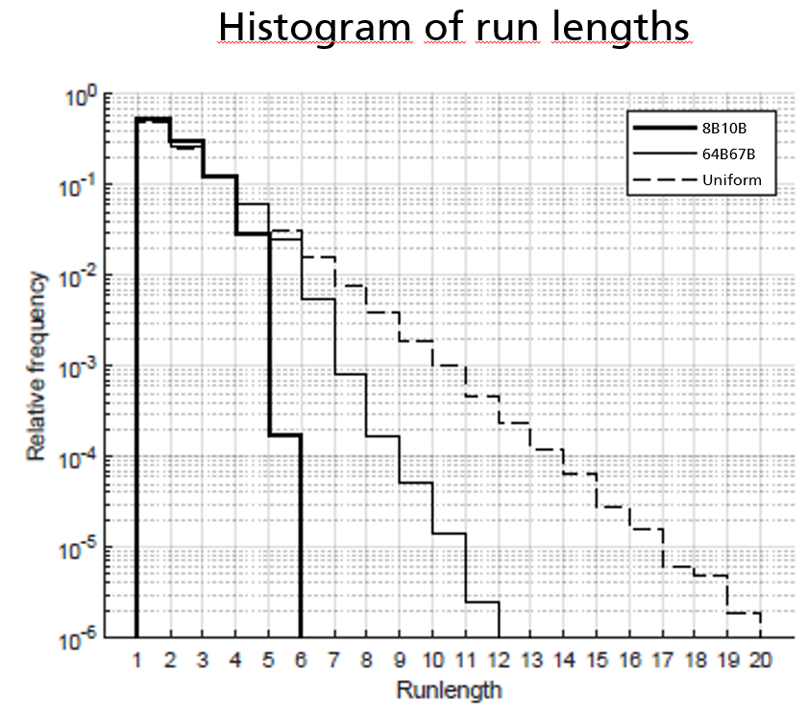
Run Length after Line Coding
Line codes can reduce run lengths
    uniformly distributed input sequences (=no line coding) are obtained by scrambling before line coding

Slide 7
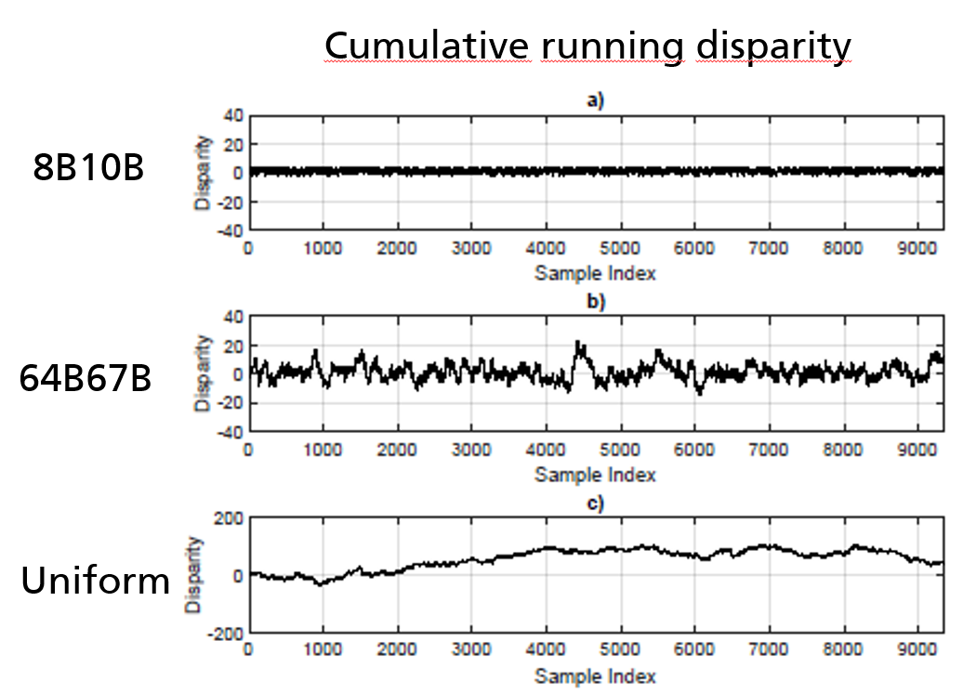
Disparity after Line Coding
8b10b and 64b67b set boundaries for disparity
Uniform (w/o Line Coding) is out of bounds (note y-axis scaling)

Slide 8
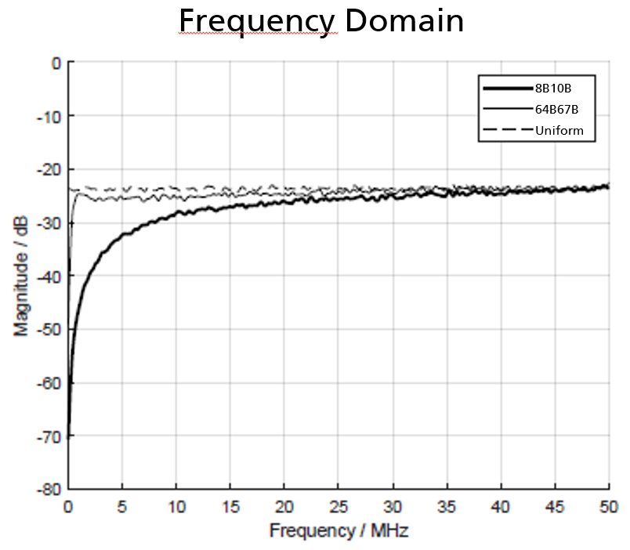
Spectrum after Line Coding
Line coding reduces low-frequency components :
    more overhead → less impairments due to baseline wander

Slide 9
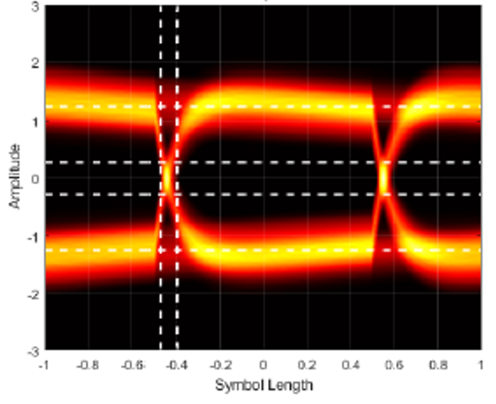
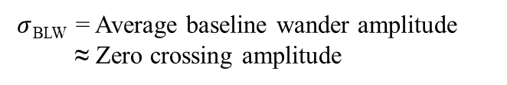
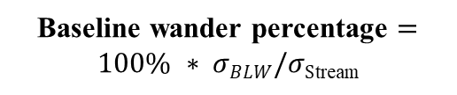
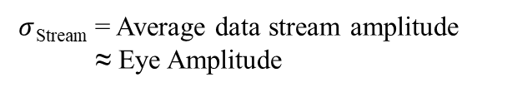
Baseline Wander after Line Coding
Calculation of baseline wander percentages
Baseline wander percentage $=100\% ∗ σBLW/σS$_{tream}
$σ$_{Stream} = Average data stream amplitude
≈ Eye Amplitude
$σ$_{BLW} = Average baseline wander amplitude
≈ Zero crossing amplitude

Slide 10
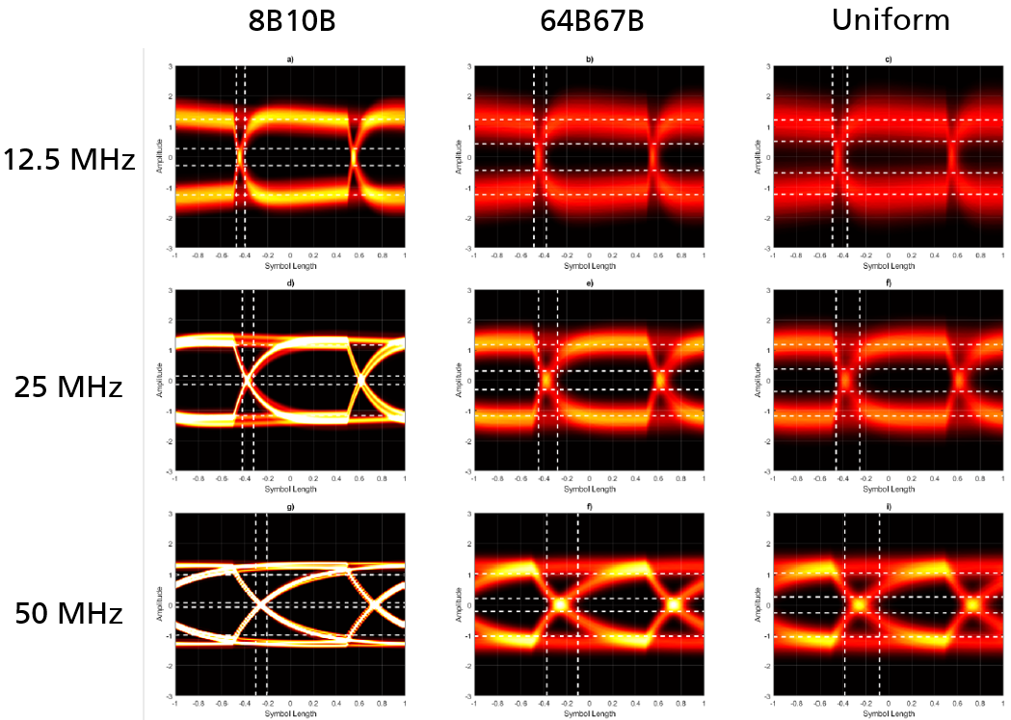
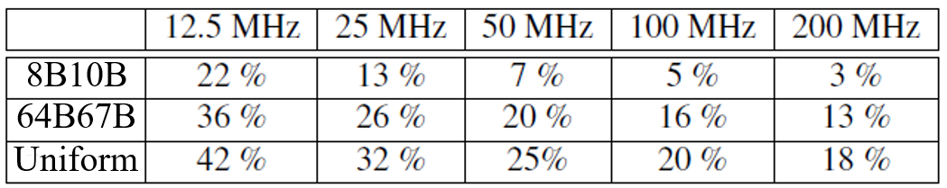
Baseline Wander vs. Symbol Rate
Baseline wander decreases with increasing symbol rate

Slide 11
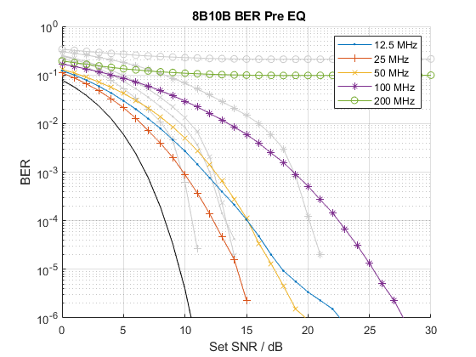
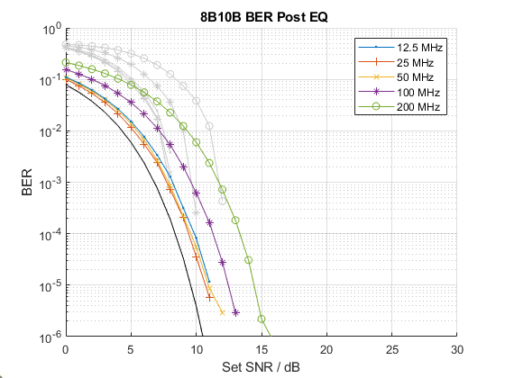
BER of 8b10b
Bit error rates for 8b10b (25% overhead)
    (Post-FEC BER is greyed out)
    8b10b can reduce baseline wander also w/o EQ at clock rates <= 50 MHz
    with EQ, the performance is much better

Slide 12
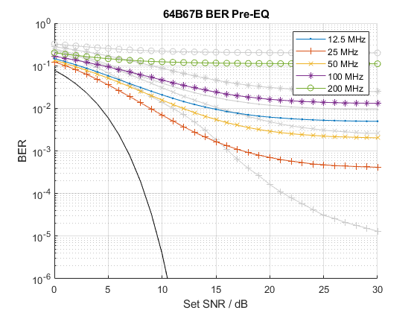
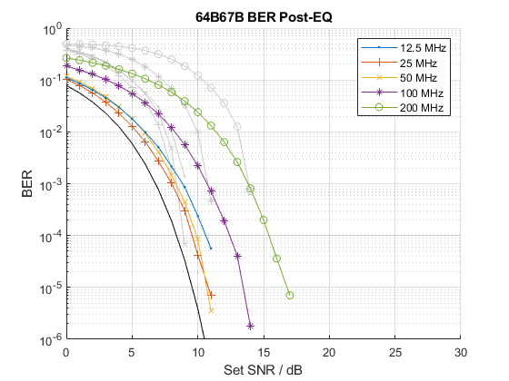
BER of 64b67b
Bit error rates for 64b67b (~5% overhead)
    (Post-FEC BER is greyed out)
    64b67b needs EQ but reduces overhead to 5%
    Needs ~ 2dB more SNR compared to 8b10b when using EQ

Slide 13
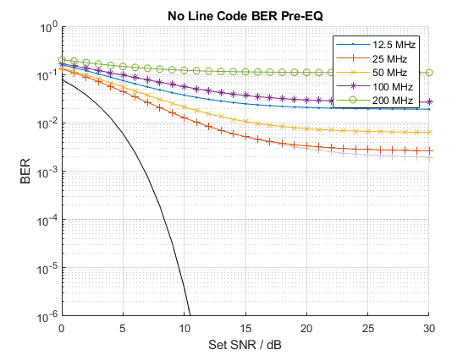
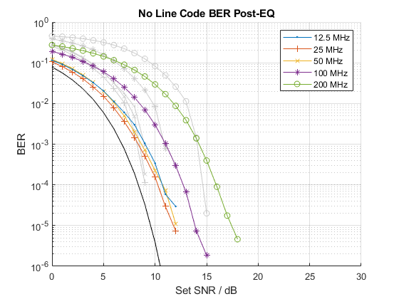
BER with Uniform Line Coding
Bit error rates with Uniform Line Coding (0% overhead)
    (Post-FEC BER is greyed out)
    Uniform Line Coding needs EQ but reduces overhead to 0%
    Needs ~ 1dB more SNR compared to 64b67b with EQ

Slide 14
Conclusions
FDE has major impact on BER
It is not needed with 8B10B and 64b67b at lower symbol rates
With FDE, the loss compared to 8B10B is 2 and 3dB SNR for 64B67B and Uniform Line Coding, respectively
Overhead of 25, 4.7, 0% for 8b10b, 64b67b and Uniform Line Coding, respectively
Proposal is to add new MCS to PM PHY which allow
  64b67b Line Coding
  Uniform Line Coding
New modes enable higher data rates for PM PHY
  At a reasonable price in terms of performance

Slide 15
To be specified
64b67b Line Coding scheme
Uniform Line Coding scheme
Integration into the PM-PHY
  Decoding approach
  Padding: Mapping of FEC code words onto the used Line Code

Slide 16
Guided Scrambling Line Coding
Exemplary: 64b67b
    N = 64, N_{a} = 3
General encoding process
    Augment (<=N)-bit data by N_{a}-bit values
    Scramble data
    Select code word out of 2^N_{a} „quotients“
General decoding process
    Descramble (<=N+N_{a})-bit code block
    Remove augmentation bits from the beginning of the output sequence

Slide 17
Guided Scrambling Line Coding
Encoding

Slide 18
Guided Scrambling Line Coding
Decoding

Slide 19
Scrambler configuration
Scrambling polynomial
    X^N_{a}+X^0
Scrambler initialization
    Initialize each scrambler for
    every data block of length (<=N) at first bit
Process for each data block
    Pre-ocuppy each scrambler with augmentation values
        aug := [C_{Na}, …, C₂, C₁] where C_{Na} is MSB of
        augmentation value
    Scramble (<=N)-bit data block
    Mux N_{a}-bit augmentation value and scrambled block
Scrambler, N_{a}=3

Slide 20
Exemplary Code Selection method
A) Specify a test vector for the first quotient for 64b67b guided scrambling LC for testing purposes
    Guided scrambler output = Q₁
B) Specify a test vector for each of the eight quotients for 64b67b guided scrambling LC for testing purposes
    Guided scrambler output = Q_{i} , i = (1 … 8)
…

Slide 21
Block decoding
Descramble (<=N+N_{a})-bit code block
Remove augmentation bits from the beginning of the output sequence
…

Slide 22
FEC segmentation and padding lengths
Data block sequences are padded to the next multiple of the FEC word length
of 240 bits and 2480 bits for header and payload respectively
Padding length must be calculated with respect to the word lengths of the line coding schemes
…

Slide 23
FEC padding lengths
Padding lengths for FEC block length fitting for 8b10b vs 64b67b vs Uniform Line Coding
…

Slide 24
Implementation in the PM-PHY
64b67b : Replace 8b10b with 64b67b in LC blocks
Uniform LC : Do not apply line coding in LC blocks
PMA layer of PM-PHY Tx
…

Slide 25
Scrambler initialization
Initialize all 2^N_{a} LSFRs
    with the augmentation values
    [0 … 0 0], [0 … 0 1] … [1 … 1 1]
    at first bit of all (<=N-bit) data blocks

Slide 26
Scrambler implementation
…

