Slide 1
Project: IEEE P802.15 Working Group for Wireless Personal Area Networks (WPANs)
Submission Title: SG4ab Agenda and Meeting Slides
Date Submitted: August 17, 2021
Source: Benjamin A. Rolfe (Blind Creek Associates)
Contact:
Voice: +1 408 395 7207, E-Mail: ben.rolfe @ ieee.org
Re: Study Group 4ab: UWB Next Generation
Abstract: Agenda and Meeting Slides
Purpose: Achieve the illusion of organization for the meeting
Notice: This document has been prepared to assist the IEEE P802.15. It is offered as a basis for discussion and is not binding on the contributing individual(s) or organization(s). The material in this document is subject to change in form and content after further study. The contributor(s) reserve(s) the right to add, amend or withdraw material contained herein.
Release: The contributor acknowledges and accepts that this contribution becomes the property of IEEE and may be made publicly available by P802.15.
Notes:
Jul 12, 2010
Page 1

Slide 2
Study Group 15.4ab Next Generation UWB Amendment
Teleconference / Virtual Meeting
August 31, 2021

Slide 3
802.15 Study Group Meeting
Pre-PAR Activity Rules
Study Group voting: everyone present can vote
Identify yourself and affiliation on first contact
Reminder: Individual Participation

Slide 4
IEEE-SA Patent, Copyright, and Participation Policies
See: https://grouper.ieee.org/groups/802/sapolicies.shtml
IEEE-SA Patent Slides for Pre-PAR Meetings:
https://development.standards.ieee.org/myproject/Public/mytools/mob/preparslides.pdf
IEEE-SA Participation Slides for Pre-PAR Meetings:
https://standards.ieee.org/content/dam/ieee-standards/standards/web/documents/other/Participant-Behavior-Individual-Method.pdf
Copyright:
https://standards.ieee.org/content/dam/ieee-standards/standards/web/documents/other/ieee-sa-copyright-policy-2019.pdf

Slide 5
Task Group Rules
PAR has been submitted
So we will abide by the rules that apply to a PAR activity also:
https://mentor.ieee.org/myproject/Public/mytools/mob/slideset.pdf

Slide 6
IEEE 802 Ground Rules
Respect … give it, get it
NO product pitches
NO corporate pitches
NO prices
NO restrictive notices – (no confidentially notices in email)
Presentations must be openly available

Slide 7
Proposed Agenda
Opening and meeting preamble
Brief recap and status
Agenda and schedule for Sept
Any other Business

Slide 8
Recap

Slide 9
5.2.b Scope of the project (As submitted to NesCom):
This amendment enhances the Ultra Wideband (UWB) physical layers (PHYs) medium access control (MAC), and associated ranging techniques while retaining backward compatibility with enhanced ranging capable devices (ERDEVs).
Areas of enhancement include:
additional coding, preamble and modulation schemes to support improved link budget and/or reduced air-time relative to IEEE Std 802.15.4 UWB;
additional channels and operating frequencies; interference mitigation techniques to support greater device density and higher traffic use cases relative to the IEEE Std 802.15.4 UWB;
improvements to accuracy, precision and reliability and interoperability for high-integrity ranging;
schemes to reduce complexity and power consumption;
definitions for tightly coupled hybrid operation with narrowband signaling to assist UWB;
enhanced native discovery and connection setup mechanisms;
sensing capabilities to support presence detection and environment mapping;
and mechanisms supporting low-power low-latency streaming as well as high data-rate streaming allowing at least 50 Mbit/s of throughput.

Slide 10
Status and plan (what now?)
Review and Revisit the TGD
Begin development of technical framework document
Hear technical contributions
Agree on framework – topics for more work
Hear detailed proposals
Develop text
First steps
Cast project goals into first cut (JH)
Volunteer(s) for TE (BV)

Slide 11
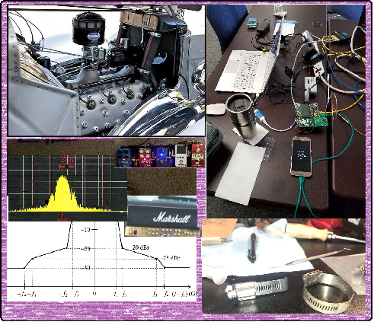
Technical Contributions

Slide 12
Next Steps

Slide 13
September Interim
 |  | Wednesday | Friday | Tuesday |  | Wednesday |  | Thursday |  | Friday |  |  | Sunday | Monday |  | Tuesday |  | Wednesday
EDT | PDT | 8-Sep | 10-Sep | 14-Sep |  | 15-Sep |  | 16-Sep |  | 17-Sep |  | UTC | 19-Sep | 20-Sep |  | 21-Sep |  | 22-Sep |  | JST
5:00 | 2:00 |  |  |  |  |  |  |  |  |  |  | 9:00 |  |  |  |  |  |  |  | 18:00
6:00 | 3:00 |  |  |  |  |  |  |  |  |  |  | 10:00 |  |  |  |  |  |  |  | 19:00
7:00 | 4:00 |  |  |  |  |  |  |  |  |  |  | 11:00 |  |  |  |  |  |  |  | 20:00
8:00 | 5:00 |  |  |  |  |  |  |  |  |  |  | 12:00 |  |  |  |  |  |  |  | 21:00
9:00 | 6:00 |  | 802 Wireless Opening | WG Opening Meeting |  | TG7a | SG6a | TG7a | SG3ma | TG7a | SC THz | 13:00 |  | TG7a | SG3ma | TG7a | SG6a | WG Closing Meeting |  | 22:00
10:00 | 7:00 | 802.15 CAC |  |  |  |  |  |  |  |  |  | 14:00 |  |  |  |  |  |  |  | 23:00
11:00 | 8:00 |  |  | SC IETF | Joint 13/7a | SC WNG |  | SC Maint |  | SG15 | AM2 | 15:00 |  | Joint 6a/4ab/14 | AM2 | SG15 | AM2 |  |  | 0:00
12:00 | 9:00 |  |  |  |  |  |  |  |  |  |  | 16:00 |  |  |  |  |  |  |  | 1:00
13:00 | 10:00 |  |  | TG16t | PM1 | TG13 | PM1 | TG13 | Joint 14/15/4ab | SG4ab | PM1 | 17:00 |  | TG4cor1 | PM1 | TG13 | PM1 |  |  | 2:00
14:00 | 11:00 |  |  |  |  |  |  |  |  |  |  | 18:00 |  |  |  |  |  |  |  | 3:00
15:00 | 12:00 | 802 Wireless Chairs mtg |  | SG15 | PM2 | SG4ab | PM2 | SG4ab | PM2 | SG14 | PM2 | 19:00 |  | SG14 | PM2 | SG14 | TG16t |  |  | 4:00
16:00 | 13:00 |  |  |  |  |  |  |  |  |  |  | 20:00 |  |  |  |  |  |  |  | 5:00
17:00 | 14:00 |  |  | EV1 | EV1 | TG4cor1 | EV1 | TG4aa | SG4ab | EV1 | EV1 | 21:00 |  | TG4aa | EV1 | TG4cor1 | SG4ab |  |  | 6:00
18:00 | 15:00 |  |  |  |  |  |  |  |  |  |  | 22:00 |  |  |  |  |  |  |  | 7:00
19:00 | 16:00 |  |  | EV2 | EV2 | EV2 | EV2 | SG6a | EV2 | EV2 | EV2 | 23:00 |  | EV2 | EV2 | EV2 | EV2 |  |  | 8:00
20:00 | 17:00 |  |  |  |  |  |  |  |  |  |  | 0:00 |  |  |  |  |  |  |  | 9:00
21:00 | 18:00 |  |  |  |  |  |  |  |  |  |  | 1:00 |  |  |  |  |  |  |  | 10:00
22:00 | 19:00 |  |  |  |  |  |  |  |  |  |  | 2:00 |  |  |  |  |  |  |  | 11:00
23:00 | 20:00 |  |  |  |  |  |  |  |  |  |  | 3:00 |  |  |  |  |  |  |  | 12:00
 |  | Required mtg slots
 |  | Extra credit slots
15.4ab
Joint

Slide 14
Teleconference Schedule Discussion
Frequency: Bi-weekly
Phase: Tuesday
Time: 10:00 ET (07:00 PT)
Offset: First call August 3rd
Duration: 1 hour.
Week | Time (ET)
Now: | [July plenary]
August 3 | 10:00 ET
August 17 | 10:00 ET
August 31 | 10:00 ET
Sept 14: | Sept Interim
We are Here
NEXT

Slide 15
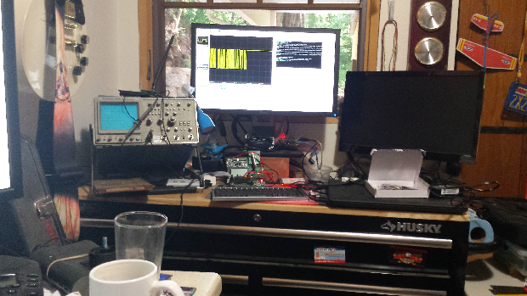
Other Business

Slide 16
Adjourned Thanks

