Slide 1
Project: IEEE P802.15 Working Group for Wireless Personal Area Networks (WPANs)
Submission Title: Narrowband assisted multi-millisecond UWB
Date Submitted: 20 July, 2021
Source: J.S. Hammerschmidt, Ersen Ekrem, Eren Sasoglu, Xiliang Luo (Apple Inc.)
Address: One Apple Park Way, Cupertino, CA 95104, USA
E-Mail: jsh@ieee.org, ersenek@gmail.com
Abstract: Discussion of how NB and UWB signaling can cooperate to improve the UWB link budget.
Purpose: Illustrate NB/UWB coordination to improve the operating range of UWB ranging use cases.
Notice: This document has been prepared to assist the IEEE P802.15. It is offered as a basis for discussion and is not binding on the authoring individual(s) or organization(s). The material in this document is subject to change in form and content after further study. The authors(s) reserve(s) the right to add, amend or withdraw material contained herein.

Slide 2
PAR Objective | Proposed Solution (how addressed)
Safeguards so that the high throughput data use cases will not cause significant disruption to low duty-cycle ranging use cases
Interference mitigation techniques to support higher density and higher traffic use cases
Other coexistence improvement
Backward compatibility with enhanced ranging capable devices (ERDEVs)
Improved link budget and/or reduced air-time | Use coordinated PHY signaling (NB and UWB) to improve link budget and/or to reduce air-time
Additional channels and operating frequencies
Improvements to accuracy / precision / reliability and interoperability for high-integrity ranging
Reduced complexity and power consumption | Off-loading of functionality to lower-complexity/power NB PHY helps reduce complexity of “heavier” UWB sub-system
Hybrid operation with narrowband signaling to assist UWB | Exploit tightly coupled concurrent operation of NB to help UWB
Enhanced native discovery and connection setup mechanisms
Sensing capabilities to support presence detection and environment mapping
Low-power low-latency streaming
Higher data-rate streaming allowing at least 50 Mbit/s of throughput
Support for peer-to-peer, peer-to-multi-peer, and station-to-infrastructure protocols
Infrastructure synchronization mechanisms

Slide 3
Contents
UWB’s 37 nJ “Energy Bucket” (1 page)
NB-assisted UWB signaling to improve the link budget (2 pages)
Considerations (3 pages)
Conclusions (1 page)

Slide 4
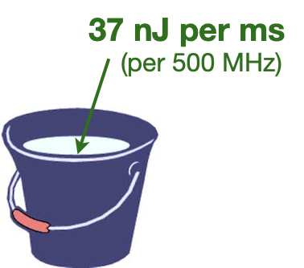
The “37 nJ per ms” Barrier
UWB is currently regulated to remain under (tiny) -41.3 dBm/MHz “Mean EIRP” across the spectrum
Assuming margin from ”Peak EIRP” violations, perfect 0 dB SPAPR, and a common 1 ms emissions test window, the best-case emitted energy in 500 MHz per ms is 37 nJ: UWB is energy-limited
Link Budget is determined by the energy made available at Tx relative to the energy needed for the corresponding Rx processing (e.g., SHR at Tx vs. Sync at Rx)
Typical 4z packets remain within 1ms, bounding the available energy to 37 nJ
Would like to break out of this 37 nJ barrier and do so efficiently
A high-performing NB companion system may be able to help us do that

Slide 5
NB Assisted Multi-Millisecond UWB
Distribute UWB over short bursts (“fragments”) spanning N milliseconds, providing an emissions budget of up to N*37 nJ
Use high-performance NB companion link to “anchor” the subsequent fragmented UWB transmissions – providing time (T) and frequency (F) sync & thereby allowing low-complexity, high-performance UWB processing to integrate energies at Rx
Example: UWB fragments contain CIR training sequences while sync and (control) data are offloaded to NB => Link Budget improvement for ranging use case amounting to more than 10*log₁₀(N) dB
Tight coupling (e.g., shared XO & MAC timer) between NB and UWB is required

Slide 6
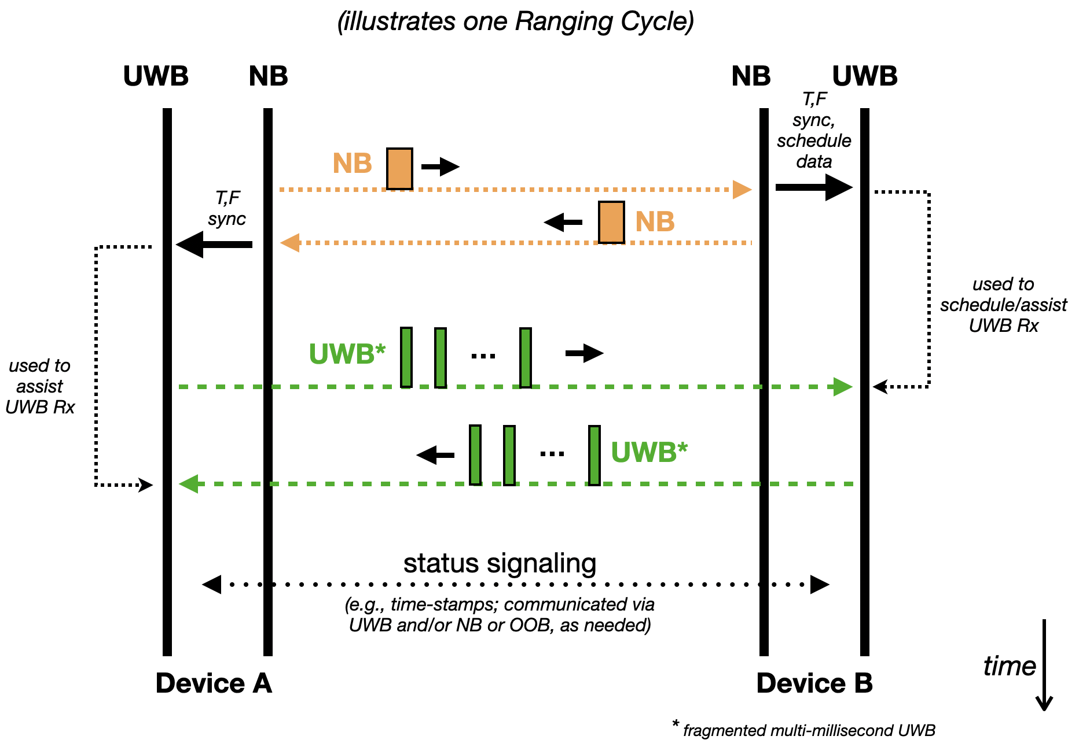
Protocol Perspective (Example)

Slide 7
Considerations (1)
Choice of NB PHY
An NB PHY from 15.4 seems like a great choice - “stay within the family”!
As per recent discussions in SG 4ab^{[1]}, the 250 kb/s OQPSK PHY seems like a great starting point (widely adopted, high performance, constant amplitude Tx, etc.)
Can consider enhancing basic OQPSK with simple optional coding layer and/or higher-speed modulation such as 1 Mb/s
Spectral Band for NB PHY
As per recent discussions in SG 4ab^{[1]}, UNII-3 (upper 5 GHz) seems like a good starting point: regulatory landscape; efficient antenna HW sharing with UWB; less crowded than 2.4 GHz
[1] “Opportunities for improved UWB/NB coordination”, Presentation at IEEE 802.15, SG4ab, May 2021, Document # 5-21-0292-00-04ab

Slide 8
Considerations (2)
Duration of UWB “fragments”
Maybe “a few dozen” microseconds (details TBD); watch Peak EIRP!
Possible UWB fragment sequence types
Training sequences such as Ipatov, Golay, etc., possibly periodic per fragment as in 4a/4z preambles, or Pseudo-Random
Need to watch out for flat spectrum (low SPAPR) to maximize energy
Duration of NB+UWB Exchange
Yes, but most of the exchange consists of “silence”
Could interleave fragments between A-to-B and B-to-A directions to compress the end-to-end duration
Could adapt number of fragments to link requirements

Slide 9
Considerations (3)
NB Fading
First of all, not every ranging cycle needs to succeed
Antenna Diversity & Frequency Hopping will dramatically mitigate fading related losses
Either way, should account for some fading margin
LRP or HRP?
The concept (especially the example outlined in this presentation) is agnostic to the PRF and may work for both frameworks by providing suitable waveform parameter sets
This may help bridge the historical gap between HRP and LRP

Slide 10
Conclusions
Break through 37 nJ ceiling by utilizing fragmented & distributed short UWB Impulse Radio sequences
Use companion NB PHY to assist synchronization purposes (and maybe control & status signaling) for efficient implementation of “multi-millisecond UWB energy harvesting”
NB-assisted multi-ms UWB may be able to provide substantial link budget gains in, e.g., ranging scenarios
May be applicable to both low and high PRF UWB PHY frameworks

