Slide 1
Project: IEEE P802.15 Working Group for Wireless Personal Area Networks (WPANs)
Submission Title: Using the 802.15.4 UWB HRP PHY for BAN
Date Submitted: July 19, 2021
Source: Benjamin A. Rolfe (Blind Creek Associates)
Contact:
Voice: +1 408 395 7207, E-Mail: ben.rolfe @ ieee.org
Re: Study Group 6a UWB PHY Considerations
Abstract: Reasons to consider adopting or adapting the 802.15.4 HRP PHY for 802.15.6a
Purpose: Contribute to the technical development of a usable standard
Notice: This document has been prepared to assist the IEEE P802.15. It is offered as a basis for discussion and is not binding on the contributing individual(s) or organization(s). The material in this document is subject to change in form and content after further study. The contributor(s) reserve(s) the right to add, amend or withdraw material contained herein.
Release: The contributor acknowledges and accepts that this contribution becomes the property of IEEE and may be made publicly available by P802.15.
Notes:
Jul 12, 2010
Page 1

Slide 2
Using the 802.15.4 UWB HRP PHY for BAN.
Some good reasons

Slide 3
Introduction
History of HRP
IEEE Std 802.15.4a-2007: First UWB Standard - Second Wave of UWB
Different direction from high data volume UWB (aka the train wreck)
Impulse radio focused on precise ranging
Minimal changes to the 2006 MAC
Used a lot in “low profile” applications
IEEE Std 802.15.4z-2020 - Third wave of UWB
Updates based on real world experience and 1.5 decades of evolution of 802.15.4
Updates to PHY to improve performance and flexibility
Slightly higher data rates (up to 31 Mbits/sec)
Improved signal integrity
Larger PPDU size (up to 4k octets payload)
MAC updates using the “modern” 802.15.4e MAC frame formats
Standardize coordination of ranging and data exchanges in support of ranging/localization
Widely used in high profile consumer devices (billions)
P802.15.4ab (New project)
Building on 802.15.4z-2020
More data rates – both higher and lower (more trade-off space)
Building on experience in high-profile, high-volume commodity uses.

Slide 4
Some Reasons
There are already a lot of 802.15.4 HRP devices in consumer platforms waiting to be exploited
There is already commodity silicon available (HRP = 4a+4z)
There are industry alliances supporting 802.15.4 HRP
Application focused conformance specs and certification programs
Advocacy in regulatory venues and other forums
Promoting growth in the UWB industry (➔ more volume)
Growth of 802.15.4 HRP based applications expanding rapidly
More vendors offering more PHY implementation options (silicon, IP)
Already in consumer devices and more every day
Established and growing ecosystem

Slide 5
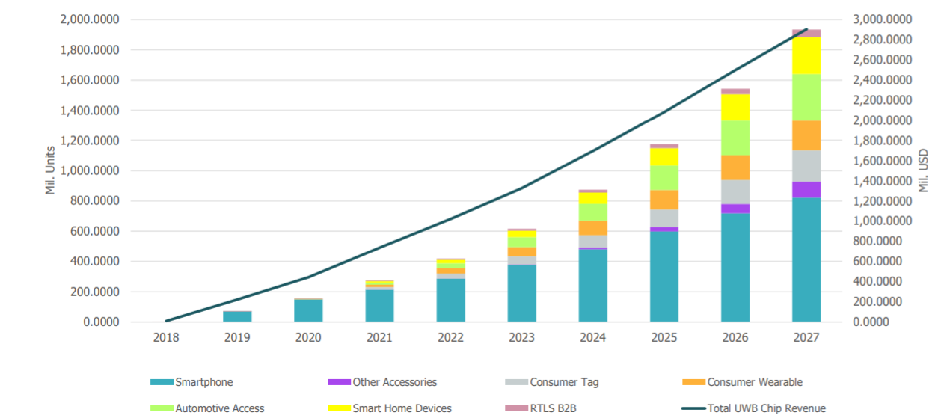
Assumes 1:1 ratio of peripherals to smartphone
Already shown to be way low
2021 shipments already exceed this forecast
Over 250 million devices shipped
Expect over 2 billion devices and $3 billion (USD) by 2027\
From FCC.gov:
https://ecfsapi.fcc.gov/file/1051094387141/AMENDED%20UWB%20FCC%20ExParteLetter%20MAY_10_2021.pdf

Slide 6
Beyond 15.4z
P802.15.4ab is building on 15.4z (z++)
Safe bet most PHY features added by 15.4ab will be available in commodity silicon soon (if not already)
Technical advantage:
Proven and known performance
A lot of stakeholders have powerful interest in good coexistence
Ecosystem expanding (Chips, antennas, etc.) => product development support
Economic advantage:
High volume generally begats lower cost
Credibility and “brand recognition”
Faster time to market
Expanded opportunity leveraging existing consumer platforms

Slide 7
Things to think about
Data rates required for 6a
Is the ~50 to ~75 Mbit/sec target enough?
Adaptation to the 802.15.6 MAC
Changes to CCA to support CSMA-CA?
Scheduled access?
Other coexistence mechanisms unique to BAN

Slide 8
Technical Contributions

