Slide 1
Project: IEEE P802.15 Working Group for Wireless Personal Area Networks (WPANs)
Submission Title: Extension of Interframe Space for supporting long distance transmission
Date Submitted: 20 July, 2021
Source: Keitarou Kondou Company HRCP Research & Development Partnership
Address: 1-24-2, Taito, Taito-ku, Tokyo, 110-0016 Japan
Voice: +81-3-6806-0236, FAX: +81-3-6806-0206, E-Mail: Keitarou.Kondou@hrcp.jp
Re:
Abstract: When 802.15.3d is employed for several-killometer wireless link, even SNR of the signal is maintained, data transmission might not be established due to huge propagation delay. Showing maximum distance supported with current spec and suggesting extension of the parameter
Purpose: Change timing parameter of Interframe space in the next version of the 802.15.3 specification.
Notice: This document has been prepared to assist the IEEE P802.15. It is offered as a basis for discussion and is not binding on the contributing individual(s) or organization(s). The material in this document is subject to change in form and content after further study. The contributor(s) reserve(s) the right to add, amend or withdraw material contained herein.
Release: The contributor acknowledges and accepts that this contribution becomes the property of IEEE and may be made publicly available by P802.15.

Slide 2
Extension of Interframe Space for supporting long distance transmission
Keitarou Kondou
HRCP R&D Partnership

Slide 3
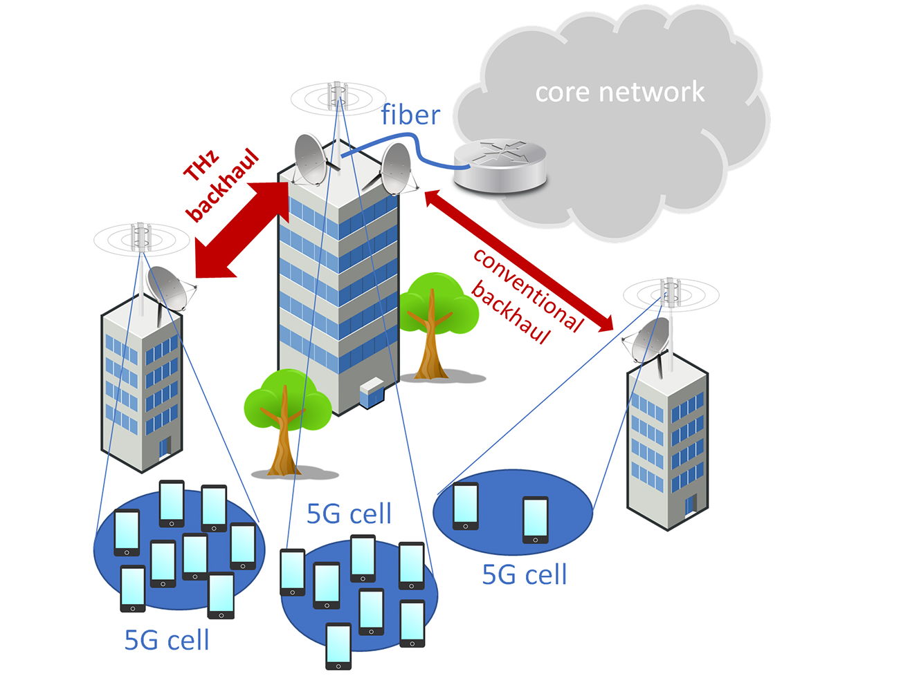
Introduction of ’ThoR’
ThoR is EU-japan project for developing THz radio link for beyond 5G network
The scope of the project is
  supporting > 100 Gbps over 1 Km at 300 GHz
  implementing the IEEE 802.15.3d Standard
Technische Universität Braunschweig (EU-Koordinator, Deutschland), Waseda University (Japan-Koordinator, Japan), Chiba Institute of Technology (Japan), Gifu University (Japan), Universität Stuttgart (Deutschland), Fraunhofer-Institut für Angewandte Festkörperphysik IAF (Deutschland), University of Lille (Frankreich), HRCP (Japan) ,Vivid Components Ltd. (Großbritannien), Siklu Communication Ltd. (Israel), NEC Corporation (Japan) and Deutsche Telekom (Deutschland/Tschechien).

Slide 4
System Overview
Employing plural modems compliant with 802.15.3e for converting user data to ‘IF’ signal
THz standard, 15.3d, shares most of PHY/MAC specification with 15.3e except for center frequency.
Several CMOS implementation of 60GHz modems are currently available and can handle Gbps data in real time.
802.15.3e V-band Modem
User Data
Network Interface
Baseband
Modem
RF
IF
Combiner/Splitter
300-GHz RF
Network Interface
Baseband
Modem
RF
IF
IF
antenna
Network Interface
Baseband
Modem
RF
IF

Slide 5
Channel Access on 15.3d/e
As 802.15.3d only supports P2P topology, two devices, PRC and DEV, transmit data alternatively.
Header with
ACK
Data
SIFS
PRC
DEV
time
Normal case
RIFS
PRC
DEV
time
Retransmission case

Slide 6

Concerns on long distance transmission
When transmission distance is getting longer, we may have to consider propagation delay
Device A
Device B
time
(a) Short distance
2 times of propagation delay is added before receiving ACK
send
receive
send
Device A
Device B
receive
send
receive
(b) Long distance
time

Slide 7
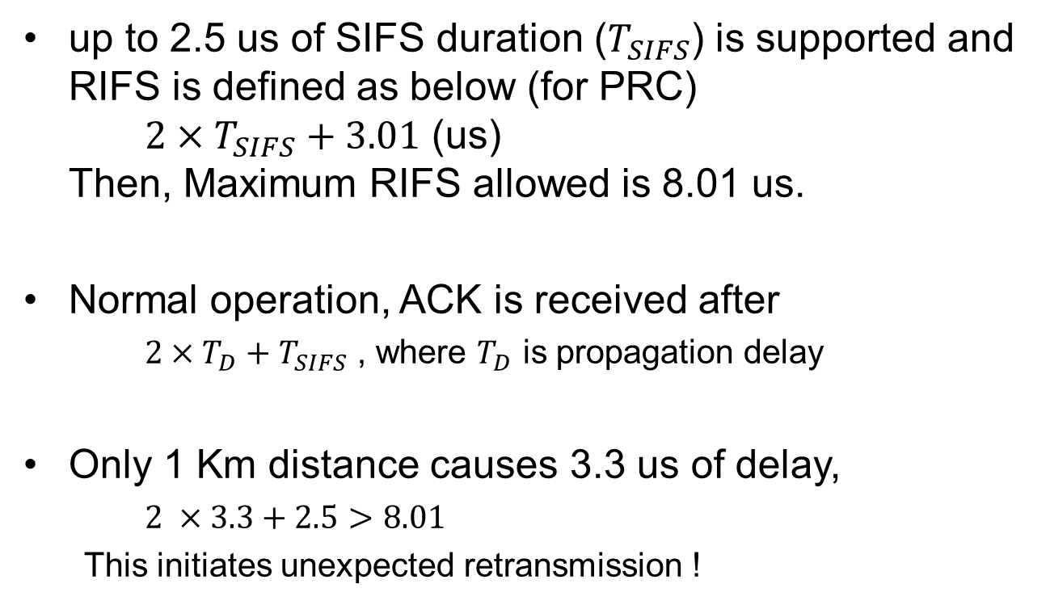
Distance covered with 15.3d standard
up to 2.5 us of SIFS duration ($T_{SIFS}$) is supported and RIFS is defined as below (for PRC)
${2×T}_{SIFS}+3.01$ (us)
Then, Maximum RIFS allowed is 8.01 us.
Normal operation, ACK is received after
  ${2×T}_{D}+T_{SIFS}$ , where $T_{D}$ is propagation delay
Only 1 Km distance causes 3.3 us of delay,
  $2 ×3.3+2.5>8.01$
  This initiates unexpected retransmission !

Slide 8
Suggested Change
The modem employed in the ThoR supports 40ms of RIFS, which results in 2800 Km in length.
  Apparently, too much
At least we have to extend RIFS 10 times of current RIFS value
We also need another equation for RIFS for supporting both short/long distance

