Slide 1
Project: IEEE P802.15 Working Group for Wireless Personal Area Networks (WPANs)
Submission Title: IR-UWB link budget analysis and how it compares with NB signaling
Date Submitted: July 2021
Source: Koorosh Akhavan (Qualcomm Inc.)
Address: 5775 Morehouse Drive San Diego, CA 92121 USA
E-Mail: kka200@gmail.com
Abstract: Go over link budget analysis and comparison between IR-UWB, BT LE and 15.4 OQPSK
Purpose: To start a discussion whether NB signaling is more efficient that IR-UWB signaling.
Notice: This document has been prepared to assist the IEEE P802.15. It is offered as a basis for discussion and is not binding on the contributing individual(s) or organization(s). The material in this document is subject to change in form and content after further study. The contributor(s) reserve(s) the right to add, amend or withdraw material contained herein.
Release: The contributor acknowledges and accepts that this contribution becomes the property of IEEE and may be made publicly available by P802.15.

Slide 2
PAR Objective | Proposed Solution (how addressed)
Safeguards so that the high throughput data use cases will not cause significant disruption to low duty-cycle ranging use cases
Interference mitigation techniques to support higher density and higher traffic use cases
Other coexistence improvement | UWB traffic can be reduced by offloading data to NB
Backward compatibility with enhanced ranging capable devices (ERDEVs)
Improved link budget and/or reduced air-time | Offloading status signaling to NB will improve LB and UWB airtime by focusing UWB energies towards channel sounding
Additional channels and operating frequencies | Propose to look for spectral regions allowing narrowband operation close to UWB bands
Improvements to accuracy / precision / reliability and interoperability for high-integrity ranging
Reduced complexity and power consumption | Prospect for antenna sharing between NB and UWB; efficient use of NB vs UWB for their respective strengths
Hybrid operation with narrowband signaling to assist UWB | Link budget analysis for IR-UWB and how it compares with NB signaling schemes like BT-LE or 15.4-OQPSK
Enhanced native discovery and connection setup mechanisms | Can build such mechanisms on NB subsystem
Sensing capabilities to support presence detection and environment mapping
Low-power low-latency streaming
Higher data-rate streaming allowing at least 50 Mbit/s of throughput
Support for peer-to-peer, peer-to-multi-peer, and station-to-infrastructure protocols
Infrastructure synchronization mechanisms | These mechanisms could benefit from NB based signaling

Slide 3
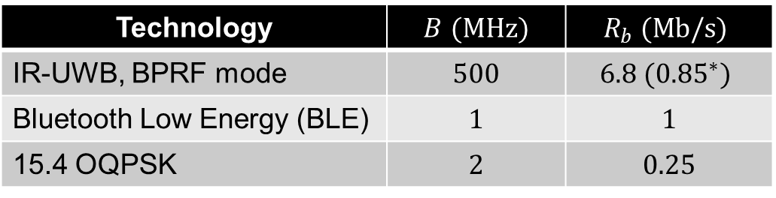

Technologies of interest
  We would like to perform a link budget analysis for the following technologies
  Here $B$ is bandwidth and $R_{b}$ is data rate
Technology | $B$ $(MHz)$ | $$R_{b} (Mb/s)$$
IR-UWB, BPRF mode | $$500$$ | $$6.8 ({0.85}^{∗})$$
Bluetooth Low Energy (BLE) | $$1$$ | $$1$$
15.4 OQPSK | $$2$$ | $$0.25$$
The 0.85 Mb/s only applies to the BPRF header.

Slide 4
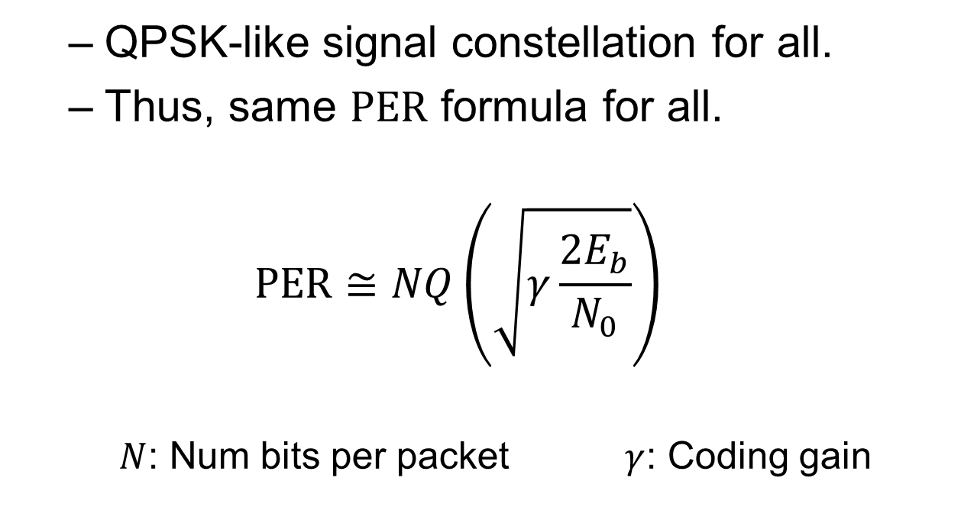

PER as a function of $E_{b}/N_{0}$
  QPSK-like signal constellation for all.
  Thus, same $PER$ formula for all.
  $$PER≅NQ\left(\sqrt{γ\frac{2E_{b}}{N_{0}}}\right)$$
    $N$: Num bits per packet $γ$: Coding gain

Slide 5


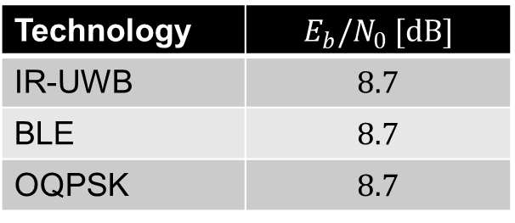
Required $E_{b}/N_{0}$ - uncoded
  Assume a 20-byte packet, i.e., $N=160$
  At $1\%$ $PER$ we get:
Technology | $$E_{b}/N_{0} [dB]$$
IR-UWB | $$8.7$$
BLE | $$8.7$$
OQPSK | $$8.7$$

Slide 6
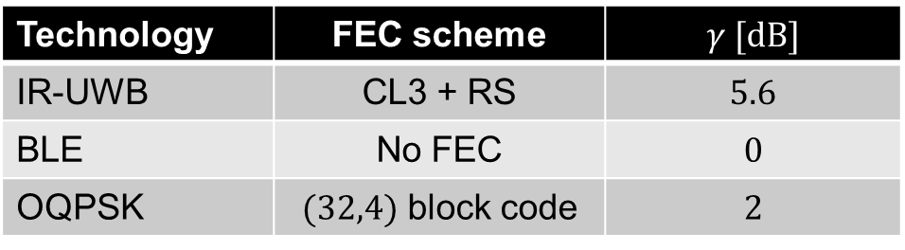

Required $E_{b}/N_{0}$, FEC coded
  Coding gain can be obtained by simulation. Here are the results:
Technology | FEC scheme | $$γ [dB]$$
IR-UWB | CL3 + RS | $$5.6$$
BLE | No FEC | $$0$$
OQPSK | $(32,4)$ block code | $$2$$

Slide 7

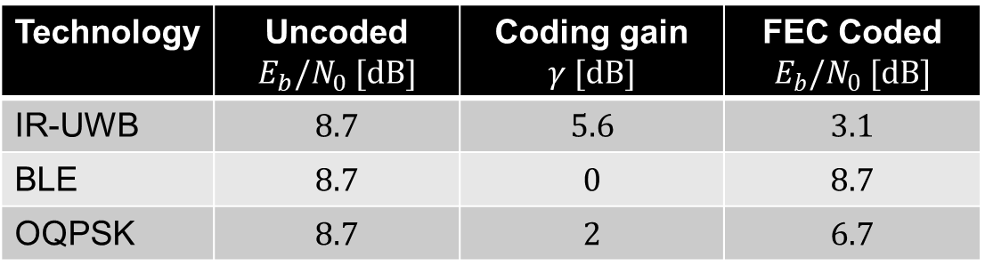
Required $E_{b}/N_{0}$, FEC coded
  This will give us the required $E_{b}/N_{0}$ for the FEC coded case
Technology | Uncoded $E_{b}/N_{0} [dB]$ | Coding gain $$γ [dB]$$ | FEC Coded $E_{b}/N_{0} [dB]$
IR-UWB | $$8.7$$ | $$5.6$$ | $$3.1$$
BLE | $$8.7$$ | $$0$$ | $$8.7$$
OQPSK | $$8.7$$ | $$2$$ | $$6.7$$

Slide 8




How ‘good’ are those three schemes?
Shannon capacity, AWGN
8.7 dB
BLE $(R_{b}=1 Mbps, B =1 MHz )$
8.2 dB
OQPSK $(R_{b}=0.25 Mbps, B =2 MHz )$
4.7 dB
IR-UWB $(R_{b}=6.8 Mbps, B =500 MHz )$
4.7 dB
IR-UWB, $(R_{b}=0.85 Mbps, B =500 MHz )$
Refers to 1% PER performance (N=160 bits)

Slide 9
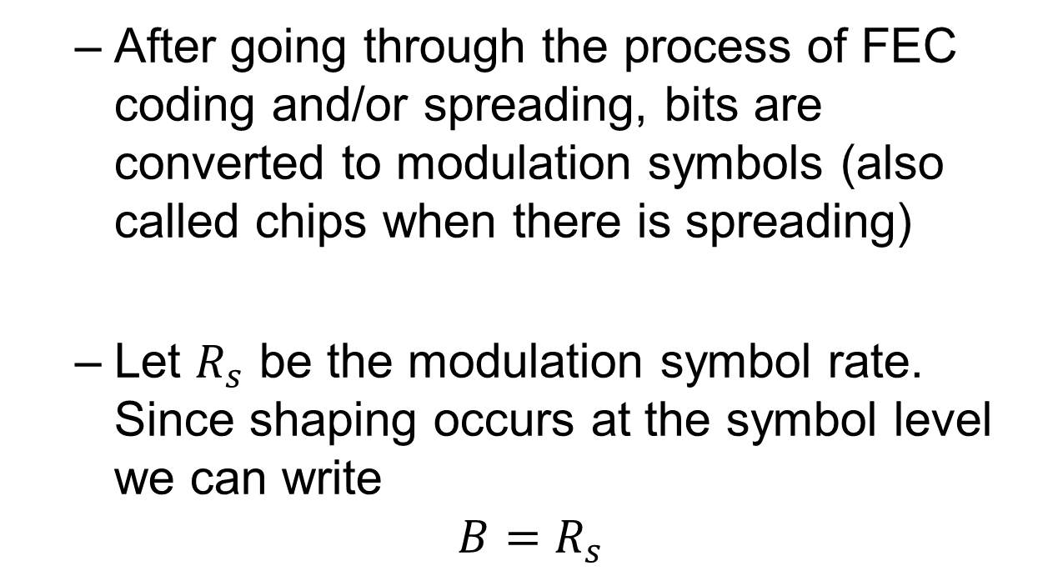
Bits vs. chips
  After going through the process of FEC coding and/or spreading, bits are converted to modulation symbols (also called chips when there is spreading)
  Let $R_{s}$ be the modulation symbol rate. Since shaping occurs at the symbol level we can write
$$B=R_{s}$$

Slide 10
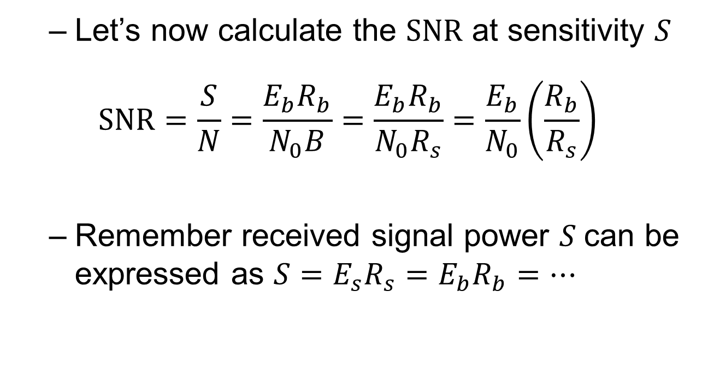

From $E_{b}/N_{0}$ to SNR
  Let’s now calculate the $SNR$ at sensitivity $S$
$$SNR=\frac{S}{N}=\frac{E_{b}R_{b}}{N_{0}B}=\frac{E_{b}R_{b}}{N_{0}R_{s}}=\frac{E_{b}}{N_{0}}\left(\frac{R_{b}}{R_{s}}\right)$$
  Remember received signal power $S$can be expressed as $S=E_{s}R_{s}=E_{b}R_{b}=…$

Slide 11
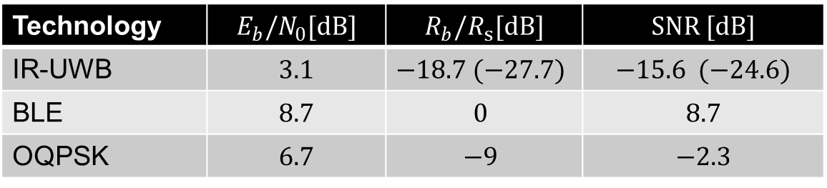

Required SNR
  Here are the $SNR$ values at sensitivity (i.e., 1% $PER$ for a 20-byte packet)
  When there is no coding or spreading as in the case for BLE, $R_{s}=R_{b}$
Technology | $$E_{b}/N_{0}[dB]$$ | $$R_{b}/R_{s}[dB]$$ | $$SNR [dB]$$
IR-UWB | $$3.1$$ | $$−18.7 (−27.7)$$ | $$−15.6 (−24.6)$$
BLE | $$8.7$$ | $$0$$ | $$8.7$$
OQPSK | $$6.7$$ | $$−9$$ | $$−2.3$$

Slide 12
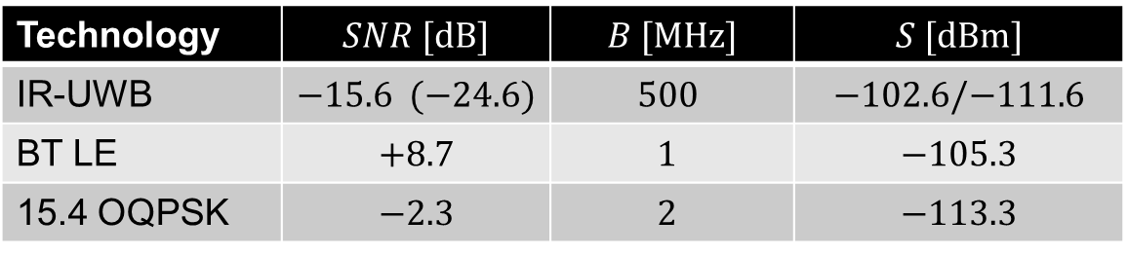

Receiver Sensitivity
  To calculate receiver sensitivity $S$ we write
  $$S\left[dBm\right]=SNR\left[dB\right]+N_{0}[dBm/Hz]+B\left[dB⋅Hz\right]+NF\left[dB\right]$$
  Here $N_{0}=−174 dBm/Hz$. Also, we ignore the $NF$
Technology | $$SNR [dB]$$ | $$B [MHz]$$ | $$S [dBm]$$
IR-UWB | $$−15.6 (−24.6)$$ | $$500$$ | $$−102.6/−111.6$$
BT LE | $$+8.7$$ | $$1$$ | $$−105.3$$
15.4 OQPSK | $$−2.3$$ | $$2$$ | $$−113.3$$

Slide 13
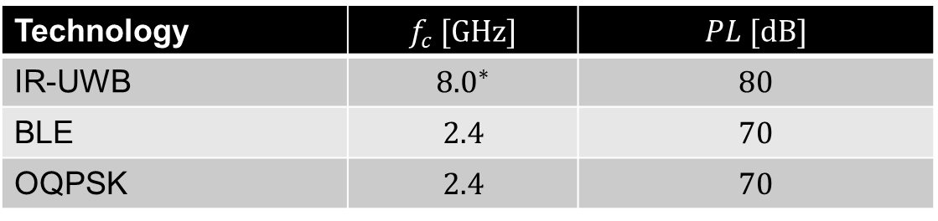

Path loss and effect of carrier frequency
  Recall
  $$\frac{P_{r}}{P_{t}}={\left(\frac{λ}{4πd}\right)}^{2}$$
  We calculate the pathloss, $PL$, at $d=30m$
Technology | $$f_{c} [GHz]$$ | $$PL [dB]$$
IR-UWB | $${8.0}^{∗}$$ | $$80$$
BLE | $$2.4$$ | $$70$$
OQPSK | $$2.4$$ | $$70$$
* IR-UWB channel 9

Slide 14
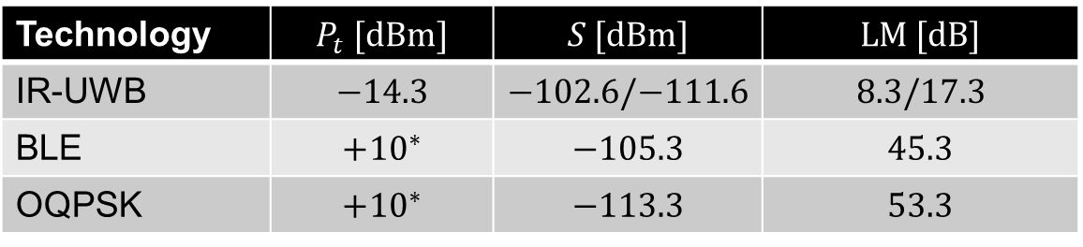

Link margin so far …
  At this point the Link Margin is
  $$LM [dB]=P_{t}[dB]−S[dB]−PL[dB]$$
Technology | $$P_{t} [dBm]$$ | $$S [dBm]$$ | $$LM [dB]$$
IR-UWB | $$−14.3$$ | $$−102.6/−111.6$$ | $$8.3/17.3$$
BLE | $$+{10}^{∗}$$ | $$−105.3$$ | $$45.3$$
OQPSK | $$+{10}^{∗}$$ | $$−113.3$$ | $$53.3$$
  * For BLE and OQPSK, the Tx power can go up to $+20 dBm$

Slide 15
Effect of fading
  Large-scale shadow fading
    Can we assume similar shadow fading effect on all signaling schemes?
  Small-scale multipath fading
    There is something important to be said about the effect of multipath

Slide 16











NB transmission
In NB transmission there is significant overlap between received pulses giving rise to NB fading
channel
$$α_{1}$$
$$c\left(t\right)$$
$$α_{2}$$
$$α_{3}$$
$$s_{P}\left(t\right)=s_{B}(t)\cos\left[ω_{c}t+φ_{c}\right]$$
$$r_{P}\left(t\right)=$$
$$τ_{1}$$
$$τ_{3}$$
$$0$$
$$τ_{2}$$
$$t$$
Received via the 1st path
$$α_{1}s_{B}(t−τ_{1})\cos\left[ω_{c}t+φ_{r1}\right]$$
$$t$$
Received via the 2nd path
$$α_{2}s_{B}(t−τ_{2})\cos\left[ω_{c}t+φ_{r2}\right]$$
$$t$$
Received via the 3rd path
$$α_{3}s_{B}(t−τ_{3})\cos\left[ω_{c}t+φ_{r3}\right]$$
$$t$$

Slide 17
Multipath is not necessarily bad
  NB systems don’t like multipath
      25-35 dB narrowband fading margin is usually assumed
  UWB systems love multipath
      The resolvable signals from different paths can be coherently combined by the Rake receiver.

Slide 18








UWB transmission
In ultrawideband transmission, there is very little overlap between pulses arriving from different paths → frequency selective fading
$$α_{1}$$
$$c\left(t\right)$$
$$α_{2}$$
$$α_{3}$$
$$s_{P}\left(t\right)=s_{B}(t)\cos\left[ω_{c}t+φ_{c}\right]$$
$$r_{P}\left(t\right)=$$
$$0$$
$$t$$
$$α_{1}s_{B}(t−τ_{1})\cos\left[ω_{c}t+φ_{r1}\right]$$
Received via the 1st path (DP)
$$t$$
Received via the 2nd path
$$α_{2}s_{B}(t−τ_{2})\cos\left[ω_{c}t+φ_{r2}\right]$$
$$t$$
Received via the 3rd path
$$α_{3}s_{B}(t−τ_{3})\cos\left[ω_{c}t+φ_{r3}\right]$$
$$t$$

Slide 19
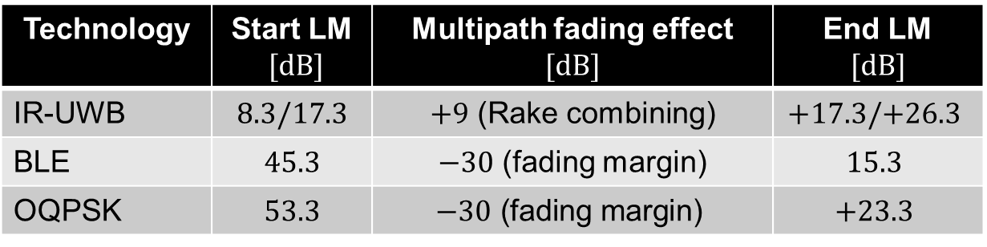
Relative Link margin
  Add effect of multipath
  Does NB systems provide a better link than IR-UWB? Can’t make a conclusive decision.
Technology | Start LM $[dB]$ | Multipath fading effect $$[dB]$$ | End LM $$[dB]$$
IR-UWB | $$8.3/17.3$$ | $+9$ (Rake combining) | $$+17.3/+26.3$$
BLE | $$45.3$$ | $−30$ (fading margin) | $$15.3$$
OQPSK | $$53.3$$ | $$−30\text{ (}\text{fading} \text{margin}\text{)}$$ | $$+23.3$$

Slide 20
Thank you

