Slide 1
Project: IEEE P802.15 Working Group for Wireless Personal Area Networks (WPANs)
Submission Title: IR-UWB link budget analysis and how it compares with NB signaling
Date Submitted: July 2021
Source: Koorosh Akhavan (Qualcomm Inc.)
Address: 5775 Morehouse Drive San Diego, CA 92121 USA
E-Mail: kka200@gmail.com
Abstract: Go over link budget analysis and comparison between IR-UWB, BT LE and 15.4 OQPSK
Purpose: To start a discussion whether NB signaling is more efficient that IR-UWB signaling.
Notice: This document has been prepared to assist the IEEE P802.15. It is offered as a basis for discussion and is not binding on the contributing individual(s) or organization(s). The material in this document is subject to change in form and content after further study. The contributor(s) reserve(s) the right to add, amend or withdraw material contained herein.
Release: The contributor acknowledges and accepts that this contribution becomes the property of IEEE and may be made publicly available by P802.15.

Slide 2
PAR Objective | Proposed Solution (how addressed)
Safeguards so that the high throughput data use cases will not cause significant disruption to low duty-cycle ranging use cases
Interference mitigation techniques to support higher density and higher traffic use cases
Other coexistence improvement | UWB traffic can be reduced by offloading data to NB
Backward compatibility with enhanced ranging capable devices (ERDEVs)
Improved link budget and/or reduced air-time | Offloading status signaling to NB will improve LB and UWB airtime by focusing UWB energies towards channel sounding
Additional channels and operating frequencies | Propose to look for spectral regions allowing narrowband operation close to UWB bands
Improvements to accuracy / precision / reliability and interoperability for high-integrity ranging
Reduced complexity and power consumption | Prospect for antenna sharing between NB and UWB; efficient use of NB vs UWB for their respective strengths
Hybrid operation with narrowband signaling to assist UWB | Link budget analysis for IR-UWB and how it compares with NB signaling schemes like BT-LE or 15.4-OQPSK
Enhanced native discovery and connection setup mechanisms | Can build such mechanisms on NB subsystem
Sensing capabilities to support presence detection and environment mapping
Low-power low-latency streaming
Higher data-rate streaming allowing at least 50 Mbit/s of throughput
Support for peer-to-peer, peer-to-multi-peer, and station-to-infrastructure protocols
Infrastructure synchronization mechanisms | These mechanisms could benefit from NB based signaling

Slide 3
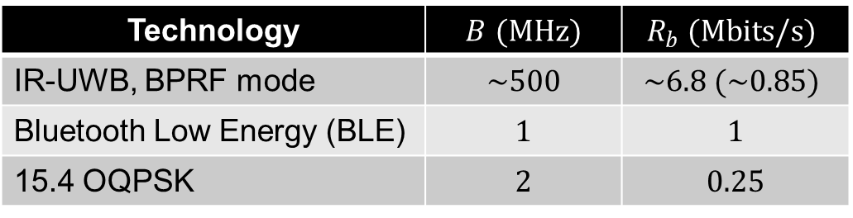

Technologies of interest
  We would like to perform a link budget analysis for the following technologies
  Here $B$ is bandwidth and $R_{b}$ is data rate
Technology | $B$ $(MHz)$ | $$R_{b} (Mbits/s)$$
IR-UWB, BPRF mode | $$\sim 500$$ | $$\sim 6.8 (\sim 0.85)$$
Bluetooth Low Energy (BLE) | $$1$$ | $$1$$
15.4 OQPSK | $$2$$ | $$0.25$$

Slide 4
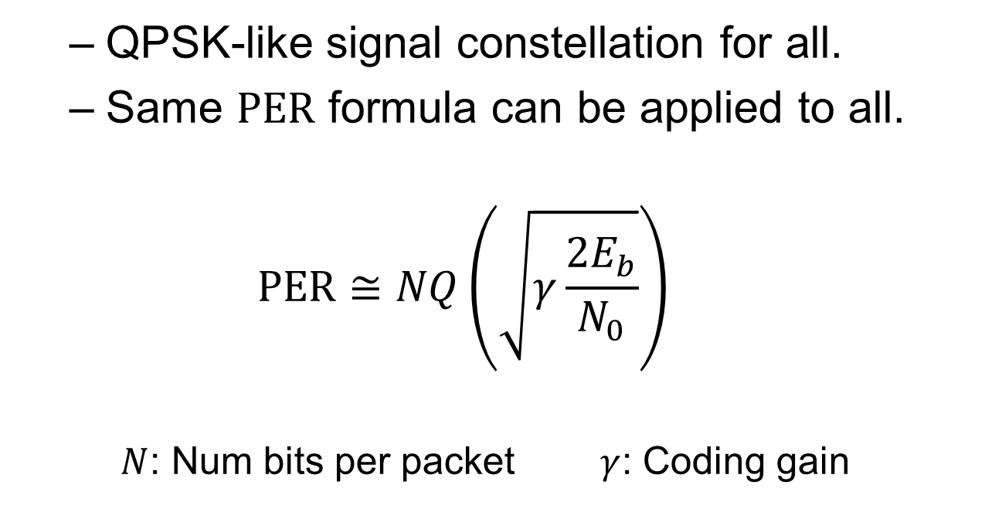

PER as a function of $E_{b}/N_{0}$
  QPSK-like signal constellation for all.
  Same $PER$ formula can be applied to all.
  $$PER≅NQ\left(\sqrt{γ\frac{2E_{b}}{N_{0}}}\right)$$
    $N$: Num bits per packet $γ$: Coding gain

Slide 5


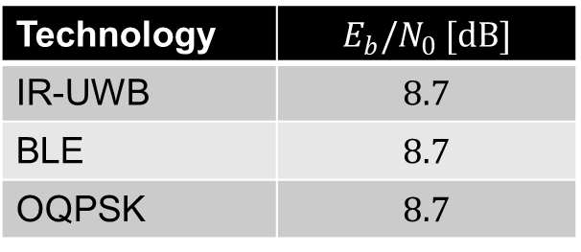
Required $E_{b}/N_{0}$ - uncoded
  Assume a 20-byte packet, i.e., $N=160$
  At $1\%$ $PER$ we get:
Technology | $$E_{b}/N_{0} [dB]$$
IR-UWB | $$8.7$$
BLE | $$8.7$$
OQPSK | $$8.7$$

Slide 6
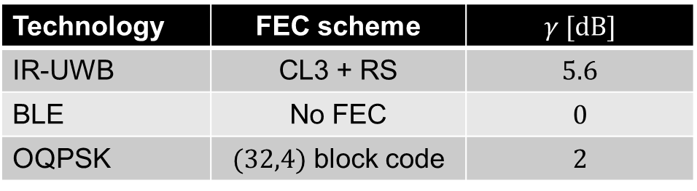

Required $E_{b}/N_{0}$, FEC coded
  We now apply FEC coding. Coding gain can be calculated via simulation. Here are the results
Technology | FEC scheme | $$γ [dB]$$
IR-UWB | CL3 + RS | $$5.6$$
BLE | No FEC | $$0$$
OQPSK | $(32,4)$ block code | $$2$$

Slide 7
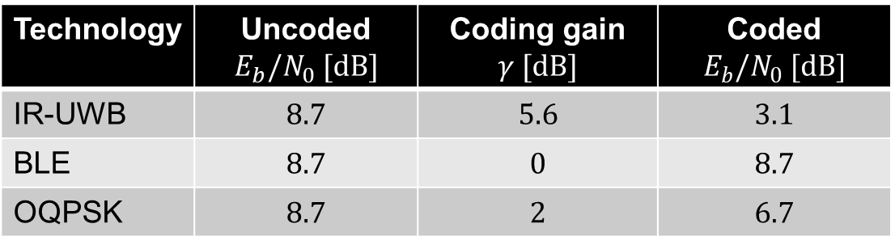

Required $E_{b}/N_{0}$, coded case
  We now apply coding. Coding gain can be calculated via simulation. Here are the results
Technology | Uncoded $E_{b}/N_{0} [dB]$ | Coding gain $$γ [dB]$$ | Coded $E_{b}/N_{0} [dB]$
IR-UWB | $$8.7$$ | $$5.6$$ | $$3.1$$
BLE | $$8.7$$ | $$0$$ | $$8.7$$
OQPSK | $$8.7$$ | $$2$$ | $$6.7$$

Slide 8
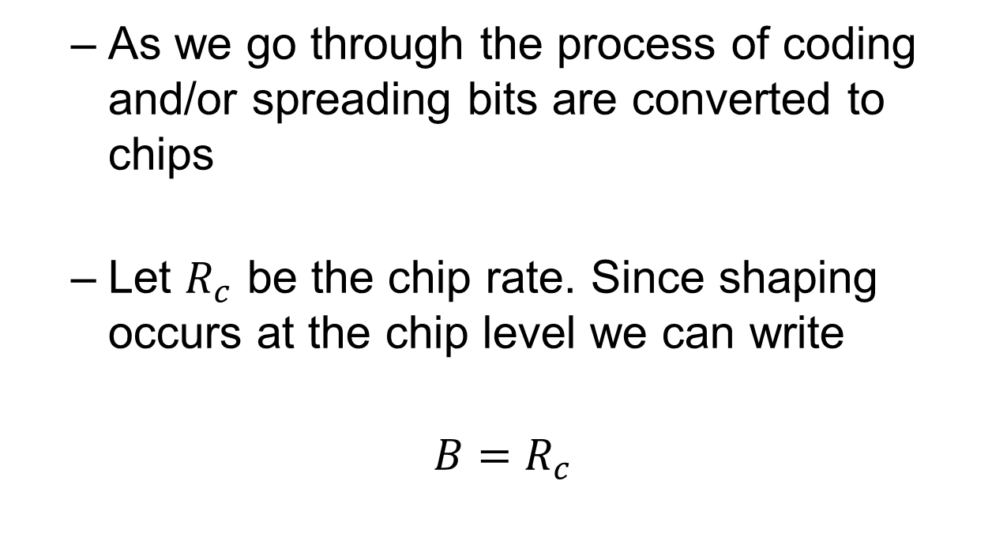
Bits vs. chips
  As we go through the process of coding and/or spreading bits are converted to chips
  Let $R_{c}$ be the chip rate. Since shaping occurs at the chip level we can write
$$B=R_{c}$$

Slide 9
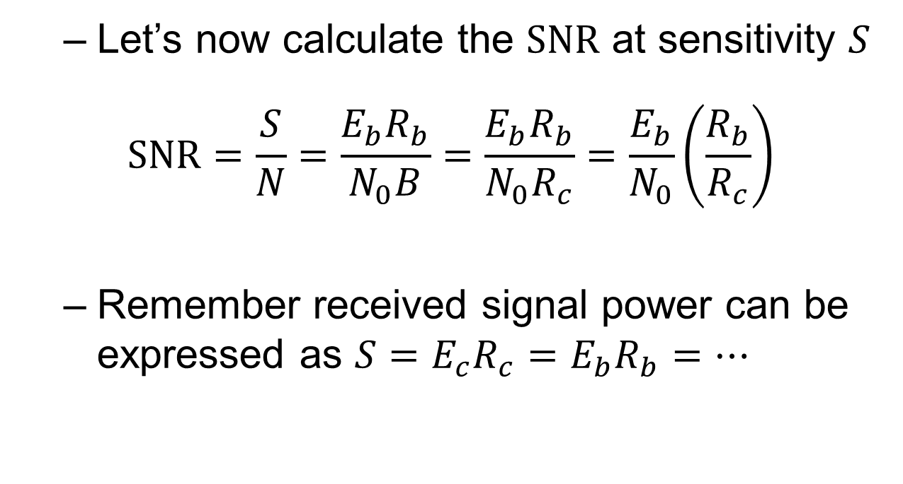

From $E_{b}/N_{0}$ to SNR
  Let’s now calculate the $SNR$ at sensitivity $S$
$$SNR=\frac{S}{N}=\frac{E_{b}R_{b}}{N_{0}B}=\frac{E_{b}R_{b}}{N_{0}R_{c}}=\frac{E_{b}}{N_{0}}\left(\frac{R_{b}}{R_{c}}\right)$$
  Remember received signal power can be expressed as $S=E_{c}R_{c}=E_{b}R_{b}=…$

Slide 10
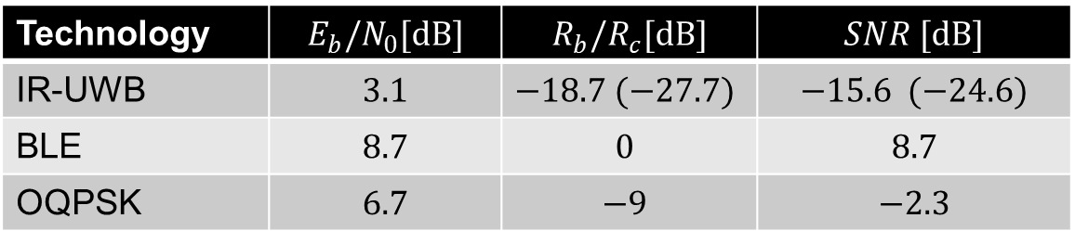

Required SNR
  Now calculate the $SNR$ at sensitivity (i.e., 1% $PER$ for a 20-byte packet)
  When there is no coding or spreading as in the case for BLE, $R_{c}=R_{b}$
Technology | $$E_{b}/N_{0}[dB]$$ | $$R_{b}/R_{c}[dB]$$ | $$SNR [dB]$$
IR-UWB | $$3.1$$ | $$−18.7 (−27.7)$$ | $$−15.6 (−24.6)$$
BLE | $$8.7$$ | $$0$$ | $$8.7$$
OQPSK | $$6.7$$ | $$−9$$ | $$−2.3$$

Slide 11
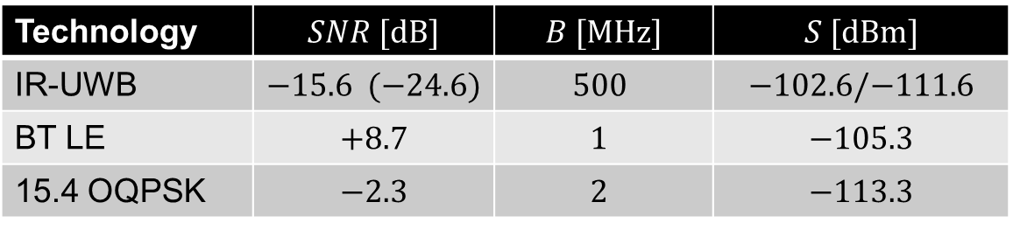

Receiver Sensitivity
  To calculate receiver sensitivity $S$ we write
  $$S\left[dBm\right]=SNR\left[dB\right]+N_{0}[dBm/Hz]+B\left[dB⋅Hz\right]+NF\left[dB\right]$$
  Here $N_{0}=−174 dBm/Hz$. Also, we ignore the $NF$
Technology | $$SNR [dB]$$ | $$B [MHz]$$ | $$S [dBm]$$
IR-UWB | $$−15.6 (−24.6)$$ | $$500$$ | $$−102.6/−111.6$$
BT LE | $$+8.7$$ | $$1$$ | $$−105.3$$
15.4 OQPSK | $$−2.3$$ | $$2$$ | $$−113.3$$

Slide 12
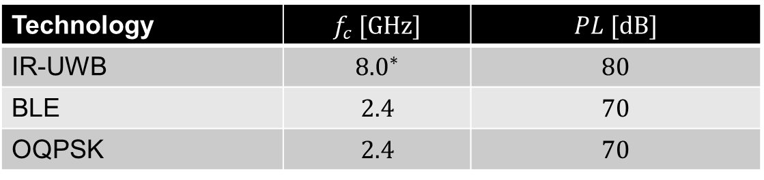

Effect of carrier frequency on path loss
  Recall
  $$\frac{P_{r}}{P_{t}}={\left(\frac{λ}{4πd}\right)}^{2}$$
  At $d=30m$ we calculate the pathloss $PL$
Technology | $$f_{c} [GHz]$$ | $$PL [dB]$$
IR-UWB | $${8.0}^{∗}$$ | $$80$$
BLE | $$2.4$$ | $$70$$
OQPSK | $$2.4$$ | $$70$$
* channel 9

Slide 13
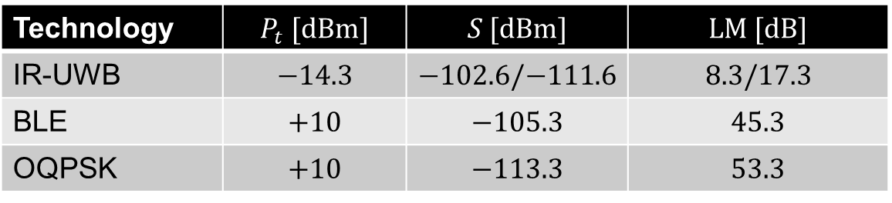

Link margin so far …
  The Link Margin is
  $$LM [dB]=P_{t}[dB]−S[dB]−PL[dB]$$
Technology | $$P_{t} [dBm]$$ | $$S [dBm]$$ | $$LM [dB]$$
IR-UWB | $$−14.3$$ | $$−102.6/−111.6$$ | $$8.3/17.3$$
BLE | $$+10$$ | $$−105.3$$ | $$45.3$$
OQPSK | $$+10$$ | $$−113.3$$ | $$53.3$$
  * For BLE, the Tx power can go all the way up to $+20 dBm$

Slide 14
Effect of fading
  Can we assume same shadow fading effect on all signaling schemes?
  But what about effect of multipath and small-scale fading?

Slide 15











Narrowband transmission
In narrowband transmission there is significant overlap between received pulses → narrowband fading
channel
$$α_{1}$$
$$c\left(t\right)$$
$$α_{2}$$
$$α_{3}$$
$$s_{P}\left(t\right)=s_{B}(t)\cos\left[ω_{c}t+φ_{c}\right]$$
$$r_{P}\left(t\right)=$$
$$τ_{1}$$
$$τ_{3}$$
$$0$$
$$τ_{2}$$
$$t$$
Received via the 1st path
$$α_{1}s_{B}(t−τ_{1})\cos\left[ω_{c}t+φ_{r1}\right]$$
$$t$$
Received via the 2nd path
$$α_{2}s_{B}(t−τ_{2})\cos\left[ω_{c}t+φ_{r2}\right]$$
$$t$$
Received via the 3rd path
$$α_{3}s_{B}(t−τ_{3})\cos\left[ω_{c}t+φ_{r3}\right]$$
$$t$$

Slide 16








Ultrawideband transmission
In ultrawideband transmission, there is very little overlap between pulses arriving from different paths → frequency selective fading
$$α_{1}$$
$$c\left(t\right)$$
$$α_{2}$$
$$α_{3}$$
$$s_{P}\left(t\right)=s_{B}(t)\cos\left[ω_{c}t+φ_{c}\right]$$
$$r_{P}\left(t\right)=$$
$$0$$
$$t$$
$$α_{1}s_{B}(t−τ_{1})\cos\left[ω_{c}t+φ_{r1}\right]$$
Received via the 1st path (DP)
$$t$$
Received via the 2nd path
$$α_{2}s_{B}(t−τ_{2})\cos\left[ω_{c}t+φ_{r2}\right]$$
$$t$$
Received via the 3rd path
$$α_{3}s_{B}(t−τ_{3})\cos\left[ω_{c}t+φ_{r3}\right]$$
$$t$$

Slide 17
Multipath can work for you
  Multipath works against narrowband systems
      25-35 dB narrowband fading margin is usually subtracted from the Link margin
  Multipath works in favor of ultrawideband systems
      The resolvable signals from different paths can be coherently combined by the Rake receiver.

Slide 18
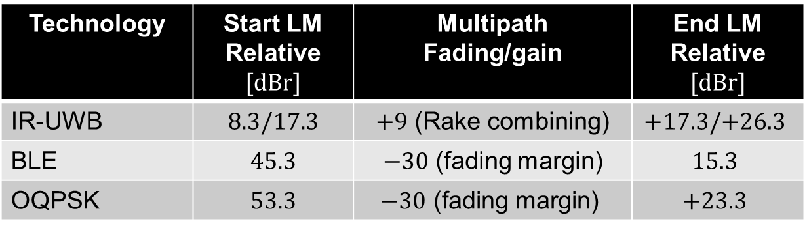
Relative Link margin
  Add effect of multipath
  Seems debatable when one claims NB signaling provides a better link than IR-UWB.
Technology | Start LM Relative $[dBr]$ | Multipath Fading/gain | End LM Relative $[dBr]$
IR-UWB | $$8.3/17.3$$ | $+9$ (Rake combining) | $$+17.3/+26.3$$
BLE | $$45.3$$ | $−30$ (fading margin) | $$15.3$$
OQPSK | $$53.3$$ | $$−30\text{ (}\text{fading} \text{margin}\text{)}$$ | $$+23.3$$

Slide 19
Thank you

