Slide 1
Project: IEEE P802.15 Working Group for Wireless Specialty Networks
Submission Title: PHY Solution for Coexisting BANs and Other Networks with Space-Time Interference Mitigation
Date Submitted: July 15th, 2021
Source: Takumi Kobayashi, Ryuji Kohno
Company: ] [1;Yokohama National University(YNU), 2;YRP International Alliance Institute(YRP-IAI)]
Address [1; 79-5 Tokiwadai, Hodogaya-ku, Yokohama, 240-8501 Japan
2; YRP1 Blg., 3-4 HikarinoOka, Yokosuka-City, Kanagawa, 239-0847 Japan]
Voice:[+81-90-5408-0611] E-Mail:[minsoo@minsookim.com, kobayashi-takumi-ch@ynu.ac.jp, marco.hernandez@ieee.org, kohno@ynu.ac.jp, Kohno@yrp-iai.jp]
Re: In response to call for technical contributions
Abstract: This provides considerations of radio environment surrounding human body area network(HBAN) and vehicle body area network(VBAN) for enhanced dependability. As an example of PHY layer countermeasure technology of these co-existence and EMC/EMI issues, signal processing technology on space and time domains based on orthogonal matched filter is introduced.
Purpose: Material for discussion in P802.15.6a SG corresponding to comments in EC Meeting
Notice: This document has been prepared to assist the IEEE P802.15. It is offered as a basis for discussion and is not binding on the contributing individual(s) or organization(s). The material in this document is subject to change in form and content after further study. The contributor(s) reserve(s) the right to add, amend or withdraw material contained herein.
Release: The contributor acknowledges and accepts that this contribution becomes the property of IEEE and may be made publicly available by P802.15.

Slide 2
PHY Solution for Coexisting BANs and Other Networks with Space-Time Interference Mitigation
Takumi Kobayashi, Ryuji Kohno
(YNU/YRP-IAI)

Slide 3
Various Interference in Coexistence
＊ IEEE 802.11a (wi-fi) （5GHz） overlaps
UWB-WBAN
IEEE 802.15.6
User “B”
Other BAN
Other UWB system.
e.g. IEEE 802.15.4-2020
IEEE 802.15.4z
Other UWB-BAN
user ？
interference
user ？
Other NB-BAN
interference
User “A”.
A wants to connect to “B”.
user ？
Inter-user interference
“IUI”
Inter-system interference
Inter-BAN interference
“IBI?”
“ISI”
Interference from a system using
the same standard.
Interference from a system using
overlapped frequency
VBAN ⬄ HBAN interference
Unknown signal.
EMI / EMC issues
Known signal.
Pre-knowledge can be used to mitigation

Slide 4
EMC (Electro-Magnetic Compatibility)
Thunder,
Electrostatic discharge; ESD
Pulse noise,
Colored noise etc..
BAN device
Other devices e.g. Medical devices
Other radio devices
e.g. cellular phone, cellular base station
Power electronics
motors
Microwave oven
Interference
Emission

Slide 5
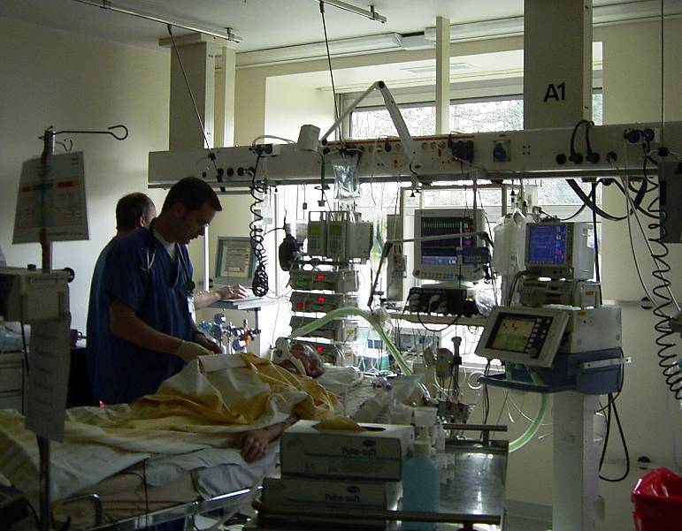
Medical room radio environment
Cardiac output monitor
Infusion pumps
Vital monitor
Artificial respirator

Slide 6
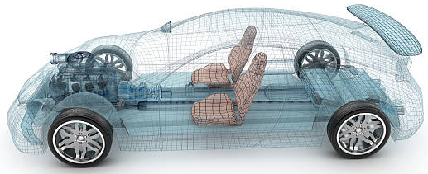
Environment Model in Vehicle
Engine/Motor room environment model
Engine/motor diagnostic sensor and controller
Air pressure sensor, wheel health sensor and controller
Transmission monitoring sensor and controller
Cabin environment sensor (temperature, brightness, humidity etc.)
Sheet sensor, health care sensors for driver
Sheet sensor, health care sensors for passenger
Cabin room environment model
Note:
Various type of car/vehicles
Bus, Bulldozer, Heavy construction equipment needed each different sensors.
4
2
5
1
3
6
https://media.istockphoto.com/photos/transparent-car-design-wire-model3d-illustration-my-own-car-design-picture-id594040008?k=6&m=594040008&s=612x612&w=0&h=XE8LiBjpM51aB4pH2CFt6-MT6IvALRPnlxPcac0RXhg=

Slide 7
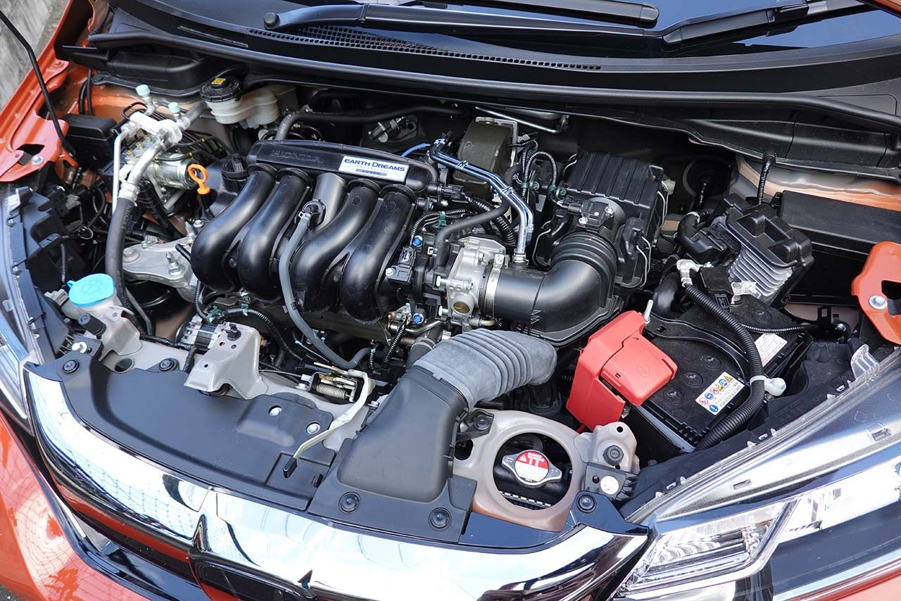
Engine/Motor Room Environment
Many metallic components
Components existing in densely
Ignition noise, motor noise
Larger path-loss than free propagation
A lot of reflection of RF signal
Electro-magnetic interference, EMI issues
Especially EV
https://www.as-web.jp/car/575374/attachment/03a_sub_dsc01273
Ignition coil
Spark plug
Electric generator
Electric motor
High current battery and cable

Slide 8
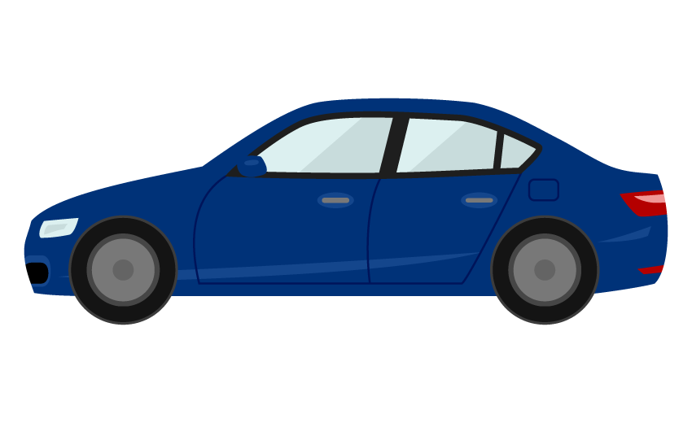
Electromagnetic Environment
Front object CCD camera
Rear object monitor CCD camera
Lane departure system
Night vision
Blind spot detection
Front airbag sensors
Nighttime pedestrian warning
Rear camera
Cross traffic alert
Drowsiness sensos
Rear object laser radar
Front object laser radar
Side airbag SRS
Tire pressure sensor
Tire pressure sensor
Automatic brake actuator
Steering angle sensor
Central computer
Wheel speed sensor
Wheel speed sensor
Active park assist
Adaptive cruise control
Nighttime pedestrian warning IR sensor
Sensors, monitors and vehicle controlling systems in modern vehicle

Slide 9
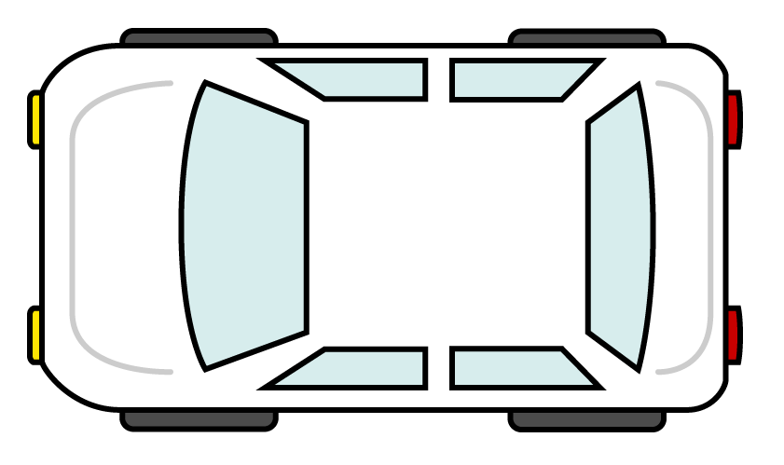
EMC model
Source
Path
Sink
Sources of EM near and far field: may be off board and on board sources
Path: radiated or conducted
Sink: intended receiver or unintended receiver
Camera application
Radar application
Engine control application
Camera application
Multimedia application
Head unit
Dashboard application
rear seat entertainment
Body control applicaition
Radar application
Camera application
Camera application

Slide 10
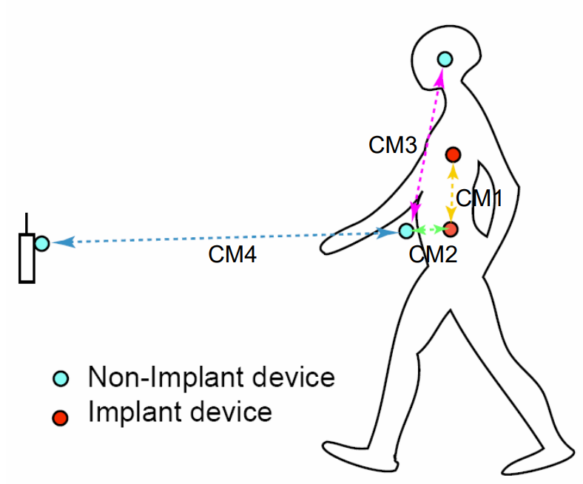
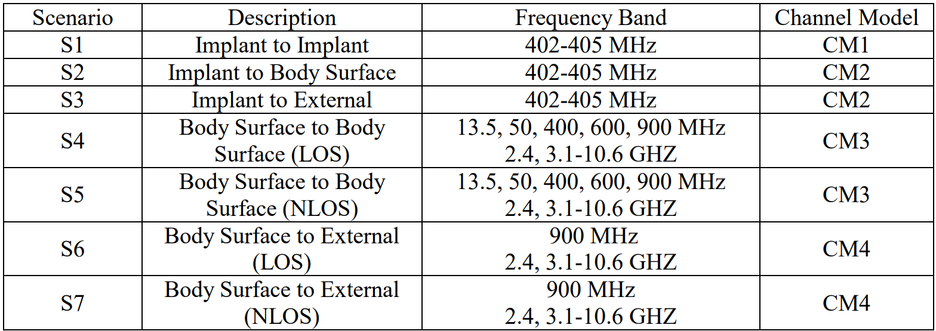
Channel models and scenarios in IEEE802.15.6-2012
IEEE P802.15-08-0780-12-0006-TG6
IEEE 802.15.6-2012 channel models considered
Fading ( Small scale/ large scale)
Path loss
Shadowing
Power delay profile
In-body (implant)
On-body (body surface)
CM1, 2, 3, 4
Scenario 1, to Scenario 7. (S1 – S7)

Slide 11
Channel model
Channel model
Path loss
Reflection
Multipath
Fading
LOS / NLOS model
White Gaussian noise
Source
Sink

Slide 12
Environmental model
Interference to the other devices
Interference from the other devices
Channel model
Source
Path loss
Reflection
Multipath
Fading
LOS / NLOS model
White Gaussian noise
Sink
Human impact
Colored noise

Slide 13
Channel and Environmental Models
Environment model
※will be defined in this amendment
Channel model
Environment model
Channel model
Path loss
Reflection
Multipath
Fading
LOS / NLOS model
White Gaussian noise
Interference from co-existing wireless systems
e.g. Bluetooth, IEEE 802.11, IEEE 802.15.4 etc.
Interference from the other BANs.
Interference from the other electric systems, devices and components (Electro-magnetic interference; EMI from electric motors, spark plugs in vehicles, etc.
Electro-magnetic compatibility; EMC. Possibility to affect to the other systems and human body.
VBAN ⬄ HBAN interference
VBAN and HBAN ⬄ Vehicle control and human body impacts.
Colored noise (Impulse noise, spike noise, ignition noise etc.)
Time-varying channel and interference modeling (Statistic, non-static, pseudo static model)
※IEEE802.15.6-2012
Other wireless systems
EMI EMC
Colored noise
Time-varying modeling
※mandatory
※optional
※mandatory
※mandatory
※Comment on 1st session
※optional
or
?
※mandatory
or
?
※optional
※mandatory
※mandatory
※optional

Slide 14
Classification of Channel and Environment Models for Human and Vehicle Body Area Networks (HBAN&VBAN)
Channel model
※Covered by
IEEE 802.15.6-2012
HBAN model
In-body (Implant)
※
On-body
※
Around body
Outdoor
※Around meaning;
Desk, WiFi AP in the room etc.
Channel model
With environment
※not covered yet
Indoor
※
Home
Office
※
Medical (e.g. Hospital)
※
VBAN model
In-vehicle
Engine room
Cabin
Note:
HBAN-model:
-Environment with co-existing systems is not considered.
VBAN model:
Key-less entry system
Localization in-body, on-body
Most dominant model should be defined and separatory defined as Mandatory and Optional.
※mandatory
Through engine room and cabin
On-vehicle
Roof
Around vehicle
Side Right/Left/Front/back
※mandatory
Bottom
Static vehicle
※mandatory
Moving vehicle

Slide 15
Issues on multiple BAN environment
  Inter-user interference
    IR-UWB uses the same pulse as all users signal in the same standard.
    Other users signal and/or the other network signal would be interference.
  Inter-system interference
    Interference from the other wreless system using overlapped frequency band. ⇒ Unknown
＊ 802.11a (wi-fi) （5GHz） overlaps
UWB-WBAN
IEEE 802.15.6
user B
Other UWB system.
e.g. IEEE 802.15.4a
user ？
user C
interference
user ？
interference
User A wants to connect to“B”.
user ？

Slide 16
Purpose and Suggestion
  Sparate and Recognize each interference from different source.
  ⇒ Apply suitable interference mitigation method according to source of interference.
  Using both of Spatial and Temporal signal processing.
Inter-user interference
Recognize and demodulate
known
“IUI” in this presentation
Interference from a system using
the same pulse
Pulse shape multiple access
Multi-user detection
Inter-system interference
unknown
“ISI” in this presentation
Remove
Interference from a system using
overlapped frequency
Interference canceller
Notes:
16

Slide 17
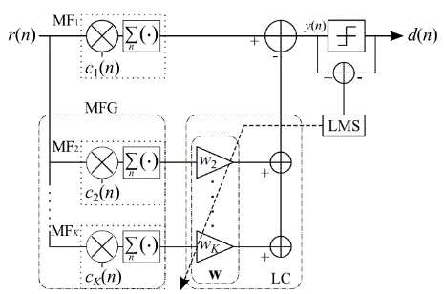
OMF； orthogonal matched filter
  consists a matched filter （MF₁） and MF Group（MFG）
  Tap coefficients of MF₁ are the same as sequence of desired signal.
  Coefficients of MF₁ and each MF_{k} that constituting MFG are orthogonal.
  Desired signal does not through MF_{2～K-1} because orthogonality.
  →only interference can through.
  MFG makes replica of interference signal by lenear combination with weight vector w of linear combiner; LC.
  Subtract interference replica from the output of MF₁ .
_{Principle of OMF}
  OMF can remove interference without any pre-knowledge of interference.
Notes:
17

Slide 18
Antenna
Desired signal + interference
Desired signal + interference
+
Matched Filter (MF) 1
Replica of interferences
subtract
Orthogonal
Matched Filter (MF) 2
W1
Orthogonal
Matched Filter (MF) 3
W2
Orthogonal
Adaptive algorithm
e.g. LMS
Matched Filter (MF) 4
W3
Orthogonal
Matched Filter (MF) k
Wk
Linear combiner
Mixed signal EXCEPT desired signal.

Slide 19
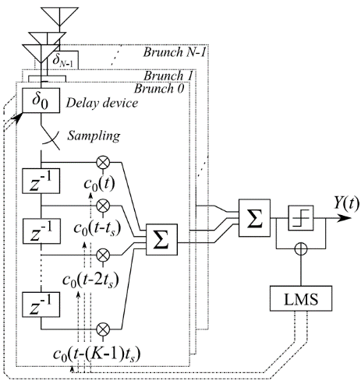
Apply pulse based OMF to spatial signal processing
  TDL array antenna
    Configured by multiple antennas and tapped delay line （TDL）
    TDL-AA can separate the signals which comes from the same direction by using time-domain signal processing.
  By applying OMF to TDL-AA
    Interference reduction is performed on the both of domains of time and space.
Space-temporal signal processing
Notes:
19
therefore

Slide 20
Gain≠0
Gain≠0
No gain
TDL-AA without null-steering（ SC.6）
Space-temporal interference reduction (SC.7)
System has gain against an interference
→residual interference
Interference signal is reduced
Notes:
20

Slide 21
Gain≠0
No gain
MHP orthogonality
TDL-AA without null-steering （ SC.6）
Space-temporal interference reduction(SC.7)
System has gain against an interference
→residual interference
Interference signal is reduced
Notes:
21

Slide 22
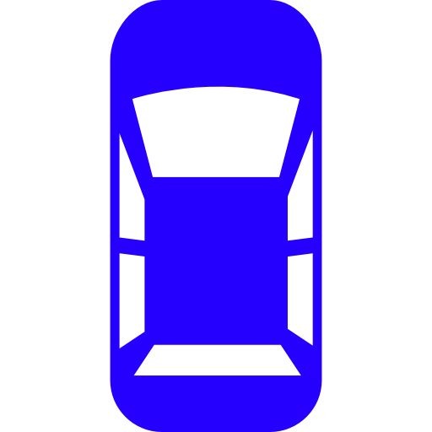




Application to V2V communication
Desired user
10$°$
10$°$
Undesired users

Slide 23
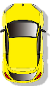
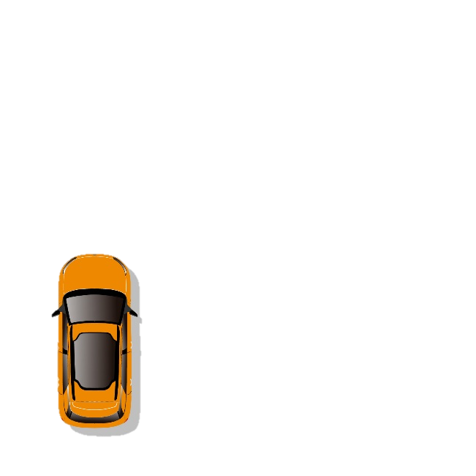

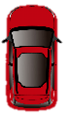
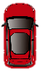


Simulation
modulation | BPSK
Spread spectrum | DSSS
code | 31bit Gold-sequence
Tx power | 10[mW]
Center freq. | 760[MHz]
Antenna | 5 elements circular array
channel | AWGN (-103.8[dBm])
User number | 4 30
Data size | 1000[bit]
Arrival angle | Desired signal: 0 deg. Interference ±180 deg. or ±10deg
Own vehicle
Desired vehicle
Interference vehicle

Slide 24
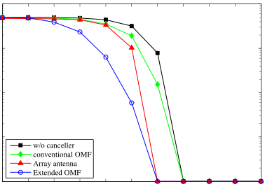
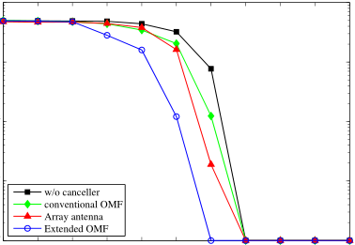









BER-DIR performance
30 users, ( 1 desired user, 29 interference)
$${10}^{0}$$
$${10}^{0}$$
Space-temporal signal processing
Space-temporal signal processing
Bit error rate
$${10}^{−2}$$
$${10}^{−2}$$
$${10}^{−4}$$
$${10}^{−4}$$
$$−50$$
$$−40$$
$$−30$$
$$−20$$
$$−10$$
$$0$$
$$−50$$
$$−40$$
$$−30$$
$$−20$$
$$−10$$
$$0$$
DIR[dB]
DIR[dB]
interference：±180 deg.
interference：±10 deg.
Extended OMF can improve BER performance.

Slide 25
Conclusion
  Importance of consideration of interference, EMC/EMI issues including as environmental models as well as channel models is suggested.
  Human and Vehicular BANs environmental model
  OMF based signal processing to interference reduction have been proposed.
    Interference reduction against unknown interference.
    =>Interference mitigation (reduction) against unknown source in Time-domain.
  OMF and its extension in space and time domain signal processing
    Interference mitigation on Time and space domains signal processing.
    => Space-time domain interference mitigation.
Notes:
25

Slide 26
References (1/2)
Takumi Kobayashi Chika Sugimoto, Ryuji Kohno, “Theoretical analysis of interference canceler using modified hermite polynomials based orthogonal matched filter for IR-UWB systems in AWGN and interference channel,” Proc. 2017 20th International Symposium on Wireless Personal Multimedia Communications (WPMC) 2017, DOI: 10.1109/WPMC.2017.8301793
Takumi Kobayashi, Masato Suzuki, Chika Sugimoto, Ryuji Kohno, “Space temporal interference cancellation using TDL array antenna and waveform based OMF for IR-UWB systems,” ICT Express, Volume 1, Issue 2, pp.71-75, 2015. ISSN 2405-9595, https://doi.org/10.1016/j.icte.2015.09.006.
Takumi KOBAYASHI Chika SUGIMOTO Ryuji KOHNO, “Interference Cancellation for Intra and Inter UWB Systems Using Modified Hermite Polynomials Based Orthogonal Matched Filter,” IEICE TRANSACTIONS on Communications Vol.E99-B No.3 pp.569-577, 2016.

Slide 27
References (2/2)
Kento Takabayashi, Shuhei Harada, Takumi Kobayashi, Katsumi Sakakibara, Ryuji Kohno, "Low-Computational Extended Orthogonal Matched Filter Structure for Multiuser Detection," Telecom, 2020, vol.1, issue.1, pp. 32-47, Jun. 2020. doi: 10.3390/telecom1010004
Shuhei Harada, Kento Takabayashi, Takumi Kobayashi, Katsumi Sakakibara, Ryuji Kohno, "Theoretical Analysis of Interference Cancellation System Utilizing an Orthogonal Matched Filter and Adaptive Array Antenna for MANET," Journal of Sensor and Actuator Networks. 2019, 8(3) 48; September, 2019. https://doi.org/10.3390/jsan8030048
Masato Suzuki and Ryuji Kohno, ”A Study on Time-Space Interference Cancellation Using Array Antenna and OMF for Inter-Vehicle Communications,” IEICE Technical Report Vol.115 No.73, Jul. 2015, pp.1-5, (in Japanese)
Masato Suzuki and Ryuji Kohno, ”Time-Space Interference Cancellation System Using OMF,” The 38th Symposium on Information Theory and Its Applications (SITA2015), Nov. 2015, pp.492-496, (in Japanese)

Slide 28
Thank you for your attention.

Slide 29
  Results (noise free channel)
DIR vs. BER (SC.1) E_{b}/N₀=+∞dB.
DIR vs. BER (SC.2) E_{b}/N₀=+∞dB.
More iteration number makes higer capacity of interference reduction
Notes:
29

Slide 30
Simulation results
  (noise free channel)
DIR vs. BER E_{b}/N₀=+∞dB.
More iteration number makes higer capacity of interference reduction

Slide 31
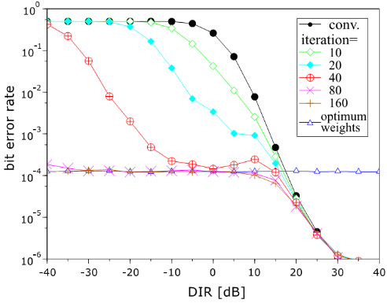
Simulation results
  (noise & interference channel)
Noise
enhancement
DIR vs. BER (SC.2) E_{b}/N₀=+25dB.
W_{opt} which is generated by theory does not satisfies minimum error In high DIR condition. ⇒ W_{opt} is not optimal solution in environment in which noise exists.
High DIR ➔ dominant cause of bit error is noise

Slide 32
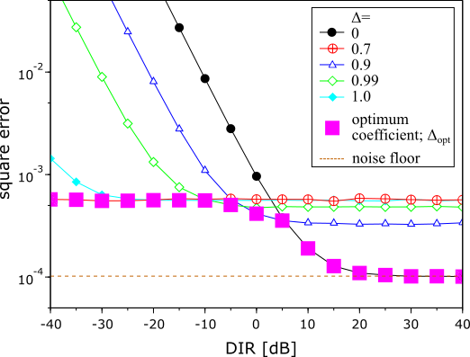
  Theoretical performance
Size reduction of weight vector by a coefficient Δ
  Smaller Δ
⇒residual interference is increased
⇒noise enhancement is suppressed
  Larger Δ
⇒residual interference is suppressed
⇒noise enhancement is increased
Optimum solution
Square error using various fixed Δ and Δ_{opt} in each DIR (SC.2) E_{b}/N₀=+25dB.
Notes:
32

Slide 33
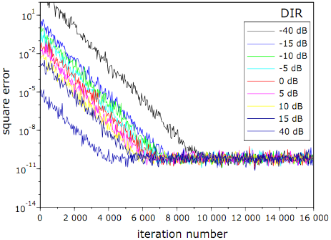
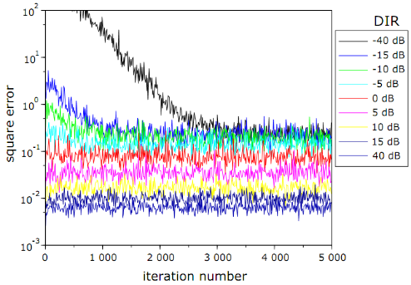
  Results of SC.1
Square error characteristics in various DIR(SC.1).
Square error characteristics in various DIR (SC.1).
E_{b}/N₀=+120dB, DIR=-40dB ~ +40dB
E_{b}/N₀=+25dB, DIR=-40dB ~ +40dB
Adaptive algorithm does not find an optimum weights in low DIR and low E_{b}/N₀. ⇒ ⇒ ⇒ Theoretical analysis with Noise
Notes:
33

Slide 34
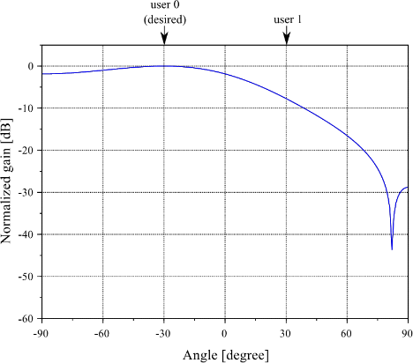
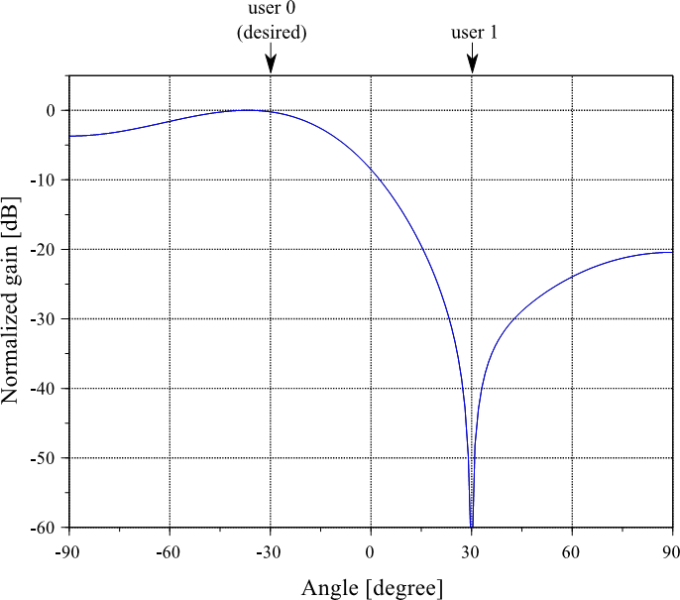
Max. gain
Max. gain
Gain≠0
reduction
TDL-AA without null-steering with OMF （ SC.8）
Space-temporal interference reduction(SC.8)
System has gain against an interference→residual interference
Interference can be eliminated if either one is different from the desired signal
Notes:
34

Slide 35
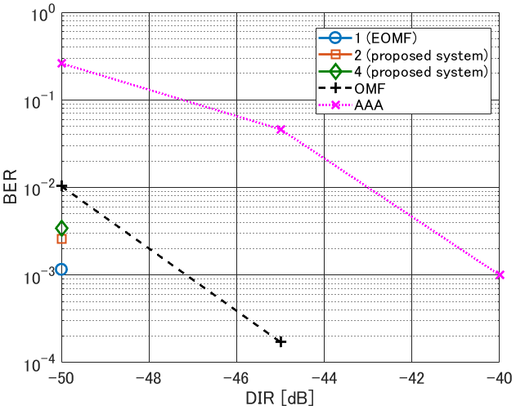
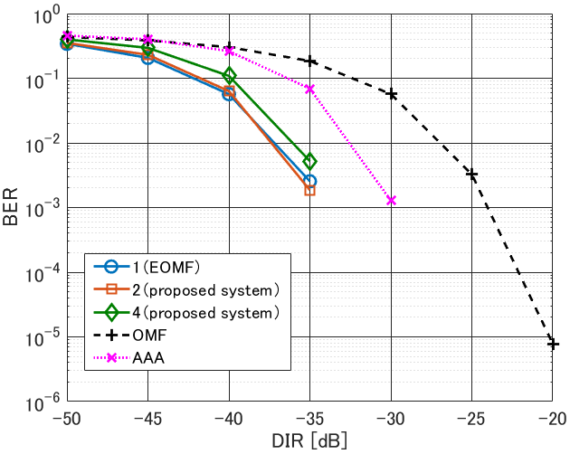
8 users
30 users

Slide 36
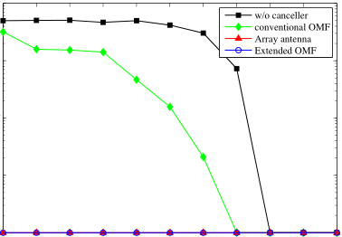
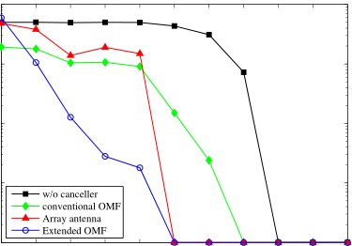
BER-DIR performance
5 users, ( 1 desired user, 4 interference)
$${10}^{0}$$
$${10}^{0}$$
Bit error rate
Bit error rate
Bit error rate
$${10}^{−2}$$
$${10}^{−2}$$
$${10}^{−4}$$
$${10}^{−4}$$
$$−50$$
$$−40$$
$$−30$$
$$−20$$
$$−10$$
$$0$$
$$−50$$
$$−40$$
$$−30$$
$$−20$$
$$−10$$
$$0$$
DIR[dB]
DIR[dB]
interference：±180 deg.
Interference: ±10 deg.
BER performance is improved in high DIR situation.

