Slide 1
Project: IEEE P802.15 Working Group for Wireless Personal Area Networks (WPANs)
Submission Title: Preamble codes for Data Communications in 802.15.4ab
Source: Carlos Aldana (Facebook), Qiyue Zou (Facebook)
Address : [1 Hacker Way, Menlo Park, CA 94025]
E-Mail: [caldana (at) fb.com]
Re: Study Group 4ab: UWB Next Generation
Abstract: [preamble code enhancements to 802.15.4z for data communications]
Purpose:
Notice: This document has been prepared to assist the IEEE P802.15. It is offered as a basis for discussion and is not binding on the contributing individual(s) or organization(s). The material in this document is subject to change in form and content after further study. The contributor(s) reserve(s) the right to add, amend or withdraw material contained herein.
Release: The contributor acknowledges and accepts that this contribution becomes the property of IEEE and may be made publicly available by P802.15.
Notes:
Jul 12, 2010
Page 1

Slide 2
Technical Guidance [1]
PAR Objective | Proposed Solution (how addressed)
Safeguards so that the high throughput data use cases will not cause significant disruption to low duty-cycle ranging use cases. | Preambles shown to have good cross correlation properties with legacy devices.
Interference mitigation techniques to support higher density and higher traffic use cases
Other coexistence improvement
Backward compatibility with enhanced ranging capable devices (ERDEVs).
Improved link budget and/or reduced air-time
Additional channels and operating frequencies
Improvements to accuracy / precision / reliability and interoperability for high-integrity ranging; s
Reduce complexity and power consumption;
Hybrid operation with narrowband signaling to assist UWB;
Enhanced native discovery and connection setup mechanisms;
Sensing capabilities to support presence detection and environment mapping;
Low-power low-latency streaming | New preamble codes could be used for this use case.
higher data-rate streaming allowing at least 50 Mbit/s of throughput. | New preamble codes are proposed
Support for peer-to-peer, peer-to-multi-peer, and station-to-infrastructure protocols;
Infrastructure synchronization mechanisms.

Slide 3
Preamble codes for Data Communications in 802.15.4ab

Slide 4
Objective
Propose preamble codes (SYNC field) candidates for data communications over IEEE 802.15.4a “UWB” channels [2]

Slide 5
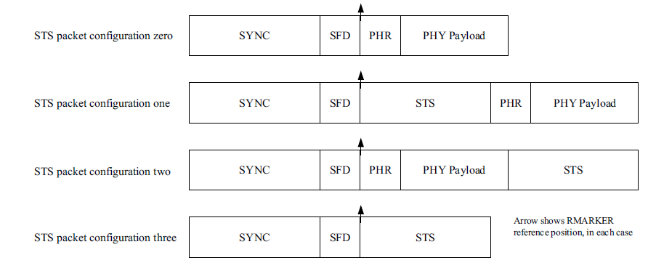
Background
4 configurations defined 802.15.4z[3]
This contribution focuses on the SYNC field

Slide 6
Key Considerations
Excellent periodic autocorrelation properties -> improved ranging and channel estimation
Good cross-correlation properties with HRP and LRP preambles -> coexist with legacy UWB devices
Good periodic cross-correlation properties -> coexist with other data communication UWB devices
Reduced SYNC field length -> reduced air time and improved PHY efficiency

Slide 7
Periodic Autocorrelation
Good periodic autocorrelation makes channel estimation easy (via matched filter)
  Ternary preamble sequences (S1-S32) [4] specified in the UWB standards have “perfect” periodic autocorrelation function (i.e., out-of-phase autocorrelation = 0)
  Matched filter output is equal to the channel impulse response plus noise (assuming symbol length T_{sym} ≥ channel duration)
  IEEE 802.15.4a CM1 – CM9 channel models defined in [2] have PDP channel duration in the range 80ns – 850ns. All channel models except CM6 and CM8 have PDP duration < 400ns
Preamble Code | Preamble Code Length | Length of Delta Spreading Function | #Chips Per Symbol | T_{sym}
S1-S8 | 31 | 16 | 496 | 0.994us
S1-S8 | 31 | 64 | 1984 | 3.974us
S9 – S24 | 127 | 4 | 508 | 1.018us
S25 – S32 | 91 | 4 | 364 | 0.729us

Slide 8
UWB Channel Model (CM1)
CM1 channel model: residential, LOS
PDP channel length = ~110ns

Slide 9
UWB Channel Model (CM2)
CM2 channel model: residential, NLOS
PDP channel length = ~210ns

Slide 10
UWB Channel Model (CM3)
CM3 channel model: indoor office, LOS
PDP channel length = ~95ns

Slide 11
UWB Channel Model (CM4)
CM4 channel model: indoor office, NLOS
PDP channel length = ~115ns

Slide 12
UWB Channel Model (CM5)
CM5 channel model: outdoor, LOS
PDP channel length = ~200ns

Slide 13
UWB Channel Model (CM6)
CM6 channel model: outdoor, NLOS
PDP channel length = ~800ns

Slide 14
UWB Channel Model (CM7)
CM7 channel model: industrial, LOS
PDP channel length = ~80ns

Slide 15
UWB Channel Model (CM8)
CM8 channel model: industrial, NLOS
PDP channel length = ~850ns

Slide 16
UWB Channel Model (CM9)
CM9 channel model: farm
PDP channel length = ~400ns

Slide 17
Periodic Autocorrelation
m-sequences have quasi-optimal periodic autocorrelation
  quasi-optimal -> Out-of-phase autocorrelation = -1 while autocorrelation peak = N
  Although not “perfect”, N can be chosen such that N/1 is large and does not degrade system performance significantly, e.g., 20*log₁₀(N/1) ≥ 20dB
m-sequences are bipolar, where only “+1” and “-1” are transmitted
Number of 1s = Number of 0s + 1
  More pulses are transmitted compared to equal length ternary sequences
  For example,
  S1 – S8 (length = 31) - each sequence has 15 0’s
  S9 – S24 (length = 127) - each sequence has 63 0’s
  S25 – S32 (length = 91) - each sequence has 10 0’s

Slide 18
S9 Length 127 sequence vs Length 63 m-sequence
Ternary preamble sequence S9n
M- sequence of length 63
ternary preamble sequence S9
m-sequence of length 63

Slide 19

Implementation
m-sequences are generated using linear-feedback shift registers (LFSR), and have low implementation cost and complexity
An n-bit LFSR generates a m-sequence of length 2^{n}-1
LFSR is determined by the feedback polynomial
A 10-bit LFSR with feedback polynomial 0x291(Hex) = 10’b 10 1001 0001
0x291 = 1 0 1 0 0 1 0 0 0 1

Slide 20
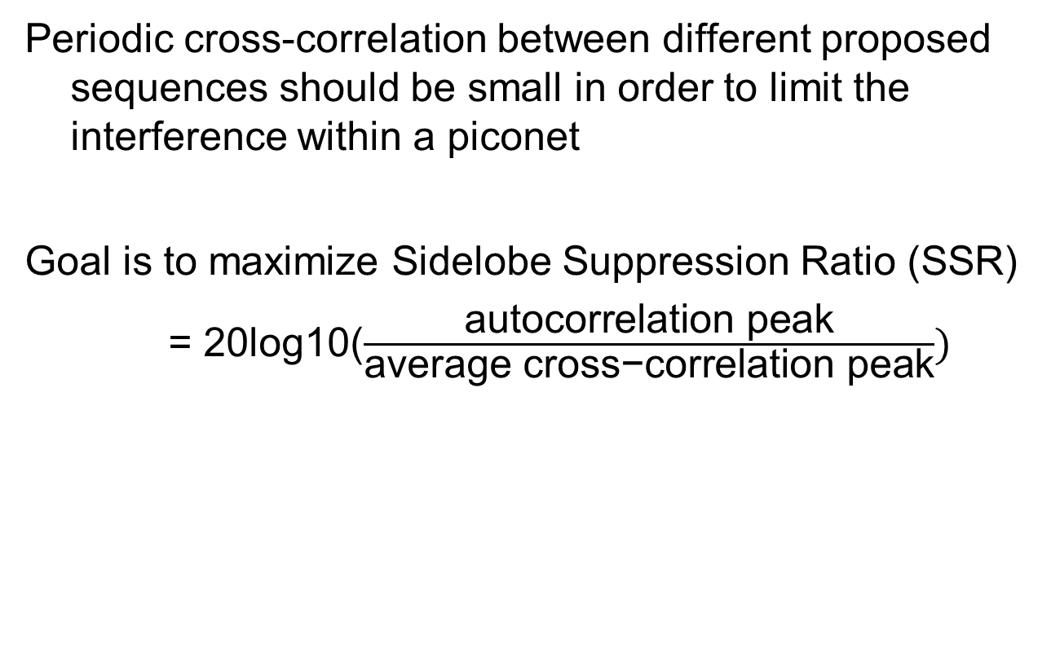
  Periodic Cross-Correlation
Periodic cross-correlation between different proposed sequences should be small in order to limit the interference within a piconet
Goal is to maximize Sidelobe Suppression Ratio (SSR)
= 20log10($\frac{\text{autocorrelation} \text{peak}}{\text{average} \text{cross}\text{−}\text{correlation} \text{peak}})$

Slide 21
Periodic Cross-Correlation of S25 (Length 91)
Maximum Sidelobe Suppression Ratio = 20log₁₀(81/15) = 14.65dB
Minimum Sidelobe Suppression Ratio = 20log₁₀(81/27) = 9.54dB
Average Sidelobe Suppression Ratio = 20*log10(81/21.43) = 11.55dB
Consistent with Table in [5]

Slide 22
Periodic Cross-Correlation of m-sequences of length 63
Maximum Sidelobe Suppression Ratio = 20log₁₀(63/15) = 12.47dB
Minimum Sidelobe Suppression Ratio = 20log₁₀(63/23) = 8.75dB
Average Sidelobe Suppression Ratio = 20*log10(63/19) = 10.41dB

Slide 23
  Cross-Correlation with HRP and LRP Preambles
Cross-correlation between proposed sequences and legacy HRP and LRP preambles needs to be small
Binary m-sequences have length 2^{m} -1, e.g.,15, 31, 63, 127, 255, …
m-sequences of length 31 and 127 have relatively large cross-correlation with length-31 and length-127 legacy preamble sequences (i.e., S1-S8, S9-S24)
m-sequences are robust to LRP preambles (see subsequent slides)
m-sequences of length 15 does not provide enough rejection.
Therefore, m-sequences of length 63, 255, 511, 1023, … are considered

Slide 24
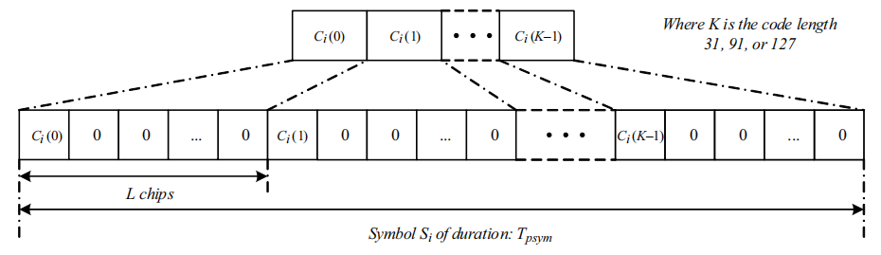
Shorter Sync Length for Existing Codes
sync_length = T_{sym} × N_{sync} = T_{c} × K × L × N_{sync}
K (preamble code length) | L (length of delta spreading function) | #Chips Per Symbol | T_{sym} | Sync Length (N_{sync} = 16 Symbols) | Sync Length (N_{sync} = 64 Symbols)
31 | 16 | 496 | 0.994us | 15.897us | 63.590us
31 | 64 | 1984 | 3.974us | 63.590us | 254.359us
127 | 4 | 508 | 1.018us | 16.282us | 65.128us
91 | 4 | 364 | 0.729us | 11.667us | 46.667us

Slide 25
Sync Length for Short Preamble
Short preamble length less than 33us reduces PPDU duration
  Smaller N_{sync} for LOS short-distance channels
    N_{sync} ≥ 16 for HRP UWB preambles
    N_{sync} = 4 or 8 can work for short-distance LOS channels
  To reduce sync length, smaller L for long sequences
    For long sequences, e.g., m-sequences of length 255 or 511, the delta spreading length L can be 1 or 2
K (preamble code length) | L (length of delta spreading function) | #Chips Per Symbol | T_{sym} | Sync Length (N_{sync} = 4 Symbols) | Sync Length (N_{sync} = 8 Symbols) | Sync Length (N_{sync} = 16 Symbols)
63 | 8 | 504 | 1.010us | 4.038us | 8.077us | 16.154us
255 | 1 | 255 | 0.511us | 2.043us | 4.087us | 8.173us
255 | 2 | 510 | 1.022us | 4.087us | 8.173us | 16.346us
511 | 1 | 511 | 1.024us | 4.095us | 8.189us | 16.378us
511 | 2 | 1022 | 2.047us | 8.189us | 16.378us | 32.756us

Slide 26
Spectrum Characteristics of Existing UWB Preambles
Preamble Code | K (preamble code length) | L (length of delta spreading function | #Chips Per Symbol | T_{sym} | SPAR (frequency domain)
S1 – S8 | 31 | 16 | 496 | 0.994us | 0.4dB
S1 – S8 | 31 | 64 | 1984 | 3.974us | 0.4dB
S9 – S24 | 127 | 4 | 508 | 1.018us | 0.5dB
S25 – S32 | 91 | 4 | 364 | 0.729us | 0.9dB

Slide 27
Spectrum Characteristics of m-sequences
K (preamble code length) | L (length of delta spreading function) | #Chips Per Symbol | T_{sym} | Sync Length (N_{sync} = 4 Symbols) | Sync Length (N_{sync} = 8 Symbols) | Sync Length (N_{sync} = 16 Symbols ) | SPAR (frequency domain) | Delta Peak EIRP over peak EIRP of preamble code 9 with L = 4 (dB) | Delta SPAR over SPAR of preamble code 9 with L = 4 (dB)
63 | 8 | 504 | 1.010us | 4.038us | 8.077us | 16.154us | 0.5dB | -3.5dB | 0dB
255 | 2 | 510 | 1.022us | 4.087us | 8.173us | 16.346us | 0.5dB | 0dB | 0dB
255 | 4 | 1020 | 2.043us | 8.173us | 16.346us | 32.692us | 0.4dB | -3.0dB | -0.1dB
511 | 1 | 511 | 1.024us | 4.095us | 8.189us | 16.378us | 0.5dB | +2.6dB | 0dB
511 | 2 | 1022 | 2.047us | 8.189us | 16.378us | 32.756us | 0.4dB | 0dB | -0.1dB
1023 | 1 | 1023 | 2.049us | 8.197us | 16.394us | 32.789us | 0.4dB | +2.9dB | -0.1dB
1023 | 2 | 2046 | 4.099us | 16.394us | 32.789us | 65.577us | 0.4dB | +0.1dB | -0.1dB
2047 | 1 | 2027 | 4.101us | 16.402us | 32.805us | 65.609us | 0.4dB | +3.0dB | -0.1dB
2047 | 2 | 4094 | 8.201us | 32.805us | 65.609us | 131.218us | 0.4dB | +0.1dB | -0.1dB

Slide 28
M-Sequences of Length 63
Code Index | Feedback Polynomial | Code Sequence
M63_1 | 21 | -1,-1,-1,-1,-1,1,1,1,1,1,1,-1,1,-1,1,-1,1,1,-1,-1,1,1,-1,1,1,1,-1,1,1,-1,1,-1,-1,1,-1,-1,1,1,1,-1,-1,-1,1,-1,1,1,1,1,-1,-1,1,-1,1,-1,-1,-1,1,1,-1,-1,-1,-1,1
M63_2 | 30 | -1,-1,-1,-1,-1,1,-1,-1,-1,-1,1,1,-1,-1,-1,1,-1,1,-1,-1,1,1,1,1,-1,1,-1,-1,-1,1,1,1,-1,-1,1,-1,-1,1,-1,1,1,-1,1,1,1,-1,1,1,-1,-1,1,1,-1,1,-1,1,-1,1,1,1,1,1,1
M63_3 | 2D | -1,-1,-1,-1,-1,1,1,1,-1,-1,-1,-1,1,-1,-1,1,-1,-1,-1,1,1,-1,1,1,-1,-1,1,-1,1,1,-1,1,-1,1,1,1,-1,1,1,1,1,-1,-1,1,1,-1,-1,-1,1,-1,1,-1,1,-1,-1,1,1,1,1,1,1,-1,1
M63_4 | 36 | -1,-1,-1,-1,-1,1,-1,1,1,1,1,1,1,-1,-1,1,-1,1,-1,1,-1,-1,-1,1,1,-1,-1,1,1,1,1,-1,1,1,1,-1,1,-1,1,1,-1,1,-1,-1,1,1,-1,1,1,-1,-1,-1,1,-1,-1,1,-1,-1,-1,-1,1,1,1
Cross-correlation Sidelobe Peak Value
Sidelobe Suppression Ratio (dB)
= 20log₁₀(autocorrelation peak / cross-correlation peak)

Slide 29
M-Sequences of Length 255
Code Index | M255_1 | M255_2 | M255_3 | M255_4 | M255_5 | M255_6 | M255_7 | M255_8
Feedback Polynomial | 95 | AF | A6 | F3 | B4 | B8 | C6 | E1
Cross-correlation Sidelobe Peak Value
Sidelobe Suppression Ratio (dB)

Slide 30
M-Sequences of Length 511
Code Index | M511_1 | M511_2 | M511_3 | M511_4 | M511_5 | M511_6 | M511_7 | M511_8
Feedback Polynomial | 143 | 15E | 17A | 1C2 | 167 | 1E5 | 1A7 | 1E6
Cross-correlation Sidelobe Peak Value
Sidelobe Suppression Ratio (dB)

Slide 31
M-Sequences of Length 1023
Code Index | M1023_1 | M1023_2 | M1023_3 | M1023_4 | M1023_5 | M1023_6 | M1023_7 | M1023_8
Feedback Polynomial | 204 | 240 | 291 | 312 | 237 | 3D8 | 262 | 28C
Cross-correlation Sidelobe Peak Value
Sidelobe Suppression Ratio (dB)

Slide 32
M-Sequences of Length 2047
Code Index | M2047_1 | M2047_2 | M2047_3 | M2047_4 | M2047_5 | M2047_6 | M2047_7 | M2047_8
Feedback Polynomial | 40B | 56A | 5E4 | 767 | 416 | 44A | 4FB | 67B
Cross-correlation Sidelobe Peak Value
Sidelobe Suppression Ratio (dB)

Slide 33
Cross-Correlation with HRP Preambles

Slide 35
Cross-Correlation with LRP Preambles
LPR preambles are a continuous stream of pulses
Mode | Modulation | PRF (MHz) | SHR
Base Mode | OOK | 1.0 | 16 - 128 pulse (non-ERDEV); 16 – 256 pulses (ERDEV)
Dual-frequency modes | PBFSK | 1.0 | 16 – 256 pulses
 | PBFSK | 2.0
 | PBFSK | 4.0

Slide 36
Cross-Correlation with LRP Preambles
 | Channel Band Number | ERIP
HRP | 9 | Mean EIRP = -14.3dBm
LRP | 2 (center freq. identical to HRP channel 9) | Peak EIRP = 12dBm
Correlation between HRP preambles and LRP preambles

Slide 37
Correlation between m-sequences and LRP preambles are not worse than HRP preambles

Slide 38
Transmit m sequences and receive LRP

Slide 39
Autocorrelation and Cross-correlation of Legacy Preambles

Slide 40
Conclusions
m-sequences could be used as preamble codes for 802.15.4ab data communications
Excellent periodic autocorrelation
Good cross-correlation properties with HRP and LRP preambles
Good periodic cross-correlation properties
  They could provide up to 30dB rejection (12 dB better than length 127 sequences) in the vicinity of 3 other devices
Sync Length can be reduced by using shorter delta spreading function (L=1, 2) and fewer number of preamble symbols (e.g. N_{sync} = 8, 16) leading to reduced air time

Slide 41
Strawpoll
M-sequences should be adopted in 802.15.4ab for data communications
Y
N
A

Slide 42
References
[1] 15-21-297-01 15.4.ab Technical Guidance Doc
[2] A.F. Molisch et al., IEEE 802.15.4a Channel Model - Final Report, IEEE TG802.15.4a, 15-04-0662-08-004a, November, 2004.
[3] IEEE Std 802.15.4z-2020
[4] V. P. Ipatov, “Ternary sequences with ideal autocorrelation properties” Radio Eng. Electron. Phys., vol. 24, pp. 75−79, Oct. 1979.
[5] 15-21-152-00 802.15.4z - HRP UWB PHY - HPRF mode preamble sequence cross-correlation properties
[6] 15-05-737-01 Length 127 Preamble codes for 500 MHz and 1500 MHz bands

Slide 43
Questions?

Slide 44
APPENDIX

Slide 45
Channel Estimation
matched filter correlates 1 preamble symbol
matched filter correlates 4 consecutive preamble symbols
  Matched filter output is equal to the channel impulse response plus noise (assume symbol length ≥ channel length)

Slide 46
Channel Estimation
matched filter correlates 1 preamble symbol
matched filter correlates 4 consecutive preamble symbols
4 preamble symbol is used for channel estimation
m-sequences can perform well as the ternary sequences in matched-filter based channel estimation

Slide 47
Channel Estimation
1 preamble symbol is used for channel estimation
4 preamble symbol is used for channel estimation
Performance of channel estimation can be improved by using least squares

Slide 48
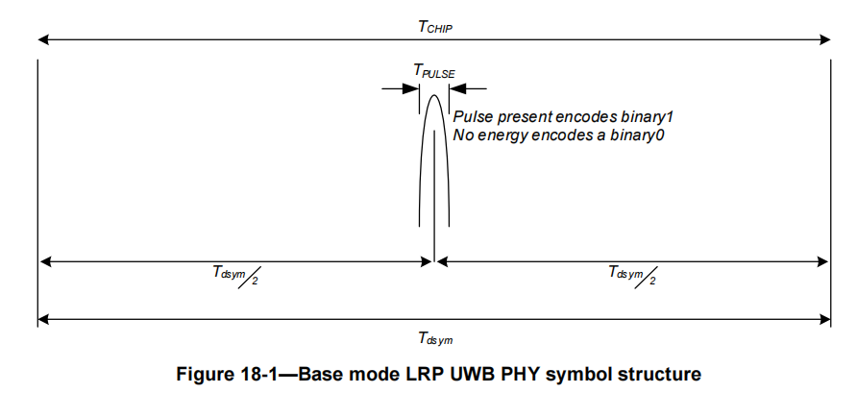
LRP Modes
LRP base mode (1 Mb/s)
  T_{sym} = 1us, T_{chip} = 1us, 1 chip per symbol
  Each pulse is much shorter than T_{chip}
  Preamble: a continuous stream of pulses with length 16 – 128 at the base mode PRF of 1 MHz

Slide 49
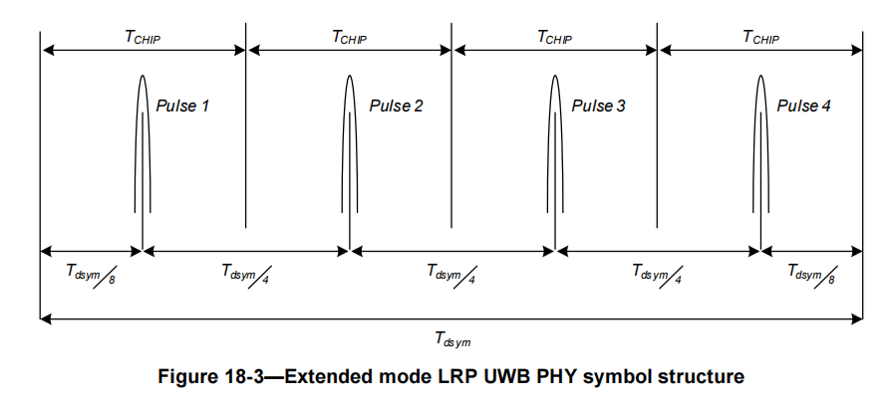
LRP Modes
LRP extended mode (250 kb/s)
  T_{sym} = 4us, T_{chip} = 1us, 4 chips per symbol
  Preamble: a continuous stream of pulses with length 16 – 256

Slide 50
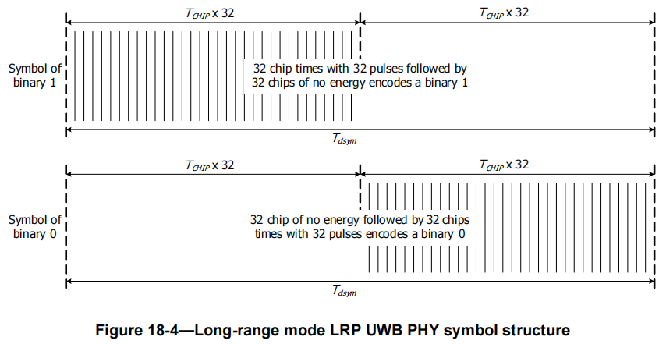
LRP Modes
LRP long-range mode (31.25 kb/s)
  T_{sym} = 32us, T_{chip} = 0.5us
Preamble consists of 3 parts:
  Part 1: a continuous stream of 1024 - 8192 pulses
  Part 2: - - - P - P - - P - - P P P - P (“P” – pulse; “-” – no pulse)
  Part 3: a stream of 16 – 64 “1” symbols

