Slide 1
Project: IEEE P802.15 Working Group for Wireless Personal Area Networks (WPANs)
Submission Title: SG14 Opening Report, Meeting Slides, Closing Report – July 2021 Mtg
Date Submitted: July 13, 2021
Source: Clint Powell (Facebook)
Contact: SAA
Voice: +1 480 586-8457, E-Mail: cpowell@ieee.org
Re: Study Group 14: NS-UWB
Abstract: Meeting Slides
Purpose: Working Slide Deck for July Mtg
Notice: This document has been prepared to assist the IEEE P802.15. It is offered as a basis for discussion and is not binding on the contributing individual(s) or organization(s). The material in this document is subject to change in form and content after further study. The contributor(s) reserve(s) the right to add, amend or withdraw material contained herein.
Release: The contributor acknowledges and accepts that this contribution becomes the property of IEEE and may be made publicly available by P802.15.
Notes:
Jul 12, 2010
Page 1

Slide 2
132nd IEEE 802.15 WSN MTG.
Held Virtually via Webex
July 13th – 22nd, 2021

Slide 3
802.15 Study Group Meeting
Pre-PAR Activity Rules for Study Group
Voting: everyone present can vote
Please identify yourself with your name and affiliation when you first speak
Participation: is by individual

Slide 4
IEEE-SA Patent, Copyright, and Participation Policies
See: https://grouper.ieee.org/groups/802/sapolicies.shtml
IEEE-SA Patent Slides for Pre-PAR Meetings:
https://development.standards.ieee.org/myproject/Public/mytools/mob/preparslides.pdf
IEEE-SA Participation Slides for Pre-PAR Meetings:
https://standards.ieee.org/content/dam/ieee-standards/standards/web/documents/other/Participant-Behavior-Individual-Method.pdf
Copyright:
https://standards.ieee.org/content/dam/ieee-standards/standards/web/documents/other/ieee-sa-copyright-policy-2019.pdf

Slide 5
IEEE 802 Ground Rules
NO product pitches
NO corporate pitches
NO prices
NO restrictive notices:
    e.g. confidential notices in email
Presentations must be openly available
Most important:
Please respect all participants

Slide 6
SG14 Meeting Slots
July 15th – 21st, 2021

Slide 7
Goals/Agenda
Opening and meeting preamble
Approve May Interim minutes: doc. # 15-21-0321-00
  https://mentor.ieee.org/802.15/dcn/21/15-21-0321-00-0014-sg14-may-2021-interim-mtg-mins.docx
Approve Agenda: doc. # 15-21-0347-00
https://mentor.ieee.org/802.15/documents?is_dcn=347&is_year=2021
Review and respond to comments received on PAR and CSD
Update PAR and CSD as required, motions
Next Steps
Any other Business

Slide 8
CSD and PAR
CSD
  15-21-0278-xx-0014-draft-csd-for-ns-uwb
  https://mentor.ieee.org/802.15/documents?is_dcn=278&is_group=0014
PAR
15-21-0274-xx-0014-ns-uwb-par-working-draft
https://mentor.ieee.org/802.15/documents?is_dcn=274&is_group=0014

Slide 9
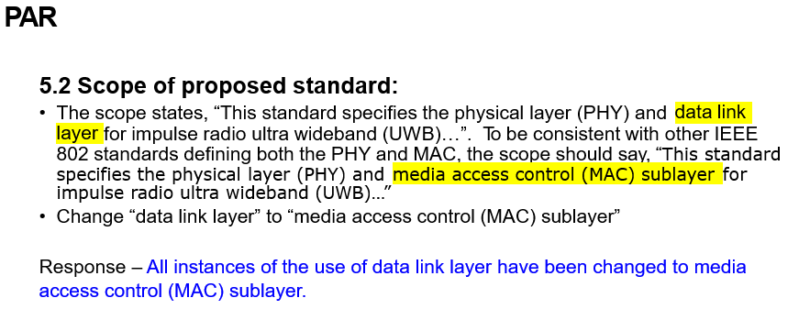
802.1 Comments on 802.15.14 Standard: Ad-Hoc Impulse Radio Ultra Wideband Wireless Networks, PAR and CSD

Slide 10
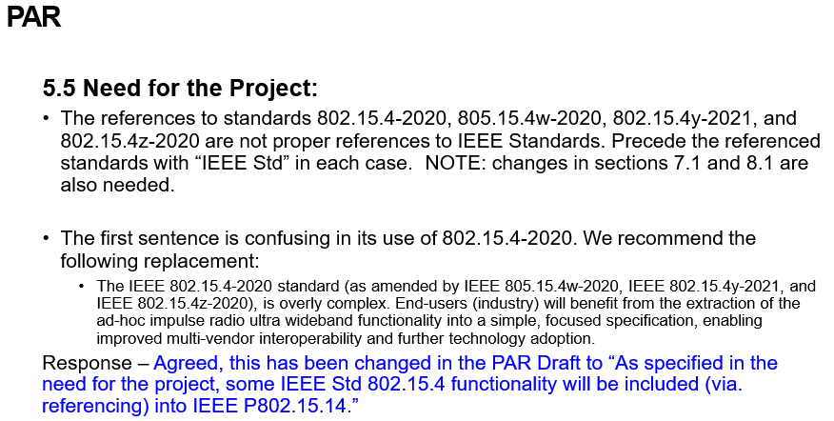
802.1 Comments on 802.15.14 Standard: Ad-Hoc Impulse Radio Ultra Wideband Wireless Networks, PAR and CSD

Slide 11
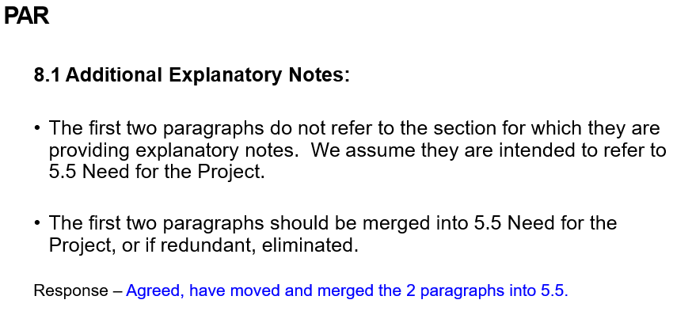
802.1 Comments on 802.15.14 Standard: Ad-Hoc Impulse Radio Ultra Wideband Wireless Networks, PAR and CSD

Slide 12
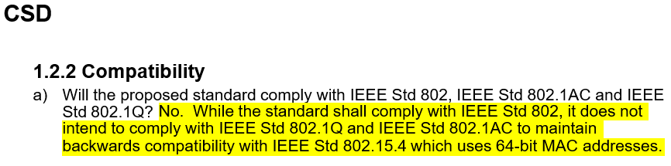
802.1 Comments on 802.15.14 Standard: Ad-Hoc Impulse Radio Ultra Wideband Wireless Networks, PAR and CSD
IEEE 802.1 believes there may be additional issues with compatibility that are not listed. Please clarify:
  Will 802.15.14 use a restricted MTU size? Restricted MTU sizes make bridging to other IEEE 802 media impossible without suitable fragmentation/reassembly support
  Will 802.15.14 have other Addressing Modes beyond the 64-bit address that are also incompatible
with IEEE Std 802.1Q and IEEE Std 802.1AC?
Response – A comprehensive response was provided at the March 2016 802 Plenary Mtg. in Macao (see doc. # ). A reference, with link to this and other related docs. has been added to the CSD.

Slide 13
802.3 Comments on 802.15.14 Standard: Ad-Hoc Impulse Radio Ultra Wideband Wireless Networks, PAR and CSD
PAR
General — Even though this document might be copied from myProject output, it is not output from myProject, and therefore, reduces confidence that the correct form is being used, and that the NesCom submittal will match what is reviewed. It is expected the pdf from myProject is used for 802 preview. Further, there are formatting problems that should be fixed when entering into myProject, and some of the formatting indicates changes in the docx that likely didn’t come from myProject.
Response – The PAR Draft, with changes per the responses in this document, has been regenerated from myProject.

Slide 14
802.3 Comments on 802.15.14 Standard: Ad-Hoc Impulse Radio Ultra Wideband Wireless Networks, PAR and CSD
PAR
General — Even though this document might be copied from myProject output, it is not output from myProject, and therefore, reduces confidence that the correct form is being used, and that the NesCom submittal will match what is reviewed. It is expected the pdf from myProject is used for 802 preview. Further, there are formatting problems that should be fixed when entering into myProject, and some of the formatting indicates changes in the docx that likely didn’t come from myProject.
Response – The PAR Draft, with changes per the responses in this document, has been regenerated from myProject.

Slide 15
802.3 Comments on 802.15.14 Standard: Ad-Hoc Impulse Radio Ultra Wideband Wireless Networks, PAR and CSD
3.1 — Why does the WG name not agree with what is listed on http://ieee802.org Did the WG change its name without approval of the EC, or is the EC page wrong? (The draft PAR WG name does agree with the WG name in myProject.)
Response – The 802.15 WG Chair will contact the 802 EC Secretary w.r.t. updating the multiple places still using the old WG name and to update it with the new WG name - “Wireless Specialty Networks”.
5.5 — Typo: “805.15.4w” should be “802.15.4w”.
Response – This has been corrected in the PAR Draft to “802.15.4w”.

Slide 16
802.3 Comments on 802.15.14 Standard: Ad-Hoc Impulse Radio Ultra Wideband Wireless Networks, PAR and CSD
5.5, General – The IEEE standards numbers in the answer should be prefaced by “IEEE Std”. Similar errors are found throughout the PAR, sometimes including IEEE but not Std (e.g., in 8.1).
Response – This has been corrected throughout the PAR Draft.
5.5, General – Though somewhat murky, we believe the proper reference to the standard and its approved amendments/corrigenda is undated (IEEE Std 802.15.4).
Response – This has been changed in the PAR Draft to state that the project will “…benefit by including (via. referencing)…”.

Slide 17
802.3 Comments on 802.15.14 Standard: Ad-Hoc Impulse Radio Ultra Wideband Wireless Networks, PAR and CSD
5.6 — Grammar: “and manufacturers and”.
Response – This has been changed in the PAR Draft to “… consumer electronics equipment, manufacturers, and users of equipment involving…”
6.1.2, Explanation — "Unique Identifiers (EUI)” should be “Extended Unique Identifiers (EUI)”.
Response – This has been changed in the PAR Draft to “Extended Unique Identifiers (EUI)”.

Slide 18
802.3 Comments on 802.15.14 Standard: Ad-Hoc Impulse Radio Ultra Wideband Wireless Networks, PAR and CSD
7.1 — The response only partially answers the question. What project will remove the extracted content from IEEE Std 802.15.4? If a future revision project will remove the IEEE Std 802.15.4 content after approval of P802.15.14 and P802.15.15, that should be stated. Or, should there be a co-contingent revision project of IEEE 802.15.4 to run in parallel? (Require simultaneous approval of P802.15.4, P802.15.14, and P802.15.15.) Is there any contingency on the active project P802.15.4aa?
Response – This has been changed in the PAR Draft to “As specified in the need for the project, some IEEE Std 802.15.4 functionality will be included (via. referencing) into IEEE P802.15.14.”

Slide 19
802.3 Comments on 802.15.14 Standard: Ad-Hoc Impulse Radio Ultra Wideband Wireless Networks, PAR and CSD
7.1 — The PAR indicates extraction of material from IEEE Std 802.15.4. There appear to be 30 Letters of Assurance on IEEE Std 802.15.4 and its amendments in the PatCom LOA listing. Based on this, please see PatCom FAQ 14, in particular the last paragraph. New LOAs may be required.
Response – The 802.15 WG Chair, along with the 802.15.14 TG Chair (once the TG is formed) will work together along with PatCom on the most suitable way to address this.
7.1.1 — "P802.15.4-2020" is neither a proper standard nor project number. (There is no date on a project number.)
Response – This has been changed in the PAR Draft to “IEEE Std 802.15.4-2020”.
7.1.1 – Typo in the title "IEEE Standard for Low?Rate Wireless Networks” the published standard uses “Low-Rate“.
Response – This has been changed in the PAR Draft to “…Low-Rate…”.

Slide 20
802.3 Comments on 802.15.14 Standard: Ad-Hoc Impulse Radio Ultra Wideband Wireless Networks, PAR and CSD
CSD: https://mentor.ieee.org/802.15/dcn/21/15-21-0278-04-0014-sg14-draft-csd-for-ns-uwb.docx
No comments.

Slide 21
802.11 Comments on 802.15.14 Standard: Ad-Hoc Impulse Radio Ultra Wideband Wireless Networks, PAR and CSD
2.1 – Title – “Ad Hoc” is only in the title, it is not used as a qualifier elsewhere in the PAR (Scope/purpose/need or explanation.)
  Suggest remove “Ad Hoc” or change to “Impulse Radio Ultra Wideband Wireless Ad Hoc Networks”.
    (Note that one definition of Ad Hoc Network is “A wireless ad hoc network or mobile ad hoc network is a decentralized type of wireless network. The network is ad hoc because it does not rely on a pre-existing infrastructure.”)
    If you leave Ad Hoc in the title, it may well be that your network description elsewhere needs an “Ad Hoc” added.
    Response – Agreed, have changed the title name as proposed above and include use of term Ad Hoc in 5.2 and correct use of Ad-Hoc to Ad Hoc or ad hoc depending on section.
5.5 Need : “ad-hoc impulse radio ultra wideband functionality”
  Should this be “Ad Hoc” as in the title?
  Should this more correctly be “impulse radio ultra wideband Ad Hoc network functionality”?
Response – Agreed, have changed to ad hoc.

Slide 22
802.11 Comments on 802.15.14 Standard: Ad-Hoc Impulse Radio Ultra Wideband Wireless Networks, PAR and CSD
5.6 – Stakeholders seems overly broad – suggest to make it more specific.
Response – Each of the listed stakeholders is a current or potential user of the technology.
7.1.1 – “Low?Rate Wireless Networks” change to “Low Rate Wireless Networks”
Response – Agreed, have changed to Low-Rate.

Slide 23
802.11 Comments on 802.15.14 Standard: Ad-Hoc Impulse Radio Ultra Wideband Wireless Networks, PAR and CSD
8.1 First 2 paragraphs should be moved to the 5.5 Need section.
Response – Agreed.
8.1 In the 2nd paragraph we suggested moving to 5.5 change “new standard will improve“ to “new standard (802.15.14) improves”
Response – Agreed.
PAR General – as this is the PAR for 802.15.14, we don’t see how the reference to 802.15.15 is needed to be included (or it needs to be more explicitly noted in the Need) (remove reference in 7.1 and 8.1. (not similar scope)).
Response – Agreed.

Slide 24
802.11 Comments on 802.15.14 Standard: Ad-Hoc Impulse Radio Ultra Wideband Wireless Networks, PAR and CSD
PAR 5.2a Scope statement may be better to be replaced with the statement from the CSD “Broad market potential“ – suggested Scope replacement:
  This standard defines the physical layer (PHY) and data link layer capabilities to support impulse radio ultra wideband features and capabilities, including real time precision ranging capability that is accurate to within a few centimeters. PHYs are defined for devices operating in a variety of regulatory domains.
  Response - Agreed, in 5.2 of the PAR have replaced “precision ranging” with “real time precision ranging capability that is accurate to within a few centimeters”.

Slide 25
802.11 Comments on 802.15.14 Standard: Ad-Hoc Impulse Radio Ultra Wideband Wireless Networks, PAR and CSD
CSD – Comments:
Title changes suggested for PAR should be reflected in the CSD.
Response – Agreed.
Broad Market Potential – b) delete “recently”
Response – Agreed.
Compatibility: a) and b) - Change “64-bit MAC addresses” should be “Extended Unique Identifier – 64 (EUI-64)”
Response – Agreed.
Distinct Identity – It was stated in the PAR that the Impulse Radio UWB technology is in 802.15.4 already and that it is being extracted. This would indicate a duplicate location. This statement should be changed to include this subtlety.
Response – We have replaced the text with the following in the PAR Draft to “As specified in the need for the project, some IEEE Std 802.15.4 functionality will be included (via. referencing) into IEEE P802.15.14.”

Slide 26
SG Motion
Motion: Request that the responses to received PAR and CSD review comments contained in document 15-21-0376-01 be approved for submission to the WG for its approval. The 802.15 working group chair and technical editor are authorized to make additional modifications to the responses as needed.
Moved by:
Seconded by:
Discussion:
Vote: No objections, unanimously approval – motion passes (>75%), with xx participants on call

Slide 27
WG Motion
Motion: Request that the responses to received PAR and CSD review comments contained in document 15-21-0376-01 be approved for submission to the EC. The 802.15 working group chair and technical editor are authorized to make additional modifications to the responses as needed.
Moved by:
Seconded by:
Discussion:
Vote: No objections, unanimously approval – motion passes (>75%), with xx participants on call

Slide 28
Next Steps
Continue work as Study Group
  Identify Content for 802.15.14
  Coordinate with SG15, SG4ab
Work via Interim telecons and virtual interim/plenary meetings

Slide 29
Sept. Plenary Mtg. Goals
Continue work on PICS analysis and content development
3 slots needed
  ≈ 1 administrivia
  ≈ 2 to work on PICS and content dev.

Slide 30
Weekly Calls
Weekly calls starting:
  Wed. 4th, August @ 7am Pacific

Slide 31
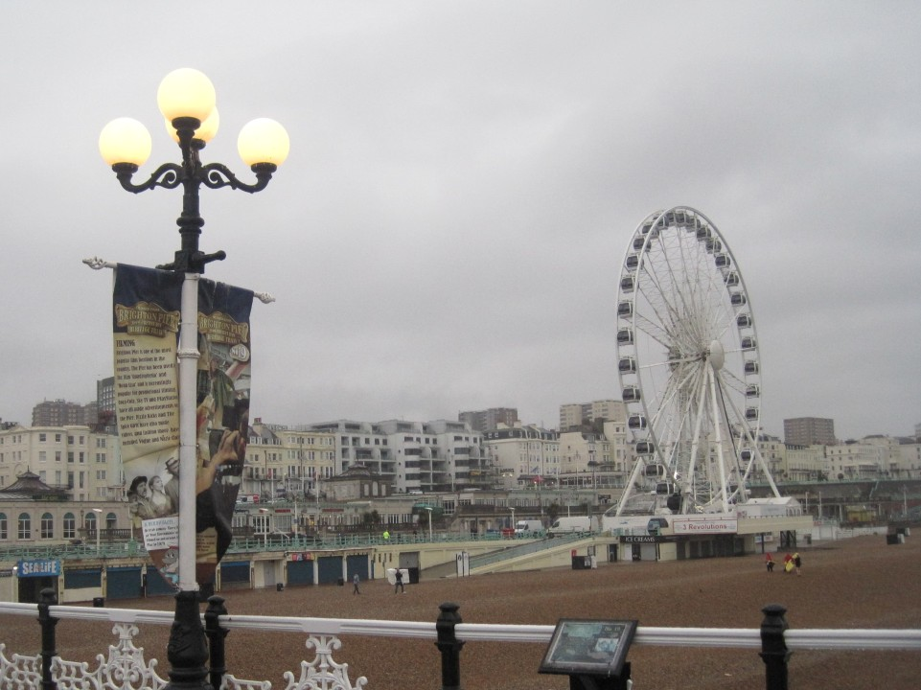

Slide 32
Adjourned
Thanks

