Slide 1
Project: IEEE P802.15 Working Group for Wireless Personal Area Networks (WPANs)
Submission Title: SG14 Opening Report, Meeting Slides, Closing Report – July 2021 Mtg
Date Submitted: July 13, 2021
Source: Clint Powell (Facebook)
Contact: SAA
Voice: +1 480 586-8457, E-Mail: cpowell@ieee.org
Re: Study Group 14: NS-UWB
Abstract: Meeting Slides
Purpose: Working Slide Deck for July Mtg
Notice: This document has been prepared to assist the IEEE P802.15. It is offered as a basis for discussion and is not binding on the contributing individual(s) or organization(s). The material in this document is subject to change in form and content after further study. The contributor(s) reserve(s) the right to add, amend or withdraw material contained herein.
Release: The contributor acknowledges and accepts that this contribution becomes the property of IEEE and may be made publicly available by P802.15.
Notes:
Jul 12, 2010
Page 1

Slide 2
132nd IEEE 802.15 WSN MTG.
Held Virtually via Webex
July 13th – 22nd, 2021

Slide 3
802.15 Study Group Meeting
Pre-PAR Activity Rules for Study Group
Voting: everyone present can vote
Please identify yourself with your name and affiliation when you first speak
Participation: is by individual

Slide 4
IEEE-SA Patent, Copyright, and Participation Policies
See: https://grouper.ieee.org/groups/802/sapolicies.shtml
IEEE-SA Patent Slides for Pre-PAR Meetings:
https://development.standards.ieee.org/myproject/Public/mytools/mob/preparslides.pdf
IEEE-SA Participation Slides for Pre-PAR Meetings:
https://standards.ieee.org/content/dam/ieee-standards/standards/web/documents/other/Participant-Behavior-Individual-Method.pdf
Copyright:
https://standards.ieee.org/content/dam/ieee-standards/standards/web/documents/other/ieee-sa-copyright-policy-2019.pdf

Slide 5
IEEE 802 Ground Rules
NO product pitches
NO corporate pitches
NO prices
NO restrictive notices:
e.g. confidential notices in email
Presentations must be openly available
Most important:
Please respect all participants

Slide 6
SG14 Meeting Slots
July 15th – 21st, 2021

Slide 7
Goals/Agenda
Opening and meeting preamble
Approve May Interim minutes: doc. # 15-21-0321-00
https://mentor.ieee.org/802.15/dcn/21/15-21-0321-00-0014-sg14-may-2021-interim-mtg-mins.docx
Approve Agenda: doc. # 15-21-0347-00 https://mentor.ieee.org/802.15/documents?is_dcn=347&is_year=2021
Review and respond to comments received on PAR and CSD
Update PAR and CSD as required
Next Steps
Any other Business

Slide 8
CSD and PAR
CSD
15-21-0278-xx-0014-draft-csd-for-ns-uwb
https://mentor.ieee.org/802.15/documents?is_dcn=278&is_group=0014
PAR
15-21-0274-xx-0014-ns-uwb-par-working-draft
https://mentor.ieee.org/802.15/documents?is_dcn=274&is_group=0014

Slide 9
Draft P802.15.14 (1)
New Standard: Ad-Hoc Impulse Radio Ultra Wideband Wireless Network
PAR
General — Even though this document might be copied from myProject output, it is not output from myProject, and therefore, reduces confidence that the correct form is being used, and that the NesCom submittal will match what is reviewed. It is expected the pdf from myProject is used for 802 preview. Further, there are formatting problems that should be fixed when entering into myProject, and some of the formatting indicates changes in the docx that likely didn’t come from myProject.
Response – The PAR Draft, with changes per the responses in this document, has been regenerated from myProject.

Slide 10
Draft P802.15.14 (2)
New Standard: Ad-Hoc Impulse Radio Ultra Wideband Wireless Network
3.1 — Why does the WG name not agree with what is listed on http://ieee802.org Did the WG change its name without approval of the EC, or is the EC page wrong? (The draft PAR WG name does agree with the WG name in myProject.)
Response – The 802.15 WG Chair will contact the 802 EC Secretary w.r.t. updating the multiple places still using the old WG name and to update it with the new WG name - “Wireless Specialty Networks”.
5.5 — Typo: “805.15.4w” should be “802.15.4w”.
Response – This has been corrected in the PAR Draft to “802.15.4w”.

Slide 11
Draft P802.15.14 (3)
New Standard: Ad-Hoc Impulse Radio Ultra Wideband Wireless Network
5.5, General – The IEEE standards numbers in the answer should be prefaced by “IEEE Std”. Similar errors are found throughout the PAR, sometimes including IEEE but not Std (e.g., in 8.1).
Response – This has been corrected throughout the PAR Draft.
5.5, General – Though somewhat murky, we believe the proper reference to the standard and its approved amendments/corrigenda is undated (IEEE Std 802.15.4).
Response – This has been changed in the PAR Draft to state that the project will “…benefit by including (via. referencing)…”.

Slide 12
Draft P802.15.14 (4)
New Standard: Ad-Hoc Impulse Radio Ultra Wideband Wireless Network
5.6 — Grammar: “and manufacturers and”.
Response – This has been changed in the PAR Draft to “… consumer electronics equipment, manufacturers, and users of equipment involving…”.
6.1.2, Explanation — "Unique Identifiers (EUI)” should be “Extended Unique Identifiers (EUI)”.
Response – This has been changed in the PAR Draft to “Extended Unique Identifiers (EUI)”.

Slide 13
Draft P802.15.14 (5)
New Standard: Ad-Hoc Impulse Radio Ultra Wideband Wireless Network
7.1 — The response only partially answers the question. What project will remove the extracted content from IEEE Std 802.15.4? If a future revision project will remove the IEEE Std 802.15.4 content after approval of P802.15.14 and P802.15.15, that should be stated. Or, should there be a co-contingent revision project of IEEE 802.15.4 to run in parallel? (Require simultaneous approval of P802.15.4, P802.15.14, and P802.15.15.) Is there any contingency on the active project P802.15.4aa?
Response – This has been changed in the PAR Draft to “As specified in the need for the project, some IEEE Std 802.15.4 functionality will be included (via. referencing) into IEEE P802.15.14 and IEEE P802.15.15.”

Slide 14
Draft P802.15.14 (6)
New Standard: Ad-Hoc Impulse Radio Ultra Wideband Wireless Network
7.1 — The PAR indicates extraction of material from IEEE Std 802.15.4. There appear to be 30 Letters of Assurance on IEEE Std 802.15.4 and its amendments in the PatCom LOA listing. Based on this, please see PatCom FAQ 14, in particular the last paragraph. New LOAs may be required.
Response – The 802.15 WG Chair, along with the 802.15.14 TG Chair (once the TG is formed) will work together along with PatCom on the most suitable way to address this.
7.1.1 — "P802.15.4-2020" is neither a proper standard nor project number. (There is no date on a project number.)
Response – This has been changed in the PAR Draft to “IEEE Std 802.15.4-2020”.
7.1.1 – Typo in the title "IEEE Standard for Low?Rate Wireless Networks” the published standard uses “Low-Rate“.
Response – This has been changed in the PAR Draft to “…Low-Rate…”.

Slide 15
Draft P802.15.14 (7)
New Standard: Ad-Hoc Impulse Radio Ultra Wideband Wireless Network
CSD: https://mentor.ieee.org/802.15/dcn/21/15-21-0278-04-0014-sg14-draft-csd-for-ns-uwb.docx
No comments.

Slide 16
Next Steps
Continue work as Study Group
Identify Content for 802.15.14
Coordinate with SG15, SG4ab
Work via Interim telecons and virtual interim/plenary meetings

Slide 17
Sept. Plenary Mtg. Goals
Continue work on PICS analysis and content development
3 slots needed
≈ 1 administrivia
≈ 2 to work on PICS and content dev.

Slide 18
Weekly Calls
Weekly calls starting:
Wed. 4th, August @ 7am Pacific

Slide 19
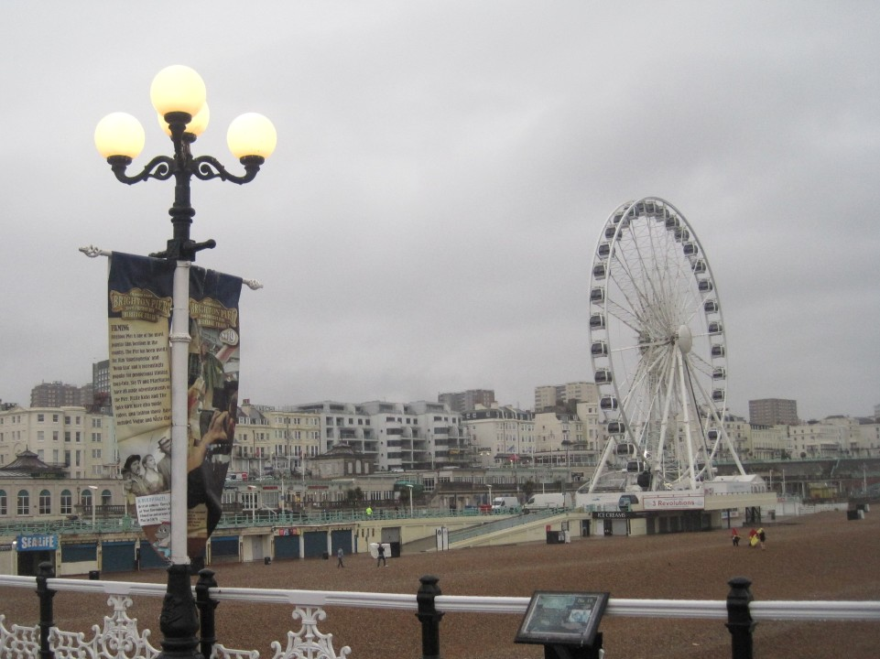

Slide 20
Adjourned Thanks

