Slide 1
Project: IEEE P802.15 Working Group for Wireless Personal Area Networks (WPANs)
Submission Title: [TG4aa JRE July Plenary 2021 Virtual meeting Opening report]
Date Submitted: [13th July,2021]
Source: [Takashi Kuramochi] Company [LAPIS TECHNOLOGY]
Address [2-4-8 Shinyokohama,Kouhoku-ku,Yokohama 222-8575 Japan]
Voice:[+81-45-476-9295], FAX: [], E-Mail:[kuramochi722@lapis-tech.com]
Re: [] Abstract: [This document contains opening information and meeting agenda for the TG4aa JRE July Plenary Teleconference,2021] Purpose: [information]
Notice: This document has been prepared to assist the IEEE P802.15. It is offered as a basis for discussion and is not binding on the contributing individual(s) or organization(s). The material in this document is subject to change in form and content after further study. The contributor(s) reserve(s) the right to add, amend or withdraw material contained herein.
Release: The contributor acknowledges and accepts that this contribution becomes the property of IEEE and July be made publicly available by P802.15.

Slide 2
IEEE 802.15 TG4aa JRE July Plenary Virtual Meeting Opening report on July 13th/15th/19th,2021

Slide 3
Administrative Items
Required notices
Affiliation FAQ - http://standards.ieee.org/faqs/affiliationFAQ.html
Anti-Trust FAQ - http://standards.ieee.org/resources/antitrust-guidelines.pdf
Ethics - http://www.ieee.org/portal/cms_docs/about/CoE_poster.pdf
Chair/Vice-Chair/Secretary/Technical Editor
Chair :Takashi Kuramochi(LAPIS)
Vice-Chair : Hiroshi Harada(Kyoto University)
Vice-Chair: Kunal Shah(ITRON)
Secretary : Kiyoshi Fukui(OKI)
Technical Editor : Kiyoshi Fukui(OKI)

Slide 4
Participants have a duty to inform the IEEE
Participants shall inform the IEEE (or cause the IEEE to be informed) of the identity of each holder of any potential Essential Patent Claims of which they are personally aware if the claims are owned or controlled by the participant or the entity the participant is from, employed by, or otherwise represents
Participants should inform the IEEE (or cause the IEEE to be informed) of the identity of any other holders of potential Essential Patent Claims
Early identification of holders of potential Essential Patent Claims is encouraged

Slide 5
Ways to inform IEEE
Cause an LOA to be submitted to the IEEE-SA (patcom@ieee.org); or
Provide the chair of this group with the identity of the holder(s) of any and all such claims as soon as possible; or
Speak up now and respond to this Call for Potentially Essential Patents
If anyone in this meeting is personally aware of the holder of any patent claims that are potentially essential to implementation of the proposed standard(s) under consideration by this group and that are not already the subject of an Accepted Letter of Assurance, please respond at this time by providing relevant information to the WG Chair

Slide 6
Other guidelines for IEEE WG meetings
All IEEE-SA standards meetings shall be conducted in compliance with all applicable laws, including antitrust and competition laws.
Don’t discuss the interpretation, validity, or essentiality of patents/patent claims.
Don’t discuss specific license rates, terms, or conditions.
Relative costs of different technical approaches that include relative costs of patent licensing terms may be discussed in standards development meetings.
Technical considerations remain the primary focus
Don’t discuss or engage in the fixing of product prices, allocation of customers, or division of sales markets.
Don’t discuss the status or substance of ongoing or threatened litigation.
Don’t be silent if inappropriate topics are discussed … do formally object.
---------------------------------------------------------------
For more details, see IEEE-SA Standards Board Operations Manual, clause 5.3.10 and Antitrust and Competition Policy: What You Need to Know at http://standards.ieee.org/develop/policies/antitrust.pdf

Slide 7
Patent-related information
The patent policy and the procedures used to execute that policy are documented in the:
IEEE-SA Standards Board Bylaws
https://standards.ieee.org/about/policies/bylaws/sect6-7.html#6
IEEE-SA Standards Board Operations Manual
https://standards.ieee.org/about/policies/bylaws/sect6-7.html#6.3
Material about the patent policy is available at
http://standards.ieee.org/about/sasb/patcom/materials.html
If you have questions, contact the IEEE-SA Standards Board Patent Committee Administrator at patcom@ieee.org

Slide 8
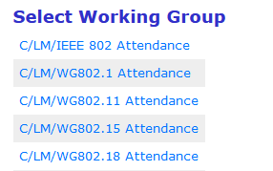
Attendance
Visit “https://imat.ieee.org” and click “802 Plenary Session” and click “C/LM/WG802.15 Attendance” shown below.
Register
Indicate attendance
Please click yellow bar on the attendance sheet.
the collar bar will be changed to green.
Important Note: In July plenary, Attendance will be counted session based. Each session gives you 6% of attendance.
In order to get voting right, you need to get at least 12 sessions during July Plenary.

Slide 9
TG4aa JRE sessions in July Plenary
 | Monday 12th July | Tuesday 13th July | Wednesday 14th July | Thursday 15th July | Friday 16th July
AM1
AM2 |  | Opening
PM1
PM2
EV1 |  | TG4aa-JRE |  | TG4aa-JRE
 | Monday 19th July | Tuesday 20th July | Wednesday 21th July | Thursday 22th July | Friday 23th July
AM1
AM2 |  |  |  | Closing
PM1
PM2
EV1 | TG4aa-JRE

Slide 10
Proposed agenda for TG4aa meetings
Target: TG Motion for SA ballot and CRG formation
Session1:
TG motion for SA ballot.
TG motion for CRG formation
Next Steps
Session2 and 3:
AOB

Slide 11
Agenda items for the weeks
19th Monday EV1(17:00-19:00)
AOB
13th Tuesday EV1(17:00-19:00)
OPEN/Patent Policy
Attendance
Approval of the Agenda
Approval of the last meeting minutes
Review and resolve WG ballot results and comments
Next steps
TG Motions for SA ballot and CRG formation
Plan for September Interim(# of sessions)
Any other business
Attendance recap
Adjourn TG4aa JRE
15th Thursday EV1(17:00-19:00)
AOB
Approval of the Agenda
Moved: Kunal Shah(Itron)
Second: Hiroshi Harada(Kyoto University)
There is no discussion or objections.
Agenda is approved unanimous consent.

Slide 12
Approval of the last meeting minutes [May Interim] May 11-19th : 15-21-0315-00-04aa [CRG meeting] June 22nd : 15-21-0336-01-04aa
Approval of the last meeting minutes
Moved: Kunal Shah(Itron)
Second: Hiroshi Harada(Kyoto University)
There is no discussion or objections.
last meeting minutes is approved unanimous consent.

Slide 13
Review and resolve WG ballot results and comments
Results of LB186 (P802.15.4aa-D08), Japanese Rate Extension amendment to IEEE 802.15.4-2020.
#LB183,LB185 and LB186 Aggregate Tally is as shown below.
WG Voting membership: 93
Responses: 65
YES: 59
ABSTAIN: 6
NO: 0
Response ratio:70%
Approve ratio:100%
Abstain ratio:9%
There were no additional comments on the ballot 186.

Slide 14
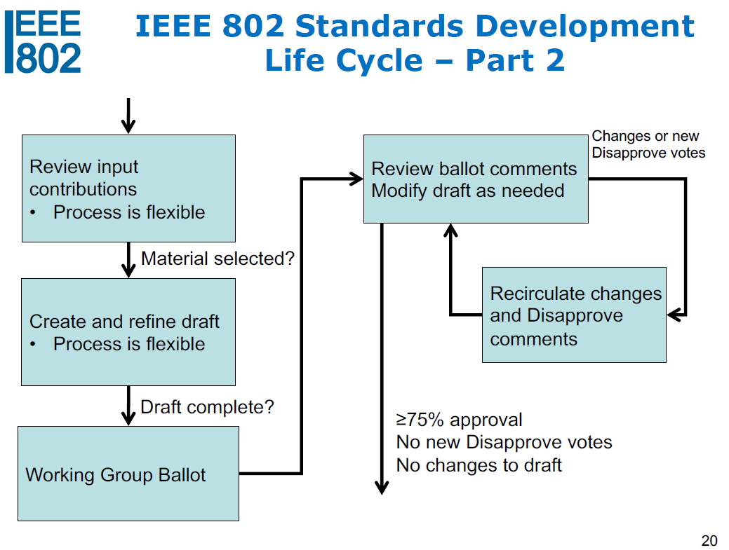
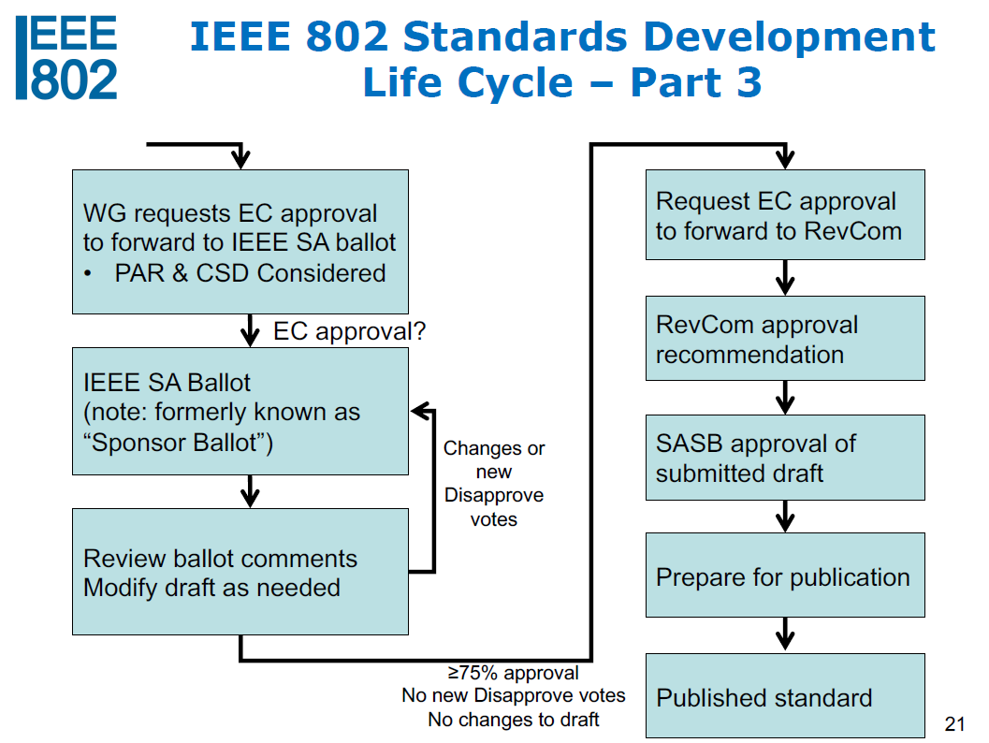
Next steps
We are here!

Slide 15
TG Motion
There are two motions for
SA Letter Ballot and the formation of CRG.
DCN:15-21-0367-00-04aa

Slide 16
Plan for September Interim
 | Monday 13th Sep | Tuesday 14th Sep | Wednesday 15th Sep | Thursday 16th Sep | Friday 17th Sep
AM1
AM2 |  | Opening
PM1
PM2
EV1 |  | TG4aa-JRE |  | TG4aa-JRE
 | Monday 20th Sep | Tuesday 21th Sep | Wednesday 22nd Sep | Thursday 23rd Sep | Friday 24th Sep
AM1
AM2 |  |  |  | Closing
PM1
PM2
EV1 | TG4aa-JRE
Topics
Review & resolve comments on SA ballot.

Slide 17
Any other business?

Slide 18
Attendance recap

Slide 19
Recess TG4aa
Moved :Kunal Shah(ITRON)
Second : Clint Powell(Facebook)
There is no discussion or objections. Adjourn is approved unanimous consent.

Slide 20
Contacts
Takashi Kuramochi, LAPIS Technology
kuramochi722@lapis-tech.com

Slide 21
Reference
The IEEE802.15 meeting schedule can be found at http://grouper.ieee.org/groups/802/15/calendar.html
Document templates (MsWord and PowerPoint) and instructions for obtaining document numbers are located at http://grouper.ieee.org/groups/802/15/pub/Download.html
TG4aa JRE reflector is (stds-802-15-jre@listserv.ieee.org)
Documents should be uploaded to https://mentor.ieee.org/802.15, to the “TG4aa” JRE group.
For help with obtaining document numbers, document formatting, document uploading and contribution scheduling, please contract the 802.15 TG4aa JRE chair, Takashi Kuramochi, at kuramochi722@lapis-tech.com
The draft objectives of the group is available at SC WNG session in January 2020:
https://mentor.ieee.org/802.15/documents

