Slide 1
Project: IEEE P802.15 Working Group for Wireless Personal Area Networks (WPANs)
Submission Title: SG4ab Agenda and Meeting Slides
Date Submitted: June 1, 2021
Source: Benjamin A. Rolfe (Blind Creek Associates)
Contact:
Voice: +1 408 395 7207, E-Mail: ben.rolfe @ ieee.org
Re: Study Group 4ab: UWB Next Generation
Abstract: Agenda and Meeting Slides
Purpose: Achieve the illusion of organization for the ad-hoc meeting
Notice: This document has been prepared to assist the IEEE P802.15. It is offered as a basis for discussion and is not binding on the contributing individual(s) or organization(s). The material in this document is subject to change in form and content after further study. The contributor(s) reserve(s) the right to add, amend or withdraw material contained herein.
Release: The contributor acknowledges and accepts that this contribution becomes the property of IEEE and may be made publicly available by P802.15.
Notes:
Jul 12, 2010
Page 1

Slide 2
Study Group 15.4ab Next Generation UWB Amendment
Teleconference / Virtual Meeting
June 1, 2021

Slide 3
802.15 Study Group Meeting
Pre-PAR Activity Rules
Study Group voting: everyone present can vote
Identify yourself and affiliation on first contact
Reminder: Individual Participation

Slide 4
IEEE-SA Patent, Copyright, and Participation Policies
See: https://grouper.ieee.org/groups/802/sapolicies.shtml
IEEE-SA Patent Slides for Pre-PAR Meetings:
https://development.standards.ieee.org/myproject/Public/mytools/mob/preparslides.pdf
IEEE-SA Participation Slides for Pre-PAR Meetings:
https://standards.ieee.org/content/dam/ieee-standards/standards/web/documents/other/Participant-Behavior-Individual-Method.pdf
Copyright:
https://standards.ieee.org/content/dam/ieee-standards/standards/web/documents/other/ieee-sa-copyright-policy-2019.pdf

Slide 5
IEEE 802 Ground Rules
Respect … give it, get it
NO product pitches
NO corporate pitches
NO prices
NO restrictive notices – (no confidentially notices in email)
Presentations must be openly available

Slide 6
Proposed Agenda
Opening and meeting preamble
Recap and Status
Technical Presentations
[TBD] (Keren)
Review Technical Guidance (Rolfe)
Other?
Next steps
Any other Business

Slide 7
Recap

Slide 8
Proposed PAR Scope
5.2.b Scope of the project: This amendment enhances the Ultra Wideband (UWB) physical layers (PHYs,) medium access control (MAC), and associated ranging techniques while retaining backward compatibility with enhanced ranging capable devices (ERDEVs). Areas of enhancement include: additional coding, preamble and modulation schemes to support improved link budget and/or reduced air-time; additional channels and operating frequencies; interference mitigation techniques to support higher density and higher traffic use cases; improvements to accuracy / precision / reliability and interoperability for high-integrity ranging; schemes to reduce complexity and power consumption; definitions for tightly coupled hybrid operation with narrowband signaling to assist UWB; enhanced native discovery and connection setup mechanisms; sensing capabilities to support presence detection and environment mapping; and mechanisms supporting low-power low-latency streaming as well as high data-rate streaming allowing at least 50 Mbit/s of throughput. Support for peer-to-peer, peer-to-multi-peer, and station-to-infrastructure protocols are in scope, as are infrastructure synchronization mechanisms. This amendment includes safeguards so that the high throughput data use cases will not cause significant disruption to low duty-cycle ranging use cases.

Slide 9
May Meeting Summary
Review and reaffirm the proposed PAR and CSD.
Further consideration of use cases and technical requirements and characteristics
Heard and discussed technical contributions
Discussed technical framework and produce a technical guidance document
Produce a call for contributions
Coordinate with other Study Groups

Slide 10
PAR Review
EC Process:
Submit for review (Done June 1st)
PAR: https://mentor.ieee.org/802.15/dcn/21/15-21-0126-02-nuwb-p802-15-4ab-par-draft-from-myproject.pdf
CSD: https://mentor.ieee.org/802.15/dcn/21/15-21-0047-05-nuwb-draft-csd-ng-uwb.docx
Comments received and resolved in July
EC and WG Review Schedule:
08 Jun 2021 | PAR Announcement
14 Jul 2021 | Submit comments against PARs / ICAIDs
21 Jul 2021 | Post responses to submitted comments against PARs / ICAIDs
23 Jul 2021 | 802 EC Closing Mtg (Consider PARs / ICAIDs)

Slide 11
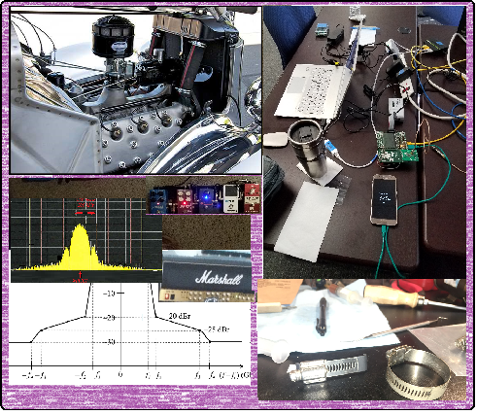
Technical Contributions

Slide 12
Other Technical
[TBD] (Keren)

Slide 13
Technical Guidance Document
15-21-0297-01
Discusion

Slide 14
Next Steps

Slide 15
Call for Contributions
Study Group 15.4ab requests technical contributions to further the development of recommendations for technical content of the proposed amendment. Contribution guidance is provided in the Technical Guidance Document (TGD), DCN #15-21-0297 (https://mentor.ieee.org/802.15/dcn/21/15-21-0297-01-04ab-15-4ab-technical-guidance-doc.docx)
Contributions may include but are not limited to the areas covered in the draft Project Authorization Request (PAR) and the TGD. Contributions may include further technical considerations, use case descriptions and requirements and background information supporting development of the amendment.
Contributions on analysis of coexistence and proposed methods to enhance coexistence are strongly encouraged.
Schedule:
Contributions to be considered on bi-weekly conference calls commencing June 1: Please advise chair of request for agenda time ahead of the call.
Contributions to be considered at the July Plenary: Please advise chair as early as possible prior to the meeting. Requests one week prior to the meeting appreciated.
Agenda time priority: Queued First In, First choice of time slot

Slide 16
Teleconference Schedule Discussion
Frequency: Bi-weekly
Phase: Tuesday
Time: 10:00 ET (07:00 PT)
Duration: 1 hour.
Week | Time (ET)
Now: | [May Interim]
June 1 | 10:00 ET
June 15 | 10:00 ET
June 29 | 10:00 ET
July 13: | July Plenary
We are Here
NEXT

Slide 17
Planning for July Plenary
Propose 4 slots
1 Joint slot with NS SGs
Technical Presentation requests
2 so far
Discussion?

Slide 18
Other Business

Slide 19
Adjourned Thanks

