Slide 1
Project: IEEE P802.15 Working Group for Wireless Speciality Networks (WSN)
Submission Title: Potential Study Group on extending IEEE Std. 802.15.3 to the frequency range 356-450 GHz
Date Submitted: 17 May 2021
Source: Thomas Kürner TU Braunschweig
Address Schleinitzstr. 22, D-38092 Braunschweig, Germany
Voice:+495313912416, FAX: +495313915192, E-Mail: t.kuerner@tu-bs.de
Re: n/a
Abstract: xxx
Purpose: Discussion Document to form a Study Group targeting to extend IEEE Std. 802.15.3 to the frequency range 356-450 GHz
Notice: This document has been prepared to assist the IEEE P802.15. It is offered as a basis for discussion and is not binding on the contributing individual(s) or organization(s). The material in this document is subject to change in form and content after further study. The contributor(s) reserve(s) the right to add, amend or withdraw material contained herein.
Release: The contributor acknowledges and accepts that this contribution becomes the property of IEEE and may be made publicly available by P802.15.

Slide 2
Potential Study Group on extending IEEE Std. 802.15.3 to the frequency range 356-450 GHz

Slide 3
Current Situation
IEEE Std. 802.15.3d-2017 covers the frequency band 252 to 321 GHz
At WRC 2019 additional frequency bands beyond 321 have been identified for the use by Land Mobile Service (LMS) and Fixed Service
Of specific interest are 94 GHz contigous spectrum between 356 and 450 GHz, which may be used especially for short-range applications

Slide 4
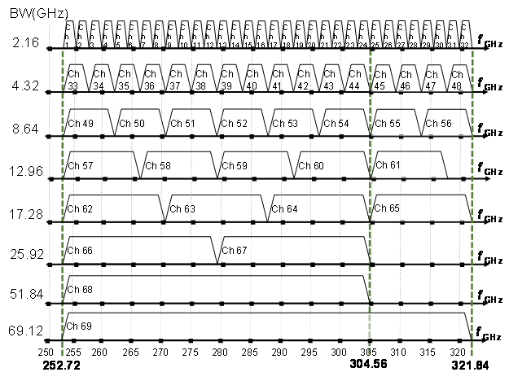
Channel Plan of IEEE Std. 802.15.3d

Slide 5
Conditions for the Use of Spectrum for THz Communications
Frequency in GHz | Status in Radio Regulations
252-275 | Allocation for land mobile and fixed service on a co-primary basis
275-296 | Identification for use for the implementation of land mobile and fixed service according to FN 5.564A; no specific conditions are necessary to protect Earth exploration-satellite service (passive) applications.
306-313
318-333
356-450
296-306 | may only be used by fixed and land mobile service applications when specific conditions to ensure the protection of Earth exploration-satellite service (passive) applications are determined in accordance with Resolution 731 (Rev.WRC-19).
313-318
318-356
Source. doc.802.15-20/0149

Slide 6
Next Steps
In order to make use of the additional available spectrum an amendment of IEEE Std. 802.15.3d is required
In order to achieve this we have to ask for a Study Group to develop a PAR and CSD
Proposal for a Study Group Name:
SG3g „300 GHz Frequency Extension“

Slide 7
Possible Time Line
May 2021:
WG Motion to ask for EC approval to form SG3g
July 2021:
EC Approval
September 2021:
SG3g Kick-Off, writing of PAR and CSD
November 2021:
Formation of TG3g
Target:
Finishing amendment until end of 2022/beginning 2023

