Slide 1
Project: IEEE P802.15 Working Group for Wireless Personal Area Networks (WPANs)
Submission Title: SG14 Meeting Slides – May 2021 Meeting
Date Submitted: May 19, 2021
Source: Clint Powell (Facebook)
Contact: SAA
Voice: +1 480 586-8457, E-Mail: cpowell@ieee.org
Re: Study Group 14: NS-UWB
Abstract: Meeting Slides
Purpose: Working Slide Deck for May Mtg
Notice: This document has been prepared to assist the IEEE P802.15. It is offered as a basis for discussion and is not binding on the contributing individual(s) or organization(s). The material in this document is subject to change in form and content after further study. The contributor(s) reserve(s) the right to add, amend or withdraw material contained herein.
Release: The contributor acknowledges and accepts that this contribution becomes the property of IEEE and may be made publicly available by P802.15.
Notes:
Jul 12, 2010
Page 1

Slide 2
802.15 Study Group Meeting
Pre-PAR Activity Rules for Study Group
Voting: everyone present can vote
Please identify yourself with your name and affiliation when you first speak
Participation: is by individual

Slide 3
IEEE-SA Patent, Copyright, and Participation Policies
See: https://grouper.ieee.org/groups/802/sapolicies.shtml
IEEE-SA Patent Slides for Pre-PAR Meetings:
https://development.standards.ieee.org/myproject/Public/mytools/mob/preparslides.pdf
IEEE-SA Participation Slides for Pre-PAR Meetings:
https://standards.ieee.org/content/dam/ieee-standards/standards/web/documents/other/Participant-Behavior-Individual-Method.pdf
Copyright:
https://standards.ieee.org/content/dam/ieee-standards/standards/web/documents/other/ieee-sa-copyright-policy-2019.pdf

Slide 4
IEEE 802 Ground Rules
NO product pitches
NO corporate pitches
NO prices
NO restrictive notices:
    e.g. confidential notices in email
Presentations must be openly available
Most important:
Please respect all participants

Slide 5
131st IEEE 802.15 WSN MTG.
Held Virtually via Webex
May 11th - 19th, 2021
SG14 Meeting Slots
May 13th - 17th, 2021

Slide 6
Goals/Agenda
Status update on PICS analysis
Prepare draft CSD and PAR
Prepare SG & WG motions for CSD & PAR
Closing report generation
Next Steps
  Detailed daily agenda:
  SG14 Agenda - doc. # 15-21-0243-xx-0014
https://mentor.ieee.org/802.15/documents?is_dcn=243&is_group=0014

Slide 7
CSD and PAR
CSD
  15-21-0278-xx-0014-draft-csd-for-ns-uwb
  https://mentor.ieee.org/802.15/documents?is_dcn=278&is_group=0014
PAR
15-21-0274-xx-0014-ns-uwb-par-working-draft
https://mentor.ieee.org/802.15/documents?is_dcn=274&is_group=0014

Slide 8
SG14 Motion
Request that the PAR and CSD contained in documents [15-21-0274-04-0014] and [15-21-0278-04-0014], respectively, be approved for submission to the WG for its approval and that the EC be requested to forward the PAR to NesCom.
Moved by: Ben Rolfe (Blind Creek Associates)
Seconded by: Don Sturek (Itron)
Discussion: Kunal Shah inquired about authorizing chair to make changes. Chair responded that it is covered in WG motion.
Vote: No objections, unanimously approval – motion passes (>75%), with 51 participants on call

Slide 9
WG Motion
WG Motion: request: move that the PAR and CSD contained in documents [15-21-0274-04-0014] and [15-21-0278-04-0014], respectively, be approved by the IEEE 802.15 WG and that the EC be requested to forward the PAR to NesCom. The 802.15 working group chair and technical editor are authorized to make additional modifications to the PAR and CSD as needed to reflect EC discussion at its closing meeting.
Moved by: Clint Powell (Facebook)
Discussion:
Vote:

Slide 10
Next Steps
Continue work as Study Group
  Write PAR and CSD (May Interim)
  Coordinate with SG15
Move PAR and CSD through 802 and SA Processes (May Interim)
Determine proposed content for standard (ongoing)
Work via Interim telecons and virtual interim/plenary meetings

Slide 11
July Plenary Mtg. Goals
Respond to comments on PAR & CSD
Continue work on PICS analysis
4 slots needed
  1 opening and address any pre comments
  2 to address comments
  1 wrap-up and next steps

Slide 12
Weekly Calls
Weekly calls starting:
  Wed. 9th, June @ 7am Pacific

Slide 13
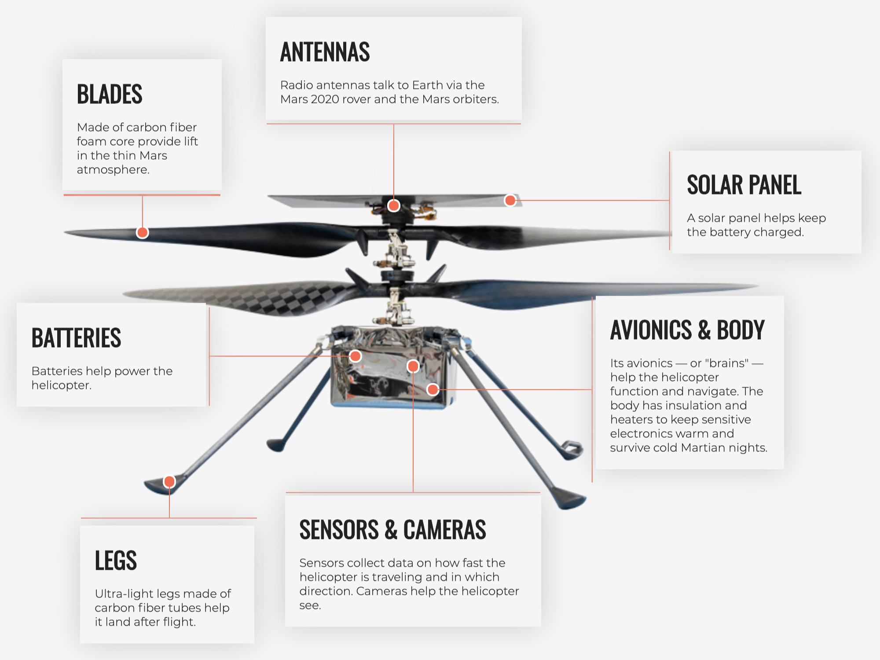
Any Other Business?

Slide 14
REFERENCE

Slide 15
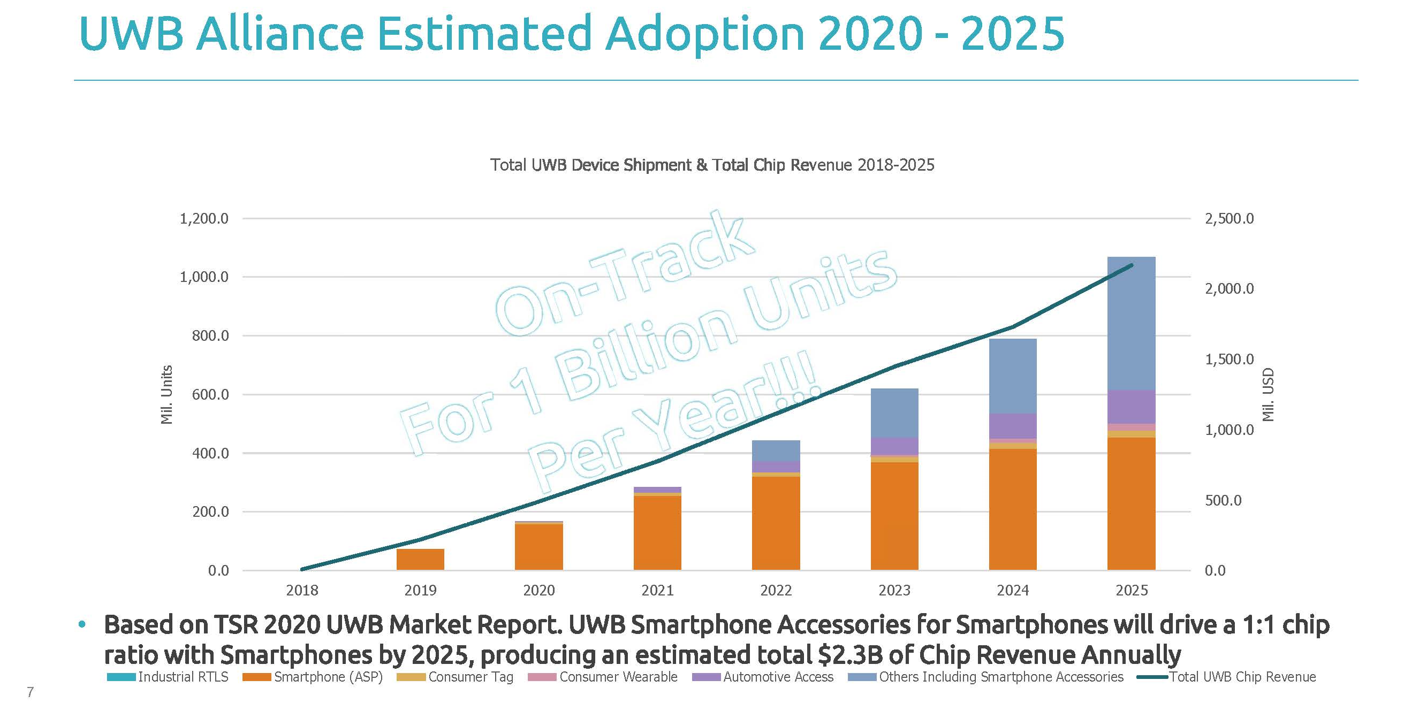
UWB Market Data
Presented to FCC in July 2020 from FCC filing
Ultra Wide Band (UWB) Alliance CORRECTED UWBA Comments FCC 6GHz FNPRM July 14 2020.pdf https://ecfsapi.fcc.gov/file/107142666226784/CORRECTED%20UWBA%20Comments%20FCC%206GHz%20FNPRM%20July%2014%202020.pdf

