Slide 1
Project: IEEE P802.15 Working Group for Wireless Personal Area Networks (WPANs)
Submission Title: SG14 Meeting Slides – May 2021 Meeting
Date Submitted: May 13, 2021
Source: Clint Powell (Facebook)
Contact: SAA
Voice: +1 480 586-8457, E-Mail: cpowell@ieee.org
Re: Study Group 14: NS-UWB
Abstract: Meeting Slides
Purpose: Working Slide Deck for May Mtg
Notice: This document has been prepared to assist the IEEE P802.15. It is offered as a basis for discussion and is not binding on the contributing individual(s) or organization(s). The material in this document is subject to change in form and content after further study. The contributor(s) reserve(s) the right to add, amend or withdraw material contained herein.
Release: The contributor acknowledges and accepts that this contribution becomes the property of IEEE and may be made publicly available by P802.15.
Notes:
Jul 12, 2010
Page 1

Slide 2
802.15 Study Group Meeting
Pre-PAR Activity Rules for Study Group
Voting: everyone present can vote
Please identify yourself with your name and affiliation when you first speak
Participation: is by individual

Slide 3
IEEE-SA Patent, Copyright, and Participation Policies
See: https://grouper.ieee.org/groups/802/sapolicies.shtml
IEEE-SA Patent Slides for Pre-PAR Meetings:
https://development.standards.ieee.org/myproject/Public/mytools/mob/preparslides.pdf
IEEE-SA Participation Slides for Pre-PAR Meetings:
https://standards.ieee.org/content/dam/ieee-standards/standards/web/documents/other/Participant-Behavior-Individual-Method.pdf
Copyright:
https://standards.ieee.org/content/dam/ieee-standards/standards/web/documents/other/ieee-sa-copyright-policy-2019.pdf

Slide 4
IEEE 802 Ground Rules
NO product pitches
NO corporate pitches
NO prices
NO restrictive notices:
e.g. confidential notices in email
Presentations must be openly available
Most important:
Please respect all participants

Slide 5
May 13th - 17th, 2021
Virtual Meeting

Slide 6
Proposed Agenda
SG14 Agenda - doc. # 15-21-0243-01-0014
https://mentor.ieee.org/802.15/documents?is_dcn=243&is_group=0014

Slide 7
Preliminary CSD and PAR
CSD
15-21-0278-00-0014-draft-csd-for-ns-uwb
https://mentor.ieee.org/802.15/documents?is_dcn=278&is_group=0014
PAR
15-21-0274-01-0014-ns-uwb-par-working-draft
https://mentor.ieee.org/802.15/documents?is_dcn=274&is_group=0014

Slide 8
Next Steps
Continue work as Study Group
Write PAR and CSD (May Interim)
Coordinate with SG14
Move PAR and CSD through 802 and SA Processes (May Interim?)
Determine proposed content for standard (ongoing)
Work via Interim telecons and virtual interim/plenary meetings

Slide 9
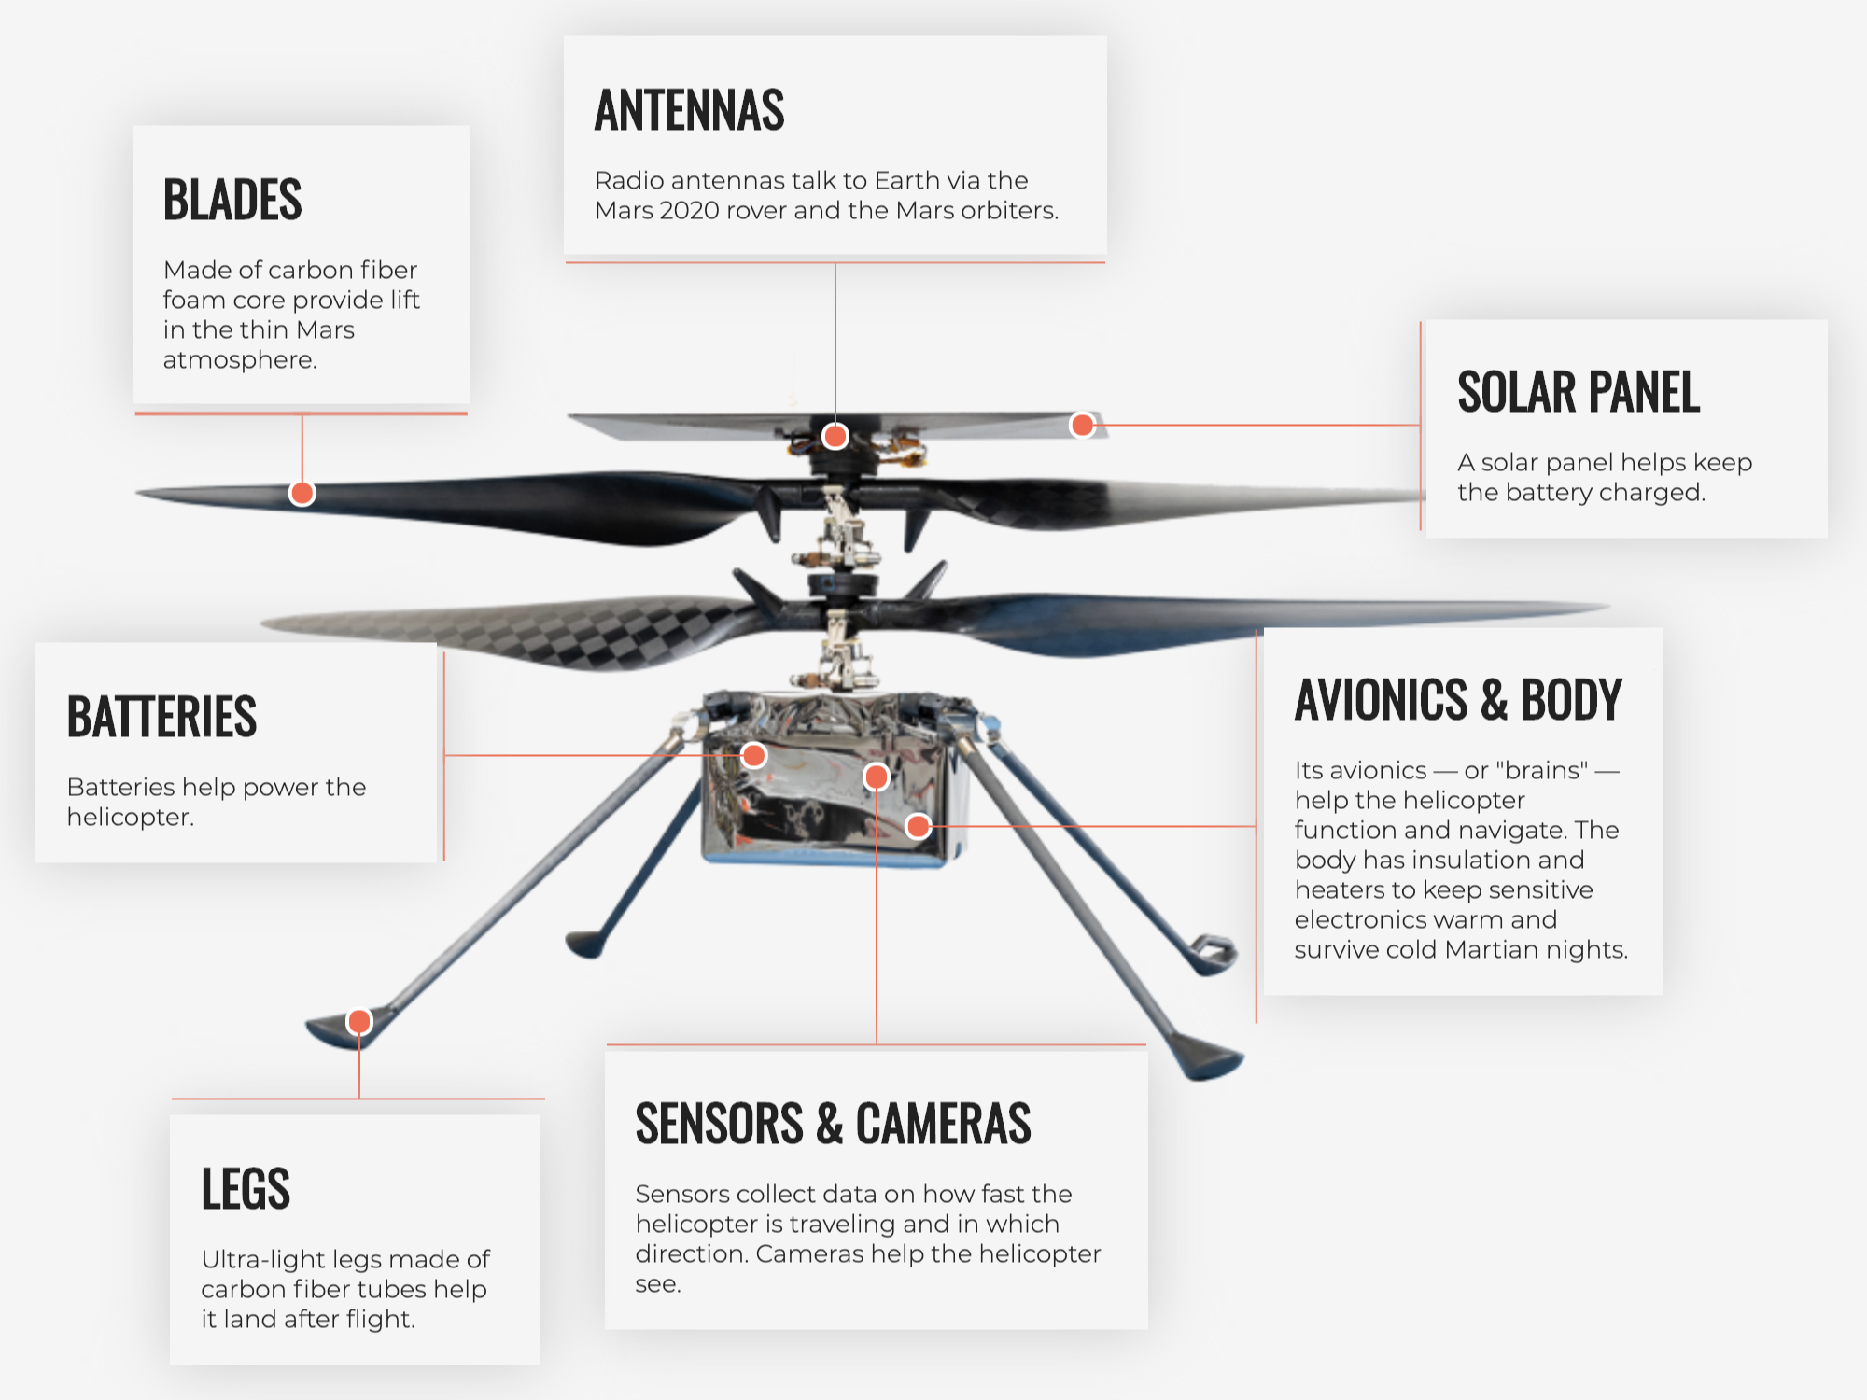
Any Other Business?

