Slide 1
Project: IEEE P802.15 Working Group for Wireless Personal Area Networks (WPANs)
Submission Title: 15.4ab Technical Guidance Framework
Date Submitted: May 11, 2021
Source: Benjamin A. Rolfe (Blind Creek Associates)
Contact:
Voice: +1 408 395 7207, E-Mail: ben.rolfe @ ieee.org
Re: Study Group 4ab: UWB Next Generation
Abstract: A Framework for the summarizing technical requirements and guidance for developing technical proposals.
Purpose: Assist in developing technical content
Notice: This document has been prepared to assist the IEEE P802.15. It is offered as a basis for discussion and is not binding on the contributing individual(s) or organization(s). The material in this document is subject to change in form and content after further study. The contributor(s) reserve(s) the right to add, amend or withdraw material contained herein.
Release: The contributor acknowledges and accepts that this contribution becomes the property of IEEE and may be made publicly available by P802.15.
Notes:
Jul 12, 2010
Page 1

Slide 2
Purpose of Technical Guidance Document
Aliases: Technical Characteristics Framework, Technical Requirements Document, System Requirements Document
Provides technical guidance for preparation of proposals.
The objective of this guidance is to provide technical recommendations for preparing and evaluating proposals, and should not be understood as mandatory requirements for the system design.
The intent is to use a flexible and efficient process that provides sufficient descriptions of the technical drivers to enable relevant responses, with efficiency of effort while meeting the critical need for a timely amendment.

Slide 3
General Guidance for 15.4ab Proposals
Must be within the scope of the PAR
Must coexist with existing HRP and LRP ERDEV implementations
Must provide compatibility with HRP and/or LRP ERDEVs
MAC additions directly related to
  PHY support
  ranging and localization related information exchange
  MAC functions to support ranging and localization control
  Sensing
  Data streaming
  Simplifications, corrections based on experience
  Mechanisms to enhance discovery and connection setup efficiently
May include additional coding, preamble and modulation schemes to support improved link budget and/or reduced air-time;
May include additional channels and operating frequencies;

Slide 4
General Guidance for 15.4ab Proposals
Other considerations
Consider cost and complexity of implementation
  Building upon the existing standard (know what is there)
  Building upon the existing ecosystem
  Consider the future
Consider application needs and differences in use case requirements
  Requirements may be different for different use cases e.g. capabilities exchange, knowledge of context.
  Some uses may not be exposed to legacy devices
  Some proposals may not apply to some use cases
Proposals should address how backward compatible is achieved
  Analysis or comparison of impacts on compatibility
  Trade-offs between coexistence/compatibility/functionality and cost/complexity
  How things are expected to change with time

Slide 5
General Guidance for 15.4ab Proposals
May include interference mitigation techniques to support higher density and higher traffic use cases;
May include improvements to accuracy / precision / reliability and interoperability for high-integrity ranging;
May include means to reduce complexity and power consumption;
May include definitions for tightly coupled hybrid operation with narrowband signaling to assist UWB;
May include sensing capabilities to support presence detection and environment mapping;
May include mechanisms supporting low-power low-latency streaming as well as high data-rate streaming
The task group does not expect a contribution to be all encompassing; ideally it will complement the current contributions as best known by the proposer. The group welcomes partial contributions that further the project objectives.
All contributions must comply with the IEEE patent and copyright policies

Slide 6
Coexistence and Compatibility
Operation of new version devices in the sphere of influence of legacy devices does not disrupt operation of legacy device (doesn’t break it)
  The behavior of a legacy device upon reception of the “new” signal/packet/frame is well define
  Ability to interoperate and/or cooperate with legacy ERDEVs
For 15.4ab, this means will not cause significant disruption to low duty-cycle ranging use cases.
Degrees of ‘compatible’, for example
  New signal not even detected by legacy devices,
  New signal demodulated and ignored
  New signal can be demodulated and understood, without the benefit of “new” features
Other coexistence considerations
  High density of UWB devices in same space and channel (legacy and new)
  Other non-UWB devices in the same space and channel (or same device)
Various ways to define “legacy”
  Can limit to subset of all things possible per the standard
  Focus on what is used or likely to be used
Proposals should consider and describe the level of compatibility and how coexistence is achieved.

Slide 7
Technical Characteristics Summary
Summarize what’s been presented so far for technical requirements
Discuss how to represent technical characteristics
  Table format
  Text/bullets
  Combination
[A few examples follow – work in progress]

Slide 8
Collected Requirements
Compatibility and coexistence
Greater flexibility for performance trade-offs (range/datarate/device density/etc)
More channels
Improved accuracy and resolution
Further enhancements for low-energy consumption
Broader application space
  Presence detection, motion tracking, environment detection, etc
Retain or improve upon robustness, integrity
  Ensure new features are robust
  Ensure new features are not harmful

Slide 9
Characteristics of Larger Industrial Scenarios
Scalability to a very large number of tags
  Number of tags can exceed 5,000
  Many anchors that may not be in radio SOI of each other
  Minimizing spectrum usage per device
Efficient resource uses
  Minimize transmissions
  Leveraging multiple communication mechanisms (out of band / different band for command and control)
Flexibility to support transmission scenarios and performance trade-offs
  Broadcast ranging (GPS like), Blinks, Two-way ranging
  Enable longer distance between devices or smaller interference footprint
Flexibility and adaptability to environment and varying application needs
  Scenario detection
  Detecting other users
  Rate and power adaptation
  Multi-mode operation
Mobility support
  Objects may move in large groups
  Efficient handover, discovery, synchronization
Coexistence requirements
  With potentially many UWB devices in the space and channel
  With other than UWB systems in the same space and channel
Reference: Document 15-21-0066
Reference: Document 15-21-0066

Slide 10
Characteristics for Low Latency Communication
Low latency == a few milliseconds
Must not monopolize the channel
  Ensure coexistence with ranging operations
  Provide sharing with many devices
  Include interference reduction and mitigation techniques
  Moderate duty cycle and activity factor
    Higher bit rate → lower duty cycle
Can be very short distances (moderate link budget)
Low energy consumption
Multiple topologies
  Peer to peer, , peer-to-multi-peer, and station-to-infrastructure
Cost sensitive
  Low cost and low complexity circa 2021
Reference: Document 15-21-0171

Slide 11
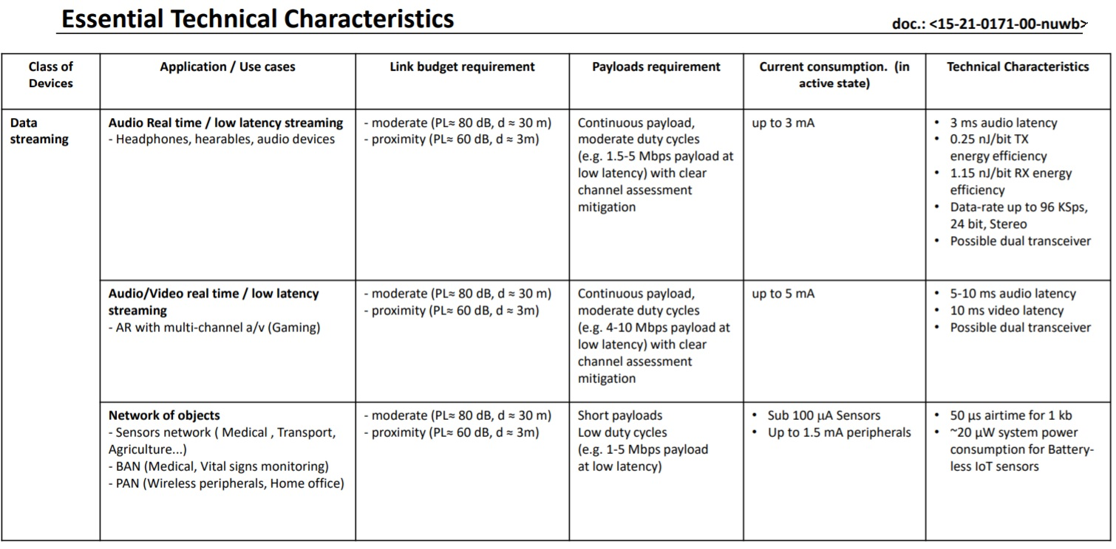
Characteristics for Low Latency Communication (Table view)
Reference:
Document 15-21-0171 and Document 15-21-0089

Slide 12
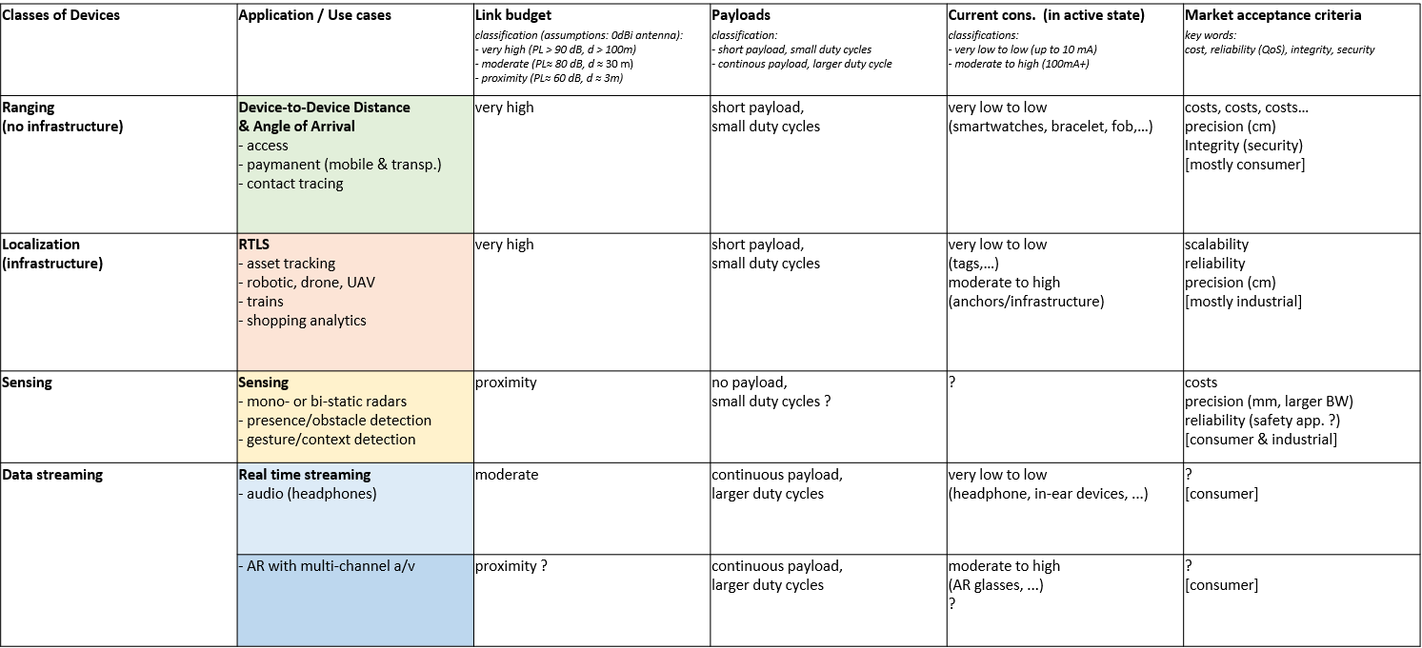
Example Table Form (15-21-0089)

