Slide 1
Project: IEEE P802.15 Working Group for Wireless Personal Area Networks (WPANs)
Submission Title: SG4ab Meeting Slides
Date Submitted: May 11, 2021
Source: Benjamin A. Rolfe (Blind Creek Associates)
Contact:
Voice: +1 408 395 7207, E-Mail: ben.rolfe @ ieee.org
Re: Study Group 4ab: UWB Next Generation
Abstract: May Interim Meeting Slides
Purpose: Achieve the illusion of organization and promote getting work done
Notice: This document has been prepared to assist the IEEE P802.15. It is offered as a basis for discussion and is not binding on the contributing individual(s) or organization(s). The material in this document is subject to change in form and content after further study. The contributor(s) reserve(s) the right to add, amend or withdraw material contained herein.
Release: The contributor acknowledges and accepts that this contribution becomes the property of IEEE and may be made publicly available by P802.15.
Notes:
Jul 12, 2010
Page 1

Slide 2
802.15.4ab Study Group Meeting
Pre-PAR Activity Rules
Study Group voting: everyone present can vote
Identify yourself and affiliation on first contact
Reminder: Individual Participation

Slide 3
IEEE-SA Patent, Copyright, and Participation Policies
See: https://grouper.ieee.org/groups/802/sapolicies.shtml
IEEE-SA Patent Slides for Pre-PAR Meetings:
https://development.standards.ieee.org/myproject/Public/mytools/mob/preparslides.pdf
IEEE-SA Participation Slides for Pre-PAR Meetings:
https://standards.ieee.org/content/dam/ieee-standards/standards/web/documents/other/Participant-Behavior-Individual-Method.pdf
Copyright:
https://standards.ieee.org/content/dam/ieee-standards/standards/web/documents/other/ieee-sa-copyright-policy-2019.pdf

Slide 4
IEEE 802 Ground Rules
Respect … give it, get it
NO product pitches
NO corporate pitches
NO prices
NO restrictive notices – (no confidentially notices in email)
Presentations must be openly available

Slide 5
May 12th through 18th, 2021
Virtual Meeting

Slide 6
Proposed Agenda
Agenda: Document 15-21-0250
131th IEEE 802.15 WSN MEETING VIA WEBEX Virtual Study Group 15.4ab - Next Generation UWB Summary of Schedule / Session Focus - SG15.4ab (NG-UWB) Times in Eastern Timezone (ET)
 |  | EST
Wednesday PM2: | Opening, Review, Technical Presentations | 3:00 PM
Thursday PM1: | Technical Presentations | 1:00 PM
Monday AM2 | Coordination with SGs (Joint w/15.14 & 15.15) | 11:00 AM
Monday PM2: | Technical Presentations, next steps, wrap-up | 3:00 PM
Call for new items

Slide 7
Meeting Goals
Review and reaffirm the proposed PAR and CSD.
Further consideration of technical requirements and characteristics
Produce technical characteristics document
Produce a call for contributions

Slide 8
Recap

Slide 9
Proposed PAR Scope
5.2.b Scope of the project: This amendment enhances the Ultra Wideband (UWB) physical layers (PHYs,) medium access control (MAC), and associated ranging techniques while retaining backward compatibility with enhanced ranging capable devices (ERDEVs). Areas of enhancement include: additional coding, preamble and modulation schemes to support improved link budget and/or reduced air-time; additional channels and operating frequencies; interference mitigation techniques to support higher density and higher traffic use cases; improvements to accuracy / precision / reliability and interoperability for high-integrity ranging; schemes to reduce complexity and power consumption; definitions for tightly coupled hybrid operation with narrowband signaling to assist UWB; enhanced native discovery and connection setup mechanisms; sensing capabilities to support presence detection and environment mapping; and mechanisms supporting low-power low-latency streaming as well as high data-rate streaming allowing at least 50 Mbit/s of throughput. Support for peer-to-peer, peer-to-multi-peer, and station-to-infrastructure protocols are in scope, as are infrastructure synchronization mechanisms. This amendment includes safeguards so that the high throughput data use cases will not cause significant disruption to low duty-cycle ranging use cases.

Slide 10
What we Accomplished in March
PAR
Reached consensus on PAR Scope
Completed PAR Drafting
Approved draft PAR document in subgroup
Approved draft PAR at Working Group
Document: 15-21-0126-01
CSD
Reached consensus on project definition, need for the project, benefits and goals statements
Completed CSD Drafting
Approved draft CSD document in subgroup
Approved draft CSD at Working Group
Document: 15-21-0047-05

Slide 11
Next Steps from March
Continue work as Study Group
Continue to dig into use cases and technical requirements
Hear and discuss technical presentations
Consider technical contributions
Develop recommendations for technical framework
Move PAR and CSD through 802 and SA Processes
Work via Interim telecons and virtual interim/plenary meetings

Slide 12
PAR and CSD Review
WG Chair requested Affirmation from SG
Work completed in IG (allowed per rule)
Approved by WG in March (also OK)
SG approved by EC in March (so here we are)
To avoid another thing to explain, have SG affirm and WG affirm prior to submitting to EC
Review
Document: 15-21-0126-01
Document: 15-21-0047-05
Motion to affirm

Slide 13
Study Group Motion
SG Motion: Request that the PAR and CSD contained in documents [15-21-0126-01] and [15-21-0047-05], respectively, be approved for submission to the WG for its approval and that the EC be requested to forward the PAR to NesCom
Moved:
Second:
Discussion:
Result:

Slide 14
Working Group Motion
WG Motion: Request that the PAR and CSD contained in documents [15-21-0126-01] and [15-21-0047-05], respectively, be approved for submission to the WG for its approval and that the EC be requested to forward the PAR to NesCom. The 802.15 working group chair and technical editor are authorized to make additional modifications to the PAR and CSD as needed to reflect EC discussion at its closing meeting.
Moved: Benjamin Rolfe
Second: Clint Powell

Slide 15
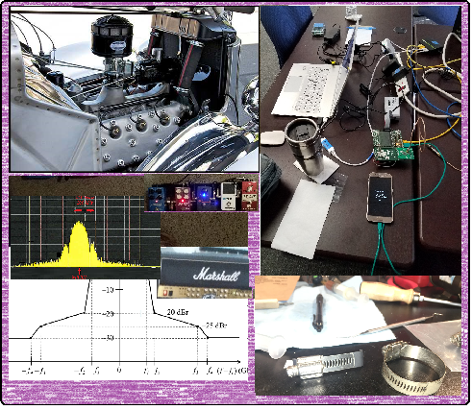
Technical Contributions

Slide 16
Contributions
15.4ab Technical Guidance Framework | https://mentor.ieee.org/802.15/dcn/21/15-21-0268-00-04ab-15-4ab-technical-guidance-framework.pptx
UWB for data streaming use cases - suitable features overview | https://mentor.ieee.org/802.15/dcn/21/15-21-0277-00-nuwb-uwb-for-data-streaming-use-cases-suitable-features-overview.pdf
Some UAS Use Cases for UWB | https://mentor.ieee.org/802.15/dcn/21/15-21-0272-00-04ab-some-uas-use-cases-for-uwb.pptx
Receiver Requirements for Realistic Interference Scenarios | https://mentor.ieee.org/802.15/dcn/21/15-21-0276-00-04ab-receiver-requirements-for-realistic-interference-scenarios.pptx
Objectives Checklist Table | https://mentor.ieee.org/802.15/dcn/21/15-21-0280-00-04ab-objectives-checklist-table.docx
Coupling between NB and UWB | https://mentor.ieee.org/802.15/dcn/21/15-21-0289-00-04ab-coupling-between-nb-and-uwb.pptx

Slide 17
Call for Contributions Work
Technical Guidance Document
Contributions can include further technical considerations, requirements and other guidance to propose
General contribution guidelines
Contribution schedule
Other discussion on contributions

Slide 18
Call for Contributions
Study Group 15.4ab requests technical contributions to further the development of recommendations for technical content of the proposed amendment. Contribution guidance is provided in the Technical Guidance Document (TGD), DCN #15-21-0297 (https://mentor.ieee.org/802.15/dcn/21/15-21-0297-01-04ab-15-4ab-technical-guidance-doc.docx)
Contributions may include but are not limited to the areas covered in the draft Project Authorization Request (PAR) and the TGD. Contributions may include further technical considerations, use case descriptions and requirements and background information supporting development of the amendment.
Contributions on analysis of coexistence and proposed methods to enhance coexistence are strongly encouraged.
Schedule: [see teleconference schedule, now through end of July meeting]

Slide 19
Next Steps

Slide 20
Next Steps
EC Process
Submit for review
Comments received and resolved in July
Call for Contributions
Post following this meeting
Technical guidance document
Refine on teleconferences?
Plan teleconferences
Prepare for July meeting

Slide 21
Teleconference Schedule Discussion
Pick a frequency and phase (how often, day+time)
Previously: Bi-weekly on Tuesday at 10:00 ET (07:00 PT)
Duration 1 hour.
Following this pattern Would look like:
We are Here
Week | Time (ET)
Now: | [May Interim]
June 1 | 10:00 ET
June 15 | 10:00 ET
June 29 | 10:00 ET
July 13: | July Plenary
NEXT?

Slide 22
Other Business

Slide 23
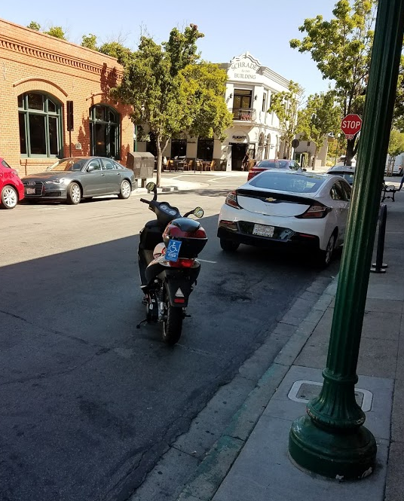
Adjourned Thanks

