Slide 1
Project: IEEE P802.15 Working Group for Wireless Personal Area Networks (WPANs)
Submission Title: May Interim SG15 Agenda and Meeting Slides
Date Submitted: May 18, 2021
Source: Phil Beecher (Wi-SUN Alliance)
Contact:
Voice: +44 1273 422275, E-Mail: pbeecher @ wi-sun.org
Re: Study Group 15: NS-NB 802.15.4 Ad–hoc Wireless Networks
Abstract: Agenda and Meeting Slides
Purpose: Achieve the illusion of organization for the ad-hoc meeting
Notice: This document has been prepared to assist the IEEE P802.15. It is offered as a basis for discussion and is not binding on the contributing individual(s) or organization(s). The material in this document is subject to change in form and content after further study. The contributor(s) reserve(s) the right to add, amend or withdraw material contained herein.
Release: The contributor acknowledges and accepts that this contribution becomes the property of IEEE and may be made publicly available by P802.15.
Notes:
Jul 12, 2010
Page 1

Slide 2
802.15 Study Group Meeting
Pre-PAR Activity Rules for Study Group
Voting: everyone present can vote
Please identify yourself with your name and affiliation when you first speak
Participation: is by individual

Slide 3
IEEE-SA Patent, Copyright, and Participation Policies
See: https://grouper.ieee.org/groups/802/sapolicies.shtml
IEEE-SA Patent Slides for Pre-PAR Meetings:
https://development.standards.ieee.org/myproject/Public/mytools/mob/preparslides.pdf
IEEE-SA Participation Slides for Pre-PAR Meetings:
https://standards.ieee.org/content/dam/ieee-standards/standards/web/documents/other/Participant-Behavior-Individual-Method.pdf
Copyright:
https://standards.ieee.org/content/dam/ieee-standards/standards/web/documents/other/ieee-sa-copyright-policy-2019.pdf

Slide 4
IEEE 802 Ground Rules
NO product pitches
NO corporate pitches
NO prices
NO restrictive notices –
(eg no “confidential” notices in email)
Presentations must be openly available
Please respect all participants

Slide 5
May 11-19, 2021
May Interim Meeting

Slide 6
Agenda
Opening and meeting preamble ✓
Approve Conference call minutes – 0210-02 ✓
Review PAR and CSD ⬅
Approval of PAR and CSD
Review updated PICS:
15-21-0284-00-0015-pics-for-ns-nb-discussion.pptx – Don Sturek
Next Steps
Any other Business

Slide 7
May Interim – SG15 Agenda
SG15 Agenda Focus:
Work on PAR and CSD ready for WG Ballot
SG14, SG15, SG4ab Agenda Focus:
Review of SG14 and SG15 PAR and CSD ready for WG Ballot

Slide 8
PAR and CSD
SG15 PAR and CSD
PAR
15-21-0265-03-0015-sg15-ns-nb-par-working-draft.docx
CSD
15-21-0301-00-0015-sg15-draft-csd-for-ns-nb.docx

Slide 9
SG15 Motion
Study Group approval of PAR and CSD
Motion:
Request that the PAR and CSD contained in documents [15-21-0265-03-0015-sg15-ns-nb-par-working-draft.docx] and [15-21-0301-00-0015-sg15-draft-csd-for-ns-nb.docx], respectively, be approved for submission to the WG for its approval and that the EC be requested to forward the PAR to NesCom
Moved:
Second:

Slide 10
WG Motions
Study Group extension
Motion:
Move that the 802.15 Working Group seeks approval from the 802 EC to extend the study group in 802.15 to develop the PAR and CSD documents for “SG15 NS-NB”
Moved: Phil Beecher (Wi-SUN Alliance)
Second:
WG approval of PAR and CSD
Motion:
Move that the PAR and CSD contained in documents 15-21-0265-03-0015-sg15-ns-nb-par-working-draft.docx] and [15-21-0301-00-0015-sg15-draft-csd-for-ns-nb.docx], respectively, be approved by the IEEE 802.15 WG and that the EC be requested to forward the PAR to NesCom. The 802.15 working group chair and technical editor are authorized to make additional modifications to the PAR and CSD as needed to reflect EC discussion at its closing meeting.
Moved: Phil Beecher (Wi-SUN Alliance)
Second: (not required)

Slide 11
Next Steps
Continue work as Study Group
Resolve comments received for PAR and CSD
Coordinate with SG14
Determine proposed content for standard (ongoing)
Work via telecons (Mondays at 7am PDT) and virtual interim / plenary sessions

Slide 12
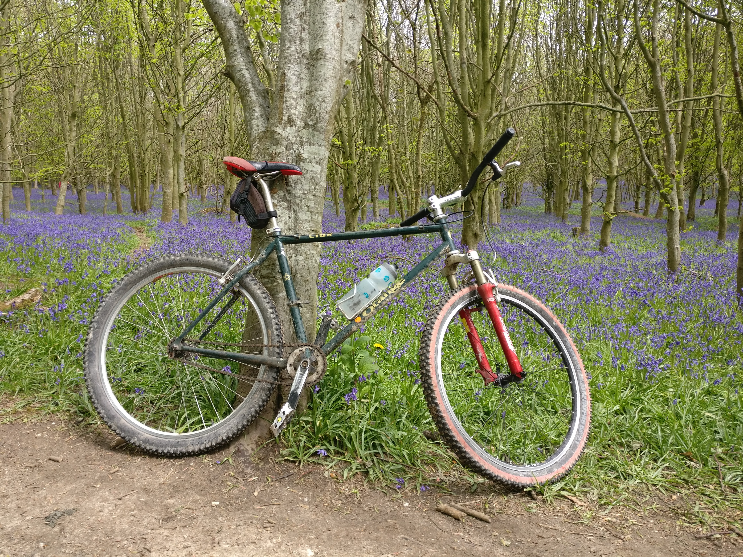
Any Other Business?

Slide 13
Thanks to everyone for your participation and contributions Motion to adjourn?

