Slide 1
Project: IEEE P802.15 Working Group for Wireless Personal Area Networks (WPANs)
Submission Title: May Interim SG15 Agenda and Meeting Slides
Date Submitted: May 11, 2021
Source: Phil Beecher (Wi-SUN Alliance)
Contact:
Voice: +44 1273 422275, E-Mail: pbeecher @ wi-sun.org
Re: Study Group 15: NS-NB 802.15.4 “Narrow Band”
Abstract: Agenda and Meeting Slides
Purpose: Achieve the illusion of organization for the ad-hoc meeting
Notice: This document has been prepared to assist the IEEE P802.15. It is offered as a basis for discussion and is not binding on the contributing individual(s) or organization(s). The material in this document is subject to change in form and content after further study. The contributor(s) reserve(s) the right to add, amend or withdraw material contained herein.
Release: The contributor acknowledges and accepts that this contribution becomes the property of IEEE and may be made publicly available by P802.15.
Notes:
Jul 12, 2010
Page 1

Slide 2
802.15 Study Group Meeting
Pre-PAR Activity Rules for Study Group
Voting: everyone present can vote
Please identify yourself with your name and affiliation when you first speak
Participation: is by individual

Slide 3
IEEE-SA Patent, Copyright, and Participation Policies
See: https://grouper.ieee.org/groups/802/sapolicies.shtml
IEEE-SA Patent Slides for Pre-PAR Meetings:
https://development.standards.ieee.org/myproject/Public/mytools/mob/preparslides.pdf
IEEE-SA Participation Slides for Pre-PAR Meetings:
https://standards.ieee.org/content/dam/ieee-standards/standards/web/documents/other/Participant-Behavior-Individual-Method.pdf
Copyright:
https://standards.ieee.org/content/dam/ieee-standards/standards/web/documents/other/ieee-sa-copyright-policy-2019.pdf

Slide 4
IEEE 802 Ground Rules
NO product pitches
NO corporate pitches
NO prices
NO restrictive notices –
(eg no “confidential” notices in email)
Presentations must be openly available
Please respect all participants

Slide 5
May 11-19, 2021
May Interim Meeting

Slide 6
Proposed Agenda
Opening and meeting preamble
Approve Conference call minutes – 0210-02
Review PAR and CSD
Approval of PAR and CSD
Next Steps
Any other Business
Previous minutes:
https://mentor.ieee.org/802.15/dcn/21/15-21-0210-02-0015-sg15-conference-call-minutes.docx

Slide 7
May Interim – SG15 Agenda
SG15 Agenda Focus:
Work on PAR and CSD ready for WG Ballot
SG14, SG15, SG4ab Agenda Focus:
Review of SG14 and SG15 PAR and CSD ready for WG Ballot

Slide 8
CSD and PICS
For review:
SG14 PAR and CSD
https://mentor.ieee.org/802.15/dcn/21/15-21-0274-03-0014-sg14-ns-uwb-par-working-draft.docx
https://mentor.ieee.org/802.15/dcn/21/15-21-0278-02-0014-sg14-draft-csd-for-ns-uwb.docx
SG15 PAR and CSD
https://mentor.ieee.org/802.15/dcn/21/15-21-0265-02-0015-sg15-ns-nb-par-working-draft.docx
https://mentor.ieee.org/802.15/dcn/21/15-21-0220-00-0015-draft-csd-for-ns-nb-ns-uwb.docx – needs updating
Send any comments / questions to cpowell@ieee.org, pbeecher@wi-sun.org

Slide 9
802.15.4 PAR (for reference)
802.15.4-2020 Standard: https://standards.ieee.org/standard/802_15_4-2020.html
Approved PAR:
https://development.standards.ieee.org/myproject-web/public/view.html#pardetail/6076

Slide 10
Next Steps
Continue work as Study Group
Write PAR and CSD (May Interim)
Coordinate with SG14
Move PAR and CSD through 802 and SA Processes (May Interim?)
Determine proposed content for standard (ongoing)
Work via Interim telecons and virtual interim/plenary meetings

Slide 11
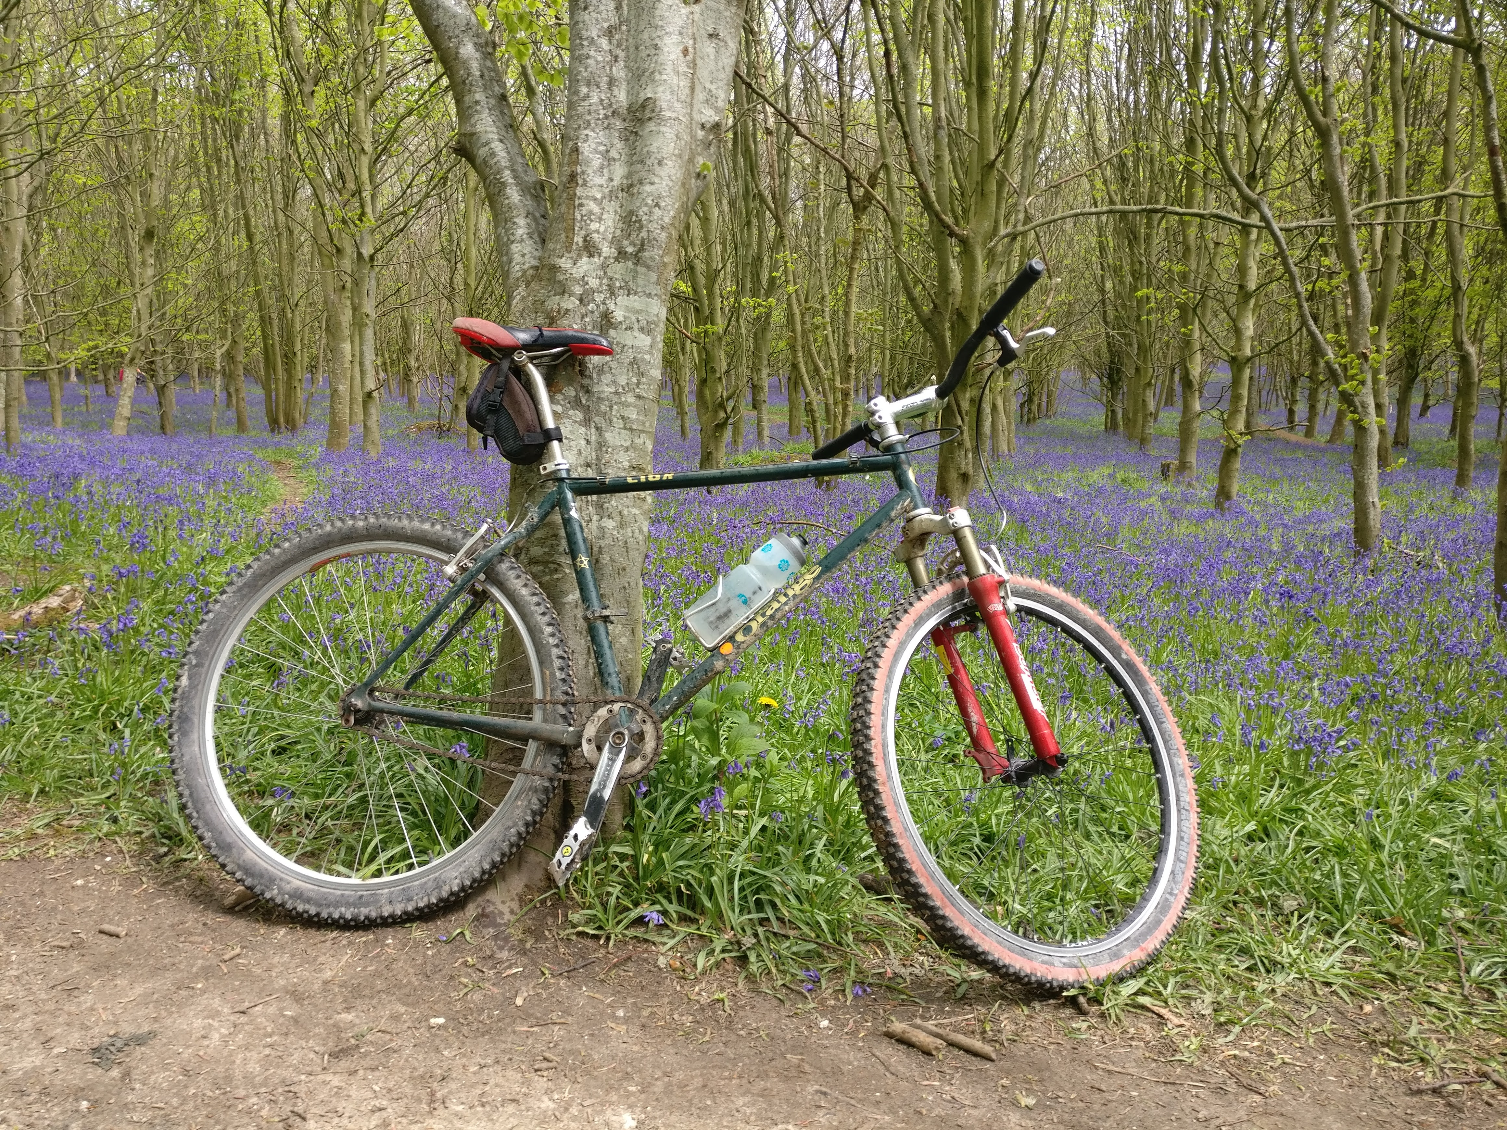
Any Other Business?

Slide 12
Adjourned Thanks

