Slide 1
Project: IEEE P802.15 Working Group for Wireless Specialty Networks
Submission Title: Introducing TSN concepts to IEEE 802.15.6 BAN with Enhanced Dependability
Date Submitted: May 11th, 2021
Source: Minsoo Kim, Takumi Kobayashi, Marco Hernandez, Ryuji Kohno
Company: (1)Yokohama National University (2) YRP International Alliance Institute
Address: (1)79-5 Tokiwadai, Hodogaya-ku, Yokohama, 240-8501 Japan,
(2) YRP1 Blg., 3-4 HikarinoOka, Yokosuka-City, Kanagawa, 239-0847 Japan
Voice:[+81-90-5408-0611] E-Mail:[minsoo@minsookim.com, kobayashi-takumi-ch@ynu.ac.jp, marco.hernandez@ieee.org, kohno@ynu.ac.jp]
Re: In response to call for technical contributions
Abstract: Major 802.15.6 BAN use cases include medical, automobile, and industrial application, so low latency, reliability, and dependability are import factors for BAN. We are trying to consider about how to introduce TSN concepts in 802.1, while covering only PHY and MAC.
Purpose: Material for discussion in P802.15.6a SG
Notice: This document has been prepared to assist the IEEE P802.15. It is offered as a basis for discussion and is not binding on the contributing individual(s) or organization(s). The material in this document is subject to change in form and content after further study. The contributor(s) reserve(s) the right to add, amend or withdraw material contained herein.
Release: The contributor acknowledges and accepts that this contribution becomes the property of IEEE and may be made publicly available by P802.15.

Slide 2
Introduction
Major use cases of 802.15.6 Wireless Body Area Networks (BAN) include medical, automobile, and industrial applications.
Concepts of 802.1 Time-Sensitive Networking (TSN), such as low latency and reliability, are also important for BAN.
Most of 802.1 TSN applications are for wired networks.
We present some potential ideas of using TSN concepts in wireless networks, especially for Human-BAN and Vehicle-BAN.

Slide 3
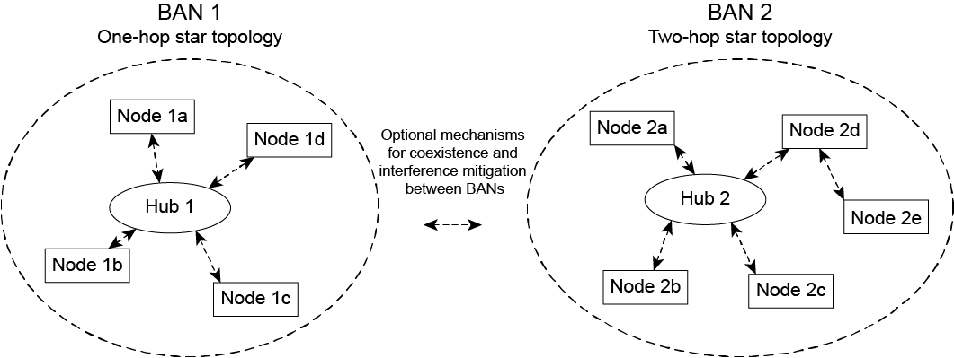
802.15.6-2012 network topology
One-hop star topology
Two-hop star topology extension except in the Medical Implant Communications Service (MICS) band
Optional mechanisms for coexistence and interference mitigation between BANs.

Slide 4
802.15.6-2012 reference model
Physical (PHY) layer
Narrowband, ultra-wideband, and human body communication
Medium access control (MAC) sublayer
Common for 3 PHYs
Contention-free and contention-based Hybrid MAC
Contention-free access based on polling
Contention-based access based on listen-before-talk
QoS support based on user priority
802.15.6 covers only PHY and MAC.
(Network Layer is not covered.)

Slide 5
802.15.6-2012 superframe in beacon mode
In modes with superframes, the time axis is divided into superframes (beacon periods) of equal length.
A superframe in beacon mode consists of access phases.
Exclusive access phase (EAP), random access phases (RAP), managed access phases (MAP), and contention access phase (CAP).
We intend to simplify the superframe structure by the amendment, while maintaining backward compatibility as
Simplified superframe from the amendment (mandatory)
Current 802.15.6-2012 superframe (optional, for backward compatibility)
Concept of Scheduled Traffic (802.1Qbv) may be introduced into MAPs or into a new proposal.

Slide 6
802.15.6-2012 access phases
Exclusive access phase (EAP)
Contention access, but restricted to the highest user priority (UP) traffics (emergency or medical implant event report).
Random access phase (RAP)
Contention access.
Managed access phase (MAP)
Improvised access, scheduled access, and unscheduled access.
Contention access phase (CAP)
Contention access.
To accommodate CSMA, Slotted Aloha, Polling and Listen-Before-Talk

Slide 7
802.15.6-2012 access modes
Beacon mode with superframes
Non-beacon mode with superframes
Only managed access phase (MAP) exists on superframe in non-beacon mode.
Non-beacon mode without superframes

Slide 8
802.15.6-2012 Priority Mapping
Priority | User priority | Traffic designation
Lowest | 1 | Background (BK) | Based on some traffic types defined in IEEE Std 802.1D™-2004
 | 2 | Best effort (BE)
 | 2 | Excellent effort (EE)
 | 3 | Video (VI)
 | 4 | Voice (VO)
 | 5 | Medical data or network control (e.g., body temperature)
 | 6 | High-priority medical data or network control (e.g., electrocardiogram (ECG), oxygen saturation (SpO2))
Highest | 7 | Emergency or medical implant event report (e.g., heart attack, respiratory failure)
A frame has priority according to its application.
Note: the term “user priority” in 802.15.6-2012 may be misleading since a single person may use multiple nodes. Moreover, a single node may be equipped with multiple sensors with different priorities. So, we suggest using “application priority”.
We would like to focus more on medical application in the amendment.
E.g., categorization of medical services, classification of priority levels

Slide 9
BAN coordinator
Like 802.1 has MAC bridge which connects two separate networks, 802.15.6 has BAN coordinator (hub).
A coordinator connects to nodes in its own network.
Not only same nodes operate on the same PHY, but also different PHYs.
The amendment may enable a coordinator to connect to other coordinators, to avoid interference and enhance dependability.
Unlike wired network, wireless network shares same medium and collision occurs which plays significant role in dependability.

Slide 10
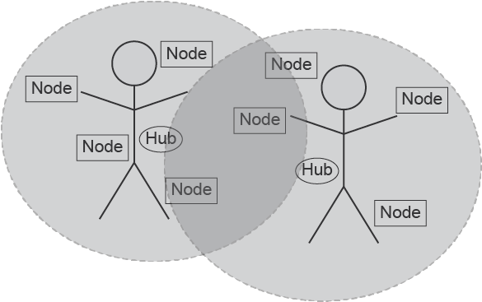
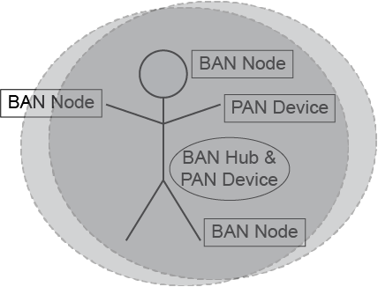
Interference among BANs or BAN and other systems
There would be cases where BANs or BAN and other networks are spatially collapsed.
Case 1: BANs, using same frequency bands
Case 2: BAN and PAN, using same frequency bands

Slide 11
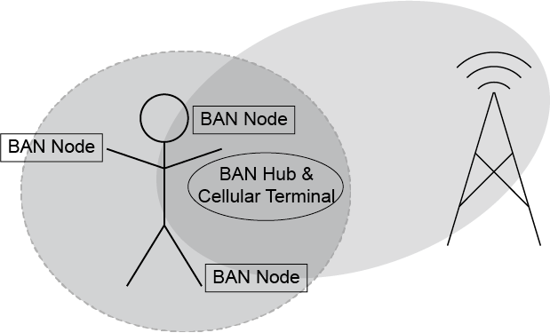
Interference among BANs or BAN and other systems (cont.)
Case 3: BAN and other piconets such as cellular network or Wi-Fi, some part of their frequency bands are overlapped.
Case 4: Case 1 to 3 combined
The concept of 802.1 MAC Bridge can be extended to enhance dependability.
The coordinator can manage interference or packet collision among same or different BANs (VBAN and/or HBAN), PANs, and other piconets.

Slide 12
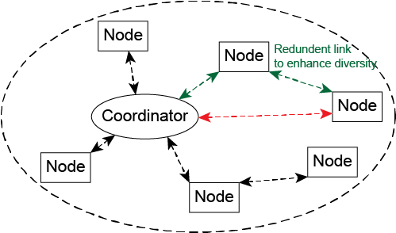
Two-hop star topology extension
Star topology + one hop (current std.)
Since there is no Line-of-Sight link between back and front of a human body, as well as a vehicular body
Star topology + multiple hops (may be introduced in the amendment)
TSN concept may be applicable.
Frame Replication and Elimination (802.1CB)
When the amendment introduces using more than 2 relay nodes simultaneously.
Link Control (802.1Qca)
Note: The relaying described in this slide operates on MAC layer, though corresponding 802.1 Stds define routing in the network layer.

Slide 13
Summary
MAC bridge concept of 802.1 TSN is useful for contention-avoidance(management?) among the multiple BANs and PANs to enhance the dependability as amendment of the original 802.15.6-2012.
We may extend the star plus 1-hop topology to star plus 2-hops, to guarantee dependable connectivity.
We intend to simplify the contention-free/contention-based hybrid MAC of the original 15.6-2012 for feasible implementations with enhanced dependability.
Priority management in original 15.6-2012 could be re-defined in HBAN and newly defined in VBAN for enhanced dependability.

