Slide 1
Project: IEEE P802.15 Working Group for Wireless Specialty Networks
Submission Title: SG15.6a Channel and Environmental Models Including EMC/EMI of Human and Vehicle Body Area Networks(HBAN and VBAN)
Date Submitted: May 11th, 2021
Source: Takumi Kobayashi, Minsoo Kim, Marco Hernandez, Ryuji Kohno
Company: (1)Yokohama National University (2) YRP International Alliance Institute
Address: (1)79-5 Tokiwadai, Hodogaya-ku, Yokohama, 240-8501 Japan,
(2) YRP1 Blg., 3-4 HikarinoOka, Yokosuka-City, Kanagawa, 239-0847 Japan
Voice:[+81-90-5408-0611] E-Mail:[minsoo@minsookim.com, kobayashi-takumi-ch@ynu.ac.jp, marco.hernandez@ieee.org, kohno@ynu.ac.jp, Kohno@yrp-iai.jp]
Re: In response to call for technical contributions
Abstract: This provides how channel and environmental model should be defined and developed for human body area network(HBAN) and vehicle body area network(VBAN) for amendment of IEEE802.15.6-2012 for wireless medical body area network(BAN) with enhanced dependability.
Purpose: Material for discussion in P802.15.6a SG corresponding to comments in EC Meeting
Notice: This document has been prepared to assist the IEEE P802.15. It is offered as a basis for discussion and is not binding on the contributing individual(s) or organization(s). The material in this document is subject to change in form and content after further study. The contributor(s) reserve(s) the right to add, amend or withdraw material contained herein.
Release: The contributor acknowledges and accepts that this contribution becomes the property of IEEE and may be made publicly available by P802.15.

Slide 2
SG15.6a Channel and Environmental Models of Human and Vehicle Body Area Networks (HBAN and VBAN)Including EMC/EMI Issues
Takumi Kobayashi
(YNU/YRP-IAI)

Slide 3
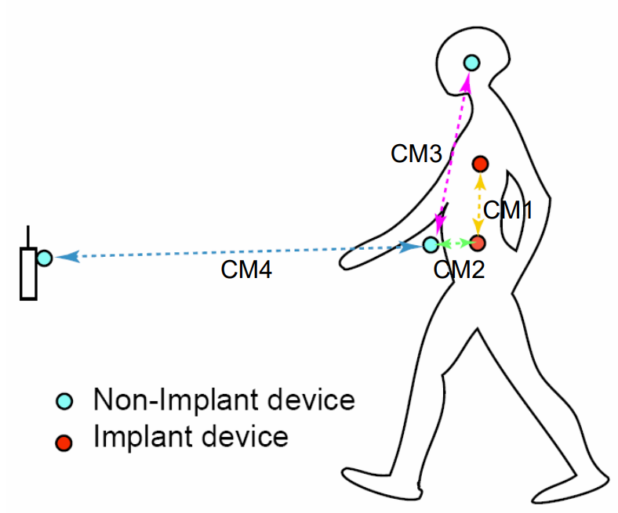
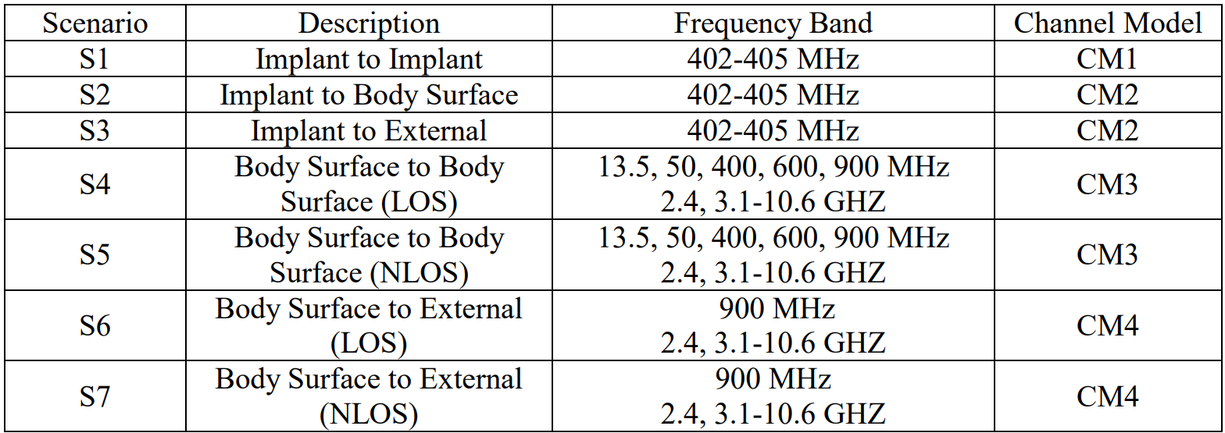
Channel models and scenarios in IEEE802.15.6-2012
IEEE P802.15-08-0780-12-0006-TG6
IEEE 802.15.6-2012 channel models considered
Fading ( Small scale/ large scale)
Path loss
Shadowing
Power delay profile
In-body (implant)
On-body (body surface)
CM1, 2, 3, 4
Scenario 1, to Scenario 7. (S1 – S7)

Slide 4
Classification of Channel and Environment Models for Human and Vehicle Body Area Networks (HBAN&VBAN)
Channel model
※Covered by
IEEE 802.15.6-2012
HBAN model
In-body (Implant)
※
On-body
※
Around body
Outdoor
※Around meaning;
Desk, WiFi AP in the room etc.
Channel model
With environment
※not covered yet
Indoor
※
Home
Office
※
Medical (e.g. Hospital)
※
VBAN model
In-vehicle
Engine room
Cabin
Note:
HBAN-model:
-Environment with co-existing systems is not considered.
VBAN model:
Key-less entry system
Localization in-body, on-body
Most dominant model should be defined and separatory defined as Mandatory and Optional.
※mandatory
Through engine room and cabin
On-vehicle
Roof
Around vehicle
Side Right/Left/Front/back
※mandatory
Bottom
Static vehicle
※mandatory
Moving vehicle

Slide 5
Channel and Environmental Models
Environment model
※will be defined in this amendment
Channel model
Environment model
Channel model
Path loss
Reflection
Multipath
Fading
LOS / NLOS model
White Gaussian noise
Interference from co-existing wireless systems
e.g. Bluetooth, IEEE 802.11, IEEE 802.15.4 etc.
Interference from the other BANs.
Interference from the other electric systems, devices and components (Electro-magnetic interference; EMI from electric motors, spark plugs in vehicles, etc.
Electro-magnetic compatibility; EMC. Possibility to affect to the other systems and human body.
VBAN ⬄ HBAN interference
VBAN and HBAN ⬄ Vehicle control and human body impacts.
Colored noise (Impulse noise, spike noise, ignition noise etc.)
Time-varying channel and interference modeling (Statistic, non-static, pseudo static model)
※IEEE802.15.6-2012
Other wireless systems
EMI EMC
Colored noise
Time-varying modeling
※mandatory
※optional
※mandatory
※mandatory
※optional
※optional
※mandatory
※optional

Slide 6
Various Interference in Coexistence
＊ IEEE 802.11a (wi-fi) （5GHz） overlaps
UWB-WBAN
IEEE 802.15.6
User “B”
Other BAN
Other UWB system.
e.g. IEEE 802.15.4-2020
IEEE 802.15.4z
Other UWB-BAN
user ？
interference
user ？
Other NB-BAN
interference
User “A”.
A wants to connect to “B”.
user ？
Inter-user interference
“IUI”
Inter-system interference
Inter-BAN interference
“IBI?”
“ISI”
Interference from a system using
the same standard.
Interference from a system using
overlapped frequency
VBAN ⬄ HBAN interference
Unknown signal.
EMI / EMC issues
Known signal.
Pre-knowledge can be used to mitigation

Slide 7
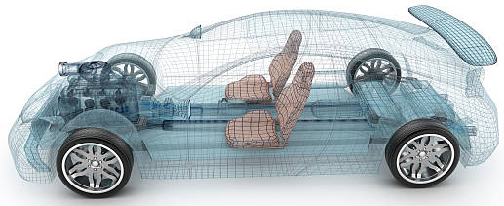
Environment Model in Vehicle
Engine room environment model
Engine diagnostic sensor and controller
Air pressure sensor, wheel health sensor and controller
Transmission monitoring sensor and controller
Cabin environment sensor (temperature, brightness, humidity etc.)
Sheet sensor, health care sensors for driver
Sheet sensor, health care sensors for passenger
Cabin room environment model
Note:
Various type of car/vehicles
Bus, Bulldozer, Heavy construction equipment needed each different sensors.
4
2
5
1
3
6
https://media.istockphoto.com/photos/transparent-car-design-wire-model3d-illustration-my-own-car-design-picture-id594040008?k=6&m=594040008&s=612x612&w=0&h=XE8LiBjpM51aB4pH2CFt6-MT6IvALRPnlxPcac0RXhg=

Slide 8
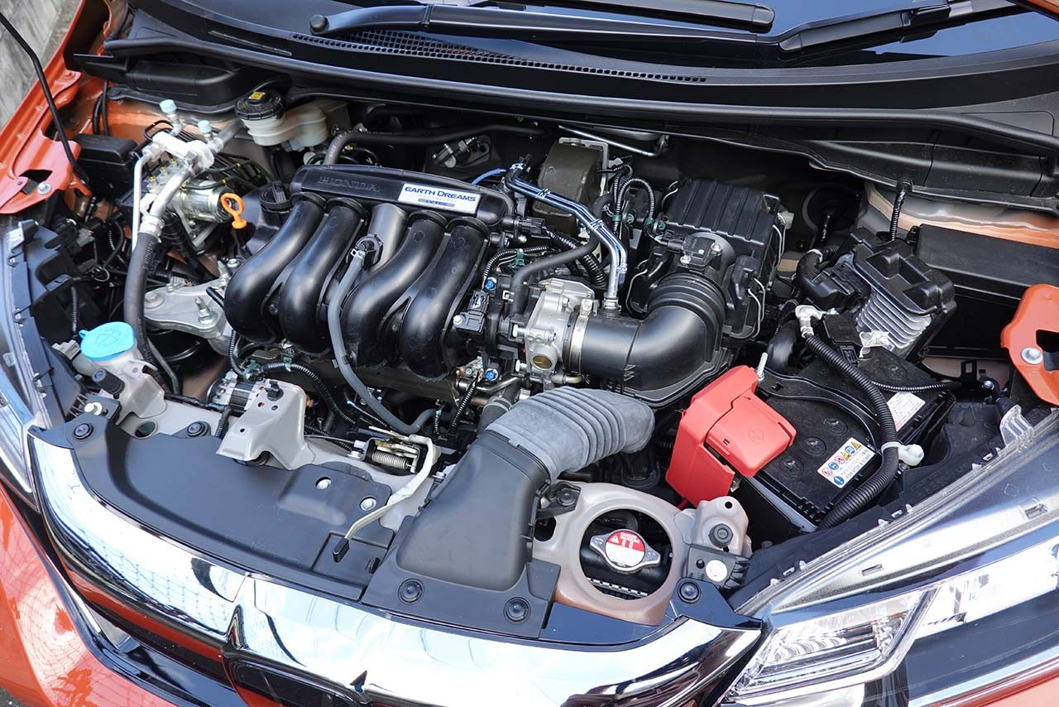
Engine Room Environment
Many metallic components
Components existing in densely
Ignition noise, motor noise
Larger path-loss than free propagation
A lot of reflection of RF signal
Electro-magnetic interference, EMIC issues
Especially EV
https://www.as-web.jp/car/575374/attachment/03a_sub_dsc01273
Dense situation
Ignition coil
Spark plug
Electric generator
Electric motor
High current battery and cable
Please add electric and hybrid vehicles

Slide 9
Cabin Room Environment
A lot of metallic components
Human being moves in the cabin room
Ignition noise, motor noise
Larger path-loss than free propagation
Human body absolve RF energy. Dynamic path loss issue and safety issue for passengers should be considered.
Even smaller effect than engine room environment, electro-magnetic interference should be considered.
Note:
Noise and interference through the glass windows cannot be ignored.
Interference from BT/WiFi/ cellular / ETC (Electric toll correction system), car navigation, DSRC (Dedicated Short Range Communications).
DSRC is not allowed to operate anymore

Slide 10
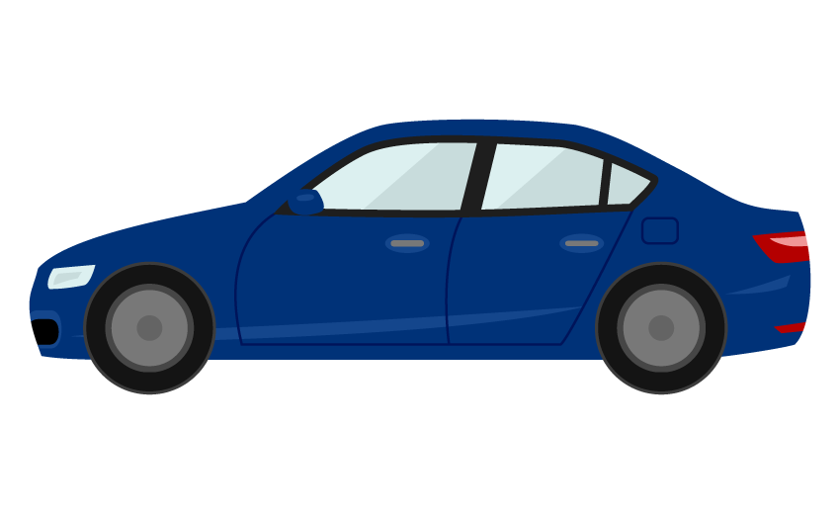
On Vehicle Environment
Around roof
・mostly free propagation can be applicable except reflection on the metallic roof
Note:
・open car
・in-door roof<=in body
Side
mostly free propagation can be applicable
Between right hand side and the left, front and back, NLOS model should be applied. (Glass window)
Note:
・key-less entry system
https://illust8.com/contents/2559
Bottom
Reflection at the body bottom and the ground should be considered.
=> maybe ignorable.
=> Depends on pavement

Slide 11
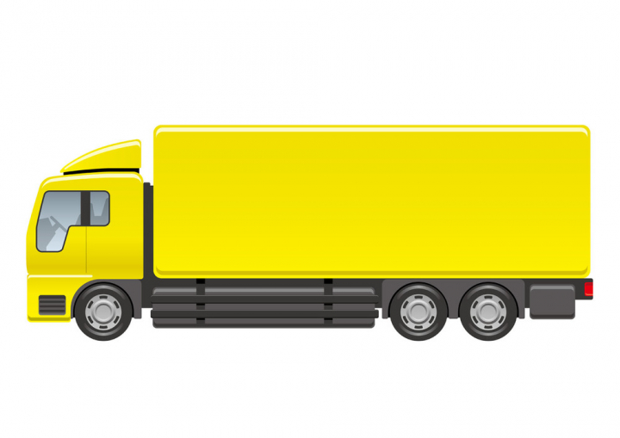
Environment models that can be applicable against different type of vehicles
Cabin
Engine
Cabin
Engine
Different
Size;
Structure;...etc.
https://nohat.cc/f/heavy-truck-illustration-isolated-on-a-white-background/comvecteezy328938-201908251309.html
Categories:
Categorize several type of vehicle like “for passengers”, “bus”, “small cargo”, “middle cargo”, “Large cargo” and “special purpose vehicles” such as a construction machines and build models for each categories.
Policy:
IEEE 802.15.6a defines several common environment models against most dominant use cases as mandatory models.

Slide 12


Channel and Environment Model Categories
Mandatory / optional
In-vehicle body
On-vehicle body
Around vehicle body
Most dominant case
CM-V1 / EM-V1
CM-V2 / EM-V2
CM-V3 / EM-V3
With engine
channel / Environment
channel / Environment
channel / Environment
Small / medium size vehicle
Electric vehicle
channel / Environment
channel / Environment
channel / Environment
or
channel / Environment
channel / Environment
channel / Environment
https://frame-illust.com/?p=8372
Large / long size vehicle
channel / Environment
channel / Environment
channel / Environment
https://illust8.com/contents/5097
Special purpose vehicle

Slide 13
In-Vehicle Body Model Categories
Mandatory / optional
Through engine room and cabin
Engine room
Cabin
Most dominant case
CM-V1 / EM-V1
With engine
Channel / Environment
Channel / Environment
channel / Environment
Small / medium size vehicle
Electric vehicle
Channel / Environment
channel / Environment
Channel / Environment
Channel / Environment
channel / Environment
Channel / Environment
Large / long size vehicle
Channel / Environment
channel / Environment
Channel / Environment
https://illust8.com/contents/5097
Special purpose vehicle

Slide 14
On-Vehicle Body Model Categories
Side Right/Left/
Front/Back
Mandatory / optional
Roof
Bottom
Most dominant case
CM-V2 / EM-V2
With engine
Channel / Environment
Channel / Environment
channel / Environment
Small / medium size vehicle
Electric vehicle
Channel / Environment
channel / Environment
Channel / Environment
or
Channel / Environment
channel / Environment
Channel / Environment
Large / long size vehicle
Channel / Environment
channel / Environment
Channel / Environment
https://illust8.com/contents/5097
Special purpose vehicle

Slide 15
Around Vehicle Body Model Categories
Mandatory / optional
Static vehicle
Moving vehicle
Most dominant case
CM-V3 / EM-V3
With engine
Channel / Environment
channel / Environment
Small / medium size vehicle
Electric vehicle
channel / Environment
Channel / Environment
or
channel / Environment
Channel / Environment
Large / long size vehicle
channel / Environment
Channel / Environment
https://illust8.com/contents/5097
Special purpose vehicle

Slide 16
Inter Vehicle (Vehicle to Vehicle) Model Categories
Mandatory / optional
With engine
EV
Most dominant case
CM-V4 / EM-V4
With engine
Channel / Environment
Channel / Environment
Channel / Environment
channel / Environment
Small / medium size vehicle
Electric vehicle
Channel / Environment
Channel / Environment
channel / Environment
Channel / Environment
or
Channel / Environment
Channel / Environment
channel / Environment
Channel / Environment
Large / long size vehicle
Channel / Environment
Channel / Environment
channel / Environment
Channel / Environment
https://illust8.com/contents/5097
Special purpose vehicle

Slide 17
Summary
Environment model which has wider meaning than channel model has been proposed.
Environment model including not only channel characteristics but also including interference, colored noise, EMC and human impact issues.
Environment models has been categorized against several typical vehicle categories.
Most dominant environment models in individual categories were assigned as "Mandatory".

Slide 18
Reference

Slide 19
Automotive Systems and EMC
The inclusion of new technologies in automotive systems has resulted in
new challenges across the radio spectrum

Slide 20
Today’s electronic and electric systems in vehicles contain many more active
components than in the past.
Those components and assemblies may emit electromagnetic (EM) noise, or be exposed to external sources of energy/EM noise, resulting in unanticipated changes in systems operation (vehicle’s control, on-board radio equipment)
Wireless/radio equipment: cellular communications, Wi-Fi, Bluetooth, NFC,
automotive radar, sensors, infotainment, GPS, etc.
Assemblies include high speed digital circuits that may be radiating EM noise.
Vehicle’s control: please insert your slide 8.

Slide 21
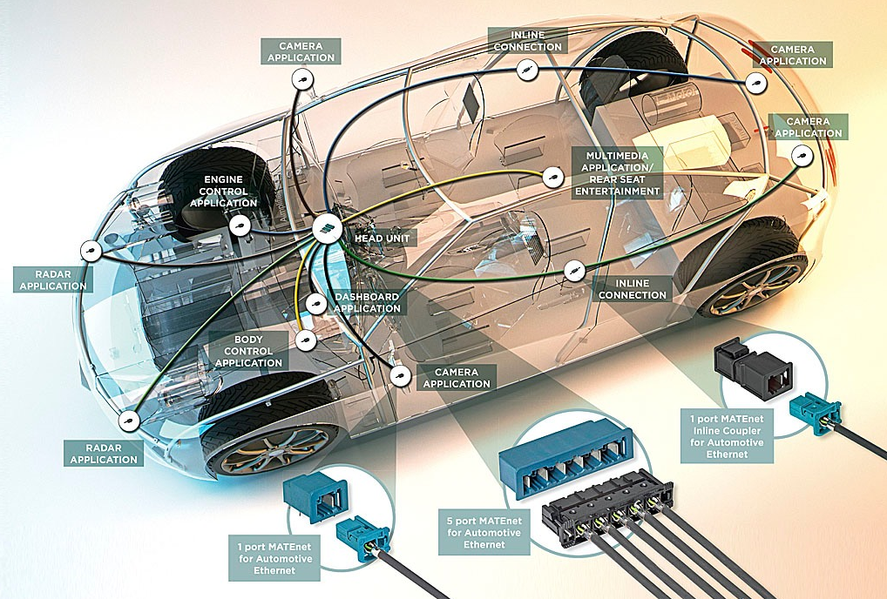
EMC model
Source -> Path -> Sink
Sources of EM near and far field: may be off board and on board sources
Path: radiated or conducted
Sink: intended receiver or unintended receiver
Figure is for reference, please include your own figure

Slide 22
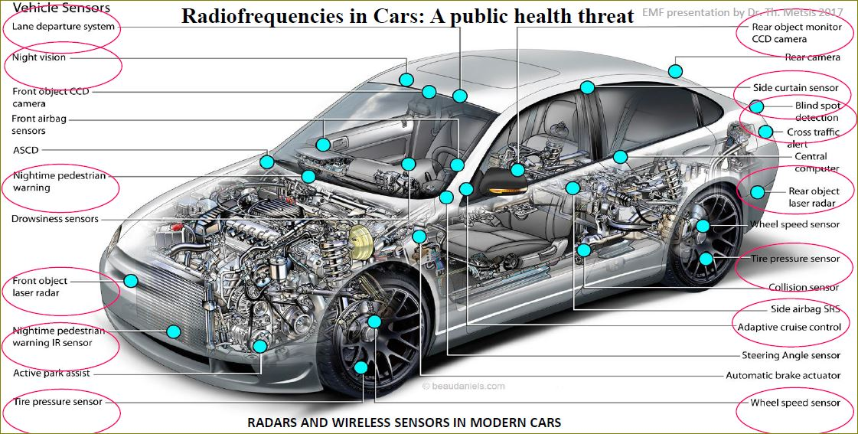
Electromagnetic Environment
Figure is for reference, please include your own figure based on this figure.
We cannot present figures without owner’s consent.

Slide 23
Vehicle Original Equipment Manufacturer (OEM) practice is to address
EMC/EMI at the component and system design phase. Moreover, the
resolution of EMC/EMI issues must take in high volume and complex
manufacturing process with the Goal to balance EMC/EMI requirements
with market-based vehicle usage, as in our case HBAN and VBAN.
15.6a does not intend to address all these items and issues.
We would like to use the knowledge base on these issues:
EMI is been categorized into four areas: conducted & radiated
emissions, and conducted & radiated susceptibility; with
their specific compliance standards and limits

Slide 24
OEMs design EMC-proof circuits and components for immunity, with the ultimate goal to achieve certification of the vehicle to relevant standards, including EMC/EMI.
So far we have been relaying on international standards for EMC/EMI environments for on-board and off-board sources in internal combustion vehicles, electric vehicle and hybrid-electric vehicles.
CISPR 25 v4 , SAE J551/1, ECE R10 r5, Nissan NDS02
We may add support from Japanese automotive industry and/or others
for testing EMC/EMI over UWB systems in-vehicles based on CISPR 25,
SAE J551/1 or relevant Standards.

