Slide 1
Project: IEEE P802.15 Working Group for Wireless Personal Area Networks (WPANs)
Submission Title: SG15 Agenda and Meeting Slides
Date Submitted: April 12, 2021 (r1), April 1, 2021 (r0)
Source: Phil Beecher (Wi-SUN Alliance)
Contact:
Voice: +44 1273 422275, E-Mail: pbeecher @ wi-sun.org
Re: Study Group 15: NS-NB 802.15.4 “Narrow Band”
Abstract: Agenda and Meeting Slides
Purpose: Achieve the illusion of organization for the ad-hoc meeting
Notice: This document has been prepared to assist the IEEE P802.15. It is offered as a basis for discussion and is not binding on the contributing individual(s) or organization(s). The material in this document is subject to change in form and content after further study. The contributor(s) reserve(s) the right to add, amend or withdraw material contained herein.
Release: The contributor acknowledges and accepts that this contribution becomes the property of IEEE and may be made publicly available by P802.15.
Notes:
Jul 12, 2010
Page 1

Slide 2
802.15 Study Group Meeting
Pre-PAR Activity Rules for Study Group
Voting: everyone present can vote
Please identify yourself with your name and affiliation when you first speak
Participation: is by individual

Slide 3
IEEE-SA Patent, Copyright, and Participation Policies
See: https://grouper.ieee.org/groups/802/sapolicies.shtml
IEEE-SA Patent Slides for Pre-PAR Meetings:
https://development.standards.ieee.org/myproject/Public/mytools/mob/preparslides.pdf
IEEE-SA Participation Slides for Pre-PAR Meetings:
https://standards.ieee.org/content/dam/ieee-standards/standards/web/documents/other/Participant-Behavior-Individual-Method.pdf
Copyright:
https://standards.ieee.org/content/dam/ieee-standards/standards/web/documents/other/ieee-sa-copyright-policy-2019.pdf

Slide 4
IEEE 802 Ground Rules
NO product pitches
NO corporate pitches
NO prices
NO restrictive notices – (e.g. confidential notices in email)
Presentations must be openly available
Please respect all participants

Slide 5
April 12, 2021
Virtual Meeting

Slide 6
Proposed Agenda
Opening and meeting preamble
Overview of PICS from Profile IG
Next Steps
Any other Business

Slide 7
Background
WG Presentation :
15-19-0128 Profile Sample PICS
Don Sturek

Slide 8
Next Steps
Continue work as Study Group
Determine proposed content for standard
Coordinate with SG14
Write PAR and CSD
Move PAR and CSD through 802 and SA Processes
Work via Interim telecons and virtual interim/plenary meetings

Slide 9
Teleconference Schedule
Weekly
10:00 EDT (07:00 PDT)
Week | Time
April 5 | 10:00 | EDT
Apr 12 | 10:00 | EDT
Apr 19 | 10:00 | EDT
Apr 26 | 10:00 | EDT
May 3 | 10:00 | EDT
May Interim

Slide 10
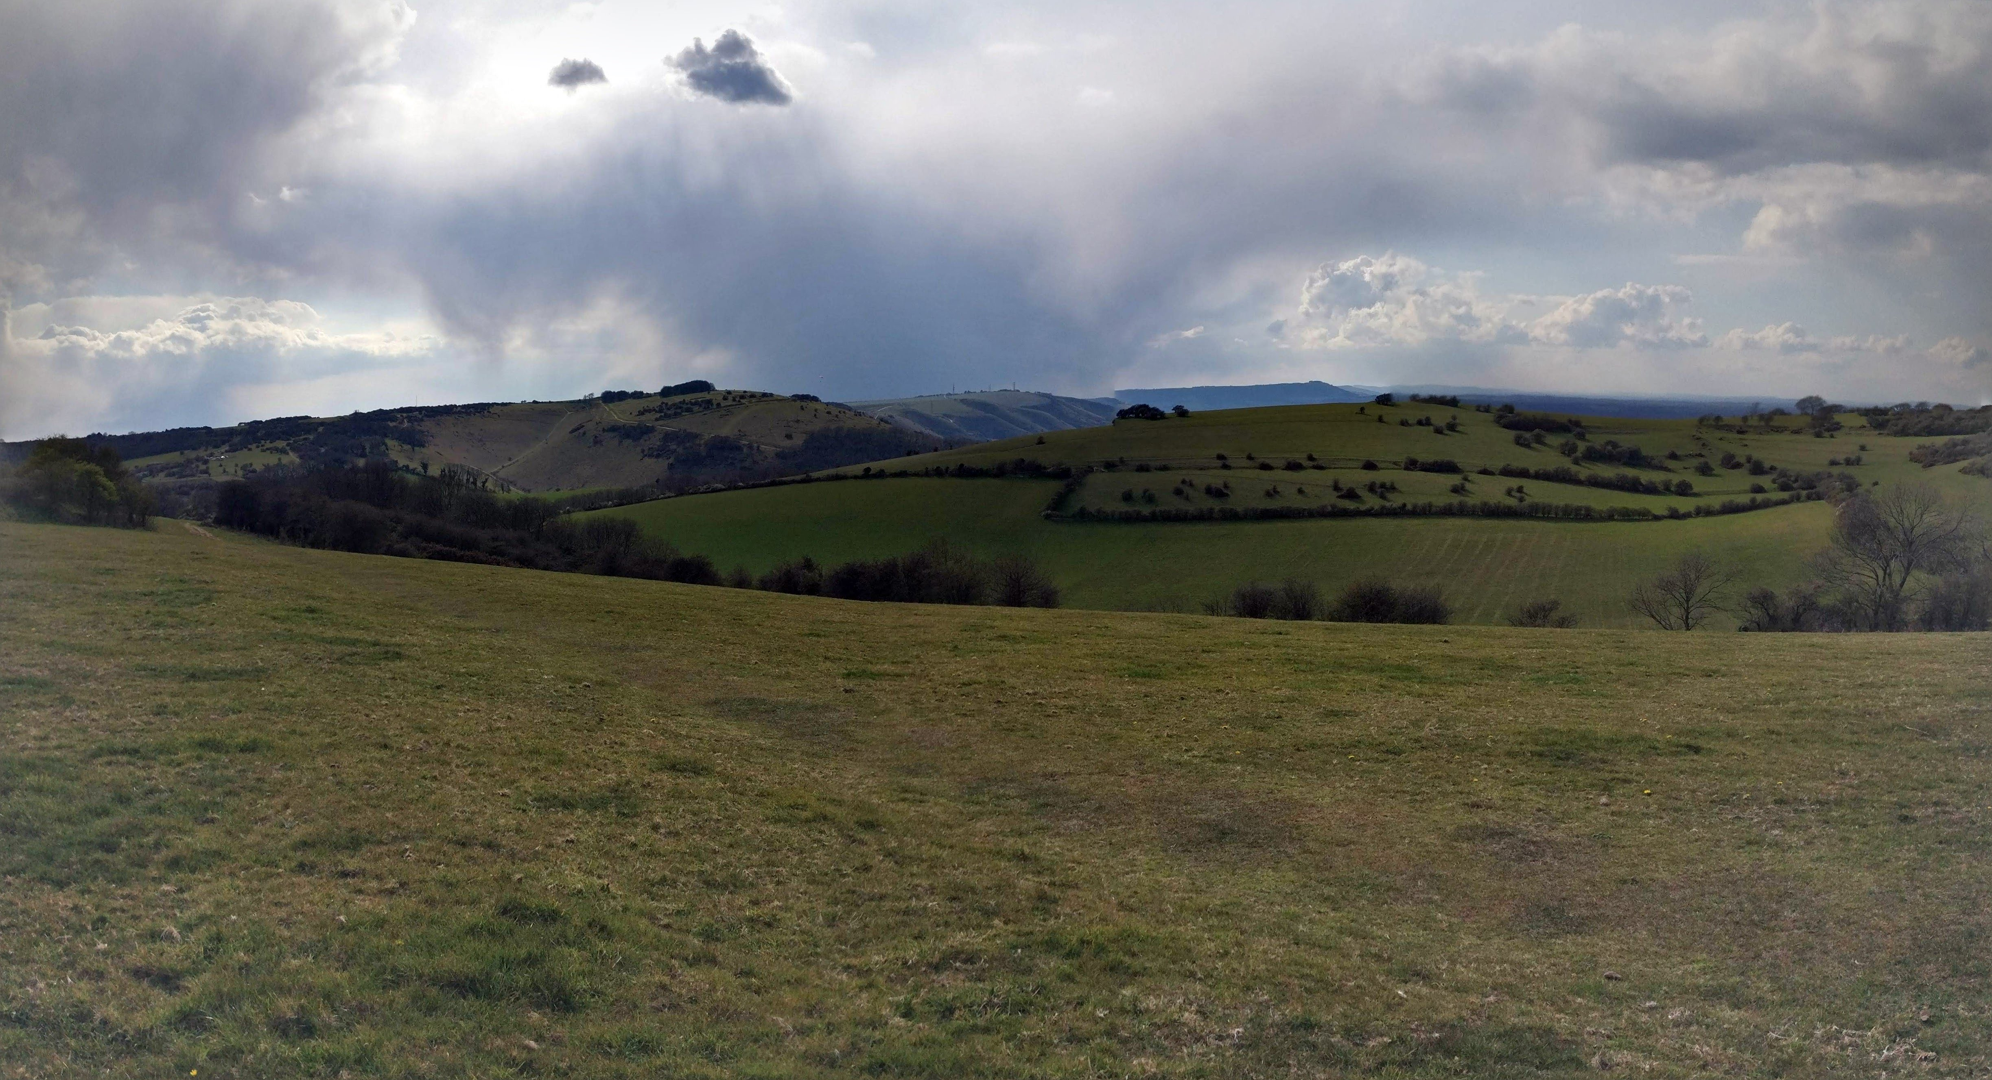
Any Other Business?

Slide 11
Adjourned Thanks

Slide 12
Appendix (Previous Meetings)

Slide 13
April 5, 2021
Virtual Meeting

Slide 14
Proposed Agenda
Opening and meeting preamble
Review Background for Study Group
WG Presentation : 15-21-0125-00-0000-narrow-band-interest-group-request
Next Steps
Any other Business

Slide 15
Background
WG Presentation :
15-21-0125-00-0000-
narrow-band-interest-group-request
Don Sturek

Slide 16
Next Steps
Continue work as Study Group
Determine proposed content for standard
Coordinate with SG14
Write PAR and CSD
Move PAR and CSD through 802 and SA Processes
Work via Interim telecons and virtual interim/plenary meetings

