Slide 1
Project: IEEE P802.15 Working Group for Wireless Personal Area Networks (WPANs)
Submission Title: Discussion on the Issues of Communication Range in TG7a TCD
Date Submitted: 17 March 2021
Source: Sang-Kyu Lim [ETRI] and Vinayagam Mariappan [SMR Automotive Modules Korea]
Address: 218 Gajeong-ro, Yuseong-gu, Daejeon, 34129, Korea
Voice:[+82-42-860-1573], FAX: [+82-42-860-5218], E-Mail:[sklim@etri.re.kr]
Re:
Abstract: This document is to discuss the technical issues in TCD and to improve the TCD document.
Purpose: Contribution to IEEE P802.15.7a
Notice: This document has been prepared to assist the IEEE P802.15. It is offered as a basis for discussion and is not binding on the contributing individual(s) or organization(s). The material in this document is subject to change in form and content after further study. The contributor(s) reserve(s) the right to add, amend or withdraw material contained herein.
Release: The contributor acknowledges and accepts that this contribution becomes the property of IEEE and may be made publicly available by P802.15.

Slide 2
Discussion on the Issues of
Communication Range in TG7a TCD
Sang-Kyu Lim [ETRI]
Vinayagam Mariappan [SMR Automotive Modules Korea]

Slide 3
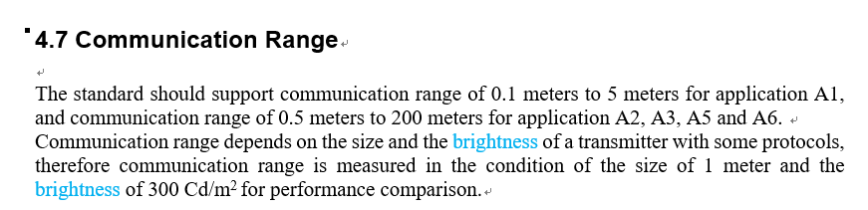
Issues on the Communication Range in TCD
The communication range is strongly connected with some factors such as the required BER, SNR, path loss depending on distance, and the transmitter output power.
Physical parameter to specify the condition for performance comparison

Slide 4
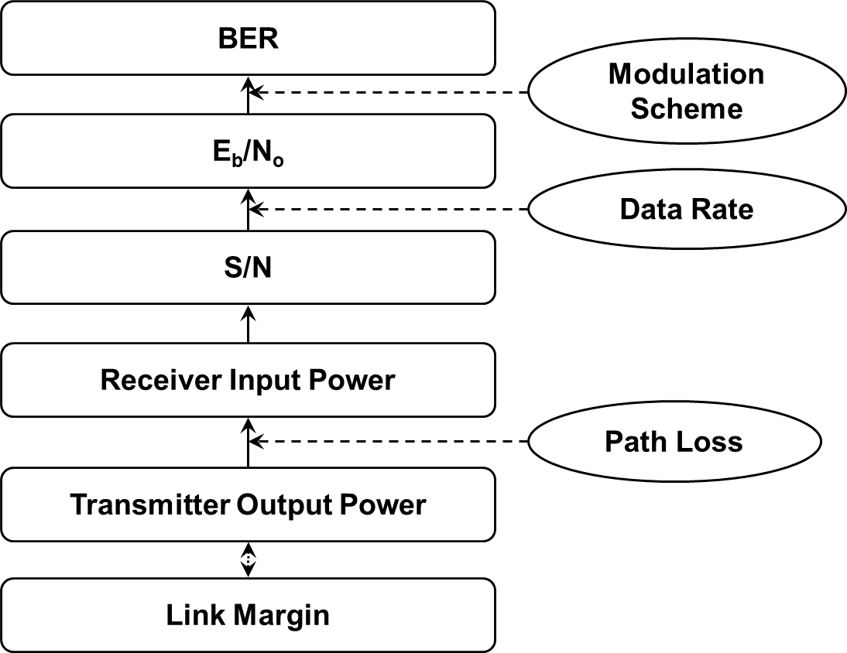
Link Budget Calculation

Slide 5
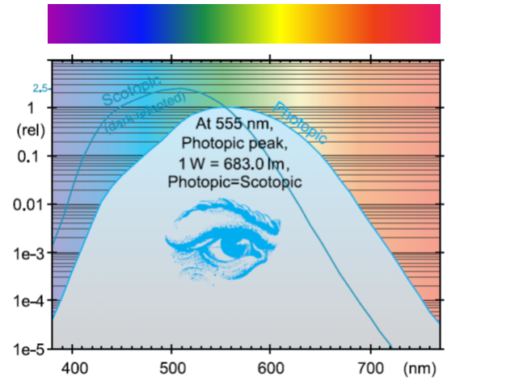
Two Unit Systems in Visible Band
Radiometric Units
Photometric Units
Radiant Flux
W
Luminous Flux
lm
Radiant Intensity
W/sr
Luminous Intensity
cd = lm/sr
Radiance
W/sr/m²
Luminance
cd/m² = lm/sr/m²
Irradiance
W/m²
Illuminance
lux = lm/m²
CIE Scotopic and Photopic Sensitivity Curves
[ Eye Sensitivity Function : V(λ) ]
* Light Measurement Handbook © 1998
by Alex Ryer, International Light Inc.
* IEEE 802.15-09-0159-00-0007
* IEEE 802.15-09-0597-02-0007

Slide 6
Conclusions
At least the BER values required for the various applications in Clause 4.7 need to be specified in TCD.
Two approaches to specify the physical quantities connected with the optical power of a transmitter all over the optical band
  The photometric units for visible band and the radiometric units for IR and UV band
  The radiometric units for all of the optical band
The expression, “brightness” for cd/m², needs to be changed to “luminance”.
TG7a needs to discuss about which parameter is more reasonable when the condition for performance comparison is specified.

