Slide 1
Project: IEEE P802.15 Working Group for Wireless Personal Area Networks (WPANs)
Submission Title: Discussion on the Issues of Communication Range in TG7a TCD
Date Submitted: 12 March 2021
Source: Sang-Kyu Lim [ETRI] and Vinayagam Mariappan [SMR Automotive Modules Korea]
Address: 218 Gajeong-ro, Yuseong-gu, Daejeon, 34129, Korea
Voice:[+82-42-860-1573], FAX: [+82-42-860-5218], E-Mail:[sklim@etri.re.kr]
Re:
Abstract: This document is to discuss the technical issues in TCD and to improve the TCD document.
Purpose: Contribution to IEEE P802.15.7a
Notice: This document has been prepared to assist the IEEE P802.15. It is offered as a basis for discussion and is not binding on the contributing individual(s) or organization(s). The material in this document is subject to change in form and content after further study. The contributor(s) reserve(s) the right to add, amend or withdraw material contained herein.
Release: The contributor acknowledges and accepts that this contribution becomes the property of IEEE and may be made publicly available by P802.15.

Slide 2
Discussion on the Issues of
Communication Range in TG7a TCD
Sang-Kyu Lim [ETRI]
Vinayagam Mariappan [SMR Automotive Modules Korea]

Slide 3
Issues on the Communication Range in TCD
The communication range is strongly connected with some factors such as the required BER, SNR, path loss depending on distance, and the transmitter output power.
This document is to propose the use of technical terminology and the reasonable physical unit system when the optical power level is characterized in TG7a.

Slide 4
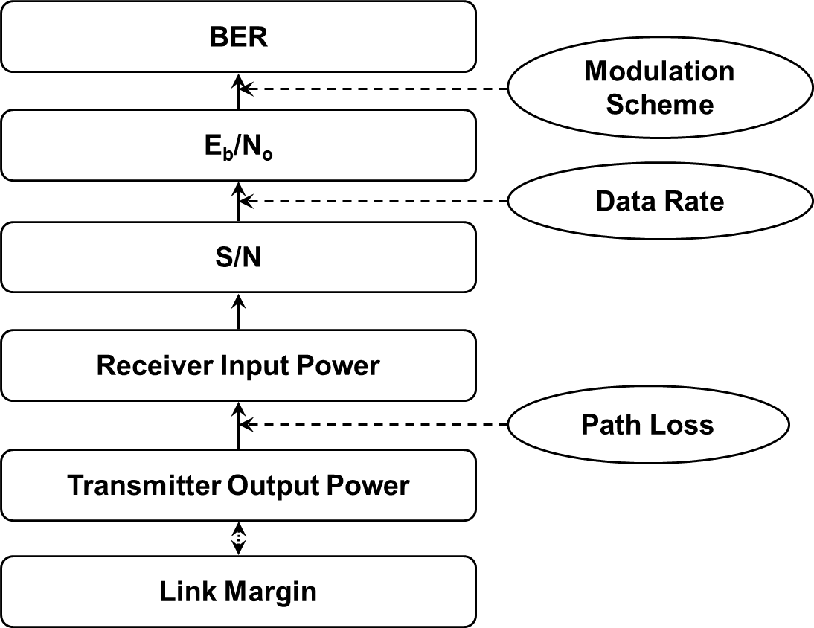
Link Budget Calculation

Slide 5
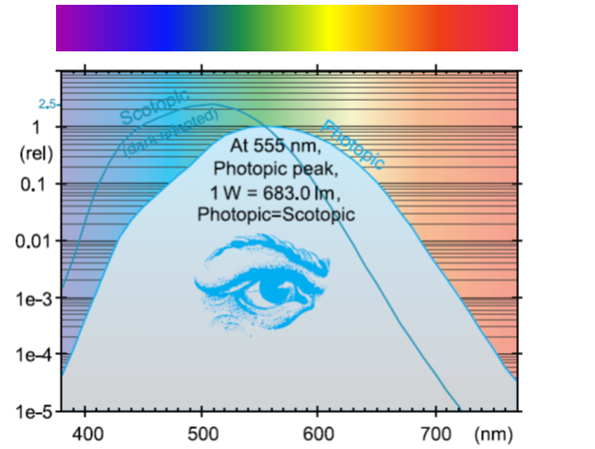
Two Unit Systems in Visible Band
Radiometric Units
Photometric Units
Radiant Flux
W
Luminous Flux
lm
Radiant Intensity
W/sr
Luminous Intensity
cd = lm/sr
Radiance
W/sr/m²
Luminance
cd/m² = lm/sr/m²
Irradiance
W/m²
Illuminance
lux = lm/m²
CIE Scotopic and Photopic Sensitivity Curves
[ Eye Sensitivity Function : V(λ) ]
* Light Measurement Handbook © 1998
by Alex Ryer, International Light Inc.
* IEEE 802.15-09-0159-00-0007
* IEEE 802.15-09-0597-02-0007

Slide 6
Conclusions
TG7a needs to use the radiometric units to characterize the power level in the transmitter and receiver side because the photometric units are the physical system calibrated with the human eye detecting visible bands only and especially IR, UV as well as visible bands are included in the wavelength region discussed in TG7a.
If the photometric unit of cd/m² is used for the power level in TG7a, then “brightness” expressed in the current TCD should be replaced by “luminance”.
At least, TCD needs to specify the required BER values for the various applications in Clause 4.7 for defining the communication range.

