Slide 1
Project: IEEE P802.15 Working Group for Wireless Personal Area Networks (WPANs)
Submission Title: SC IETF March Slides
Date Submitted: 14 March, 2021
Source: Tero Kivinen Company -
E-Mail: kivinen@iki.fi
Re: SC IETF March Slides
Abstract:
Opening Report and slides for SC IETF March Meeting.
Purpose: Provide information which kind of changes are needed to the standard.
Notice: This document has been prepared to assist the IEEE P802.15. It is offered as a basis for discussion and is not binding on the contributing individual(s) or organization(s). The material in this document is subject to change in form and content after further study. The contributor(s) reserve(s) the right to add, amend or withdraw material contained herein.
Release: The contributor acknowledges and accepts that this contribution becomes the property of IEEE and may be made publicly available by P802.15.

Slide 2
Instructions for the WG Chair
The IEEE-SA strongly recommends that at each WG meeting the chair or a designee:
Show slides #1 through #4 of this presentation
Advise the WG attendees that:
IEEE’s patent policy is described in Clause 6 of the IEEE-SA Standards Board Bylaws;
Early identification of patent claims which may be essential for the use of standards under development is strongly encouraged;
There may be Essential Patent Claims of which IEEE is not aware. Additionally, neither IEEE, the WG, nor the WG Chair can ensure the accuracy or completeness of any assurance or whether any such assurance is, in fact, of a Patent Claim that is essential for the use of the standard under development.
Instruct the WG Secretary to record in the minutes of the relevant WG meeting:
That the foregoing information was provided and that slides 1 through 4 (and this slide 0, if applicable) were shown;
That the chair or designee provided an opportunity for participants to identify patent claim(s)/patent application claim(s) and/or the holder of patent claim(s)/patent application claim(s) of which the participant is personally aware and that may be essential for the use of that standard
Any responses that were given, specifically the patent claim(s)/patent application claim(s) and/or the holder of the patent claim(s)/patent application claim(s) that were identified (if any) and by whom.
The WG Chair shall ensure that a request is made to any identified holders of potential essential patent claim(s) to complete and submit a Letter of Assurance.
It is recommended that the WG Chair review the guidance in IEEE-SA Standards Board Operations Manual 6.3.5 and in FAQs 14 and 15 on inclusion of potential Essential Patent Claims by incorporation or by reference.
Note: WG includes Working Groups, Task Groups, and other standards-developing committees with a PAR approved by the IEEE-SA Standards Board.
Notes:
<number>

Slide 3
Participants have a duty to inform the IEEE
Participants shall inform the IEEE (or cause the IEEE to be informed) of the identity of each holder of any potential Essential Patent Claims of which they are personally aware if the claims are owned or controlled by the participant or the entity the participant is from, employed by, or otherwise represents
Participants should inform the IEEE (or cause the IEEE to be informed) of the identity of any other holders of potential Essential Patent Claims
Early identification of holders of potential Essential Patent Claims is encouraged

Slide 4
Ways to inform IEEE
Cause an LOA to be submitted to the IEEE-SA (patcom@ieee.org); or
Provide the chair of this group with the identity of the holder(s) of any and all such claims as soon as possible; or
Speak up now and respond to this Call for Potentially Essential Patents
If anyone in this meeting is personally aware of the holder of any patent claims that are potentially essential to implementation of the proposed standard(s) under consideration by this group and that are not already the subject of an Accepted Letter of Assurance, please respond at this time by providing relevant information to the WG Chair

Slide 5
Other guidelines for IEEE WG meetings
All IEEE-SA standards meetings shall be conducted in compliance with all applicable laws, including antitrust and competition laws.
Don’t discuss the interpretation, validity, or essentiality of patents/patent claims.
Don’t discuss specific license rates, terms, or conditions.
Relative costs of different technical approaches that include relative costs of patent licensing terms may be discussed in standards development meetings.
Technical considerations remain the primary focus
Don’t discuss or engage in the fixing of product prices, allocation of customers, or division of sales markets.
Don’t discuss the status or substance of ongoing or threatened litigation.
Don’t be silent if inappropriate topics are discussed … do formally object.
---------------------------------------------------------------
For more details, see IEEE-SA Standards Board Operations Manual, clause 5.3.10 and Antitrust and Competition Policy: What You Need to Know at http://standards.ieee.org/develop/policies/antitrust.pdf

Slide 6
Patent-related information
The patent policy and the procedures used to execute that policy are documented in the:
IEEE-SA Standards Board Bylaws (http://standards.ieee.org/develop/policies/bylaws/sect6-7.html#6)
IEEE-SA Standards Board Operations Manual (http://standards.ieee.org/develop/policies/opman/sect6.html#6.3)
Material about the patent policy is available at http://standards.ieee.org/about/sasb/patcom/materials.html
If you have questions, contact the IEEE-SA Standards Board Patent Committee Administrator at patcom@ieee.org

Slide 7
Instructions for Chairs of standards development activities
At the beginning of each standards development meeting the chair or a designee is to:
Show the following slides (or provide them beforehand)
Advise the standards development group participants that:
IEEE SA’s copyright policy is described in Clause 7 of the IEEE SA Standards Board Bylaws and Clause 6.1 of the IEEE SA Standards Board Operations Manual;
Any material submitted during standards development, whether verbal, recorded, or in written form, is a Contribution and shall comply with the IEEE SA Copyright Policy;
Instruct the Secretary to record in the minutes of the relevant meeting:
That the foregoing information was provided and that the copyright slides were shown (or provided beforehand).

Slide 8
IEEE SA Copyright Policy
By participating in this activity, you agree to comply with the IEEE Code of Ethics, all applicable laws, and all IEEE policies and procedures including, but not limited to, the IEEE SA Copyright Policy.
Previously Published material (copyright assertion indicated) shall not be presented/submitted to the Working Group nor incorporated into a Working Group draft unless permission is granted.
Prior to presentation or submission, you shall notify the Working Group Chair of previously Published material and should assist the Chair in obtaining copyright permission acceptable to IEEE SA.
For material that is not previously Published, IEEE is automatically granted a license to use any material that is presented or submitted.

Slide 9
IEEE SA Copyright Policy
The IEEE SA Copyright Policy is described in the IEEE SA Standards Board Bylaws and IEEE SA Standards Board Operations Manual
IEEE SA Copyright Policy, see Clause 7 of the IEEE SA Standards Board Bylaws https://standards.ieee.org/about/policies/bylaws/sect6-7.html#7 Clause 6.1 of the IEEE SA Standards Board Operations Manual https://standards.ieee.org/about/policies/opman/sect6.html
IEEE SA Copyright Permission
https://standards.ieee.org/content/dam/ieee-standards/standards/web/documents/other/permissionltrs.zip
IEEE SA Copyright FAQs
http://standards.ieee.org/faqs/copyrights.html/
IEEE SA Best Practices for IEEE Standards Development
https://standards.ieee.org/develop/policies/best_practices_for_ieee_standards_development_051215.pdf
Distribution of Draft Standards (see 6.1.3 of the SASB Operations Manual)
https://standards.ieee.org/about/policies/opman/sect6.html

Slide 10
Agenda for March
Discuss on what happened in IETF 110 finished last week

Slide 11
IETF 110
IETF 110 was held as virtual meeting between Monday 8th of March and Friday 12th of March.
Timezone used in the virtual IETF meeting was CET (UTC +2) and sessions were held between 13:00-19:00 ICT (UTC +2), or 12:00-18:00 UTC.

Slide 12
Working groups to cover
6tisch - IPv6 over the TSCH mode of IEEE 802.15.4e
Raw - Reliable and Available Wireless
Core - Constrained RESTful Environments
6lo - IPv6 over Networks of Resource-constrained Nodes
Roll - Routing Over Low power and Lossy networks
Suit - Software Updates for Internet of Things
Lpwan - IPv6 over Low Power Wide-Area Networks
Lake - Lightweight Authenticated Key Exchange
Anima – Autonomic Networking Integrated Model and Approach

Slide 13
6tisch -IPv6 over the TSCH mode of IEEE 802.15.4e
Did not meet in IETF 110
Most of the documents are in RFC Editor queue waiting for references.
draft-ietf-6tisch-architecture
draft-ietf-6tisch-enrollment-enhanced-beacon
draft-ietf-6tisch-minimal-security
draft-ietf-6tisch-msf
So nothing happening until documents from roll.

Slide 14
Raw - Reliable and Available Wireless
Did meet in IETF 110
https://codimd.ietf.org/notes-ietf-110-raw
L-Band Digital Aeronautical Communications System
Air-to-Ground and Air-to-Air plane communications
draft-ietf-raw-ldacs
Raw Technologies
Wi-Fi 6, IEEE Std 802.15.4 TSCH, 3GPP 5G, LDACS
draft-ietf-raw-technologies, draft-pthubert-raw-architecture
Use Cases
Aeronautical Communications, Amusement Parks, Wireless for Industrial Applications, Pro Audio and Video, Wireless gaming, UAV platooning and control, Edge Robotics control, Emergencies: Instrumented emergency vehicle
draft-ietf-raw-use-cases

Slide 15
Core - Constrained RESTful Environments
Did meet in IETF 110 for 2 sessions
Has several interim meetings, every few weeks
https://codimd.ietf.org/notes-ietf-110-core
Lots of work ongoing
6tisch was waiting for draft-ietf-core-stateless
Published as RFC8974 January 2021.

Slide 16
6lo - IPv6 over Networks of Resource-constrained Nodes
Did meet in 110
https://codimd.ietf.org/notes-ietf-110-6lo
Most of stuff in RFC editor queue.
Still working on the Applicability and Use Cases draft

Slide 17
Roll - Routing Over Low power and Lossy networks
Did meet in IETF 110
https://codimd.ietf.org/notes-ietf-110-roll
In the RFC Editor queue:
draft-ietf-roll-unaware-leaves
draft-ietf-roll-useofrplinfo
6tisch documents waiting for those.

Slide 18
Suit - Software Updates for Internet of Things
Did meet in IETF 110
https://codimd.ietf.org/notes-ietf-110-suit
Architecture is now in the RFC Editor queue.
Information model received some comments from the IESG and trying to fix them.
Working on manifest.

Slide 19
Lpwan - IPv6 over Low Power Wide-Area Networks
Did meet in IETF 110
Do have lots of interim meetings.
https://codimd.ietf.org/notes-ietf-110-lpwan
Static Context Header Compression (SCHC) for CoAP and LoRaWAN are now in the RFC Editor queue.
SCHC for NB-IoT and SigFox in progress.

Slide 20
Lake - Lightweight Authenticated Key Exchange
Did meet in IETF 110
They have some interim meetings.
https://datatracker.ietf.org/doc/minutes-110-lake/
Working on the Ephemeral Diffie-Hellman over COSE (EDHOC)
draft-ietf-lake-edhoc
Have done some interop during interop
Had 3 implementations in tests out of 5 known implementations.
They are doing formal verification also.
Still doing some small changes, for example in error cases and doing test cases.
Plan to get document finished by March 2022.
EDHOC/OSCORE is something that is interesting for draft-ietf-6tisch-minimal-security

Slide 21
Anima – Autonomic Networking Integrated Model and Approach
Did meet in IETF 110.
https://codimd.ietf.org/notes-ietf-110-anima
Basic core architecture drafts in RFC editor queue, should be published soon
draft-ietf-anima-{grasp, prefix-management, referencemode, bootstrapping-keyinfra, autonomic-control-plane and grasp-ap}

Slide 22
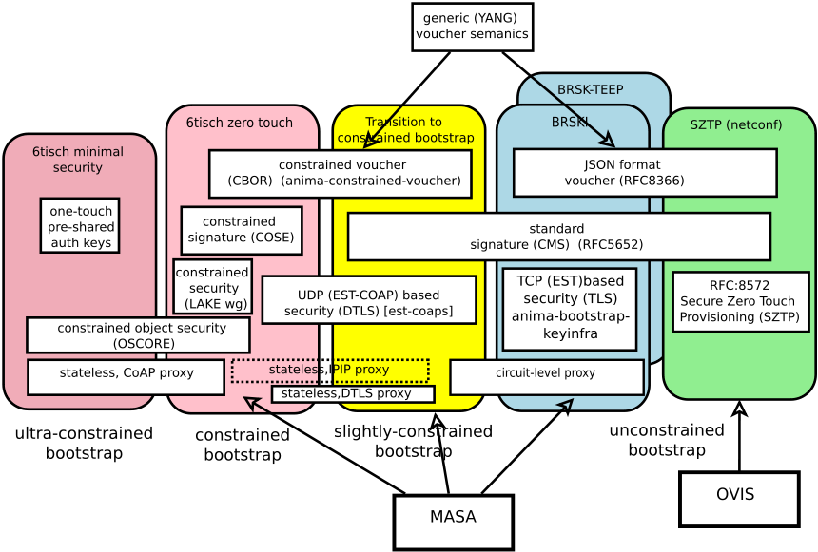
Enrollement Roadmap

