Slide 1
Project: IEEE P802.15 Working Group for Wireless Personal Area Networks (WPANs)
Submission Title: Interest Groups UWB Next Generation
Date Submitted: March 9, 2021
Source: Benjamin A. Rolfe (Blind Creek Associates)
Contact:
Voice: +1 408 395 7207, E-Mail: ben.rolfe @ ieee.org
Re: UWB Next Generation
Abstract: Agenda and Meeting Slides, 802.15 Interest Groups, UWB NG
Purpose: Achieve the illusion of organization for the ad-hoc meeting
Notice: This document has been prepared to assist the IEEE P802.15. It is offered as a basis for discussion and is not binding on the contributing individual(s) or organization(s). The material in this document is subject to change in form and content after further study. The contributor(s) reserve(s) the right to add, amend or withdraw material contained herein.
Release: The contributor acknowledges and accepts that this contribution becomes the property of IEEE and may be made publicly available by P802.15.
Notes:
Jul 12, 2010
Page 1

Slide 2
802.15 Interest Group Meeting
Pre-PAR Activity Rules
Interest Group voting: everyone present can vote
Note document group IG UWB-NG (nuwb)
Identify yourself and affiliation on first contact
Reminder: Individual Participation

Slide 3
IEEE-SA Patent, Copyright, and Participation Policies
See: https://grouper.ieee.org/groups/802/sapolicies.shtml
IEEE-SA Patent Slides for Pre-PAR Meetings:
https://development.standards.ieee.org/myproject/Public/mytools/mob/preparslides.pdf
IEEE-SA Participation Slides for Pre-PAR Meetings:
https://standards.ieee.org/content/dam/ieee-standards/standards/web/documents/other/Participant-Behavior-Individual-Method.pdf
Copyright:
https://standards.ieee.org/content/dam/ieee-standards/standards/web/documents/other/ieee-sa-copyright-policy-2019.pdf

Slide 4
IEEE 802 Ground Rules
Respect … give it, get it
NO product pitches
NO corporate pitches
NO prices
NO restrictive notices – (no confidentially notices in email)
Presentations must be openly available

Slide 5
March 10, 2021
Through
March 16, 2021
Plenary Meeting

Slide 6
Proposed Agenda
Document 15-21-0129-01

Slide 7
Attendance
IMAT is your friend
https://imat.ieee.org/sp7200043/attendance-log?p=3392400005&t=47600043
100% == 16 slots (75% == 12)
Don’t forget to log your attendance!

Slide 8
Recap

Slide 9
IG Work Since January:
Continued work on teleconferences
Discussed use cases and use case needs
Consensus to proceed with developing the PAR and CSD for amendment to 802.15.4 around the 4 major areas shown in 15-21-0089:
  • Ranging (no infrastructure)
  • Localization (infrastructure)
  • Sensing
  • Data streaming
Reached consensus on PAR and CSD
  Draft PAR: https://mentor.ieee.org/802.15/dcn/21/15-21-0126-01-nuwb-p802-14-4ab-par-draft-from-myproject.pdf
  Draft CSD: https://mentor.ieee.org/802.15/dcn/21/15-21-0047-05-nuwb-draft-csd-ng-uwb.docx
Seeking WG approval in this plenary
To begin 802 review period following this plenary

Slide 10
Next Steps
Continue work as Study Group
  Address any comments on PAR and CSD
  Continue to dig into use cases and technical requirements
  Hear and discuss technical presentations
  Consider technical contributions
  Develop recommendations for technical framework
Move PAR and CSD through 802 and SA Processes
Work via Interim telecons and virtual interim/plenary meetings

Slide 11
Agenda Update
Proposed Agenda Changes:
https://mentor.ieee.org/802.15/dcn/21/15-21-0129-03-nuwb-march-2021-agenda.xlsx
Add presentation, UAS Use Case
Add time to discuss Call for Contributions
Requests for agenda time?

Slide 12
Call for Contributions
Continue refining technical requirements
Begin to hear technical content contributions
  Proposed changes to the base standard
  Analysis and supporting background information
Areas of focus:
  PHY changes
  MAC changes
  Coexistence
  Performance analysis
  etc

Slide 13
Teleconference Schedule Discussion
Question: Frequency of telecons before March interim?
  Weekly
  Bi-weekly
  Another interval?
Day and Time discussion
Week | Day
March 22-26
March 29 – Apr 1
Apr 5-9
Apr 12-16
Apr 19-23
Apr 26-30
May
[May Interim]

Slide 14
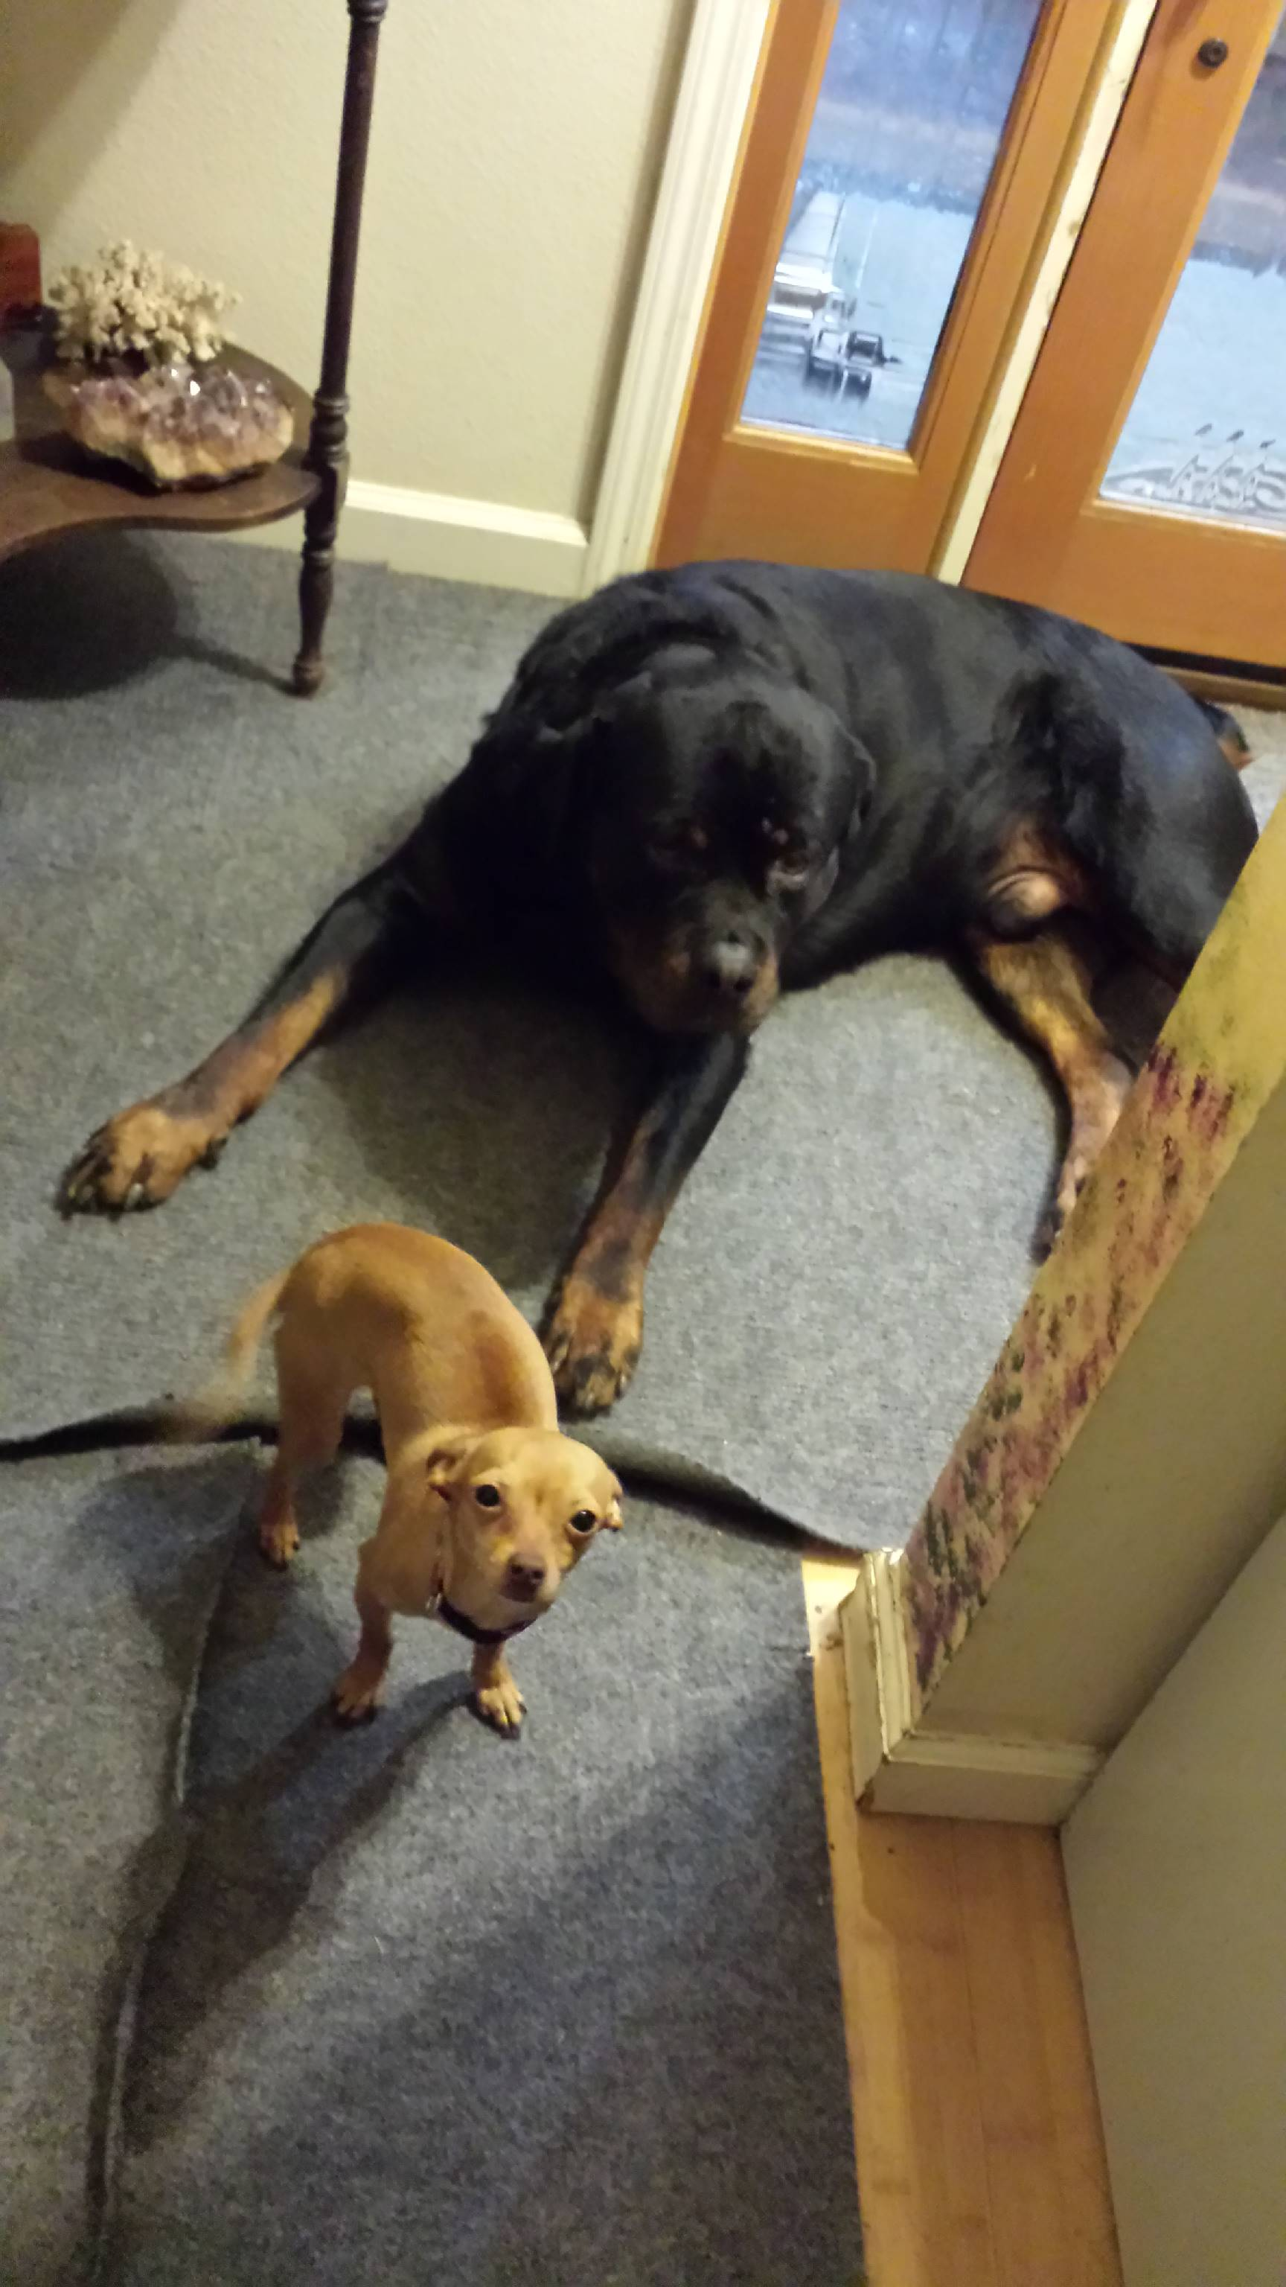
Other Business

Slide 15
Adjourned
Thanks

