Slide 1
Project: IEEE P802.15 Working Group for Wireless Personal Area Networks (WPANs)
Submission Title: Interest Groups UWB Next Generation
Date Submitted: Marc 2, 2021
Source: Benjamin A. Rolfe (Blind Creek Associates)
Contact:
Voice: +1 408 395 7207, E-Mail: ben.rolfe @ ieee.org
Re: UWB Next Generation
Abstract: Agenda and Meeting Slides, 802.15 Interest Groups, UWB NG
Purpose: Achieve the illusion of organization for the ad-hoc meeting
Notice: This document has been prepared to assist the IEEE P802.15. It is offered as a basis for discussion and is not binding on the contributing individual(s) or organization(s). The material in this document is subject to change in form and content after further study. The contributor(s) reserve(s) the right to add, amend or withdraw material contained herein.
Release: The contributor acknowledges and accepts that this contribution becomes the property of IEEE and may be made publicly available by P802.15.
Notes:
Jul 12, 2010
Page 1

Slide 2
802.15 Interest Group Meeting
Pre-PAR Activity Rules
Interest Group voting: everyone present can vote
Note document group IG UWB-NG (nuwb)
Identify yourself and affiliation on first contact
Reminder: Individual Participation

Slide 3
IEEE-SA Patent, Copyright, and Participation Policies
See: https://grouper.ieee.org/groups/802/sapolicies.shtml
IEEE-SA Patent Slides for Pre-PAR Meetings:
https://development.standards.ieee.org/myproject/Public/mytools/mob/preparslides.pdf
IEEE-SA Participation Slides for Pre-PAR Meetings:
https://standards.ieee.org/content/dam/ieee-standards/standards/web/documents/other/Participant-Behavior-Individual-Method.pdf
Copyright:
https://standards.ieee.org/content/dam/ieee-standards/standards/web/documents/other/ieee-sa-copyright-policy-2019.pdf

Slide 4
March 2, 2021
IG Call

Slide 5
Teleconference Schedule
IG Weekly:
Tuesday
06:30 PT / 09:30 ET
IG/SG: To Be Discussed
 | Tuesday
February | 16
March | 23
March | 2
[Plenary]

Slide 6
Proposed Agenda
Meeting preamble
PAR draft discussion and work
CSD draft discussion and work
Planning for plenary
AoB

Slide 7
Straw Poll Results
Continue focusing on developing the PAR and CSD for amendment to 802.15.4 around the 4 major areas shown in 15-21-0089:
• Ranging (no infrastructure)
• Localization (infrastructure)
• Sensing
• Data streaming

Slide 8
Progress - PAR
Converging on scope (doc # 15-21-0115)
  Merge of points from meetings
  Refined 23-Feb call
  Entered into MyProject (first cut)
https://mentor.ieee.org/802.15/dcn/21/15-21-0115-02-nuwb-consensus-par-proposal-for-ng-uwb-from-the-perspective-of-former-4z-participants.pptx

Slide 9
PAR
Amendment to 802.15.4 (z++):
Draft in MyProject
  https://development.standards.ieee.org/myproject-web/app#viewpar/12569/9081
On Mentor (PDF):
  https://mentor.ieee.org/802.15/dcn/21/15-21-0126-00-nuwb-p802-14-4ab-par-draft-from-myproject.pdf

Slide 10
Plenary Planning
Proposed Agenda:
Complete PAR and CSD for WG approval
Continue to review and refine use case and technical characteristics
Requests for agenda time?
Repeat Call for Contributions

Slide 11
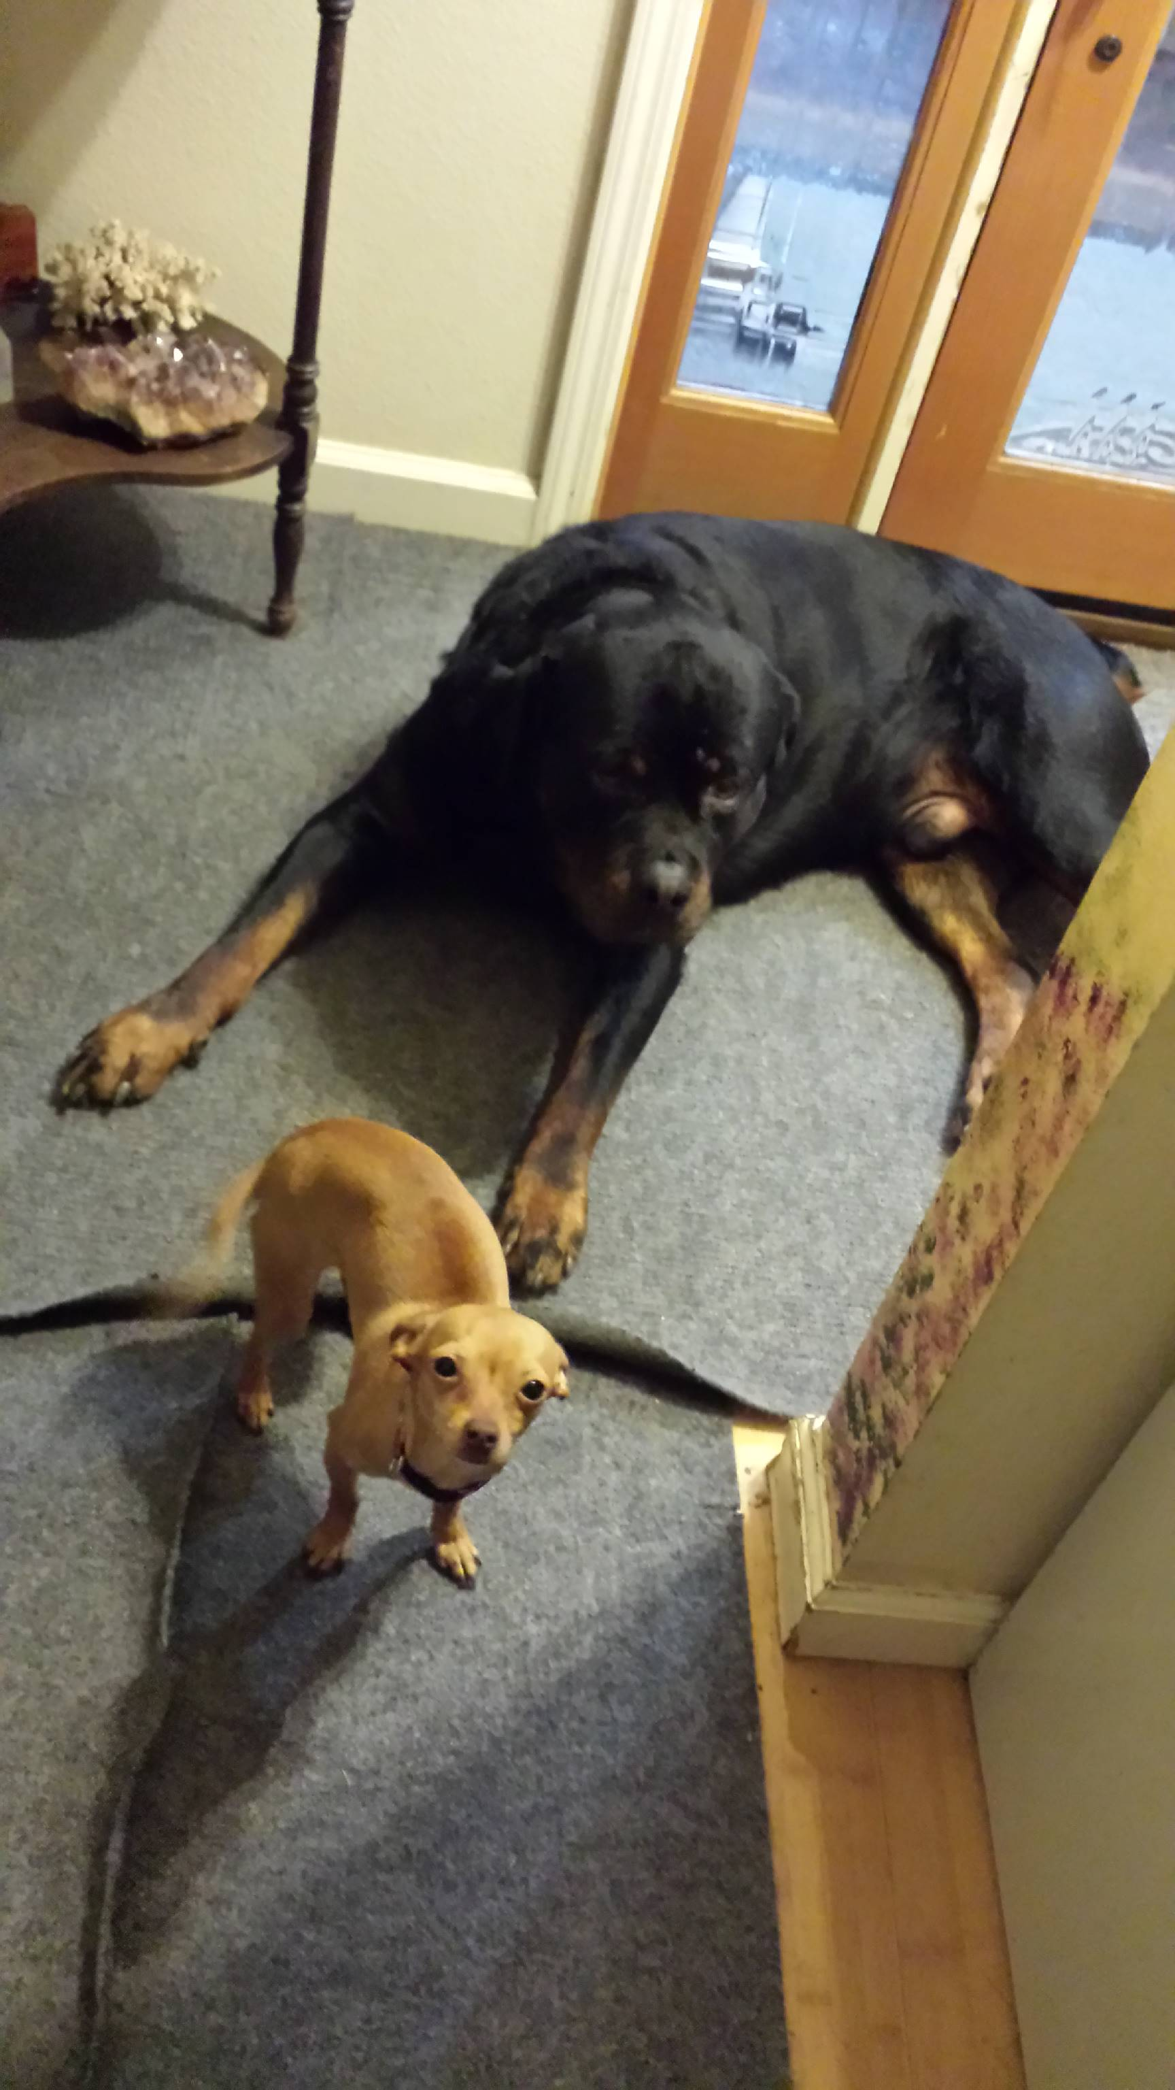
Other Business

Slide 12
Adjourned
Thanks

