Slide 1
Project: IEEE P802.15 Working Group for Wireless Personal Area Networks (WPANs)
Submission Title: Interest Groups UWB Next Generation
Date Submitted: January 11, 2020
Source: Benjamin A. Rolfe (Blind Creek Associates)
Contact:
Voice: +1 408 395 7207, E-Mail: ben.rolfe @ ieee.org
Re: Wireless Next Generation
Abstract: Agenda and Meeting Slides, 802.15 Interest Groups, UWB and 802.15.4 organization.
Purpose: Achieve the illusion of organization for the ad-hoc meeting
Notice: This document has been prepared to assist the IEEE P802.15. It is offered as a basis for discussion and is not binding on the contributing individual(s) or organization(s). The material in this document is subject to change in form and content after further study. The contributor(s) reserve(s) the right to add, amend or withdraw material contained herein.
Release: The contributor acknowledges and accepts that this contribution becomes the property of IEEE and may be made publicly available by P802.15.
Notes:
Jul 12, 2010
Page 1

Slide 2
802.15 Interest Group Meeting
Pre-PAR Activity Rules
Interest Group voting: everyone present can vote
Note document group IG UWB-NG (nuwb)
Identify yourself and affiliation on first contact
Reminder: Individual Participation

Slide 3
IEEE-SA Patent, Copyright, and Participation Policies
See: https://grouper.ieee.org/groups/802/sapolicies.shtml
IEEE-SA Patent Slides for Pre-PAR Meetings:
https://development.standards.ieee.org/myproject/Public/mytools/mob/preparslides.pdf
IEEE-SA Participation Slides for Pre-PAR Meetings:
https://standards.ieee.org/content/dam/ieee-standards/standards/web/documents/other/Participant-Behavior-Individual-Method.pdf
Copyright:
https://standards.ieee.org/content/dam/ieee-standards/standards/web/documents/other/ieee-sa-copyright-policy-2019.pdf

Slide 4
February 9, 2021
IG Call

Slide 5
Proposed Agenda
Meeting preamble
Project Planning
Continue CSD discussions
AoB

Slide 6
Process Discussion
Two projects
Amendment to 802.15.4 (z++)
  Continue with CSD and PAR development in IG
  PHY Enhancements and related
  Converge on key needs (common ground)
  Draft CSD and PAR to circulate ready by end of March
  WG Review (30 days min) then EC approval on EC Telecon
New standard
  Alternate Data Link Layer
  Form study group (SG) in March
  Meet between March plenary and May interim
  Draft CSD and PAR (compliment amendment)
Closely coordinated working in parallel

Slide 7
Straw Polls
STRAW POLL 1
Should we continue focusing on developing the PAR and CSD around the 4 major areas shown in 15-21-0089?
• Ranging (no infrastructure)
• Localization (infrastructure)
• Sensing
• Data streaming
Yes/no/abstain: 39/0/0
STRAW POLL 2
Should we proceed for now with opening up just one project?
Yes/no/abstain: 38/0/1

Slide 8
Straw Polls
STRAW POLL 3
If just one project, amendment for now
  Yes/no/abstain: 27/0/0
New standard now
  Yes/no/abstain: See 3a
If two projects, would you be involved just one or both: See 3a
Should we defer decision on a split until we have a better understanding what we’re planning to do in NG UWB: See 3a

Slide 9
Straw Polls
STRAW POLL 4
Should we continue drafting PAR and CSD aimed at an amendment project?
See 3a
STRAW POLL 5 [Deferred]
Are we ready to submit PAR and CSD for 802.15 WG & 802 EC approval and forwarding to NesCom for approval and auth. of TG formation?

Slide 10
CSD Discussion
Draft document after discussion and work:
https://mentor.ieee.org/802.15/dcn/21/15-21-0047-01-nuwb-draft-csd-ng-uwb.docx

Slide 11
Teleconference Schedule
IG Weekly:
Tuesday
06:30 PT / 09:30 ET
IG/SG: To Be Discussed
 | Tuesday
February | 16
March | 23
March | 2
[Plenary]

Slide 12
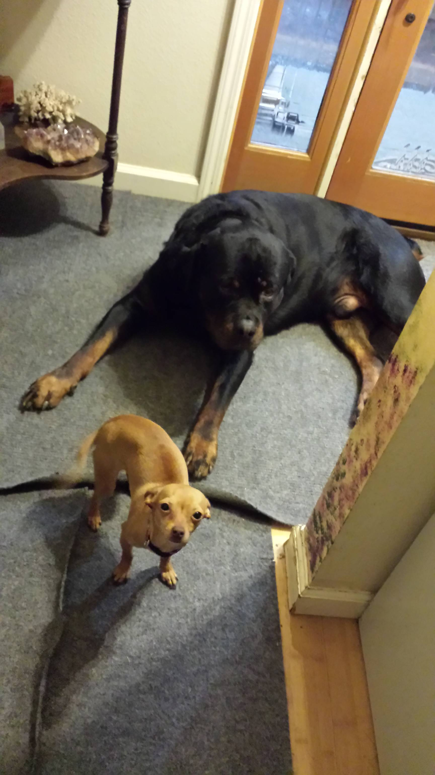
Other Business

Slide 13
Adjourned
Thanks

