Slide 1
Project: IEEE P802.15 Working Group for Wireless Personal Area Networks (WPANs)
Submission Title: Interest Groups UWB Next Generation
Date Submitted: January 11, 2020
Source: Benjamin A. Rolfe (Blind Creek Associates)
Contact:
Voice: +1 408 395 7207, E-Mail: ben.rolfe @ ieee.org
Re: Wireless Next Generation
Abstract: Agenda and Meeting Slides, 802.15 Interest Groups, UWB and 802.15.4 organization.
Purpose: Achieve the illusion of organization for the ad-hoc meeting
Notice: This document has been prepared to assist the IEEE P802.15. It is offered as a basis for discussion and is not binding on the contributing individual(s) or organization(s). The material in this document is subject to change in form and content after further study. The contributor(s) reserve(s) the right to add, amend or withdraw material contained herein.
Release: The contributor acknowledges and accepts that this contribution becomes the property of IEEE and may be made publicly available by P802.15.
Notes:
Jul 12, 2010
Page 1

Slide 2
802.15 Interest Group Meeting
Pre-PAR Activity Rules
Interest Group voting: everyone present can vote
Note document group IG UWB-NG (nuwb)
Identify yourself and affiliation on first contact
Reminder: Individual Participation

Slide 3
IEEE-SA Patent, Copyright, and Participation Policies
See: https://grouper.ieee.org/groups/802/sapolicies.shtml
IEEE-SA Patent Slides for Pre-PAR Meetings:
https://development.standards.ieee.org/myproject/Public/mytools/mob/preparslides.pdf
IEEE-SA Participation Slides for Pre-PAR Meetings:
https://standards.ieee.org/content/dam/ieee-standards/standards/web/documents/other/Participant-Behavior-Individual-Method.pdf
Copyright:
https://standards.ieee.org/content/dam/ieee-standards/standards/web/documents/other/ieee-sa-copyright-policy-2019.pdf

Slide 4
February 9, 2021
IG Call

Slide 5
Proposed Agenda
Meeting preamble
Project Planning
Continue CSD discussions
AoB

Slide 6
Process Discussion
Two projects
Amendment to 802.15.4 (z++)
  Continue with CSD and PAR development in IG
  PHY Enhancements and related
  Converge on key needs (common ground)
  Draft CSD and PAR to circulate ready by end of March
  WG Review (30 days min) then EC approval on EC Telecon
New standard
  Alternate Data Link Layer
  Form study group (SG) in March
  Meet between March plenary and May interim
  Draft CSD and PAR (compliment amendment)
Closely coordinated working in parallel

Slide 7
CSD Discussion
Draft document after discussion and work:
https://mentor.ieee.org/802.15/dcn/21/15-21-0047-01-nuwb-draft-csd-ng-uwb.docx

Slide 8
Teleconference Schedule
IG Weekly:
Tuesday
06:30 PT / 09:30 ET
IG/SG: To Be Discussed
 | Tuesday
February | 16
March | 23
March | 2
[Plenary]

Slide 9
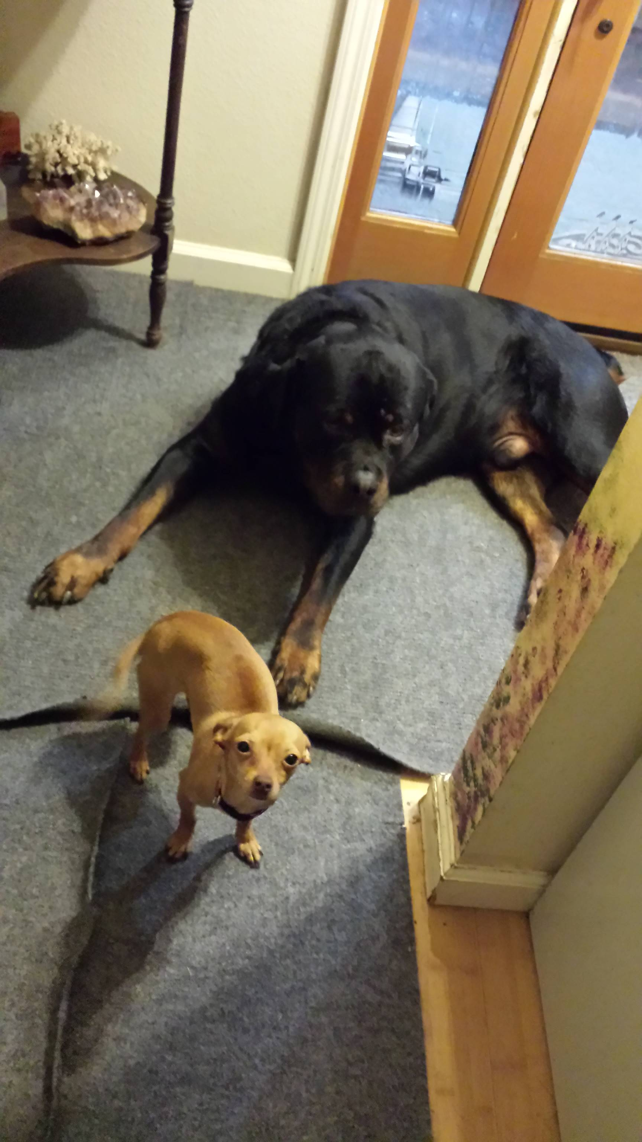
Other Business

Slide 10
Adjourned
Thanks

