Slide 1
Project: IEEE P802.15 Working Group for Wireless Personal Area Networks (WPANs)
Submission Title : New modulation technique for optical vehicular communication.
Date Submitted : [January, 2021]
Source : Md. Osman Ali and Yeong Min Jang
Company : [Kookmin University]
Address : [Seoul, Korea]
Voice : [+82-2-910-5068], E-Mail: [yjang@kookmin.ac.kr]
Re :
Abstract : This document focuses on new modulation techniques for optical vehicular communication.
Purpose : To have a high-rate modulation technique for vehicular communication.
Notice: This document has been prepared to assist the IEEE P802.15. It is offered as a basis for discussion and is not binding on the contributing individual(s) or organization(s). The material in this document is subject to change in form and content after further study. The contributor(s) reserve(s) the right to add, amend or withdraw material contained herein.
Release : The contributor acknowledges and accepts that this contribution becomes the property of IEEE and may be made publicly available by P802.15.
Slide 1

Slide 2
Introduction
Optical camera communication (OCC) uses existing lighting sources as transmitters and cameras as receivers.
OCC uses license free visible light spectrum that is almost interference free.
Again, most of the modern cars are equipped with one or multiple cameras for driver assistance.
Hence, vehicular OCC system is considered as one of the potential candidate for vehicular communication.
Vehicular communication is expected to play a key role to ensure road safety.

Slide 3
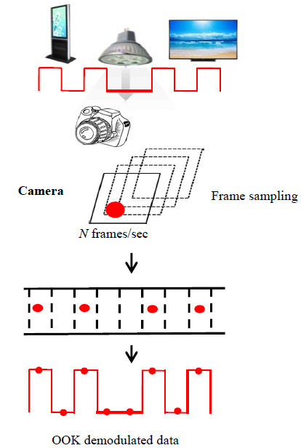
OCC operating principle
Figure 1. Basic operating principle of OCC.

Slide 4
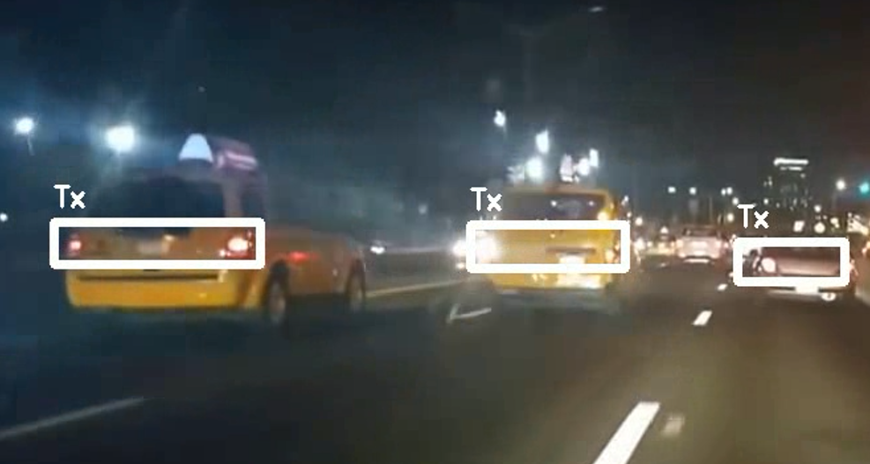
A general on-road scenario
Figure 2. A congested traffic scenario at night time
One of the main challenges of VOCC system is to detect the vehicles’ head or tail lights among numerous light sources on the streets.
Thus, every vehicle need unique vehicular ID to be distinguished from other vehicles.
Therefore, vehicular IDs need to be transmitted to establish a successful communication link.

Slide 5
Current status of modulation techniques
At present, there are only two modulation techniques for VOCC system, such as Twinkle-AM and HS-PSK.
In both case, a low-rate stream is transmitted as vehicular ID along with the high-rate stream used for transmitting necessary information to the drivers.
In Twinwle-AM, the low-rate stream is generated by varying the pulse width of the variable pulse position (VPPM) waveform.
On the other hand, in HS-PSK, the low rate spatial 2-phase shift keying (S2-PSK) is generated by varying the dimming level of DS8-PSK waveform.

Slide 6
General architecture of VOCC system
Figure 3. General block diagram for VOCC system

Slide 7
Technical considerations
The safety of the human eye is a must in terms of quality and intensity.
The modulation technique should be flicker free so that the human eye can not perceive.
It should support high mobility.

