Slide 1
Project: IEEE P802.15 Working Group for Wireless Personal Area Networks (WPANs)
Submission Title: [Technical Proposal on Channel Numbering for TG4aa JRE]
Date Submitted: [19th January, 2021]
Source: [Hiroshi Harada, Ryota Okumura] Company [Kyoto University]
Address : Kyoto University [Yoshidahonmachi, Sakyo-ku, Kyoto 606-8501 Japan]
Voice:[+81-75-753-5318], FAX: [], E-Mail:[hiroshi.harada@i.kyoto-u.ac.jp]
Re: [] Abstract: [This document includes Technical Contributions toward the development the amendment of IEEE Std 802.15.4-2020] Purpose: [Technical Proposal for TG4aa JRE.]
Notice: This document has been prepared to assist the IEEE P802.15. It is offered as a basis for discussion and is not binding on the contributing individual(s) or organization(s). The material in this document is subject to change in form and content after further study. The contributor(s) reserve(s) the right to add, amend or withdraw material contained herein.
Release: The contributor acknowledges and accepts that this contribution becomes the property of IEEE and may be made publicly available by P802.15.

Slide 2
Proposed Parameters
Frequency band (MHz) | Parameter | Operating mode
 |  | #1 | #2 | #3 | #4 | #5 | #6 | #7 | #8
920-928 MHz | Data rate (kb/s) | 50 | 100 | 200 | 400 | 400 | 600 | 600 | 800
 | Modulation | 2-FSK | 2-FSK | 2-FSK | 4-FSK | 2-FSK | 2-FSK | 4-FSK | 4-FSK
 | Modulation index | 1.0 | 1.0 | 1.0 | 0.33 | 0.5 | 0.4 | 0.5 | 0.33
 | Channel spacing (kHz) | 200 | 400 | 600 | 600 | 200 * N 1≦N≦5 [2] | 200 * N 1≦N≦5 [2] | 200 * N 1≦N≦5 [2] | 200 * N 1≦N≦5 [2]
 | Standard | 802.15.4-2020 [1] |  |  |  | Proposed
Note: N is integer number
Overlapped channel spacing was proposed

Slide 3
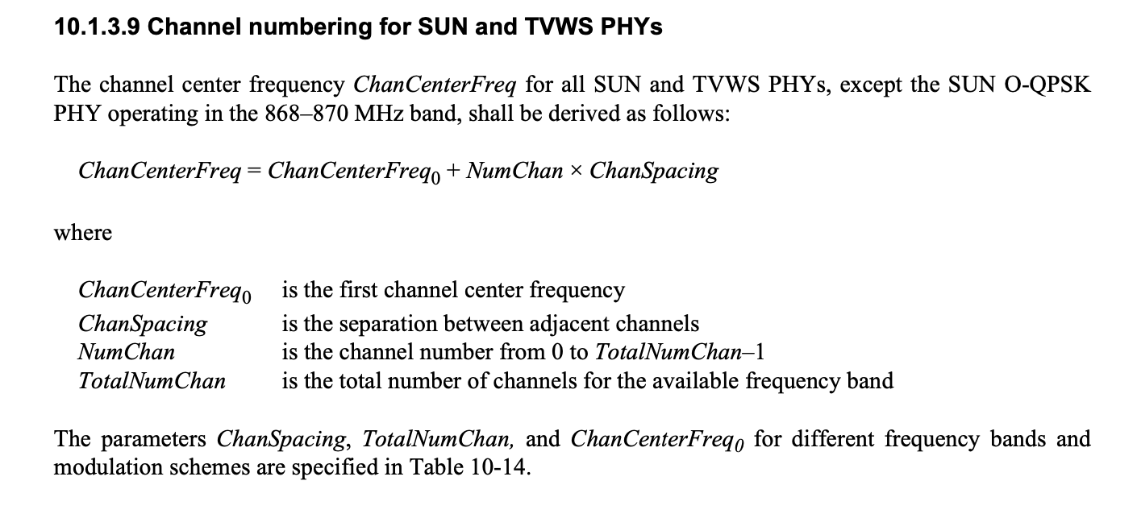
Current Channel Numbering [1]
Only one type of channel spacing per operating mode
Table 10-14
a)
a) Modification for 38 is proposed in Cor2 [3]

Slide 4
Current Channel Numbering
Only one type of channel spacing per operating mode
↓: Center Frequency
SUN FSK operating mode #1
TotalNumChan=38, ChanSpacing=0.2MHz, ChanCenterFreq₀ =920.6MHz
 | 0 | 1 | 2 | 3 | 4 | 5 | 6 | 7 | 8 | 9 | 10 | 11 | 12 | 13 | 14 | 15 | 16 | 17 | 18 | 19 | 20 | 21 | 22 | 23 | 24 | 25 | 26 | 27 | 28 | 29 | 30 | 31 | 32 | 33 | 34 | 35 | 36 | 37
 | ↓ | ↓ | ↓ | ↓ | ↓ | ↓ | ↓ | ↓ | ↓ | ↓ | ↓ | ↓ | ↓ | ↓ | ↓ | ↓ | ↓ | ↓ | ↓ | ↓ | ↓ | ↓ | ↓ | ↓ | ↓ | ↓ | ↓ | ↓ | ↓ | ↓ | ↓ | ↓ | ↓ | ↓ | ↓ | ↓ | ↓ | ↓
SUN FSK operating mode #2
TotalNumChan=18, ChanSpacing=0.4MHz, ChanCenterFreq₀ =920.9MHz
0 |  | 1 |  | 2 |  | 3 |  | 4 |  | 5 |  | 6 |  | 7 |  | 8 |  | 9 |  | 10 |  | 11 |  | 12 |  | 13 |  | 14 |  | 15 |  | 16 |  | 17
↓ |  | ↓ |  | ↓ |  | ↓ |  | ↓ |  | ↓ |  | ↓ |  | ↓ |  | ↓ |  | ↓ |  | ↓ |  | ↓ |  | ↓ |  | ↓ |  | ↓ |  | ↓ |  | ↓ |  | ↓
920
922
924
926
928
Frequency (MHz)

Slide 5
Proposed Serial Channel Numbering
Channel numbers for different spacings are defined in continuance
SUN FSK operating mode #5, #6, #7, #8
N=1
$l_{1}$ Channels
200kHz spacing
$F_{C}=f_{0, 1}+0.2 k$ in MHz,
for $k=0, …,{(l}_{1}−1)$
$F_{C}$: ChanCenterFreq
$f_{0, N}:$ChanCenterFreq₀ for each N
$l_{N}$: TotalNumChan for each N
N=2
$l_{2}$ Channels
400kHz spacing
$F_{C}=f_{0, 2}+0.4 (k−l_{1})$ in MHz,
for $k=l_{1}, …,{(l}_{1}+l_{2}−1)$
N=3
$l_{3}$ Channels
600kHz spacing
$F_{C}=f_{0, 3}+0.6 (k−l_{1}−l_{2})$ in MHz,
for $k={(l}_{1}{+l}_{2}), …,{(l}_{1}+l_{2}+l_{3}−1)$
N=4
$l_{4}$ Channels
800kHz spacing
$F_{C}=f_{0, 4}+0.8 (k−l_{1}−l_{2}−l_{3})$ in MHz,
for $k={(l}_{1}{+l}_{2}{+l}_{3}), …,{(l}_{1}+l_{2}+l_{3}+l_{4}−1)$
N=5
$l_{5}$ Channels
1MHz spacing
$F_{C}=f_{0, 5}+1.0 (k−l_{1}−l_{2}−l_{3}−l_{4})$ in MHz,
for $k={(l}_{1}{+l}_{2}{+l}_{3}{+l}_{4}), …,(l_{1}+l_{2}+l_{3}+l_{4}+l_{5}−1)$

Slide 6
Proposed Serial Channel Numbering
Channel numbers for different spacings are defined in continuance
↓: Center Frequency
SUN FSK operating mode #5, #6, #7, #8
N=1
$l_{1}$ Channels
200kHz spacing
 |  | 0 | 1 | 2 | 3 | 4 | 5 | 6 | 7 | 8 | 9 | 10 | 11 | 12 | 13 | 14 | 15 | 16 | 17 | 18 | 19 | 20 | 21 | 22 | 23 | 24 | 25 | 26 | 27 | 28 | 29 | 30 | 31 | 32 | 33
 |  | ↓ | ↓ | ↓ | ↓ | ↓ | ↓ | ↓ | ↓ | ↓ | ↓ | ↓ | ↓ | ↓ | ↓ | ↓ | ↓ | ↓ | ↓ | ↓ | ↓ | ↓ | ↓ | ↓ | ↓ | ↓ | ↓ | ↓ | ↓ | ↓ | ↓ | ↓ | ↓ | ↓ | ↓
N=2
$l_{2}$ Channels
400kHz spacing
 |  | 34 |  | 35 |  | 36 |  | 37 |  | 38 |  | 39 |  | 40 |  | 41 |  | 42 |  | 43 |  | 44 |  | 45 |  | 46 |  | 47 |  | 48 |  | 49 |  | 50
 |  | ↓ |  | ↓ |  | ↓ |  | ↓ |  | ↓ |  | ↓ |  | ↓ |  | ↓ |  | ↓ |  | ↓ |  | ↓ |  | ↓ |  | ↓ |  | ↓ |  | ↓ |  | ↓ |  | ↓
N=3
$l_{3}$ Channels
600kHz spacing
 |  |  |  | 51 |  |  | 52 |  |  | 53 |  |  | 54 |  |  | 55 |  |  | 56 |  |  | 57 |  |  | 58 |  |  | 59 |  |  | 60 |  |  | 61 |  |  | 62
 |  |  |  | ↓ |  |  | ↓ |  |  | ↓ |  |  | ↓ |  |  | ↓ |  |  | ↓ |  |  | ↓ |  |  | ↓ |  |  | ↓ |  |  | ↓ |  |  | ↓ |  |  | ↓
N=4
$l_{4}$ Channels
800kHz spacing
 |  | 63 |  |  |  | 64 |  |  |  | 65 |  |  |  | 66 |  |  |  | 67 |  |  |  | 68 |  |  |  | 69 |  |  |  | 70 |  |  |  | 71
 |  | ↓ |  |  |  | ↓ |  |  |  | ↓ |  |  |  | ↓ |  |  |  | ↓ |  |  |  | ↓ |  |  |  | ↓ |  |  |  | ↓ |  |  |  | ↓
N=5
$l_{5}$ Channels
1MHz spacing
 |  | 72 |  |  |  |  | 73 |  |  |  |  | 74 |  |  |  |  | 75 |  |  |  |  | 76 |  |  |  |  | 77 |  |  |  |  | 78
 |  | ↓ |  |  |  |  | ↓ |  |  |  |  | ↓ |  |  |  |  | ↓ |  |  |  |  | ↓ |  |  |  |  | ↓ |  |  |  |  | ↓
920
922
924
926
928
Frequency (MHz)

Slide 7
Proposed Serial Channel Numbering
Channel numbers for different spacings are defined in continuance
In a PAN, either channels 0–33, 34–50, 51–62, 63–71, or 72–78 are used.
 | ChanSpacing | ChanCenterFreq₀ for N | Last ChanCenterFreq | NumChan | TotalNumChan for N
$N$=1 | 0.2 MHz | 921.0 MHz | 927.6 MHz | 0–33 | 34
$N$=2 | 0.4 MHz | 921.0 MHz | 927.4 MHz | 34–50 | 17
$N$=3 | 0.6 MHz | 921.0 MHz | 927.6 MHz | 51–62 | 12
$N$=4 | 0.8 MHz | 921.0 MHz | 927.4 MHz | 63–71 | 9
$N$=5 | 1.0 MHz | 921.0 MHz | 927.0 MHz | 72–78 | 7
Sum: 79

Slide 8
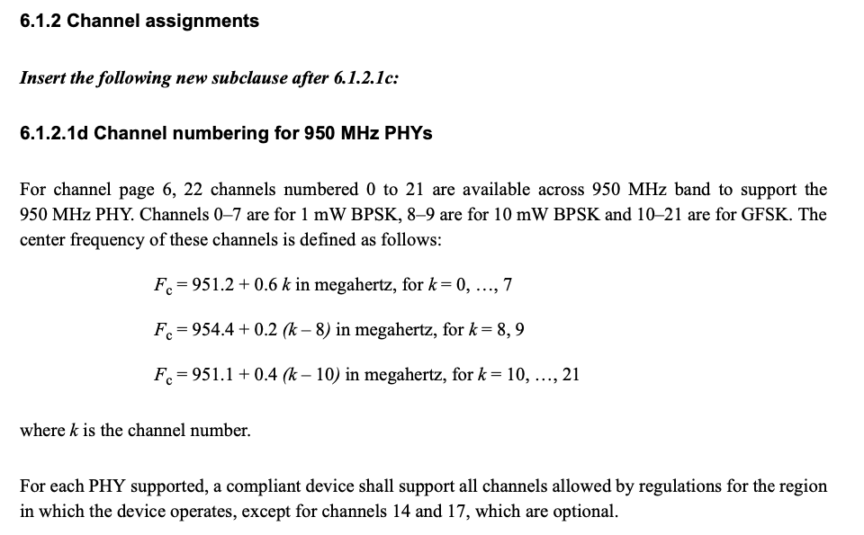
Example: Channel Numbering in IEEE 802.15.4d-2009 [4]

Slide 9
Example: Channel Numbering in IEEE 802.15.4d-2009 [4]
1mW BPSK
10mW BPSK
GFSK
Channel Num | Center Frequency (MHz)
0 | 951.2
1 | 951.8
2 | 952.4
3 | 953.0
4 | 953.6
5 | 954.2
6 | 954.8
7 | 955.4
Channel Num | Center Frequency (MHz)
8 | 954.4
9 | 954.6
Channel Num | Center Frequency (MHz)
10 | 951.1
11 | 951.5
12 | 951.9
13 | 952.3
14 | 952.7
15 | 953.1
16 | 953.5
17 | 953.9
18 | 954.3
19 | 954.7
20 | 955.1
21 | 955.5
Define channels for different systems with a single serial channel number

Slide 10
Reference
[1] IEEE, “IEEE 802.15.4-2020,” July 2020.
[2] ARIB, “ARIB STD-T108 920MHz-BAND TELEMETER, TELECONTROLAND DATA TRANSMISSION RADIO EQUIPMENT ver 1.3,” Apr. 2019.
[3] IEEE 802.15-20-0397-00-Cor2, Dec. 2020.
[4] IEEE, “IEEE 802.15.4d-2009,” Apr. 2009.

