Slide 1
Project: IEEE P802.15 Interest Group for Wireless Personal Area Networks (WPANs)
Submission Title: Synchronization Issue for Optical Camera Communications
Date Submitted: January, 2021
Source: Cong Hoan Nguyen and Yeong Min Jang [Kookmin University].
Contact: +82-2-910-5068 E-Mail: yjang@kookmin.ac.kr
Re:
Abstract: Synchronization Issue for Optical Camera Communications
Purpose: To summary general technical consideration of Synchronization Issue for Optical Camera Communications
Notice: This document has been prepared to assist the IEEE P802.15. It is offered as a basis for discussion and is not binding on the contributing individual(s) or organization(s). The material in this document is subject to change in form and content after further study. The contributor(s) reserve(s) the right to add, amend or withdraw material contained herein.
Release: The contributor acknowledges and accepts that this contribution becomes the property of IEEE and may be made publicly available by P802.15.

Slide 2
Synchronization Issue for Optical Camera Communications
Notes:
LEDs-based lights offer many advantages such as reduced energy consumption, higher switching speeds, higher efficiency, longer lifetime and lower cost, compared with conventional light sources.
In addition, LEDs are used in new vehicles (head- and taillight, street and traffic lights, etc., thus making non radio frequency (RF)-based wireless a possibility.

Slide 3
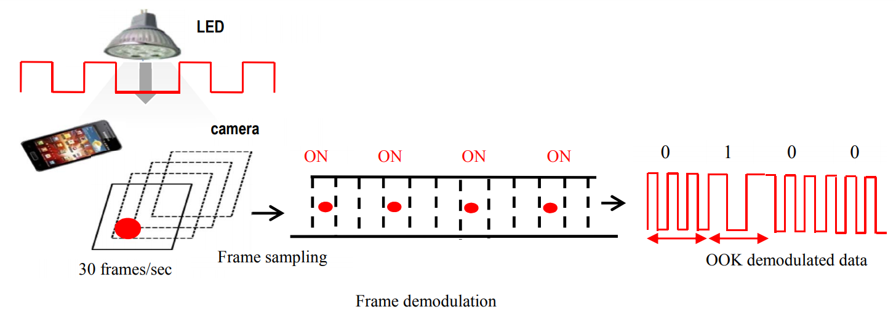
Introduction
Optical wireless camera communication is considered as an extension of visible light communication. With the advantages of visible light communication on directional transmission, security and potential safety environment, optical camera communication (camcom) can inherit and take advantage by no extended cost hardware of receiver. Optical camera communication uses optical channel so it achieves a highly directional transmission compare with RF omnidirectional system.
Notes:
LEDs-based lights offer many advantages such as reduced energy consumption, higher switching speeds, higher efficiency, longer lifetime and lower cost, compared with conventional light sources.
In addition, LEDs are used in new vehicles (head- and taillight, street and traffic lights, etc., thus making non radio frequency (RF)-based wireless a possibility.

Slide 4
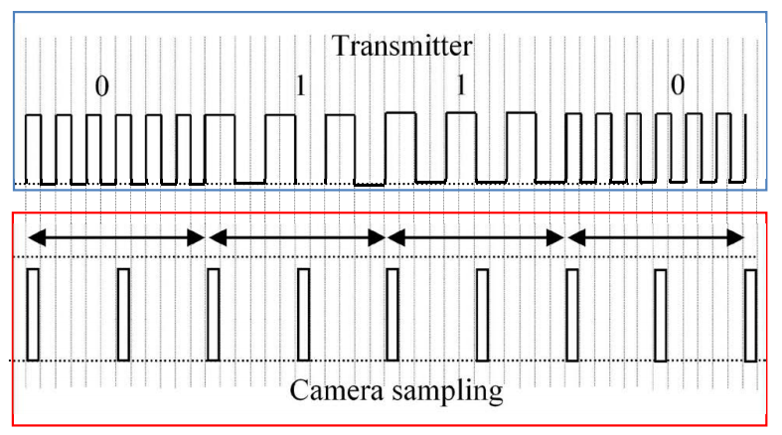
Synchronization Issue for Shift OOK OCC
The synchronization is important issue in optical camera communication because two main reasons. Firstly, the time of starting capturing can happen randomly. Secondly, the interval of frame sampling depends on the CMOS characteristic and brightness level of optical channel. So the configuration frame rate is not exactly as given value of camera.
Frequency shift OOK modulation.

Slide 5
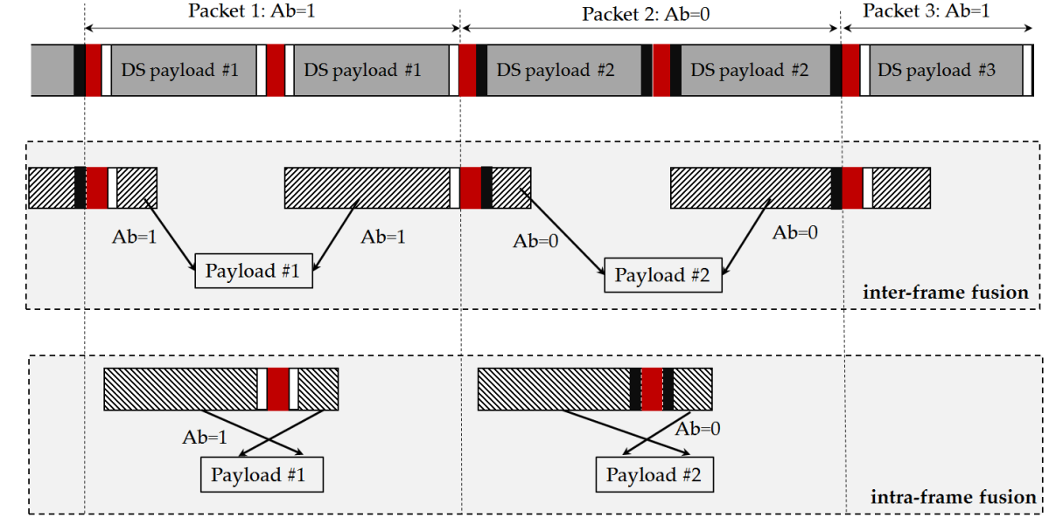
Solution of synchronization issue
The synchronization issue can be solved by using synchronization phase. The structure of synchronization frame is shown in Figure. By using three bits for synchronization phase which the second one must orthogonal phase with two another bit.
Synchronization bit

Slide 6
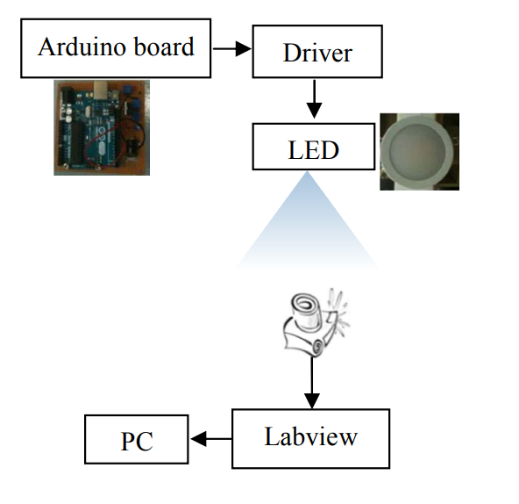
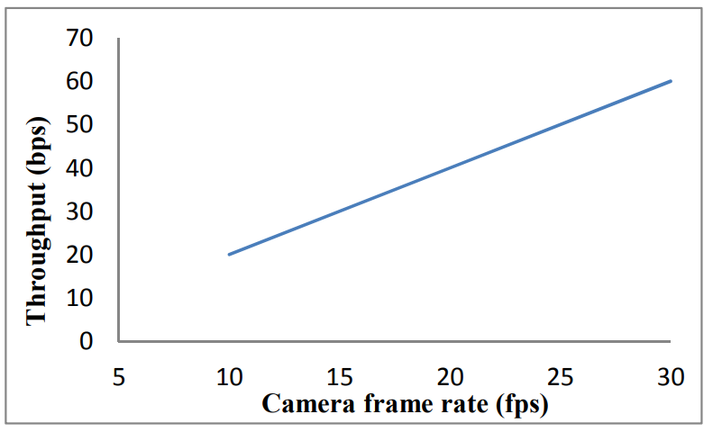
Experiment Performance
Notes:
For performance evaluation, we implemented the OCC system with suggested synchronization The receiver processing interface is based on Labview; the Arduino board is used for controlling transmitter LED. The system configuration which includes transmitter superframe and receiver camera with different setting modulation and shutter speed

Slide 7
Conclusion
Synchronization is one of the most important issues in communication theory. For optical camera communication, it is not only the signal synchronization, it relates to the camera with discrete image.
By using the orthogonal bit pattern signals from the free decoded image signals, the proposed scheme is promising reference solution for OCC system design.

Slide 8
References
[1] Huy Nguyen, and et al., “Rolling MIMO-OFDM for Optical Camera Communication System,” ICAIIC conference, February 2020..
[2] Huy Nguyen, and et al., "The Impact of Camera Parameters on Optical Camera Communication," The International Conference on Artificial Intelligence in Information and Communication, Feb. 2019.

