Slide 1
Project: IEEE P802.15 Interest Group for Wireless Personal Area Networks (WPANs)
Submission Title: The Effect of Camera Parameters on the Performance of V2V Optical Camera Communications
Date Submitted: January. 2021
Source: Cong Hoan Nguyen and Yeong Min Jang [Kookmin University].
Contact: +82-2-910-5068 E-Mail: yjang@kookmin.ac.kr
Re:
Abstract: General technical considerations of OCC system for V2V systems
Purpose: To summary general technical consideration of OCC system for V2V scenarios.
Notice: This document has been prepared to assist the IEEE P802.15. It is offered as a basis for discussion and is not binding on the contributing individual(s) or organization(s). The material in this document is subject to change in form and content after further study. The contributor(s) reserve(s) the right to add, amend or withdraw material contained herein.
Release: The contributor acknowledges and accepts that this contribution becomes the property of IEEE and may be made publicly available by P802.15.

Slide 2
The Effects of Camera Parameters on the Performance of V2V Optical Camera Communications

Slide 3
Introduction
There has been a growing interest in a field of intelligent transportation systems in order to reduce traffic congestion, accidents, air and noise pollution, and other environmental concerns, thus improving the economy and the quality of life.
OCC is a wireless technology that uses light-emitting diodes (LEDs) for data transmission and localization as well as illumination.
Traffic light
Monitor
V2I
OCC
Optical Signal
LED
Camera
Phone
V2V
OCC
Notes:
LEDs-based lights offer many advantages such as reduced energy consumption, higher switching speeds, higher efficiency, longer lifetime and lower cost, compared with conventional light sources.
In addition, LEDs are used in new vehicles (head- and taillight, street and traffic lights, etc., thus making non radio frequency (RF)-based wireless a possibility.

Slide 4
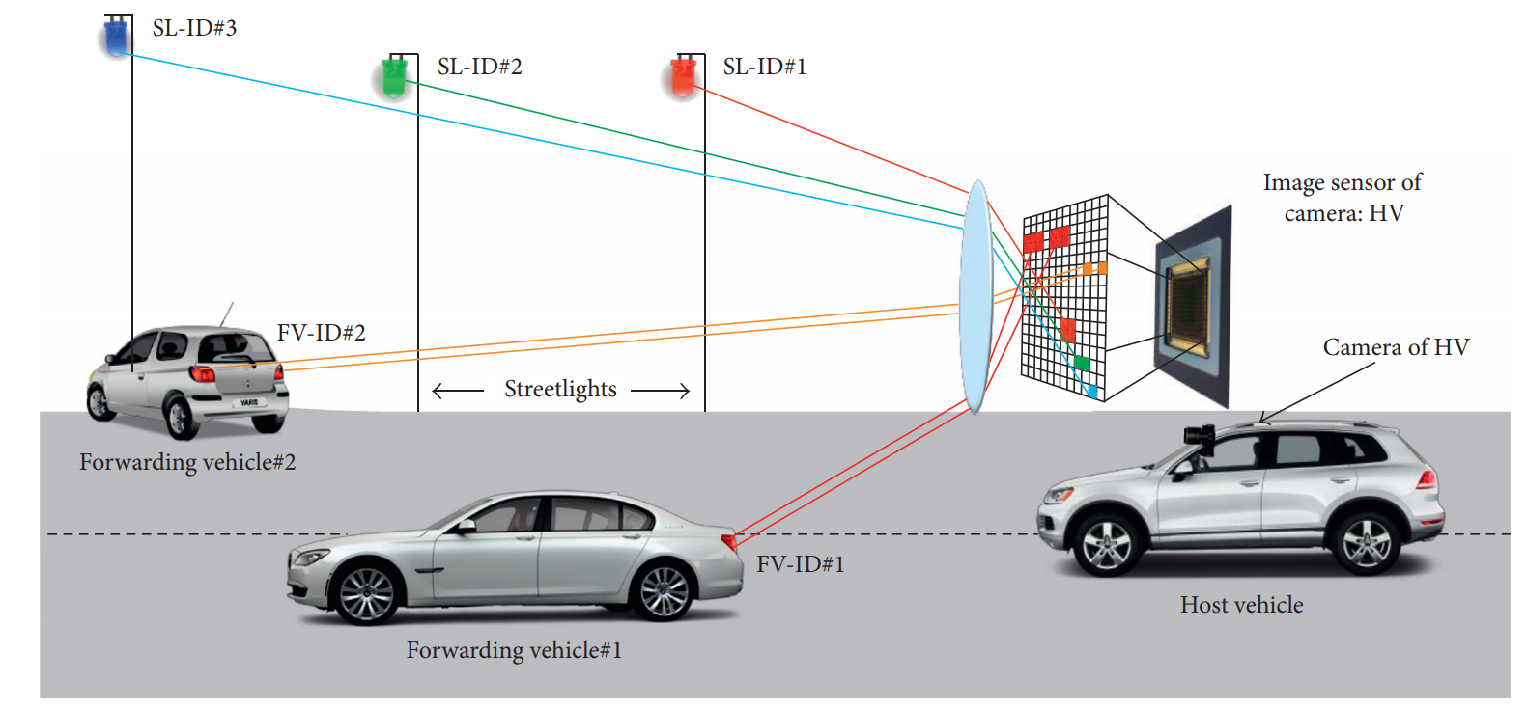
OCC system for V2V applications
OCC systems have their limitations including light flickering due to the low frame rates and particularly in global shutter-based cameras; and lower data rates (a few kbps) compared with PD-based Rxs. CMOS cameras with the rolling-shutter effect and dedicated modulation schemes have been used to overcome flickering and increased the transmission data rates within the smart environment applications
Simulation setup of the OCC-based V2V system.

Slide 5
Technical considerations for
V2V systems
In OCC systems, the camera’s parameters have an impact on the system performance, as reported in the literature. However, few papers have investigated the influence of camera settings in OCC systems, which is the subject of this work.
Here, we consider the impact of lens f-number, IS size, resolution and exposure time, light source radiation pattern, camera noise sources, lens dimension and atmospheric attenuation on the performance of OCC-based V2Vcommunications by developing a model.

Slide 6
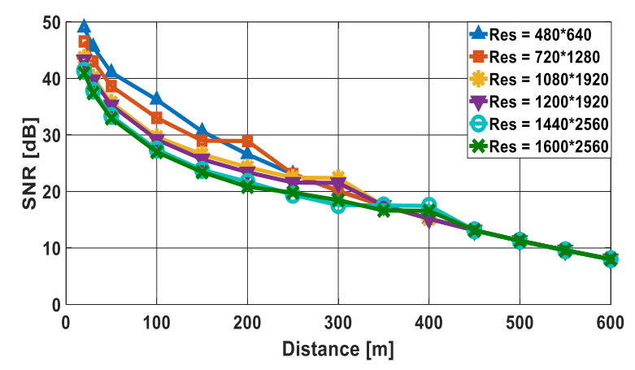
Resolution effect
Figure shows the SNR versus the distance between two vehicles for a range of IS’s resolution. As shown, SNR drops with d and higher values of the IS resolution, particularly for d < 200 m.

Slide 7
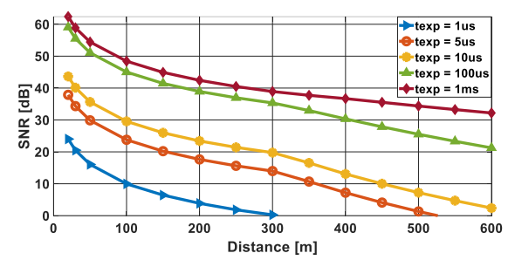
Exposure time effect
Figure represents the impact of the camera’s exposure time on the system’s SNR performance as a function of d. As expected, for a fixed distance, the best SNR is
achieved at higher camera exposure times. Moreover, generally, as the distance increases, the SNR performance of the system decreases almost exponentially

Slide 8
References
[1] Huy Nguyen, and et al., “Rolling MIMO-OFDM for Optical Camera Communication System,” ICAIIC conference, February 2020..
[2] Huy Nguyen, and et al., "The Impact of Camera Parameters on Optical Camera Communication," The International Conference on Artificial Intelligence in Information and Communication, Feb. 2019.

