Slide 1
Project: IEEE P802.15 Working Group for Wireless Personal Area Networks (WPANs)
Submission Title: OCC based IoT Devices for Industrial Applications
Date Submitted : January, 2021
Source : Van Hoa Nguyen and Yeong Min Jang
Company : [Kookmin University]
Address : [Seoul, Korea]
Voice : [+82-2-910-5068], E-Mail: [yjang@kookmin.ac.kr]
Re :
Abstract : This document discusses about the OCC devices for industrial applications.
Purpose : To get real-time data for industrial applications using IoT devices based on OCC technology
Notice: This document has been prepared to assist the IEEE P802.15. It is offered as a basis for discussion and is not binding on the contributing individual(s) or organization(s). The material in this document is subject to change in form and content after further study. The contributor(s) reserve(s) the right to add, amend or withdraw material contained herein.
Release : The contributor acknowledges and accepts that this contribution becomes the property of IEEE and may be made publicly available by P802.15.

Slide 2
Introduction
OCC stands for Optical Camera Communication with many advantages
over existing technology:
Zero interference.
Massive connectivity.
Higher life time.
Stable connectivity even when the distance is increased.
Not harmful for human body.
Camera used in OCC system
Power consumption is very small and low cost for devices.

Slide 3
Advantages of using OCC devices in industrial applications
OCC devices can support high-speed data rate, long distance communication based IoT network
OCC based IoT devices is a promising module that offers cost-effectiveness and useful features such as easy to implement, high data rate, human safety and has great potential in the monitoring system in the factory.

Slide 4
A proposed design of IoT device based on OCC technology
<Transmitter architecture using LED matrix>
Our designed IoT module includes three types of sensors (Temperature and Humidity sensors, CO2 sensor)
This device can measure the environmental condition in the factory and send to the gateway or server for further analysis.

Slide 5
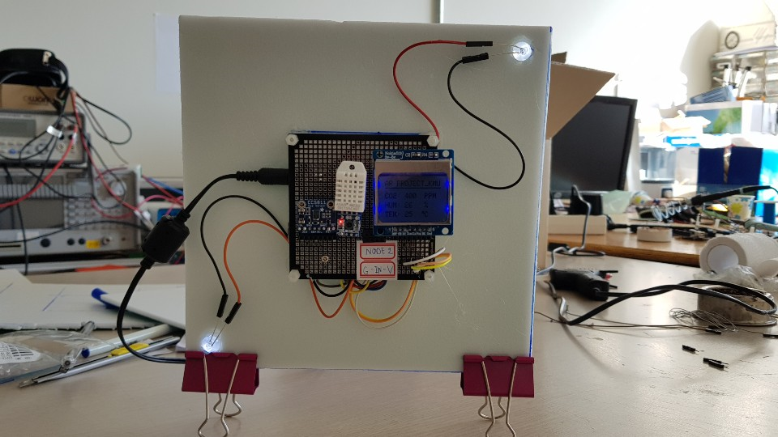
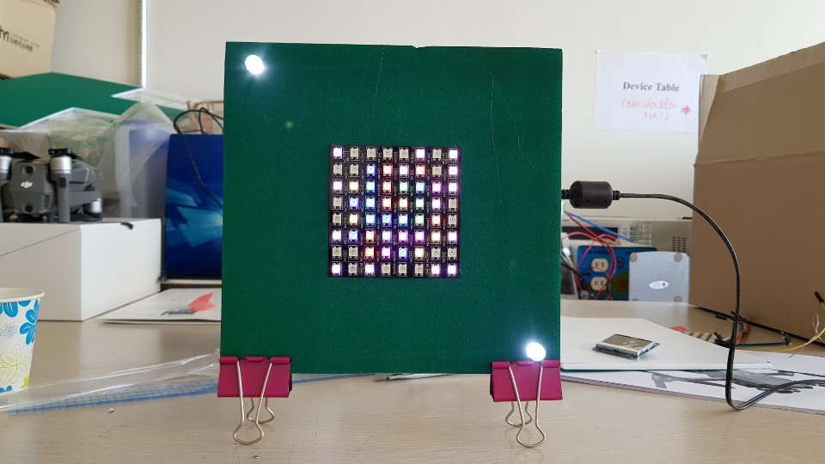
A prototype of IoT device based on OCC technology
We used a LED matrix (8x8) to transmit multiple data in a factory environment.
The camera is used to capture the LED matrix and extract data

