Slide 1
Project: IEEE P802.15 Working Group for Wireless Personal Area Networks (WPANs)
Submission Title: Promising of Optical Camera Communication for Internet of Things system
Date Submitted: January 2021
Source: Huy Nguyen, Yeong Min Jang [Kookmin University].
Contact: +82-2-910-5068 E-Mail: yjang@kookmin.ac.kr
Re:
Abstract: Consideration of Optical Camera Communication for Internet of Things system
Purpose: To discuss about the need for applying OCC for IoT system
Notice: This document has been prepared to assist the IEEE P802.15. It is offered as a basis for discussion and is not binding on the contributing individual(s) or organization(s). The material in this document is subject to change in form and content after further study. The contributor(s) reserve(s) the right to add, amend or withdraw material contained herein.
Release: The contributor acknowledges and accepts that this contribution becomes the property of IEEE and may be made publicly available by P802.15.

Slide 2
Promising of Optical Camera Communication for Internet of Things system

Slide 3
Introduction
The advances of OCC over RF communication can be summarized as follows:
- Visible Light bandwidth more than 1000 times compare with RF bandwidth.
- Non-effect for human health.
- Easy to setup OCC system with light source.
- Cameras is ready in million devices.

Slide 4
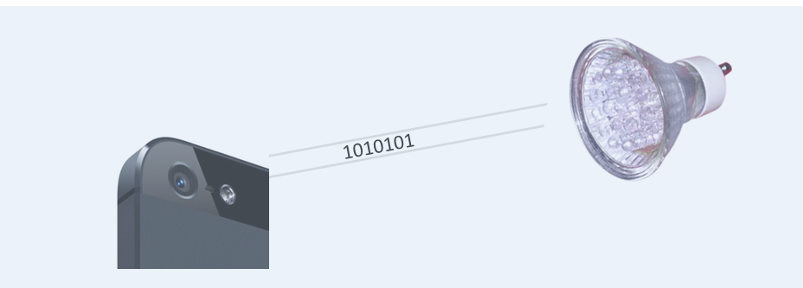
Introduction
OCC is modulating an LED light with data bits that can be received by a camera, which then decodes the bits and extracts the data.
Today we have millions of mobile devices enabled to receive visible light communications via the camera, but we lack standards to describe the modulation format.

Slide 5
Introduction
Unlike VLC or Li-Fi communications that use Photodiodes as receivers, the OCC technique uses an image sensor as the detector to receive data.
Compare with VLC/LiFi, OCC shows some advantages:
The camera lens can spatially separate light sources, and thus OCC technique can implement MIMO.
Camera available everywhere, particularly smartphone cameras and CCTV. Thus, OCC may be a promising solution for market acceptance.

Slide 6
Optical Camera Communication technique for IoT system
Despite the potential of a massive industrial market for monitoring system, OCC technology still a few challenge by the environment requirements:
The asynchronous communication algorithm must support in OCC system.
Flicker should be support. Optical clock rate should be at least 200Hz for no flicker-free
Power consumption should be consider in transmitter side.

Slide 7
Optical Camera Communication technique for IoT system
Example of OCC for IoT

