Slide 1
Project: IEEE P802.15 Working Group for Wireless Personal Area Networks (WPANs)
Submission Title: Candidates for SUN-OFDM PHR of New Low Rates
Date Submitted: 18 Jan. 2021
Source: Jeng-Shiann Jiang, Vertexcom Technologies, Taiwan
Address: 3F-9, No. 1, Taiyuan 2nd ST., Zhubei City, Hsinchu County, Taiwan 30288
E-Mail: js.jiang@vertexcom.com
Re:
Abstract: Comparison of the candidates for SUN-OFDM PHR of new low rates
Purpose: Resolve the issues of SUN-OFDM PHR for new low rates
Notice: This document has been prepared to assist the IEEE P802.15. It is offered as a basis for discussion and is not binding on the contributing individual(s) or organization(s). The material in this document is subject to change in form and content after further study. The contributor(s) reserve(s) the right to add, amend or withdraw material contained herein.
Release: The contributor acknowledges and accepts that this contribution becomes the property of IEEE and may be made publicly available by P802.15.

Slide 2
Candidates for SUN-OFDM PHR of New Low Rates
Jeng-Shiann Jiang, Vertexcom

Slide 3
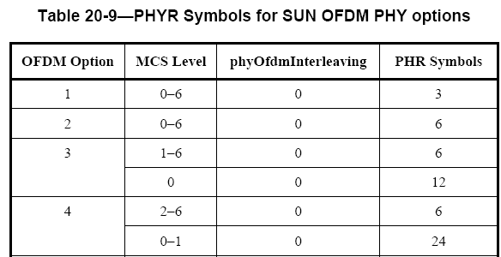
Origin of the Issues
Inconsistency between the text and Table 20-9
Backward incompatible with legacy devices (IEEE 802.15.4-2015)
MCS independent
Inconsistent
MCS dependent

Slide 4
Candidates
Candidate 1
15-20-0171: Keep Table. Change Text
Candidate 2
15-20-0393: Keep Text. Change Table
Candidate 3
15-20-0305: Append PHR2
Candidate 4
15-20-0387: Cancel new low rates.
Set aside the issue for further observation, experiment, use case check, and better solution.
Leave room for change for future amendment

Slide 5
More About PHR2 Proposal (1/2)
A typical approach used in Wi-Fi 802.11 to guarantee backward compatibility
802.11
802.11g → 802.11n: Keep L-SIG, append HT-SIG
802.11n → 802.11ac: Keep L-SIG, append VHT-SIG
packet length is re-calculated based on 11g MCS0 with 6Mbps
PHR2 approach
new low rates: Keep PHR, append PHR2
Frame length is re-calculated base on lowest supported rate
Backward compatibility: Legacy devices know the packet duration to avoid causing interference and affecting throughput

Slide 6
More About PHR2 Proposal (2/2)
Cons pointed out in 15-21-0029
Higher power consumption
Negligible because new low-rate packets only occupy a small portion of all packets.
Worthy for the trade-off of backward compatibility
Restricted packet length
Packet duration is around 0.655 sec for O3M0 2047B, and 1.3 secs for O4M0 2047B. Super long packet is vulnerable to time-varying channels and interferences from legacy devices
The restricted packet length is around 330ms, which exceeds the maximum channel dwelling time 250 ms when frequency hopping is used in Wi-SUN.
The real concern about this proposal is that the packet format change is now suitable for Corrigendum, but it is suitable for future amendment

Slide 7
Weighting of the Factors for Decision Making
Candidate 1: 15-20-0171: Keep Table. Change Text
Candidate 2: 15-20-0393: Keep Text. Change Table
Candidate 3: 15-20-0305: Append PHR2
Candidate 4: 15-20-0387: Cancel new low rates
Weighting of factors
1. Backward compatibility: can only be sacrificed when
Technical errors in previous version (no error in PHR of 802.15.4-2015)
Greenfield (assume no legacy devices)
4 = 3 > 2 > 1
2. Performance
Better sensitivity with down to 12.5Kbps
3 = 1 > 2
3. Others (simplicity, power consumption, …)

Slide 8
Our Preference
Candidate 1: 15-20-0171: Keep Table. Change Text
Candidate 2: 15-20-0393: Keep Text. Change Table
Candidate 3: 15-20-0305: Append PHR2
Candidate 4: 15-20-0387: Cancel new low rates
Preference
4 > 3 > 2 > 1
Pros
Backward compatible
Room for future amendment
Backward compatible
Good sensitivity
Simple
Good sensitivity
Packet format change
Backward incompatible
Suffer sensitivity
Backward incompatible
Higher Rx complexity
Cons

