Slide 1
Project: IEEE P802.15 Working Group for Wireless Personal Area Networks (WPANs)
Submission Title: OOC Enabled V2X Stack Architecture for Connected Mobility
Date Submitted: January 2021
Source: Vinayagam Mariappan (SMR Automotive Modules Korea Ltd.), Geonyoung Choi, Jaehong Kim, Jong Chang Ham, Wonsik Hong, Hojin Huh (SMR Automotive Modules Korea Ltd.).
Address: Contact Information: +82-32-6507-785, FAX: +82-32-6507-871, E-Mail: vinayagam@ieee.org
Re:
Abstract: This document introduces the OCC enabled V2X technology stack architecture to be used in IEEE802.15.7a High Data Rate OCC (Optical Camera Communication) TG. The proposed V2X stack architecture requirements considered to use with varying channel conditions and maintaining automotive connectivity during high mobility (speeds up to 350 km/h), flicker mitigation, Radio Frequency (RF) co-existence, and a communication range of up to 200m in on-road mobility scenario.
Purpose: To provided OCC enabled V2X stack architecture for IEEE802.15.7a High Data Rate OCC.
Notice: This document has been prepared to assist the IEEE P802.15. It is offered as a basis for discussion and is not binding on the contributing individual(s) or organization(s). The material in this document is subject to change in form and content after further study. The contributor(s) reserve(s) the right to add, amend or withdraw material contained herein.
Release: The contributor acknowledges and accepts that this contribution becomes the property of IEEE and may be made publicly available by P802.15.
Slide 1

Slide 2
Contents
Connectivity in the Automotive / Mobility
V2X Stack Architecture
V2X Data Communication Standards
OCC Enabled V2X Stack Architecture
Conclusion
Slide 2

Slide 3
Connectivity in the Automotive / Mobility
Automotive / Mobility landscape is undergoing a significant transformation driven by connectivity
Connectivity on Mobility is a critical piece of automotive evolution that will unlock new capabilities such as safety alerts, enhanced traffic management, and next-gen capabilities (e.g., ADAS, Autonomous).
Connectivity-enabled services in Mobility will support a proliferating, future set of mobility models and continued evolution in the connected vehicles, which requires communication standards to ensure data interoperability and security to maximize the benefits of V2X (vehicle-to-everything) infrastructure.
Wi-Fi DSRC (Dedicated Short-Range Communications ), C-V2X (Cellular V2X), and 5G C-V2X standards have risen as the primary candidates for V2X data communication.
Slide 3

Slide 4
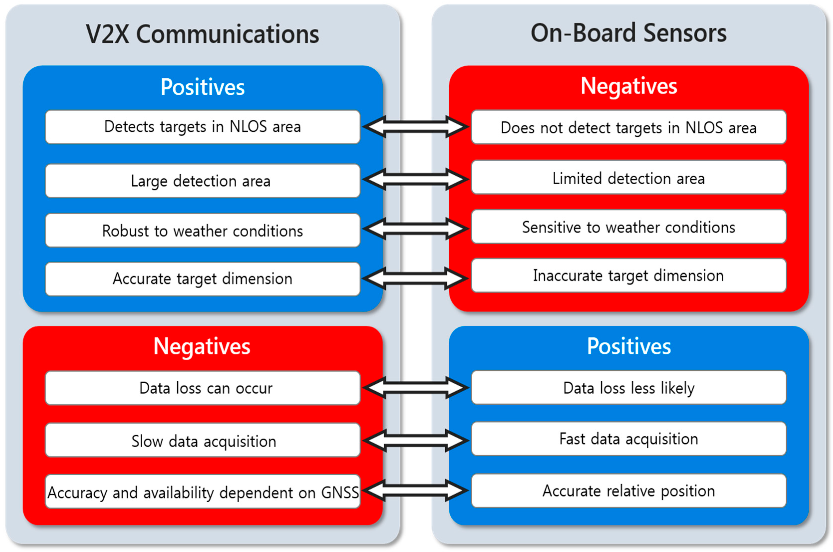
Connectivity in the Automotive / Mobility…Cont.
Connectivity-Enabled Services Vs On-Board Sensors-Enabled Services
Slide 4

Slide 5
Connectivity in the Automotive / Mobility…Cont.
Communication Standards in V2X Evolution
Player across the Automotive, Mobile, and Telecom industries are driving investment / innovation in connectivity / sensors for vehicles, infrastructure, and vehicle networks on the path towards next-generation V2X mobility.
Growth of Smart Mobility
Incumbents and new entrants are experimenting with novel mobility models (e.g. ride share) which are enhanced by a V2X connectivity environment, with the potentials to unlock new capabilities (e.g., ADAS, Autonomous).
Connected Ecosystem Development
Driving a computing Applications in Mobility which offer added functionality for the in-vehicle experience, linkage to other connected ecosystems (e.g., connected home,), eventually surrounding vehicles, and connected on-road infrastructure .
Impact on Automotive / Mobility Industry
Slide 5

Slide 6
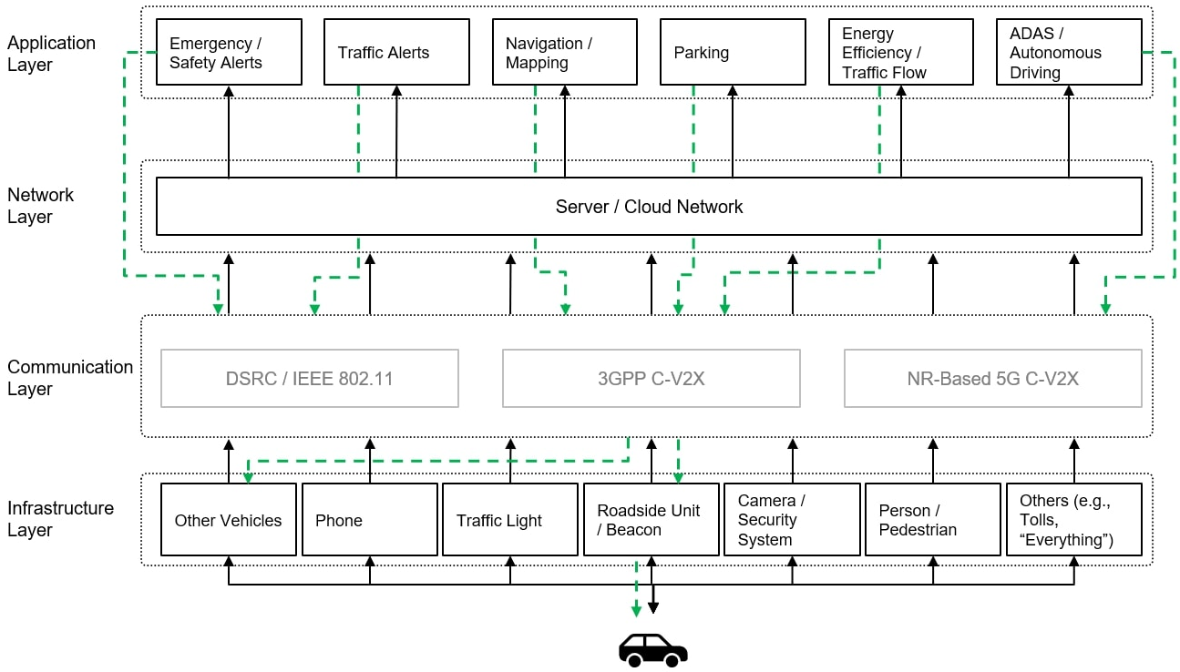
V2X Stack Architecture
< V2X Stack Architecture >
Sources(s): Red Chalk Group Analysis
Slide 6

Slide 7
V2X Data Communication Standards
Wi-Fi DSRC / IEEE 802.11p
3GPP C-V2X
NR-Based 5G V-V2X
Commercial Readiness
Commercialized and installed in Vehicles
Commercialization started
Commercialization started
Illustrative
Use Cases
Safety-related messages for local/close range communication for V2V and V2I situations
Supports node-to-note (V2V, V2I, V2P) as well as node-to-network (V2N) communication
Ability to support autonomous driving due to data volume, reliability and latency capabilities
Data Transmission Characteristics
Data Volume:
Low-to moderate data volumes
Ability to drive high capacity / throughput by leveraging existing mobile infrastructure
Expected to have order of magnitude increases in data volume and device capacity per geographical area
Range / Reliability:
Short range (~ 1 km) communication limits the possibility of data interference
High advantage on line-of-sight communication range
Strong data reliability , even in high density environment
Latency:
Low Latency (2ms) for basic safety messages
Transmission duration is fixed at 1ms
Expected to reach 1ms for V2X communication
Slide 7

Slide 8
OCC Enabled V2X Stack Architecture
Emergency / Safety Alerts
Traffic Alerts
Navigation / Mapping
Parking
Energy Efficiency / Traffic Flow
ADAS / Autonomous Driving
Server / Cloud Network
OCC-V2X / IEEE 802.15
DSRC / IEEE 802.11
3GPP C-V2X
NR-Based 5G C-V2X
On-Road Signage
Vehicles Camera / Lights
Other Vehicles
Phone
Traffic Light
Roadside Unit / Beacon
Camera / Security System
Person / Pedestrian
On-Road infrastructure
< OCC Enabled V2X Stack Architecture >
Slide 8

Slide 9
OCC Enabled V2X Stack Architecture…Cont.
V2X OCC Link Characteristics
Carries 300 THz of license-free bandwidth carried on visible wavelengths .
Low-to moderate data volumes
Short range (~ 200 m) communication limits the possibility of data interference
Low Latency for basic safety and alert messages
Provides flexible, secure, and safety communication.
Does not required additional automotive cybersecurity methods in connected mobility.
Slide 9

Slide 10
Conclusion
Proposed the OOC Enabled V2X Stack Architecture for Connected Mobility.
This proposed V2X stack architecture will act as a central driver in the enhancement of mobility through increased safety, value-added services, and advanced driving capabilities (e.g., ADAS, Autonomous, etc.).
Discussed the different V2X Infrastructure Data Communication standards.
This proposed OCC Enabled V2X stack design consideration helps to provide flexible, secure, and safety communication in an on-road mobility scenario through the OCC access link.
Slide 10

