Slide 1
Project: IEEE P802.15 Working Group for Wireless Personal Area Networks (WPANs)
Submission Title: [Proposal for SUN OFDM PHY PHR Clarifications]
Date Submitted: [13 January 2021]
Source: [Ruben Salazar Cardozo, Chris Hett] Company [Landis+Gyr]
Address: [30000 mill creek avenue Alpharetta GA USA]
Voice: [], E-Mail: [ruben.salazar@landisgyr.com, chris.hett@landisgyr.com]
Re: [Proposal for 802.15.4-2020 Corrigendum]
Abstract: [This contribution proposes a way to address and clarify certain aspect of the 802.15.4 – 2020 description of the SUN OFDM PHY PHR]
Purpose: [Discussion and Agreement]
Notice: This document has been prepared to assist the IEEE P802.15. It is offered as a basis for discussion and is not binding on the contributing individual(s) or organization(s). The material in this document is subject to change in form and content after further study. The contributor(s) reserve(s) the right to add, amend or withdraw material contained herein.
Release: The contributor acknowledges and accepts that this contribution becomes the property of IEEE and may be made publicly available by P802.15.

Slide 2
Current Issue
The description of the PHY header in section 20.2.4 of IEEE 802.15.4-2020 is confusing and may be ambiguous
Detailed analysis shows that it is also incomplete
Specifically, one of the fields in the PHY header, the first bits of the field representing the “Rate”, is described only in very general manner
The information in the “Rate” field may lead to multiple interpretations or implementations that verify the description, yet are incompatible
Also, it sacrifices the opportunity to define valid behavior of legacy devices as well as additional behavior for new devices

Slide 3
Addressing the Issue
Editing the text that defines how to transmit the PHR, editing one of the tables in the PHR section, as well as completing the description of the “Rate” field as proposed below, should alleviate the ambiguity in the specification and open the opportunity for determining a clear behavior of legacy devices, i.e., those prior to the 802.15.4x amendment, and clear the path to potentially additional behavior in new devices, i.e., those compliant with the 802.15.4-2020 and beyond.

Slide 4
Proposal -1/4
Current text:
The PHR shall be transmitted using the lowest supported MCS level, as described in Table 20-10, for the option being used, except for OFDM option 3 and OFDM Option 4, the PHR shall be transmitted using MCS1 and MCS2 respectively.
Proposed text:
The PHR shall be transmitted at 50kbps, except that for OFDM option 1 the PHR shall be transmitted at 100kbps.

Slide 5
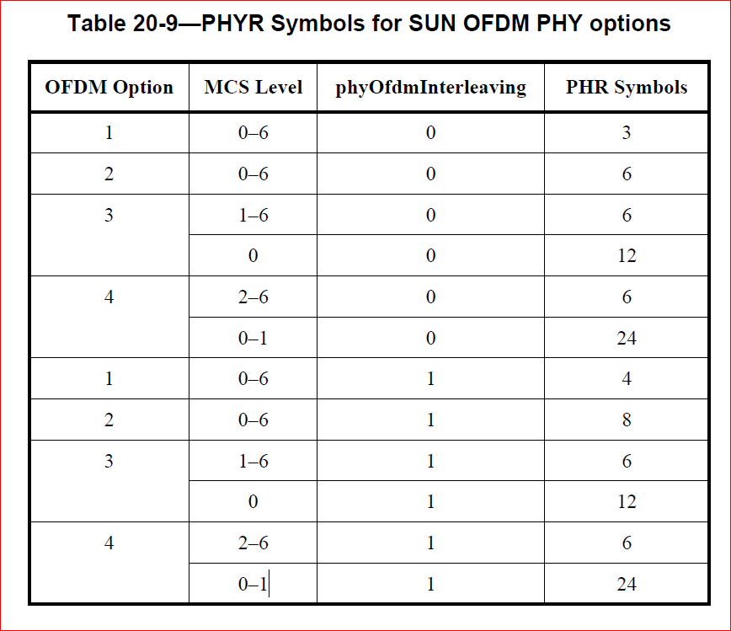
Proposal - 2/4
Edit Table 20-9 to reflect accurately the PHR description
Current Table includes MCS levels that are not used in the PHR according to the text description, so creating confusion.

Slide 6
Proposal – 2/4 – cont.
Proposed change to Table 20-9
Include in Table 20-9 only the valid modes for transmitting the PHR.
Table 20-9—PHR Symbols for SUN OFDM PHY options
OFDM Option | MCS Level | phyOfdmInterleaving | PHR Symbols
1 | 0 | 0 | 3
 |  | 1 | 4
2 | 0 | 0 | 6
 |  | 1 | 8
3 | 1 | 0 | 6
 |  | 1 | 6
4 | 2 | 0 | 6
 |  | 1 | 6

Slide 7
Proposal - 3/4
Current text:
The Rate field is set to the numerical value of the MCS, as described in 20.4, transmitted MSB first. The datarates for each OFDM bandwidth option can be found in 20.3.
Proposed text:
The Rate field is set to the numerical value of the MCS, as described in Table 20-9a, transmitted MSB first. The datarates for each OFDM bandwidth option can be found in 20.3.

Slide 8
Proposal - 4/4
Include in section 20-2.4, after the “Rate” description text, the explanatory table as presented below:
Table 20-9a Rate field values
MCS Index | Numerical value | “Rate” Field
MCS0 | 0 | 00000
MCS1 | 1 | 00001
… | … | …
MCS6 | 6 | 00110
--- | >6 | reserved

Slide 9
Compatibility analysis
Sender | Receiver | Comment for any OFDM Option
802.15.4-2015 | 802.15.4-2015 | DataRate only 50kbps and above
802.15.4-2015 | 802.15.4-2020 | DataRate only 50kbps and above
802.15.4-2020 | 802.15.4-2015 | DataRate only 50kbs and above
802.15.4-2020 | 802.15.4-2020 | All OFDM DataRates defined

