Slide 1
Project: IEEE P802.15 Working Group for Wireless Personal Area Networks (WPANs)
Submission Title: Resolutions for SUN-OFDM PHR of New Low Rate
Date Submitted: 15 Dec. 2020
Source: Jeng-Shiann Jiang, Vertexcom Technologies, Taiwan
Address: 3F-9, No. 1, Taiyuan 2nd ST., Zhubei City, Hsinchu County, Taiwan 30288
E-Mail: js.jiang@vertexcom.com
Re:
Abstract: Summarize the resolutions for IEEE802.15.4-2020 OFDM PHR of new low rates
Purpose: Determine the best resolution for IEEE802.15.4-2020 OFDM PHR of new low rates
Notice: This document has been prepared to assist the IEEE P802.15. It is offered as a basis for discussion and is not binding on the contributing individual(s) or organization(s). The material in this document is subject to change in form and content after further study. The contributor(s) reserve(s) the right to add, amend or withdraw material contained herein.
Release: The contributor acknowledges and accepts that this contribution becomes the property of IEEE and may be made publicly available by P802.15.

Slide 2
Resolutions for SUN-OFDM PHR of New Low Rates
Jeng-Shiann Jiang, Vertexcom

Slide 3
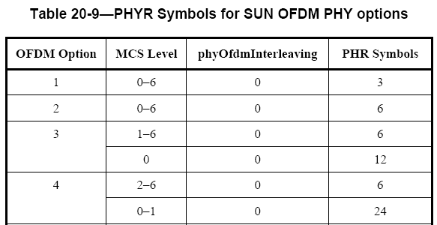
Problem Description
In Table 20-9 on page 571, PHR symbols of Option 3 is 6 for PAYLOAD MCS1~6, and 12 for MCS0. For Option4, PHR symbols is 6 for PAYLOAD MCS2~6, and 24 for MCS0~1.
  The decoding of PHR depends on the PAYLOAD MCS, while the PAYLOAD MCS is unknown until PHR is successfully decoded, which results in a deadlock.
  The approach is not backward compatible, which might cause higher probability of collision and throughput reduction
PAYLOAD MCS is unknown here
STF
LTF
PHR
PHY Payload

Slide 4
Definition
New low rate:
  OFDM Option 3 MCS0
  OFDM Option 4 MCS0 and MCS1
Legacy device: device that follows IEEE802.15.4-2015 which does not support new low rate

Slide 5
Resolutions
Approach 1
  PHR MCS dependent on the payload MCS. Provide the mechanism to inform the receiver the payload MCS in advance for new low rates
Approach 2
  PHR use MCS1 for all rates of Option3
  PHR use MCS2 for all rates of Option4
Approach 3
  Proposal of PHR+PHR2
Approach 4
  Cancel the support of new low rates

Slide 6
Approach 1
PHR use MCS1 for all rates of Option3, except for MCS0 in which PHR use MCS0.
PHR use MCS2 for all rates of Option4, except for MCS0~1 in which PHR use MCS0.
Solve the MCS ambiguity issue by providing a mechanism to inform the receiver the payload MCS in advance for new low rates
Problems:
  Lack of the mechanism in current standard
    Interop issue: proprietary mechanism used by
    one vendor cannot be recognized by the other
    vendors
  Overhead:
    Additional mechanism to inform the Rx in
    advance
OFDM Option | PHR MCS | Payload MCS | PHR Symbols
3 | 1 | 1~6 | 6
3 | 0 | 0 | 12
4 | 2 | 2~6 | 12
4 | 0 | 0~1 | 24

Slide 7
Approach 1
Problems (cont.):
  Interference from legacy devices:
    Legacy device might consider unsupported modes as false alarm
  Impractical:
    New low rates are usually used when channel quality becomes poor. The receiver might not be able to receive the notification of PHR MCS with current rates.
    Ex: Plan to change to MCS0 from MCS2, but failed to inform the Rx with current MCS2
New
New
MCS0
B
A
D
C
legacy
legacy

Slide 8
Approach 2
PHR use MCS1 for all rates of Option 3 and use MCS2 for all rates of Option 4.
No MCS ambiguity issue
Problems:
  Sensitivity is limited by PHR error rate
  Backward incompatibility:
    Legacy device might consider unsupported modes as false alarm
    Legacy device might calculate packet duration of unsupported modes incorrectly
OFDM Option | PHR MCS | Payload MCS | PHR Symbols
3 | 1 | 0~6 | 6
4 | 2 | 0~6 | 12

Slide 9
Approach 3
Proposal of PHR + PHR2
  Backward compatible by keeping PHR
  Sensitivity not limited by PHR error rate by adding PHR2 with MCS0
  No MCS ambiguity issue
Problems:
  Overhead
    12 or 24 more symbols of overhead are added
    Overhead is less than that of Approach 1
  Significant modification
    Adding PHR2 is significant change for
    corrigendum
802.15.4x new low data rate
STF
LTF
PHR
PHR2
PHY Payload
Option 1 | Option2 | Option3 | Option4
MCS0 | MCS0 | MCS0 | MCS0
MCS1 | MCS1 | MCS1 | MCS1
MCS2 | MCS2 | MCS2 | MCS2
MCS3 | MCS3 | MCS3 | MCS3
MCS4 | MCS4 | MCS4 | MCS4
MCS5 | MCS5 | MCS5 | MCS5
MCS6 | MCS6 | MCS6 | MCS6
PHR+PHR2
PHR only

Slide 10
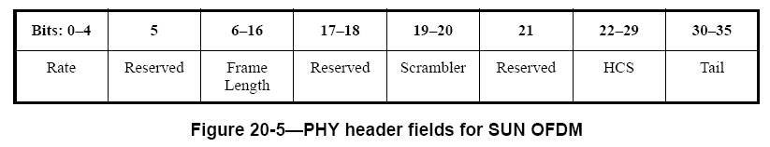
Approach 3
PHR content modification for low data rate
  The purpose of PHR in these cases is to let the legacy devices calculate correct packet length, in order to avoid collision and throughput reduction
  Original PHR
  Modified PHR
    Rate(b0-b4): Set to MCS1 for Option3, and MCS2 for Option4. The behavior is unpredictable for legacy devices if the field is set to low rate.
    Frame Length(b6-b16): calculate corresponding length with MCS1 in Option3 and MCS2 in Option4. The length must be larger than or equal to real payload length
      Option3: additional 12 symbols is included in payload.
        MCS0: FL = 2*(FL0+ 5.5), FL0 < 1019 octets, FL0 is payload frame length using MCS0
      Option4: additional 24 symbols is included in payload
        MCS0: FL = 4*(FL0+ 5.25), FL0 < 507 octets , FL0 is payload frame length using MCS0
        MCS1: FL = 2*(FL1+ 9.375), FL1 < 1015 octets , FL1 is payload frame length using MCS1
    PHR2 (b21): set to 1 if PHR2 exist, otherwise set to 0
Bits:0-4 | 5 | 6-16 | 17-18 | 19-20 | 21 | 22-29 | 30-35
Rate | Reserved | Frame Length | Reserved | Scrambler | PHR2 | HCS | Tail

Slide 11
Approach 4
Cancel the support of new low rates
Problem:
  No new low rates for better coverage

