Slide 1
Project: IEEE P802.15 Working Group for Wireless Personal Area Networks (WPANs)
Submission Title: Resolutions for SUN-OFDM PHR of New Low Rate
Date Submitted: 2 Dec. 09, 2020
Source: Jeng-Shiann Jiang, Vertexcom Technologies, Taiwan
Address: 3F-9, No. 1, Taiyuan 2nd ST., Zhubei City, Hsinchu County, Taiwan 30288
E-Mail: js.jiang@vertexcom.com
Re:
Abstract: Compare resolutions for IEEE802.15.4-2020 OFDM PHR of new low rates
Purpose: Determine the best resolution for IEEE802.15.4-2020 OFDM PHR of new low rates
Notice: This document has been prepared to assist the IEEE P802.15. It is offered as a basis for discussion and is not binding on the contributing individual(s) or organization(s). The material in this document is subject to change in form and content after further study. The contributor(s) reserve(s) the right to add, amend or withdraw material contained herein.
Release: The contributor acknowledges and accepts that this contribution becomes the property of IEEE and may be made publicly available by P802.15.

Slide 2
Resolutions for SUN-OFDM PHR of New Low Rates
Jeng-Shiann Jiang, Vertexcom

Slide 3
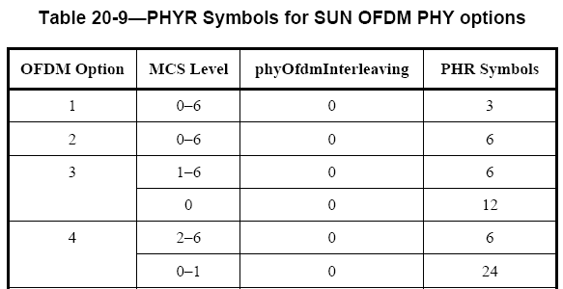
Problem Description
In Table 20-9 on page 571, PHR symbols of Option 3 is 6 for PAYLOAD MCS1~6, and 12 for MCS0. For Option4, PHR symbols is 6 for PAYLOAD MCS2~6, and 24 for MCS0~1.
The decoding of PHR depends on the PAYLOAD MCS, while the PAYLOAD MCS is unknown until PHR is successfully decoded, which results in a deadlock.
The approach is not backward compatible, which might cause higher probability of collision and throughput reduction
PAYLOAD MCS is unknown here
STF
LTF
PHR
PHY Payload

Slide 4
Resolutions
Approach 1
PHR use MCS1 for all rates of Option3
PHR use MCS2 for all rates of Option4
Approach 2
PHR MCS dependent on the payload MCS. Provide the mechanism to inform the receiver the payload MCS in advance for new low rates
Approach 3
Proposal of PHR+PHR2
Approach 4
Cancel the support of new low rates

Slide 5
Approach 1
PHR use MCS1 for all rates of Option 3, and use MCS2 for all rates of Option 4.
Problems:
Sensitivity is limited by PHR error rate
Backward incompatibility. Behavior of legacy devices is unpredictable for new low rates
Might drop the packet or consider it as false alarm.
Might not be able to calculate the packet duration correctly.
OFDM Option | PHR MCS | Payload MCS | PHR Symbols
3 | 1 | 0~6 | 6
4 | 2 | 0~6 | 12

Slide 6
Approach 2
PHR use MCS1 for all rates of Option3, except for MCS0 in which PHR use MCS0.
PHR use MCS2 for all rates of Option4, except for MCS0~1 in which PHR use MCS0.
Provide a mechanism to inform the receiver the payload MCS in advance for new low rates
Problems:
Backward incompatible. Behavior of legacy
devices is unpredictable for new low rates
Some packets from other nodes might arrive
before the low rate packet
Impractical. New low rate is used for poor
channel quality. The receiver might not be able to
receive the notification of PHR MCS with other
higher rates.
OFDM Option | PHR MCS | Payload MCS | PHR Symbols
3 | 1 | 1~6 | 6
3 | 0 | 0 | 12
4 | 2 | 2~6 | 12
4 | 0 | 0~1 | 24

Slide 7
Approach 3
Proposal of PHR + PHR2
Backward compatible by keeping PHR
Sensitivity not limited by PHR error rate by adding PHR2 with MCS0
Problems:
12 or 24 more symbols of overhead are added
Modification of adding PHR2 is quite significant for corrigendum
802.15.4x new low data rate
STF
LTF
PHR
PHR2
PHY Payload

Slide 8
Approach 4
Cancel the support of new low rates
Problem:
No new low rates for better coverage

