Slide 1
Project: IEEE P802.15 Working Group for Wireless Personal Area Networks (WPANs)
Submission Title: [Consolidated Technical Proposal for TG4aa JRE]
Date Submitted: [14th December, 2020]
Source: [Hiroshi Harada, Ryota Okumura] Company [Kyoto University]
[Takamitsu Hafuka] Company [Lapis Technology]
Address : Kyoto University [Yoshidahonmachi, Sakyo-ku, Kyoto 606-8501 Japan]
Lapis Technology[2-4-8 Shinyokohama,Kouhoku-ku,Yokohama 222-8575 Japan]
Voice:[+81-75-753-5318], FAX: [], E-Mail:[hiroshi.harada@i.kyoto-u.ac.jp]
Re: [] Abstract: [This document includes Technical Contributions toward the development the amendment of IEEE Std 802.15.4-2020] Purpose: [Consolidated Technical Proposal for TG4aa JRE.]
Notice: This document has been prepared to assist the IEEE P802.15. It is offered as a basis for discussion and is not binding on the contributing individual(s) or organization(s). The material in this document is subject to change in form and content after further study. The contributor(s) reserve(s) the right to add, amend or withdraw material contained herein.
Release: The contributor acknowledges and accepts that this contribution becomes the property of IEEE and may be made publicly available by P802.15.

Slide 2
Current SUN FSK options for Japan in IEEE 802.15.4
Frequency band (MHz) | Parameter | Operating mode
 |  | #1 | #2 | #3 | #4
920-928 MHz | Data rate (kb/s) | 50 | 100 | 200 | 400
 | Modulation | 2-FSK | 2-FSK | 2-FSK | 4-FSK
 | Modulation index | 1.0 | 1.0 | 1.0 | 0.33
 | Channel spacing (kHz) | 200 | 400 | 600 | 600
 | Standard | 802.15.4-2020 [1]

Slide 3
Consolidated Proposals
Frequency band (MHz) | Parameter | Operating mode
 |  | #1 | #2 | #3 | #4 | #XX | #XX | #XX | #XX
920-928 MHz | Data rate (kb/s) | 50 | 100 | 200 | 400 | 400 | 600 | 600 | 800
 | Modulation | 2-FSK | 2-FSK | 2-FSK | 4-FSK | 2-FSK | 2-FSK | 4-FSK | 4-FSK
 | Modulation index | 1.0 | 1.0 | 1.0 | 0.33 | 0.5 | 0.4 | 0.5 | 0.33
 | Channel spacing (kHz) | 200 | 400 | 600 | 600 | 200 * N 1≦N≦5 [2] | 200 * N 1≦N≦5 [2] | 200 * N 1≦N≦5 [2] | 200 * N 1≦N≦5 [2]
 | Standard | 802.15.4-2020 [1] |  |  |  | Proposed
Note: N is integer number

Slide 4
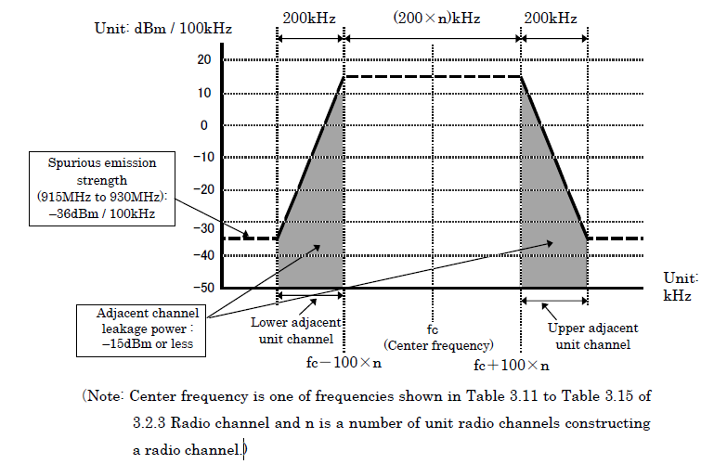
Spurious emission strength requirement from ARIB-T108[1]
MOST Stringent requirement : -36dBm at BW 700-800kHz for n=5(BW=1000kHz) case

Slide 5
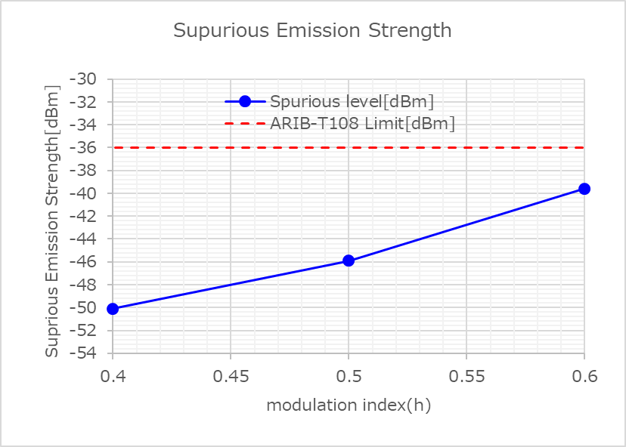
2FSK_400kbps Spurious Emission Strength measurement by TELEC-T245 (Purple portion in slide4)
Condition:2FSK
Data rate= 400kbps, Gaussian BT= 0.5, BW=1000kHz, Pout =13dBm, Spurious band = 700-800kHz
Signal Generator : Keysight E4438C
ARIB-T108 Spurious Emission Strength
requirement ≦ -36dBm
Proposed
modulation index 0.5 :10dB margin
modulation index 0.6: 4dB margin

Slide 6
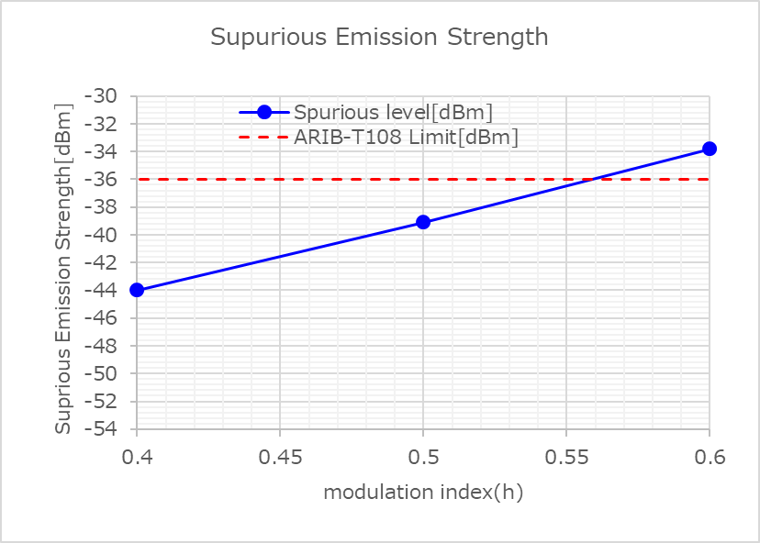
2FSK_600kbps Spurious Emission Strength measurement by TELEC-T245 (Purple portion in slide4)
Condition:2FSK
Data rate= 600kbps, Gaussian BT= 0.5, BW=1000kHz, Pout =13dBm, Spurious band = 700-800kHz
Signal Generator : Keysight E4438C
ARIB-T108 Spurious Emission Strength
requirement ≦ -36dBm
Proposed
modulation index 0.4 :9dB margin
modulation index 0.5: 3dB margin

Slide 7
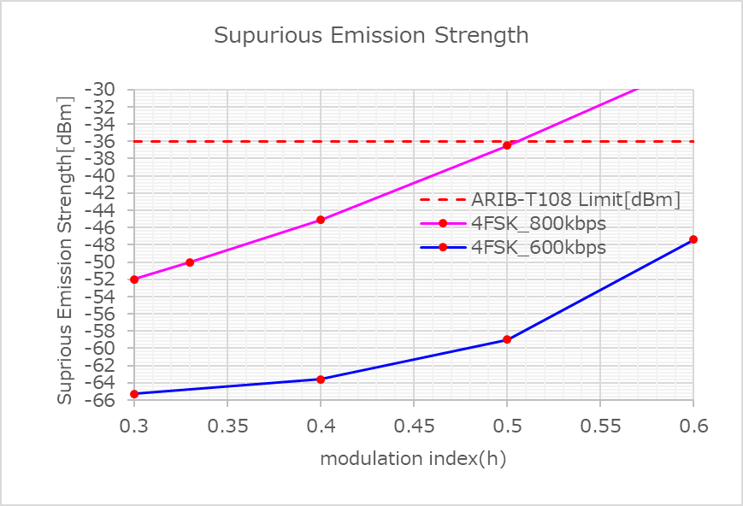
4FSK_600kbps/800kbps Spurious Emission Strength measurement by TELEC-T245 (Purple portion in slide4)
Condition:4FSK
Data rate= 600kbps/800kbps, Gaussian BT= 0.5, BW=1000kHz, Pout =13dBm, Spurious band = 700-800kHz
Signal Generator : Keysight E4438C
ARIB-T108 Spurious Emission Strength
requirement ≦ -36dBm
Proposed
4FSK 600kbps :
modulation index 0.5 :23dB margin
Proposed
4FSK 800kbps :
modulation index 0.33 :14dB margin

Slide 8
Reference
[1] IEEE, “IEEE 802.15.4-2020,” July 2020.
[2] ARIB, “ARIB STD-T108 920MHz-BAND TELEMETER, TELECONTROLAND DATA TRANSMISSION RADIO EQUIPMENT ver 1.3,” Apr. 2019.
[3] H.Harada and R. Okumura, “15-20-295-03-04aa”
[4] T.Hafuka and T.Kuramochi, “15-20-294-01-04aa”
[5] T.Kuramochi, “15-20-0321-01-04aa”

