Slide 1
Project: IEEE P802.15 Working Group for Wireless Personal Area Networks (WPANs)
Submission Title : AI based channel estimation for vehicular optical camera communication (OCC) system.
Date Submitted : November, 2020
Source : Md. Osman Ali, Moh. Khalid Hasan, and Yeong Min Jang
Company : [Kookmin University]
Address : [Seoul, Korea]
Voice : [+82-2-910-5068], E-Mail: [yjang@kookmin.ac.kr]
Re :
Abstract : This document focuses on developing high accuracy channel model for vehicular OCC system.
Purpose : To ensure reliable communication between high mobility vehicles using OCC.
Notice: This document has been prepared to assist the IEEE P802.15. It is offered as a basis for discussion and is not binding on the contributing individual(s) or organization(s). The material in this document is subject to change in form and content after further study. The contributor(s) reserve(s) the right to add, amend or withdraw material contained herein.
Release : The contributor acknowledges and accepts that this contribution becomes the property of IEEE and may be made publicly available by P802.15.

Slide 2
Contents
Introduction to Optical Camera Communication (OCC)
Necessity of channel model
Why do we need AI based channel model?
System Architecture
Conclusion

Slide 3
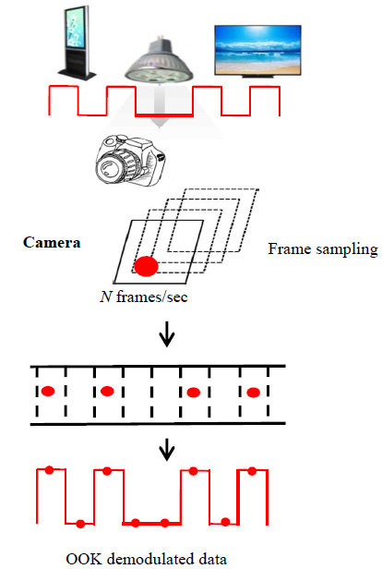
Introduction to Optical Camera Communication (OCC)
OCC is a technique to receive binary data from LED panel or digital signage (Display) through image sensor of camera.
It requires less additional cost as it needs a simple driver circuit to existing digital signage and camera/smartphone (usually 30 frames/sec).

Slide 4
Necessity of channel model
Communicating data from one location to another requires some form of pathway or medium called communication channels.
Channel state information (CSI), which enables wireless systems to adapt their transmission parameters to instantaneous channel conditions and consequently achieve great performance boost, plays an increasingly vital role in mobile communications.
In case of vehicular OCC system, obtaining accurate CSI is challenging due to rapid channel variation caused by the high mobility of the vehicles.
Our aim is to develop a model that can accurately predict the channel model for vehicular OCC system.

Slide 5
Why do we need AI based channel model?
The processing delay in conventional pilot carrier based system causes inaccuracy, especially in high mobility scenarios.
Channel prediction can be used as an alternative technique of the existing system.
Its key idea is to forecast future CSI in advance with a time span that counteracts the induced delay.
Another advantage is that it can improve the accuracy of CSI directly without spending extra radio resources.

Slide 6
System Architecture

Slide 7
Conclusion
Proper channel estimation plays a key role in vehicular communications.
AI based channel model predicts future CSI in advance with a time span that counteracts the induced delay in pilot signal based system.
Necessity of pilot signal can be avoided.

