Slide 1
Project: IEEE P802.15 Working Group for Wireless Personal Area Networks (WPANs)
Submission Title : Vehicular localization scheme based on optical camera communication (OCC) using single camera.
Date Submitted : November, 2020
Source : Md. Osman Ali, Md. Faisal Ahmed, and Yeong Min Jang
Company : [Kookmin University]
Address : [Seoul, Korea]
Voice : [+82-2-910-5068], E-Mail: [yjang@kookmin.ac.kr]
Re :
Abstract : This document focuses on the localization of vehicles both accurately and economically. Purpose : To localize vehicles from the images of its either front or rear LEDs.
Notice: This document has been prepared to assist the IEEE P802.15. It is offered as a basis for discussion and is not binding on the contributing individual(s) or organization(s). The material in this document is subject to change in form and content after further study. The contributor(s) reserve(s) the right to add, amend or withdraw material contained herein.
Release : The contributor acknowledges and accepts that this contribution becomes the property of IEEE and may be made publicly available by P802.15.

Slide 2
Introduction
At present, light-emitting diodes (LEDs) and cameras are used almost everywhere. Optical camera communication (OCC) can utilize existing lighting sources as transmitters with minimum cost and cameras as receivers.
Camera can track objects as well as decode data from modulated light.
OCC is one of the most promising technologies for vehicular communication.
Vehicle to vehicle distance measurement will play a key role to ensure safe road.
Vehicular front and rear light-emitting diodes (LEDs), traffic LEDs, traffic signage, and lamp post LEDs have the potential to enormously contribute to intelligent transportation system (ITS).

Slide 3
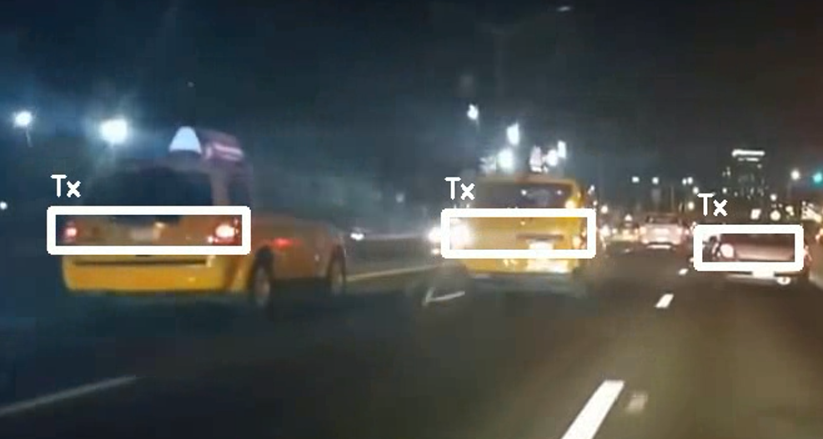
Region of Interest (RoI) Detection
Camera captures the pair of tail LEDs of front vehicles (FV) and convolutional neural network (CNN) detects the proper region of interest.
Vehicles are differentiated based on their IDs. Vehicular IDs are prerequisite for vehicular localization and communication using OCC.
Figure 1. Selection of RoI in the street at night.

Slide 4
Variation of LED Size with Distance
The size of the pair of tail LEDs of FV decreases with the increasing distance. The more is the distance, the smaller the size of the LEDs on image sensor.
Figure 2. The size of the pair of tail LEDs of FV decreases with the increase in distance between vehicles. (a) FV is at a minimum distance. (b) FV is at a safe distance. (c) FV is at a long distance.

Slide 5
Alternation of LED Co-ordinates on Image Sensor
When the front vehicle changes its lane, the co-ordinate of the tail LEDs on the image sensor are also changed.
Figure 3. Change of co-ordinate of a pair of tail LEDs of front vehicle (FV) moving from left to right on image sensor. (a) FV at the left side (b) FV at the front (c) FV at the right side

Slide 6
Technical considerations
It is interesting in the output that selected areas are not directly related to objects or low-level and high-level features but rather depend on the annotation output and thus depend on the subjective content of the image which is derived from the camera of the training set, so the selected area doesn’t have common visual or spatial features.
In fact, the accuracy of the selected tags is important, if the annotation output is correct, likely RoI will be selected correctly.
Finally, the selected regions without putting specific constraints, possibly are continuous which shows that the weights were not randomly assigned to the area and so it is a good approximation of the importance degree of the region based on the mental model of vehicle.

