Slide 1
Project: IEEE P802.15 Working Group for Wireless Personal Area Networks (WPANs)
Submission Title : Promising Solution for vehicle communication using Optical Camera Communication
Date Submitted : November, 2020
Source : Cong Hoan Nguyen and Yeong Min Jang
Company : [Kookmin University]
Address : [Seoul, Korea]
Voice : [+82-2-910-5068], E-Mail: [yjang@kookmin.ac.kr]
Re :
Abstract : Promising Solution for vehicle communication using Optical Camera Communication.
Purpose : To discuss about the need for applying Optical Camera Communication technique on high-speed V2V communications.
Notice: This document has been prepared to assist the IEEE P802.15. It is offered as a basis for discussion and is not binding on the contributing individual(s) or organization(s). The material in this document is subject to change in form and content after further study. The contributor(s) reserve(s) the right to add, amend or withdraw material contained herein.
Release : The contributor acknowledges and accepts that this contribution becomes the property of IEEE and may be made publicly available by P802.15.

Slide 2
Promising Solution for vehicle communication using Optical Camera Communication

Slide 3
Introduction
Optical Camera Communications (OCC)
OCC is modulating an LED light with data bits that can be received by a camera, which then decodes the bits and extracts the data.
Today we have millions of devices enabled to receive visible light communications via the camera, but we lack standards to describe the modulation format.
This contribution discusses some OCC topics of interest.

Slide 4
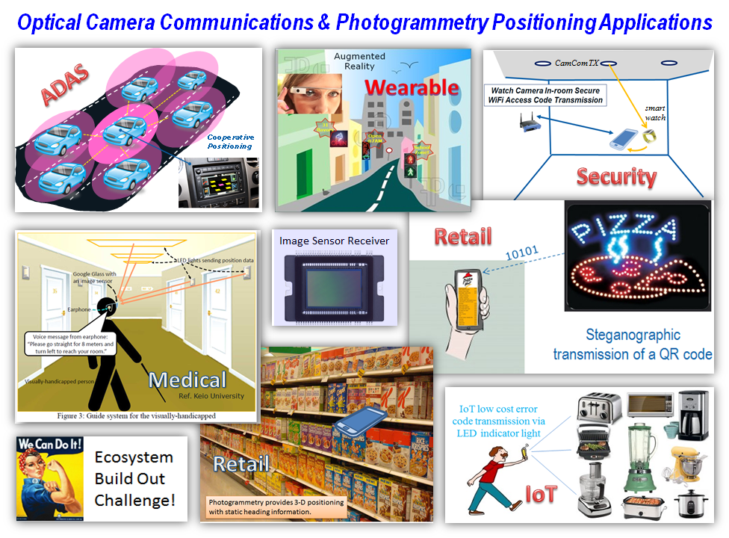
Introduction

Slide 5
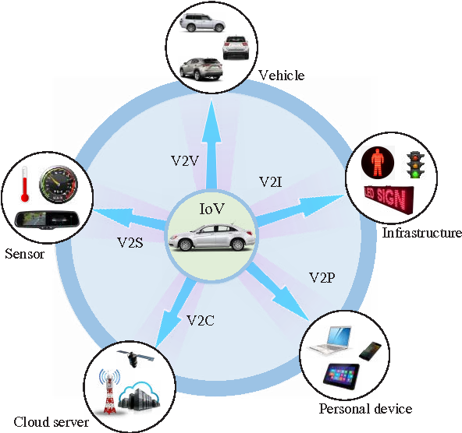
Optical camera communication for vehicle system
The main parts of IoV consist of communication between vehicle-to-vehicle (V2V), vehicle-to-infrastructure (V2I), vehicle-to-cloud (V2C), vehicle-to-sensors (V2S), and vehicle-to-personal devices (V2P). This whole system can be defined as vehicle-to everything (V2X) communication. A general architecture of V2X is illustrated in figure

Slide 6
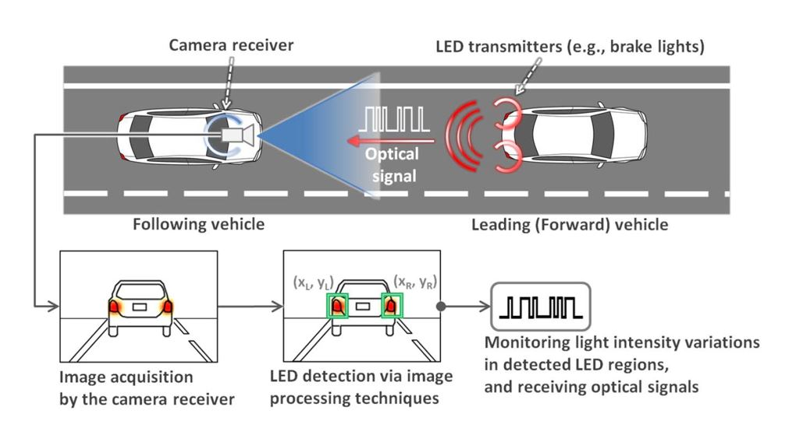
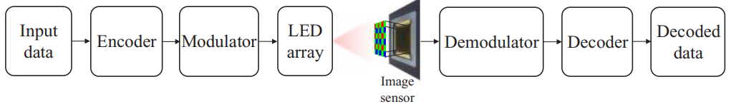
Optical camera communication for vehicle system

Slide 7
Advantages of OCC
Wireless | OCC
High interference | No interference
Bluetooth only offers limited data rate. | Higher data rate
Communication range up to 100m. | High communication range up to 200m
Short life time | Communication can be done within long time
It can only connect limited devices at once | Smartphone cameras can be used as receiver
It can lose connection in certain conditions | Can lose connection if light is blocked
Harmful for human body | Not harmful at all
Main advantages of OCC:
Power consumption is very small and low cost for devices.
It provides high security – field of view.
Zero interference.
Massive connectivity.
Higher life time.
Stable connectivity even when the distance is increased.
Not harmful for human body.
Camera used in OCC system have already installed in factory.
<Compare OCC with Wireless Connection>

Slide 8
Conclusion
Optical camera communication (OCC) is an excellent complementary solution to its radio frequency (RF) counterpart.
OWC technologies have been demonstrated to be able to support high traffic generated by massive connectivity of the Internet of Things (IoT) and upcoming 5th generation (5G) wireless communication systems.
OCC system already had standardized.

