Slide 1
Project: IEEE P802.15 Working Group for Wireless Personal Area Networks (WPANs)
Submission Title: Potential of Neural Network for Optical Camera Communication system
Date Submitted: November 2020
Source: Huy Nguyen, Yeong Min Jang [Kookmin University].
Contact: +82-2-910-5068 E-Mail: yjang@kookmin.ac.kr
Re:
Abstract: Considerations of applying Neural Network for OCC system
Purpose: To discuss about the need for applying Neural Network on OCC system.
Notice: This document has been prepared to assist the IEEE P802.15. It is offered as a basis for discussion and is not binding on the contributing individual(s) or organization(s). The material in this document is subject to change in form and content after further study. The contributor(s) reserve(s) the right to add, amend or withdraw material contained herein.
Release: The contributor acknowledges and accepts that this contribution becomes the property of IEEE and may be made publicly available by P802.15.

Slide 2
Potential of Neural Network for Optical Camera Communication system

Slide 3
Introduction
In general, Neural Network is very helpful for OCC technique if it is properly used.
In the PHY layer of OCC, the following use-cases of Neural Network are promising to note:
NN can be applied for reliable light sources detection and tracking. Later, we call massive-Tx detection a compressed-sensing platform.
NN can bring amazing performance for the decoder by taking its nonlinear classification potential.

Slide 4
Challenges in Optical Vehicular Communication system
HS-PSK is a typical modulation scheme which had been introduced in IEEE 802.15.7-2018 standard as high-rate data scheme using in hybrid waveform of Optical Camera Communication (OCC) and Vehicle-to-Vehicle(V2V) scenario.
Commercialize OCC for Vehicular communication still be a challenging work due to the complexity of channel model caused by various type of noise and weather condition.
These technical issues lead to the design of an adaptive Rx that could be trained to self-modify its parameters and better reflect the correlation between real-world input data and our desired system output

Slide 5
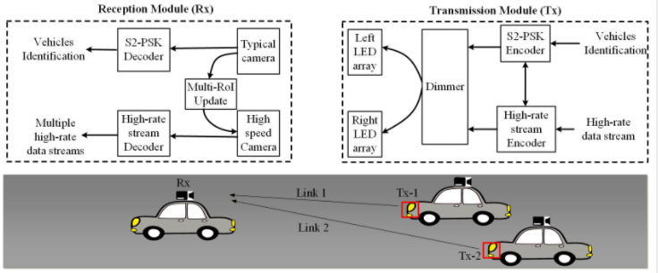
Overall System Architecture
A simple HS-PSK architecture for OCC system is as Figure:

Slide 6
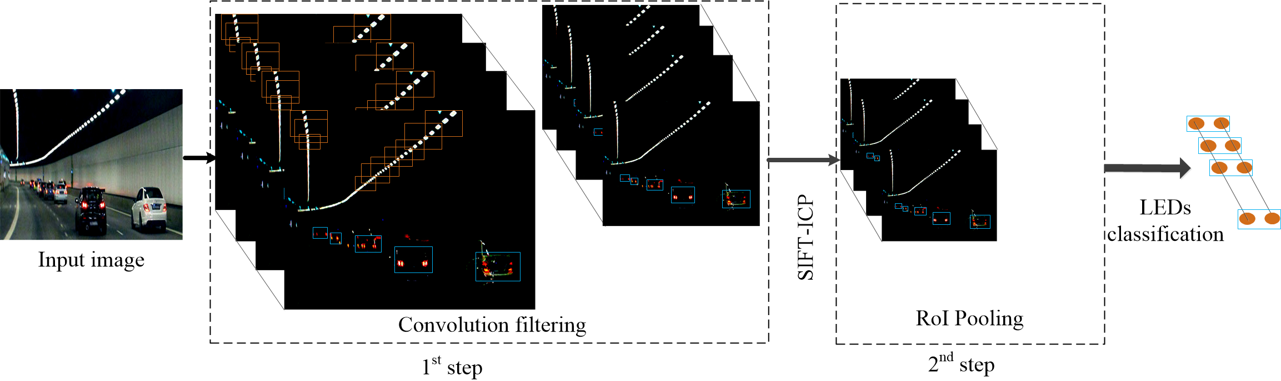
Neural Network-Assisted Detection
This Figure draws the idea for applying CNN to detect the light sources.
In this way, our Tx has its unique characteristic compared to other noise sources, so that CNN can learn to detect and track the Tx(s) efficiently.

Slide 7
Neural Network-Assisted Decoder
The channel condition directly impacts to the communication. If the decoder is trained based on particular channel conditions, it should perform better.

Slide 8
Conclusion
Neural Network is very helpful for OCC technique.
NN can apply for the light sources detection and decoder to increase the system performance.
Due to the complexity of NN algorithms, we should use it appropriately to reduce the processing time.

