Slide 1
Project: IEEE P802.15 Working Group for Wireless Personal Area Networks (WPANs)
Submission Title: Potential of OCC technique for high speed V2V system
Date Submitted: November 2020
Source: Huy Nguyen, Yeong Min Jang [Kookmin University].
Contact: +82-2-910-5068 E-Mail: yjang@kookmin.ac.kr
Re:
Abstract: Considerations of applying Optical Camera Communication for high speed V2V system
Purpose: To discuss about the need for applying Optical Camera Communication technique on high-speed V2V communications
Notice: This document has been prepared to assist the IEEE P802.15. It is offered as a basis for discussion and is not binding on the contributing individual(s) or organization(s). The material in this document is subject to change in form and content after further study. The contributor(s) reserve(s) the right to add, amend or withdraw material contained herein.
Release: The contributor acknowledges and accepts that this contribution becomes the property of IEEE and may be made publicly available by P802.15.

Slide 2
Potential of OCC technique for high speed V2V system

Slide 3
Introduction
Nowadays, OWC are strong candidates for delivering the V2V communication power to cars due to many advantages over conventional RF-based solution.
However, there are many challenges need to overcome for a successful deployment of these new technologies in the market.
In OWC, communication channel is affected by various type of light sources. Among noisy light sources, the sunlight can be seen as the most powerful source of noise.

Slide 4
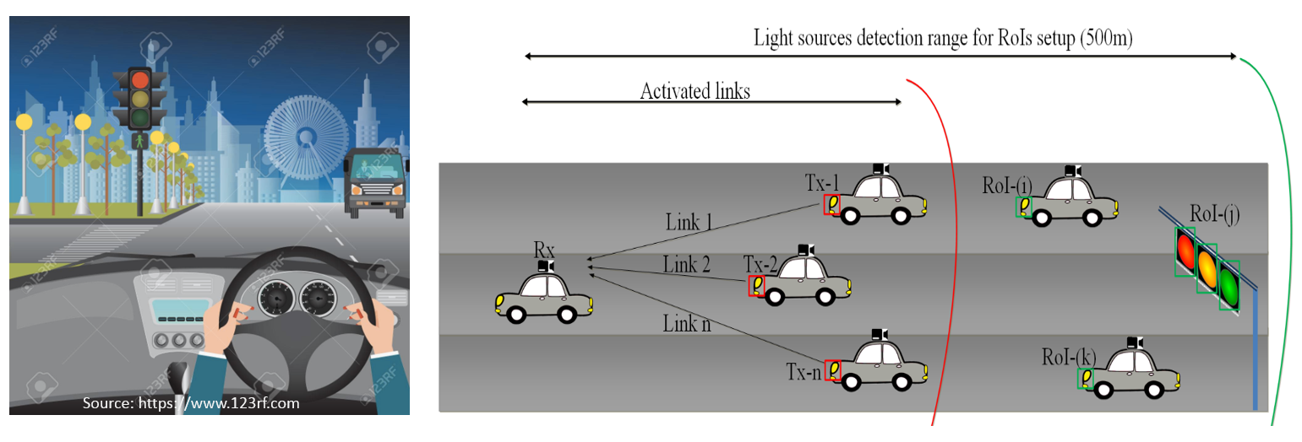
Introduction
In the context of a safety assistance communication-based solution, OWC is a strong candidate for delivering the V2V communication power to cars.
It is realized that the LED lighting is quipped to car mandatorily, meanwhile, a camera is considered as one of the indispensable sensors for car vision.
The existence of supportive infrastructure enables the great potential for accepting OWC technology into the vehicle industry.

Slide 5
Characteristics of high-speed V2V scenario
High mobility: The dramatic increase of vehicle speed will cause frequent handover. Given a cell size of 1-2km, a high-speed vehicle of 350 km/h experiments one handover every 10-20 seconds. The maximum speed of HSR in China is currently 486 km/h [1].
Unique channel characteristics: The moving vehicle encounters diverse scenarios (e.g. cuttings, viaducts and tunnels) with different channel propagation characteristics.

Slide 6
Challenges of OCC for high speed V2V
How to track and differentiate interested light-sources among others (including the sun/stars and ambient lights, building lamps, etc.)
How to set up the link for high-rate transfer under mobility (wherein camera lens is a barrier)?
What camera is applicable? Implementation & Market acceptance issue?
➔RoI detection and AI algorithms applied for OCC system to resolve these issues.

Slide 7
References
[1] Shengfeng Xu, Gang Zhu, Bo Ai, Zhangdui Zhong, “A Survey on High-Speed Railway Communications: A Radio Resource Management Perspective”, March 2016.

